Slide 1
All Hail LLMs!
CS 542 - Natural Language Processing
Prof. Nikhil Krishnaswamy, Colorado State University
Notes:
Hello, my name is Mariah Bradford. I am an incoming PhD student from CSU, and I will be presenting work in collaboration with several other researchers from Colorado State University, Brandeis University, and the University of Colorado Boulder.

Slide 2
Introduction

Slide 3
Introduction
Large Language Models are like…

Slide 4


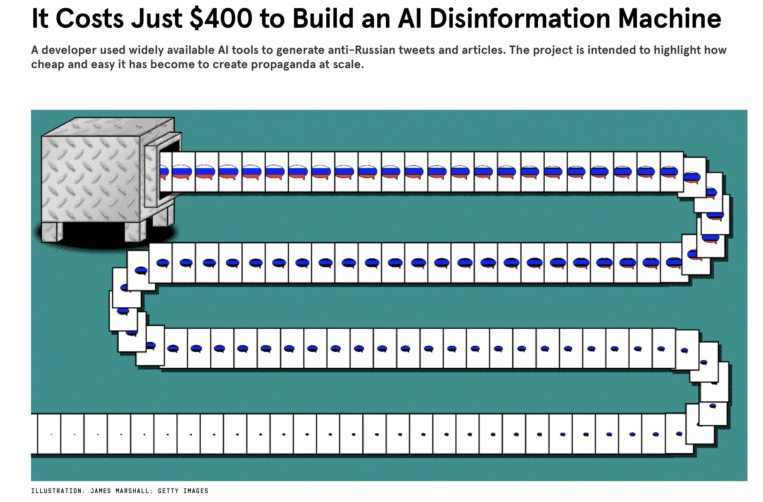

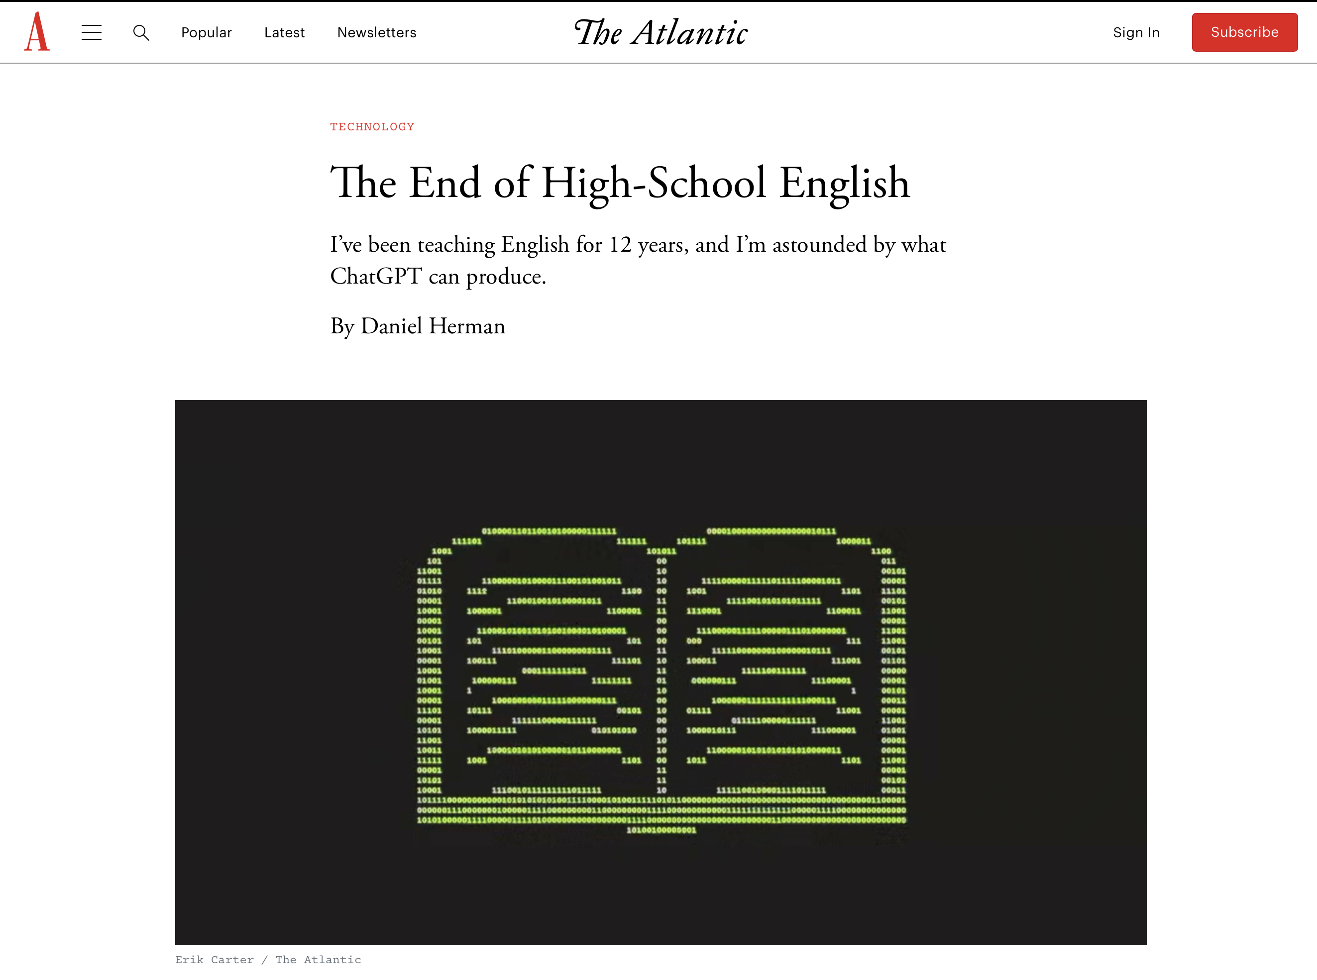

Introduction
Undoubtedly, LLMs have captured the imagination of business and popular media

Slide 5
Introduction
Is it really all about scale?
Are we seeing “emergence” or some other qualitative change in capability?
Is LLM performance best attributed to statistical modeling or semantic modeling?
TBH this picture of a Cylon is just to fill space

Slide 6
Scale

Slide 7
Scale
A language model can be characterized in terms of 4 values:
$N$, the number of parameters:
Parameters are the coefficients in the mapping function (input to output)
Language mapping functions are highly non-linear
How non-linear exactly? That depends on the number of parameters available
With an infinite parameter limit, you have infinite degrees of freedom in your mapping function
Infinite parameter limits are not possible, but we’d like to get as close to that as we can

Slide 8
Scale
A language model can be characterized in terms of 4 values:
$∣D∣$, the size of the training set $D$
Measured in number of tokens
Compute budget used to train
Measured in FLOPs
Network architecture
Related to but not equivalent to number of parameters
Neural networks are universal function approximations
But the types of connections within and between layers makes a difference
e.g., LSTM blocks vs. Transformer encoder blocks
It’s been ~6-8 years since attention/Transformers first took hold and nothing else has come along to disrupt since

Slide 9
Scale
It is now well known that increasing the number of parameters in a model leads to better performance in a wide range of linguistic tasks
Which is more important: $N$ (number of parameters) or $∣D∣$(training size)?
Assuming fixed increases in compute budget, in what proportion should we increase $N$ and $∣D∣$to achieve optimal loss $L$?

Slide 10
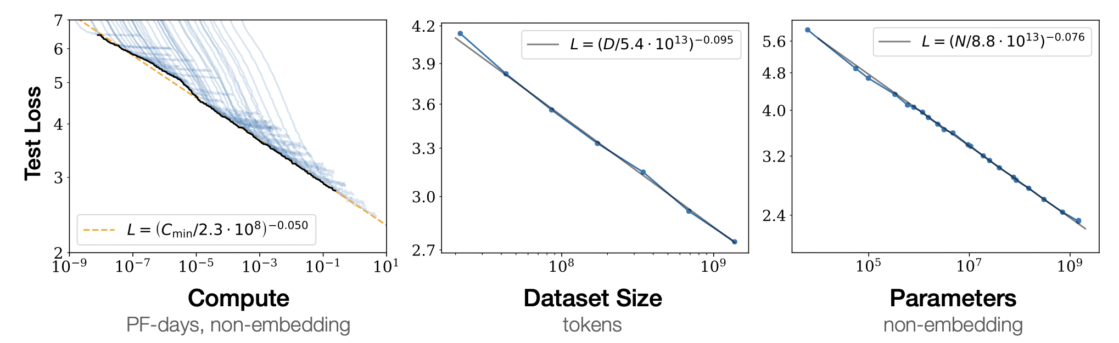
Scale
Scaling Laws for Neural Language Models (OpenAI, 2020)
Suggests that increasing the number of parameters is three times more important than increasing the size of the dataset
$$L(N)=(N_{c}/N)^{α_{N}};α_{N}∼0.076,N_{c}∼8.8×{10}^{13}$$
$$L(D)=(D_{c}/D)^{α_{D}};α_{D}∼0.095,D_{c}∼5.4×{10}^{13}$$
$$L(C)=(C_{c}/C)^{α_{C}};α_{C}∼0.0050,C_{c}∼3.1×{10}^{8}$$

Slide 11
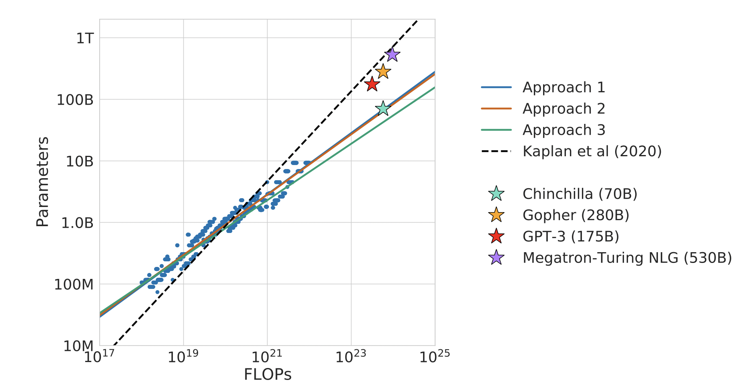
Scale
Training Compute-Optimal Large Language Models (DeepMind, 2022)
Empirically showed that $N$ and $∣D∣$are equally important and must be increased in equal proportion
$$N_{opt}(C),D_{opt}(C)=\underset{N,D\text{s.t.}FLOPs(N,D)=C}{\text{argmin}}L(N,D)$$

Slide 12
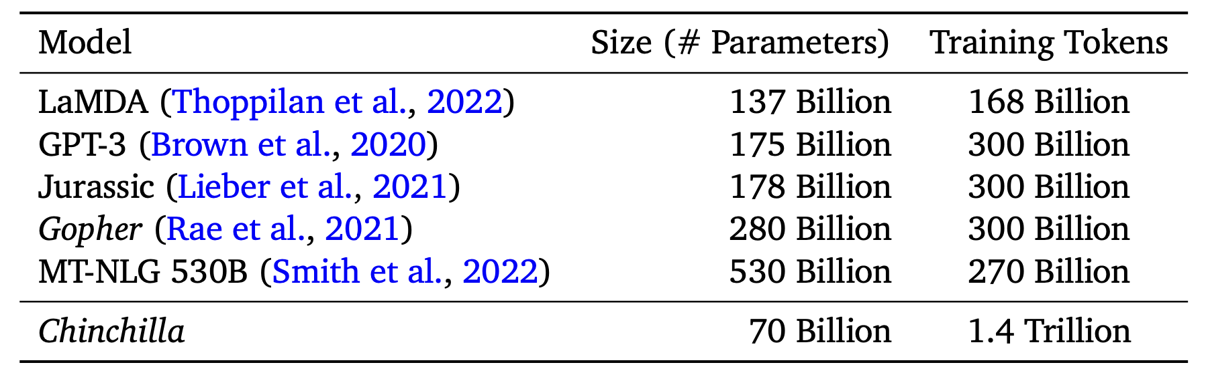
Scale
Training Compute-Optimal Large Language Models (DeepMind, 2022)
Training optimal model (Chinchilla) took ~20x more training tokens than parameters
N/|D|
0.81
0.58
0.59
0.93
1.96
20.00

Slide 13
Scale
Model | Parameters (B) | Tokens (B) | Loss
Gopher (DeepMind) | 280 | 300 | 1.993
Chinchilla (DeepMind) | 70 | 1400 | 1.936
PaLM (Google) | 540 | 780 | 1.924

Slide 14
Scale
Ideal LM loss can be deterministically predicted given $N$ and $D$
$$L(N,D)=\frac{406.4}{N^{0.34}}+\frac{410.7}{D^{0.28}}+1.96$$
$N$ = number of parameters (finite model)
$D$ = number of training tokens (finite data)
1.96 is “irreducible” error for an ideal generative process
Corresponds to the entropy of “natural language” (paper did not state which language, though English is presumed)

Slide 15
Scale
How does increasing $D$ affect model training?
More training data requires
More optimization steps (cannot be easily parallelized)
Increases in batch size (degrades the model past a certain point)
Most AI labs still emphasize number of parameters rather than data size
(to say nothing of what’s actually in the data…)
How to increase the data size while keeping good training efficiency?
Efficiently-trained GPT model using RLHF: 1.3B parameters, equals performance of GPT-3 with 175B parameters

Slide 16
“Emergence”
or lack thereof…

Slide 17
Emergence
When quantitative changes in a system result in qualitative changes in behavior
Example: the relationship between population size and social structure
Short version: as humans developed larger family/tribe sizes, they developed agriculture and social roles to manage them
That’s one version anyway—it could have possibly gone the other way
Example: ants or bees
A single hive insect is stupid, but put a bunch together and complex roles and communication networks start to emerge and they behave like an intelligent community
Emergent properties occur across fields such as physics, biology, and economics
One could argue that language use itself is an emergent property
Individual words have atomized meaning that may be underspecified
Put them together and the total is greater than the sum of individual words

Slide 18
Emergence
Are LLMs displaying “emergent behavior”?
Quantifying the emergence definition: “When quantitative changes in a system result in qualitative changes in behavior”
Qualitative change: a behavior that could not have previously been predicted from the behavior of the previous (smaller) system
e.g., Two ants aren’t just doing one ant things two times over
LLM displaying emergent behavior wouldn’t just be doing things that could be extrapolated from the performance of previous (smaller) models
Therefore we need to look at the data we have about smaller model performance

Slide 19
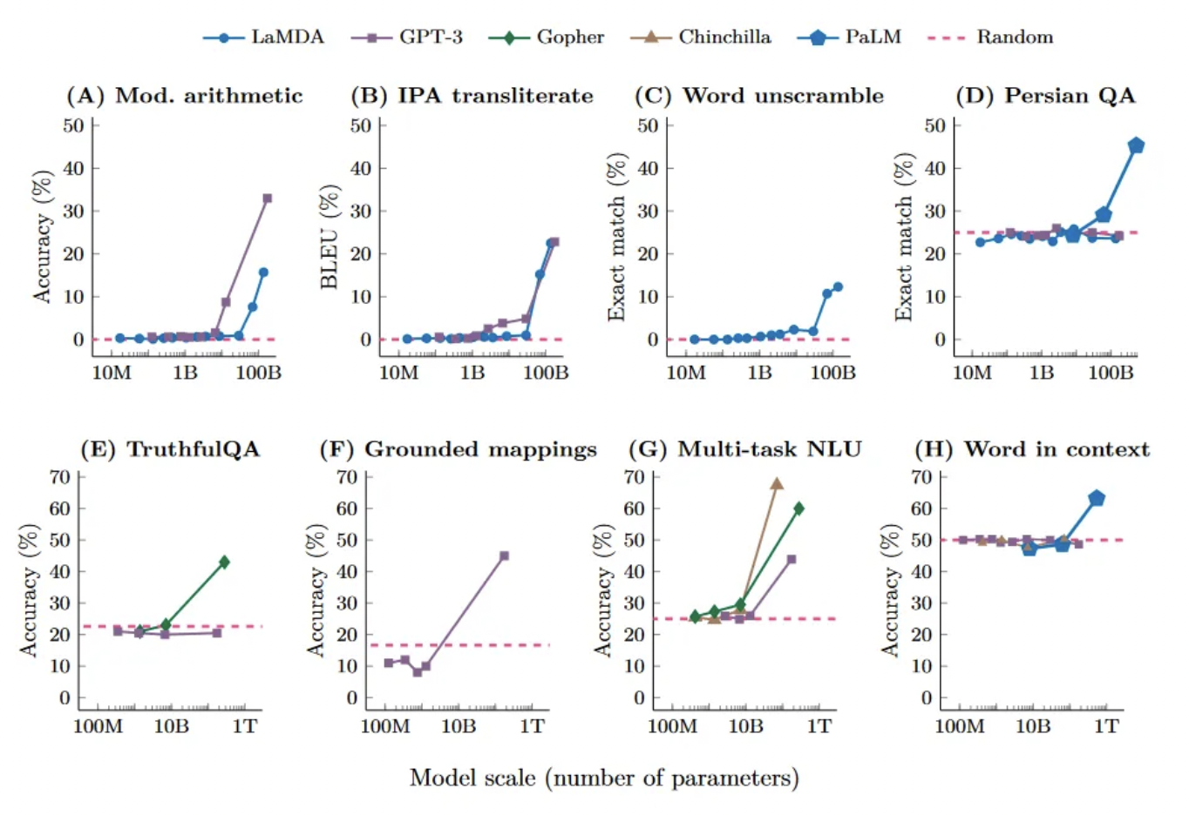
Emergence
Emergent Abilities of Large Language Models (Google, Stanford, UNC, DeepMind, 2022)
Claim that LLMs display “emergent abilities” as they scale to larger and larger numbers of parameters
“We consider an ability to be emergent if it is not present in smaller models but is present in larger models. Thus, emergent abilities cannot be predicted simply by extrapolating the performance of smaller models.”

Slide 20
Emergence

Slide 21
Emergence
Problems with log-scales
1B/10M = 100
100B/1B = 100

Slide 22
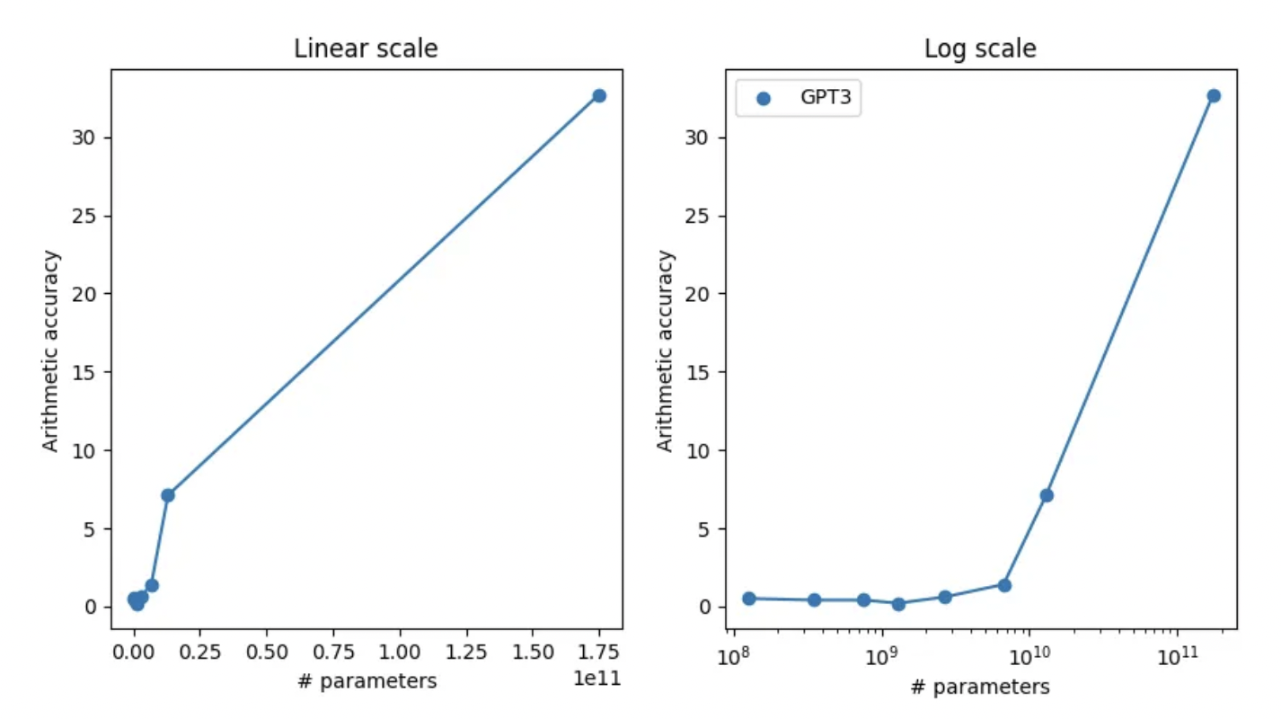
Emergence
Problems with log-scales
1B/10M = 100
100B/1B = 100

Slide 23
Emergence
Models are growing so fast, the comparison almost has to be done on a log scale
The “hockey stick” jump in performance might just a visual artifact of the data

Slide 24
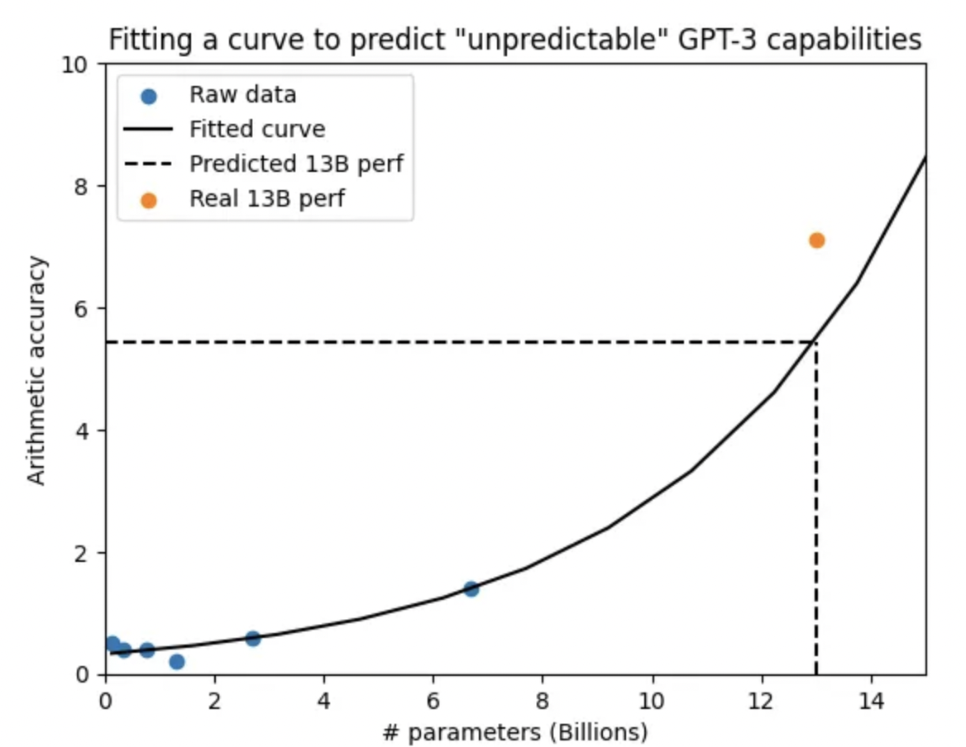
Emergence
Models are growing so fast, the comparison almost has to be done on a log scale
The “hockey stick” jump in performance might just a visual artifact of the data
“Unpredictable” performance might actually be very predictable

Slide 25
Emergence
Are Emergent Abilities of Large Language Models a Mirage? (Stanford, 2023)
More than just visual artifacts
Calls into question the claim that LLMs display sharp and unpredictable changes as a function of model scale
Looks at the evaluation metrics and statistical analysis
“Emergent abilities” appear on tasks that are either Multiple Choice Grade (1 if highest probability mass on correct option, else 0), or Exact String Match (1 if output string exactly matches target string, else 0)

Slide 26
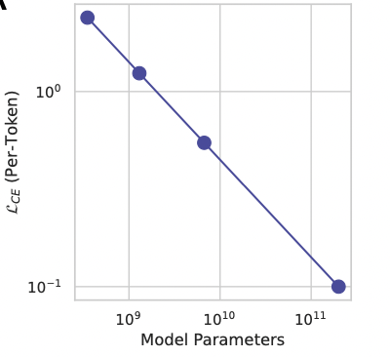
Emergence
Suppose per-token CE loss decreases monotonically with model scale (i.e., $L_{CE}$ is a power law as previously described)

Slide 27
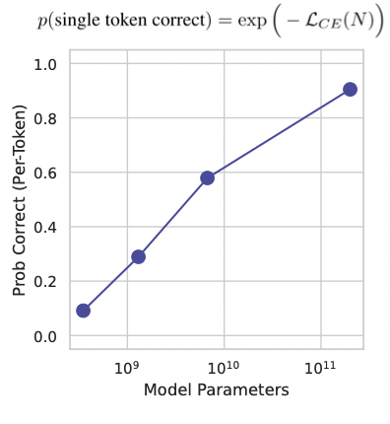
Emergence
The per-token probability of selecting the correct token asymptotes toward 1

Slide 28
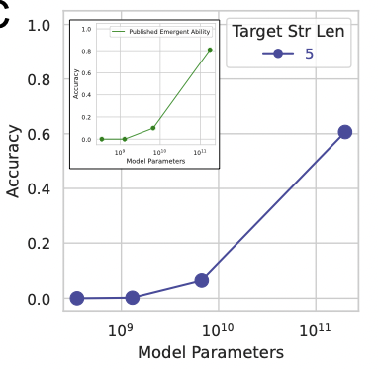
Emergence
If I score model output using accuracy (all tokens are correct), the metric nonlinearly scales performance

Slide 29
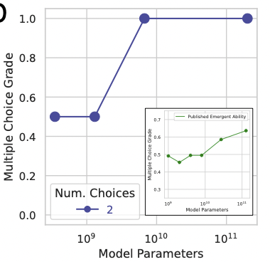
Emergence
If I score model output using multiple choice (discontinuous), performance again changes sharply and unpredictably

Slide 30
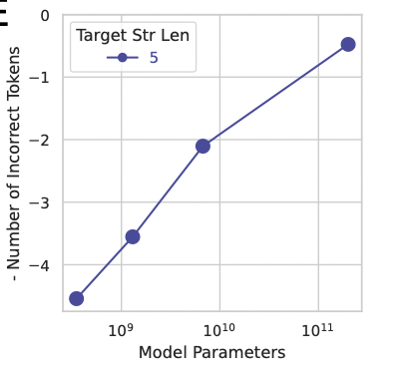
Emergence
If I use a linear scoring metric instead (e.g., token edit distance or similarity coefficient), I see smooth, predictable increases in performance

Slide 31
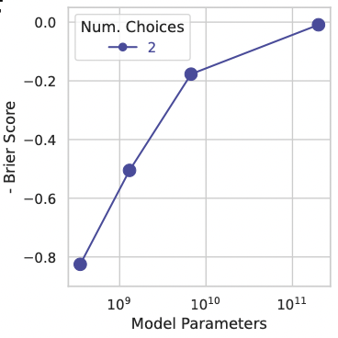
Emergence
If I use a continuous scoring metric instead, I also see smooth, predictable increases in performance

Slide 32
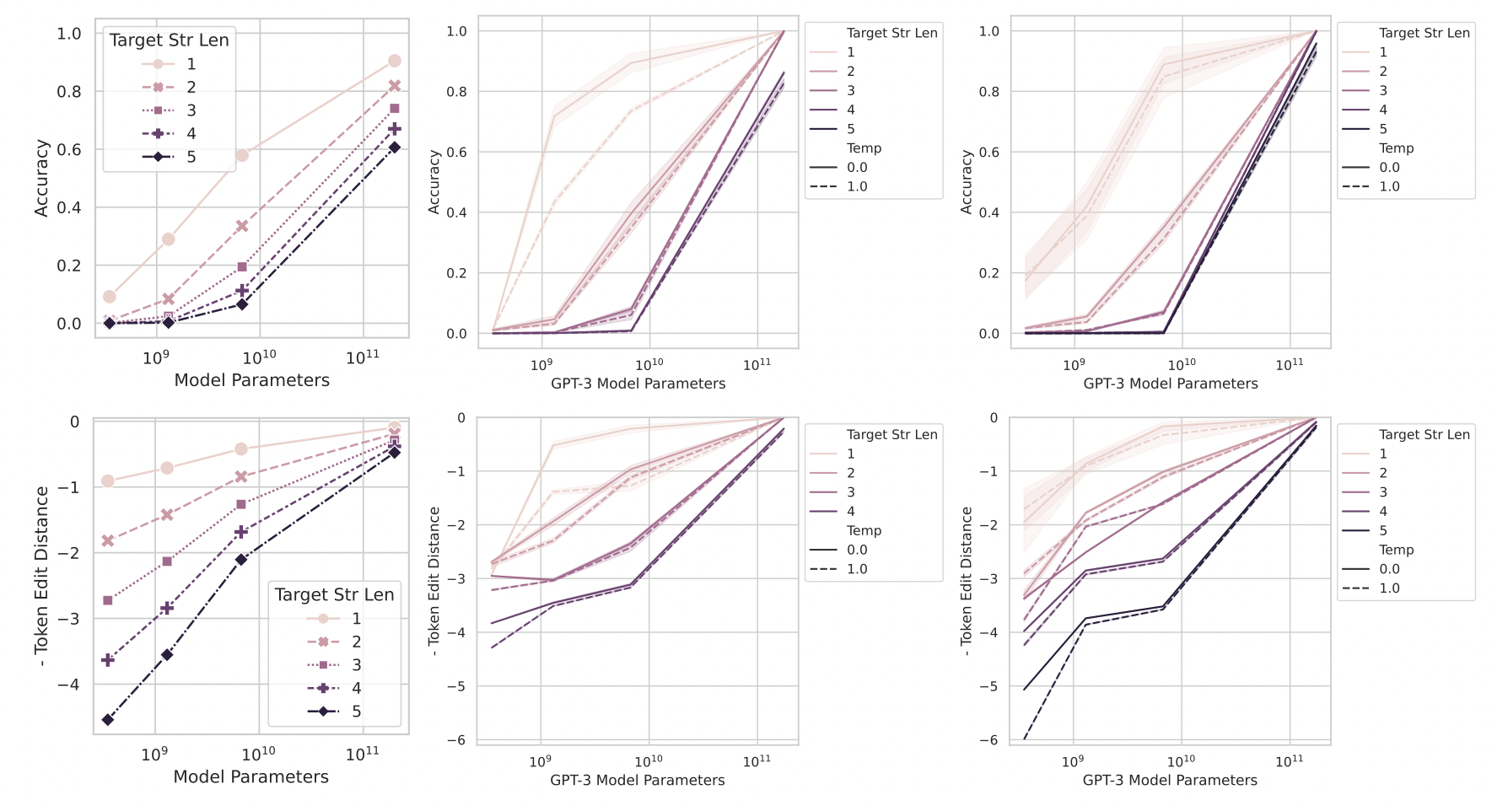
Emergence
Claimed emergent abilities evaporate upon changing the metric
2-4 digit arithmetic

Slide 33
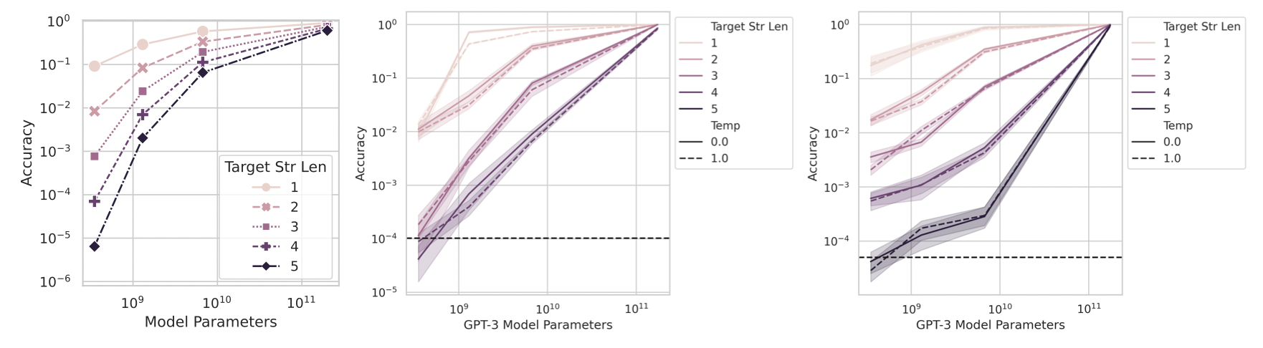
Emergence
Claimed emergent abilities evaporate upon better statistics (generating additional test data)
2-4 digit arithmetic

Slide 34
Does it matter if LLMs are “emergent” or not?
Yes
Why?
Because of hype
A) What controls which abilities will emerge?
B) What controls when abilities will emerge?
C) How can we make desirable abilities emerge faster, and ensure undesirable abilities never emerge?
The notion of “emergent” abilities is what gives rise to the idea that AI might acquire undesirable skills without warning
If we can show that AI is not emergent, or predict when capabilities will arise, this answers A-C, or renders them moot

Slide 35
Statistics or Semantics?

Slide 36
The Statistical Hypothesis
What gives LLMs their abilities?
Sophisticated cooccurrence modeling?
Do the DoFs in the parameters allow us to tune the weights just so to be good predictors of what humans would say?
Semantic understanding?
In the weights, have they captured something more fundamental about language
“You shall know a word by the company it keeps”
“The meaning of a word is its use in the language”

Slide 37
The Statistical Hypothesis
Word embeddings: fixed-length numerical representations learned from context
Context = pattern recognition at scale
Word2Vec seems quaint now, but was transformative 10 years ago
The ability to create analogical relationships between words seemed entirely out of reach for ML or formal approaches

Slide 38
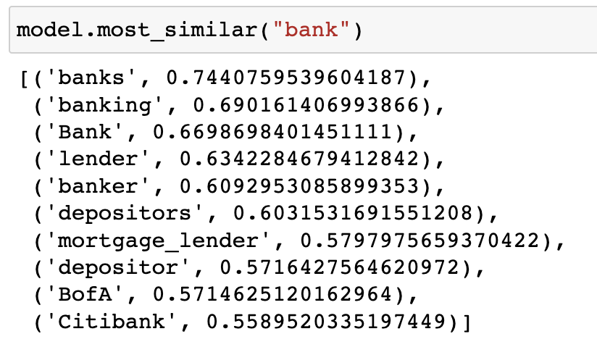
The Statistical Hypothesis
But, we all know words can have multiple meanings
Bank = financial institution
Bank = shore of a river
“Static” vectors are sensitive to training data
Most similar vectors to “bank” in static word vectors trained over Google News

Slide 39
The Statistical Hypothesis
I can’t have individual pretrained vectors for every occurrence of a new word in a different context
Due to the productivity of language, I can’t enumerate all possible context beforehand
This is clearly a more complicated compression problem
We like to encode things into fixed-length representations
Doing so can still lose information
Attention mechanism is a way to retain information across long distances
Attention can operate
between different sequences
or over one sequence

Slide 40
The Statistical Hypothesis
Words in different contexts will have attention weights correlated with different words
More parameters, more degrees of freedom, more fine-grained correlations
IOW: “you shall know a word by the company it keeps”

Slide 41
The Statistical Hypothesis
Enumerating regions:
A set of vectors representing the same concept form (at minimum) the spanning set of the representation region corresponding to that entity
“At minimum” → many valid concept vectors do not bound the region (fall inside) → novel valid concept vectors might fall outside the expected region
A “concept” region in a model is necessarily approximate
e.g., same token in new context
https://en.wikipedia.org/wiki/Spherical_sector

Slide 42
The Statistical Hypothesis
This gives us flexible, high-dimensional representations of words in any context
With different training objectives, we can:
Predict words in context
Predict adjacent sentences
Answer questions
Continue prompts

Slide 43
The Statistical Hypothesis
By training over large volumes of text, models learn the structure and syntax of language
Chomsky was actually wrong!
Grammar induction appears possible with finite (though large) data
Why is this?
People use language to communicate (compression algorithm)
In order to be understood by a community, you must obey a certain form
Ungrammatical text (though frequent) is actually an outlier
Statistical modeling can effectively learn which tokens are “legal” given a preceding context
When did *GPT “achieve” grammaticality?
Input text
Encoder
Vector representations
Training objective
(Attention weights)
Next word prediction

Slide 44
The Semantic Hypothesis
Previous work in semantics largely focused on philosophical questions like propositional truth-testing
Frege’s “sense and reference”
Sense: what a name expresses
Reference: object a name indicates
Gottlob Frege

Slide 45
The Semantic Hypothesis
Sense vs. reference:
The name “Odysseus” is intelligible, and therefore has a sense, even there is no individual (object) to whom it corresponds
The sense of different names can be different, even if the reference is the same
“Hesperus [the evening star] is the same planet as Phosphorus [the morning star]”
The proper names have a different sense, but the object is the same

Slide 46
The Semantic Hypothesis
The reference of a sentence is its truth value
The sense is the thought it expresses
Realizing a sentence as a proposition subjects it to a truth test under a model $M$
$M⊨p$ - “p is satisfied by M”, “M models p”
Under the modal logic semantics developed by Saul Kripke, a set of models $M∈M$ are realized as possible worlds within which different propositions are satisfied
Between worlds, accessibility relations hold, which describe which changes in propositional truth values lead to different models

Slide 47
The Semantic Hypothesis
In x4, it is possible that q does not hold
(x5 is accessible from x4)
$$x_{4}⊨⋄¬q$$
In x5, it is possible that q does hold and that p holds
(x4 and x6 are accessible from x5)
$$x_{5}⊨⋄q∧⋄p$$
In x2, it is necessary that p
(In all worlds accessible from x2, p)
$$x_{2}⊨□p$$

Slide 48
The Semantic Hypothesis
Modal logics can be easily adapted to handle time, space, evidencing, etc.

Slide 49
The Semantic Hypothesis
People and modal logic(s):
Laypersons probably don’t have the formal grasp of modal logic as is captured in the above systems
These were developed by philosophers and specialists
Adult humans do display an intuitive understanding of antecendent-consequent relations as modeled in modal logic
e.g., Time, space, changes in circumstance, etc.
They aren’t always able to articulate this in words
What consequences does this have for LLM training?

Slide 50
The Semantic Hypothesis
There appears to be a disconnect: LLMs are adept at predicting what a human would say/write
Answers are grammatical, coherent, topic sensitive in a way that previous (smaller) models were unable to produce
But the ability to produce realistic-looking output is disconnected from an underlying model that may not be easy to articulate in the kinds of data the LLM is exposed to
Neural networks are universal function approximators
Provided the function is continuous and differentiable, gradient descent can approximate the function within linear coefficients to within an acceptable error
However, many of the “functions” describing underlying semantic models are non-continuous, piecewise, non-differentiable
Can still approximate these with a neural network but the error will be larger
Most importantly, one of these hypotheses describes what we can verify the LLM is actually doing

Slide 51
Causality
Modal logics and possible world semantics provide a neat accounting of counterfactuals
While the key strength of modern AI lies in its ability to uncover patterns in data at scale, these patterns are correlations between inputs and outputs
As countless scientists have observed, correlation does not equate to causation
Modern AI methods, which are sophisticated correlation-learning machines, still have a weak handle on causal relationships
In humans, meanwhile, a full understanding of cause and effect appears to manifest somewhere between the ages of 2 and 4
This appears to be a distinct developmental stage
Little evidence for this sense being innate
Causal reasoning appears to be learnable by humans from experience with the right underlying developmental scaffolding

Slide 52
Causality
LLMs lack experience
There is experience in the reinforcement learning from human feedback (RLHF) process 👉
But that experience is of positive and negative rewards of next word predictions relative to prompts
This does nothing to fundamentally change the directedness of the trained model
Children (and scientists) learn a lot from intervening in the world
LLMs do not intervene
Passive data (even multimodal) is not enough because it doesn’t have experience of intervention and counterfactuals
https://huggingface.co/blog/rlhf

Slide 53
Conclusion

Slide 54
Conclusion
Despite their power, LLMs struggle with certain classes of problems
Scale helps, but the performance jump appears unlikely to outstrip scaling laws
Language (text) alone misses a lot of the unseen information a grounded reasoner has and needs
An LLM triumphalist: “With a trillion more tokens we’ll solve this.”
We will continue to be able to leverage the power of data and computation, however…
The burden of proof is not on LLM skeptics that LLMs cannot do a thing
The burden of proof is on LLM believers that they can

Slide 55
All Hail LLMs?

