Slide 1
Offline Preference Optimization: Your Language Model Is Secretly a Reward Model
CS 542 - Natural Language Processing
Prof. Nikhil Krishnaswamy, Colorado State University
Notes:
Hello, my name is Mariah Bradford. I am an incoming PhD student from CSU, and I will be presenting work in collaboration with several other researchers from Colorado State University, Brandeis University, and the University of Colorado Boulder.

Slide 2
Introduction

Slide 3
Language Models “Know” A Lot
Actually LLMs don’t know anything
They are “aware” of a lot, but we want them to select only a subset of things they are aware of
e.g., being aware of a misconception held by 50% of people doesn’t mean you should reproduce it 50% of the time
Humans have preferences for (e.g.) helpful, truthful responses
RLHF steers LMs to match human behavior via reinforcement learning
RLHF pipeline is highly complex
Involves multiple LMs and sampling steps
Incurs significant computational cost

Slide 4
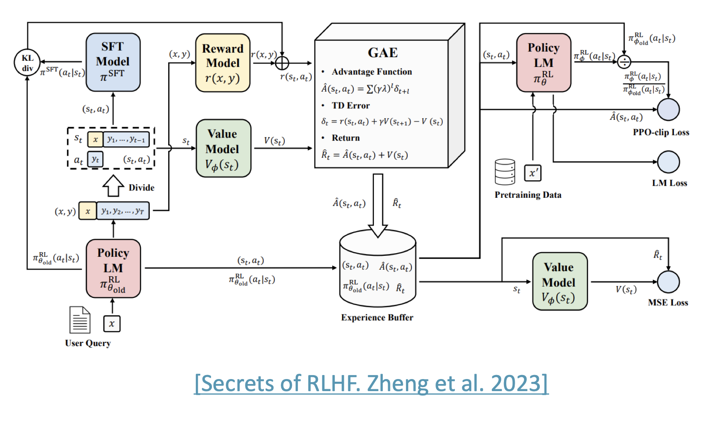
Recap: RLHF Pipeline

Slide 5
Your Language Model is Secretly a Reward Model

Slide 6
Simplifying RLHF
RLHF pipeline:
Train reward model $RM_{ϕ}(x,y)$ to produce scalar rewards for LM outputs, trained on a dataset of human comparisons
Optimize pretrained LM $p^{PT}(y|x)$ to produce final LM $p_{θ}^{RL}(\overset{̂}{y}|x)$
Can we write $RM_{ϕ}(x,y)$ in terms of $p_{θ}^{RL}(\overset{̂}{y}|x)$?

Slide 7
Simplifying RLHF
RLHF pipeline:
Train reward model $RM_{ϕ}(x,y)$ to produce scalar rewards for LM outputs, trained on a dataset of human comparisons
Optimize pretrained LM $p^{PT}(y|x)$ to produce final LM $p_{θ}^{RL}(\overset{̂}{y}|x)$
Can we write $RM_{ϕ}(x,y)$ in terms of $p_{θ}^{RL}(\overset{̂}{y}|x)$?
If so, then optimize parameters $θ$ by fitting $RM_{θ}(x,y)$ to the preference data directly instead of to $RM_{ϕ}(x,y)$
But how this possible?
The only information external to the optimization comes from preference labels

Slide 8
Simplifying RLHF
$$E_{\overset{̂}{y}∼p_{θ}^{RL}(\overset{̂}{y}|x)}[RM(x,\overset{̂}{y})-β\text{log}(\frac{p_{θ}^{RL}(\overset{̂}{y}|x)}{p_{PT}(\overset{̂}{y}|x)})]$$
We want to maximize:
Closed-form solution:
Rewrite:
$$p^{*}(\overset{̂}{y}|x)=\frac{1}{Z(x)}p^{PT}(\overset{̂}{y}|x)e^{\frac{1}{β}RM(x,\overset{̂}{y})}$$
$$\frac{p^{*}(\overset{̂}{y}|x)}{p^{PT}(\overset{̂}{y}|x)}=\frac{e^{\frac{1}{β}RM(x,\overset{̂}{y})}}{Z(x)}⇒\text{log}\frac{p^{*}(\overset{̂}{y}|x)}{p^{PT}(\overset{̂}{y}|x)}=\text{log}\frac{e^{\frac{1}{β}RM(x,\overset{̂}{y})}}{Z(x)}⇒\text{log}\frac{p^{*}(\overset{̂}{y}|x)}{p^{PT}(\overset{̂}{y}|x)}=\frac{1}{β}RM(x,\overset{̂}{y})-\text{log}Z(x)⇒$$
$$\text{log}\frac{p^{*}(\overset{̂}{y}|x)}{p^{PT}(\overset{̂}{y}|x)}+\text{log}Z(x)=\frac{1}{β}RM(x,\overset{̂}{y})⇒β⋅(\text{log}\frac{p^{*}(\overset{̂}{y}|x)}{p^{PT}(\overset{̂}{y}|x)}+\text{log}Z(x))=RM(x,\overset{̂}{y})$$

Slide 9
Simplifying RLHF
For arbitrary LMs:
$$β⋅(\text{log}\frac{p^{*}(\overset{̂}{y}|x)}{p^{PT}(\overset{̂}{y}|x)}+\text{log}Z(x))=RM(x,\overset{̂}{y})⇒β\text{log}\frac{p^{*}(\overset{̂}{y}|x)}{p^{PT}(\overset{̂}{y}|x)}+β\text{log}Z(x)=RM(x,\overset{̂}{y})$$
$$RM(x,\overset{̂}{y})=β\text{log}\frac{p^{*}(\overset{̂}{y}|x)}{p^{PT}(\overset{̂}{y}|x)}+β\text{log}Z(x)$$
$$RM_{θ}(x,\overset{̂}{y})=β\text{log}\frac{p_{θ}^{RL}(\overset{̂}{y}|x)}{p^{PT}(\overset{̂}{y}|x)}+β\text{log}Z(x)$$

Slide 10
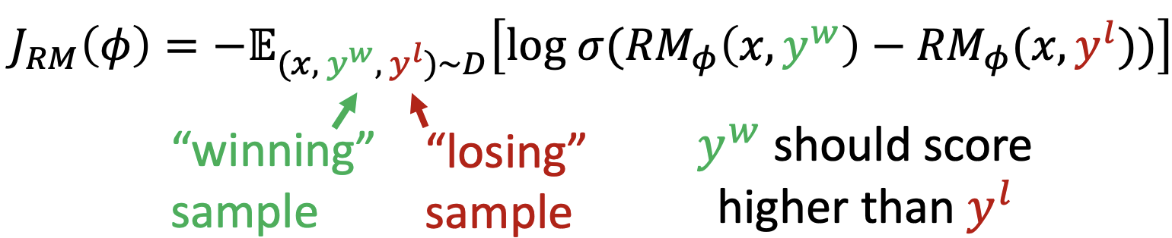
Simplifying RLHF
Fitting the reward model $RM_{ϕ}(x,y)$:
We only need the difference in rewards between winning and losing samples (a.k.a. reward advantage)
Simplify for $RM_{θ}(x,y)$: $RM_{θ}(x,y^{w})-RM_{θ}(x,y^{l})=β\text{log}\frac{p_{θ}^{RL}(y^{w}|x)}{p^{PT}(y^{w}|x)}-β\text{log}\frac{p_{θ}^{RL}(y^{l}|x)}{p^{PT}(y^{l}|x)}$
DPO loss function: $J_{DPO}(θ)=-E_{(x,y^{w},y^{l})∼D}[\text{log}σ(RM_{θ}(x,y^{w})-RM_{θ}(x,y^{l}))]$
Simple classification loss that directly connects preference data and LM parameters!

Slide 11
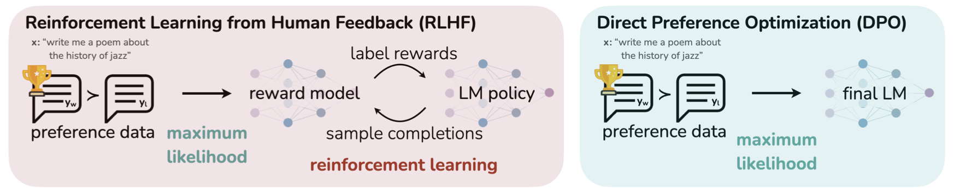
DPO: Your Language Model is Secretly a Reward Model

Slide 12
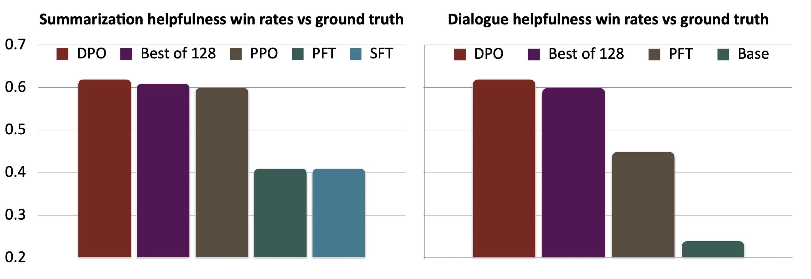
DPO: Your Language Model is Secretly a Reward Model

Slide 13
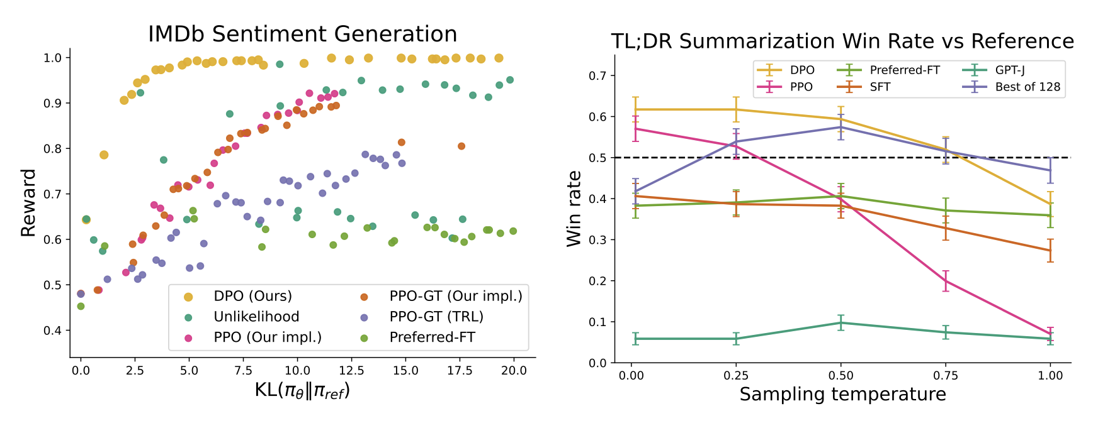
DPO: Your Language Model is Secretly a Reward Model
Expected reward vs. KL to reference policy
Summarization win-rate

Slide 14
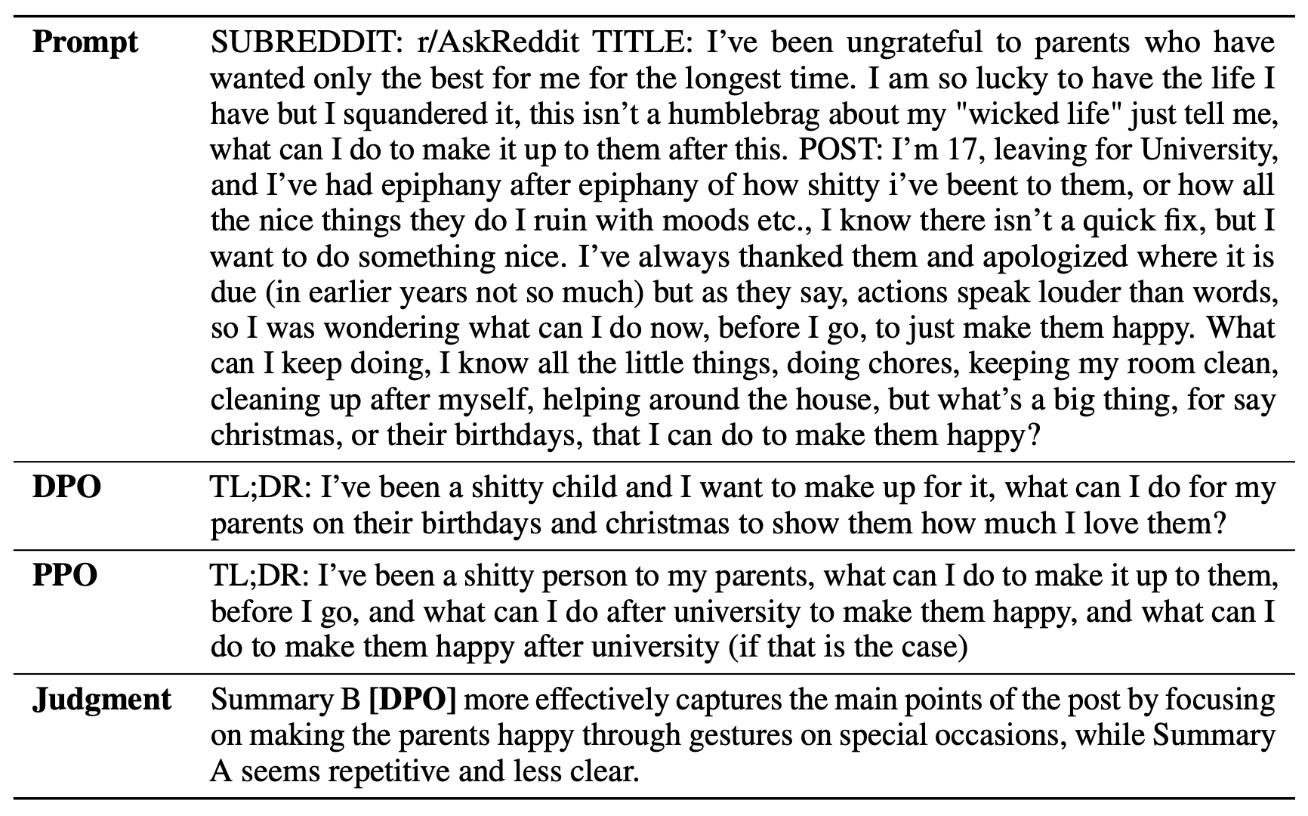
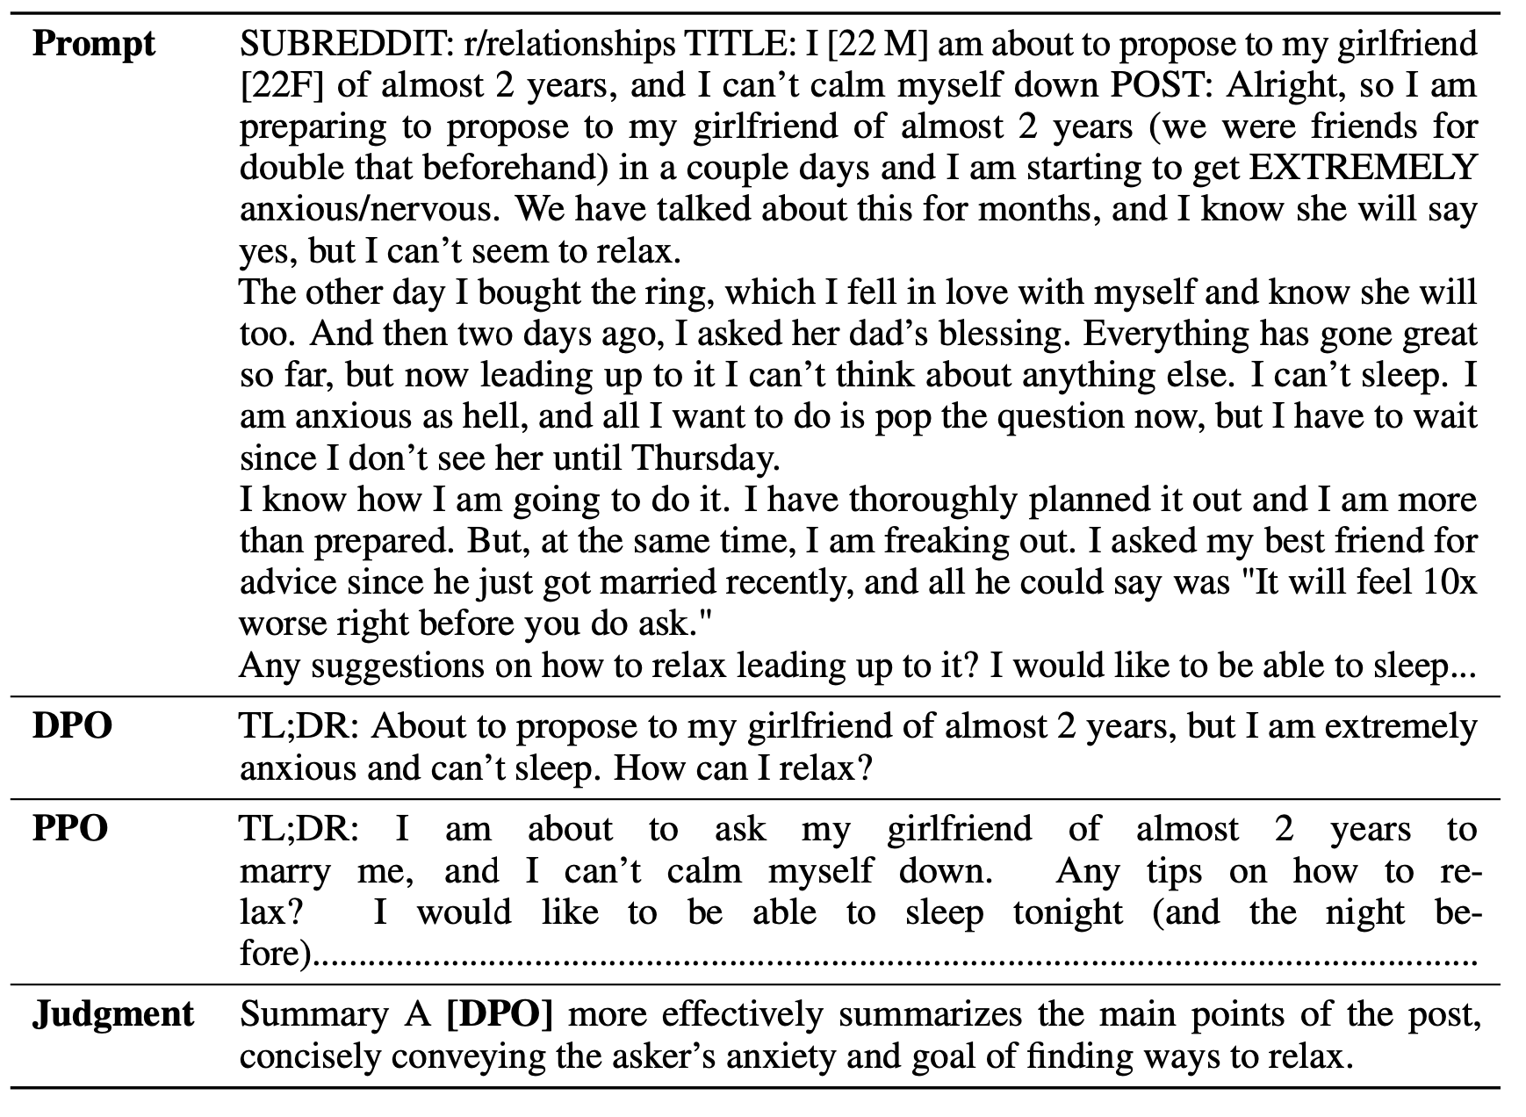
DPO: Your Language Model is Secretly a Reward Model

Slide 15
RLHF and DPO
We want to optimize for human preferences
Instead of humans writing answers or giving miscalibrated scores, get humans to compare LM-generated answers
Reinforcement Learning from Human Feedback
Train an explicit reward model on comparisons to predict a score for a given completion
Optimize the LM to maximize the predicted score
KL constraint to prevent the model from drifting too far from pretrained model
Very effective when tuned well, computationally expensive and tricky to get right
Direct Preference Optimization
Optimize LM parameters directly on preference data as a binary classification problem (predict winner vs. loser)
Simple and effective, similar properties to RLHF
Offline method

Slide 16
Problems with the Bradley-Terry Model
Note to self: DO NOT SAY ANYTHING ABOUT THE 2024 U.S. PRESIDENTIAL ELECTION

Slide 17
Problems with BT Model
If A > B and B > C, then necessarily A > C

Slide 18
Problems with BT Model
Following the BT preference probability $p^{*}(y_{1}≻y_{2}|x)=\frac{e^{r^{*}(x,y_{1})}}{e^{r^{*}(x,y_{1})}+e^{r^{*}(x,y_{2})}}$, $J(θ)$ fits $RM_{θ}$ of underlying true reward $r^{*}$ using reward advantage of winner $y_{w}$ over loser $y_{ℓ}$
$$J(θ)=-E[\text{log}σ(RM_{θ}(x,y_{w})-RM_{θ}(x,y_{ℓ}))]$$
Let $D_{\text{pref}}=\{(x^{(i)},y_{w}^{(i)},y_{ℓ}^{(i)}\}_{i=1}^{N}$ represent preference data consisting of samples $(x^{(i)},y_{w}^{(i)},y_{ℓ}^{(i)})$
Let $Y$ be the space of possible LM outputs, $A∼Y$ be a distribution expressing roughly the same semantics with different surface forms
e.g., “I am unwell” vs. “I am feeling ill”
Let $B∼Y$ be another such distribution, disjunct from $A$
Let $y_{A}∼A$ and $y_{B}∼B$ be two individual responses drawn from $A$ and $B$, respectively

Slide 19
Problems with BT Model
If $y_{A}$ is preferred to $y_{B}$ in the data:
$σ(RM_{θ}(x,y_{A})-RM_{θ}(x,y_{B}))→1$ $⇒\text{log}σ(RM_{θ}(x,y_{A})-RM_{θ}(x,y_{B}))→0$ $⇒-E[\text{log}σ(RM_{θ}(x,y_{A})-RM_{θ}(x,y_{B}))]→0$
Ensuing weight updates are small because $RM_{θ}$ for this sample is already close to correct
However, if $σ(RM_{θ}(x,y_{A})-RM_{θ}(x,y_{B}))→0$:
$σ(RM_{θ}(x,y_{A})-RM_{θ}(x,y_{B}))→0$ $⇒-E[\text{log}σ(RM_{θ}(x,y_{A})-RM_{θ}(x,y_{B}))]→∞$
In this case, $RM_{θ}$ is very wrong, resulting in large updates
Over training, $RM_{θ}$ learns to score samples from $A$ higher than samples from $B$

Slide 20
Problems with BT Model
If $y_{A}≻y_{B}$ and $y_{B}≻y_{C}$ in data, RM implicitly scores $y_{A}≻y_{C}$, even if $y_{A}$ and $y_{C}$ never actually compete in the data
Now, imagine that $D_{\text{pref}}$ does contain samples where $y_{A}$ and $y_{C}$ directly compete, but the true preference is that $y_{C}≻y_{A}$
$$p^{*}(y_{C}≻y_{A}|x)≈1$$
This creates an intransitive preference cycle
According to $RM_{θ}$ that has implicitly learned that $y_{A}≻y_{C}$, $σ(RM_{θ}(x,y_{C})-RM_{θ}(x,y_{A}))→0$
As before, $-E[\text{log}σ(RM_{θ}(x,y_{C})-RM_{θ}(x,y_{A}))]→∞$, leading to larger weight updates in $RM_{θ}$ when it encounters these samples

Slide 21
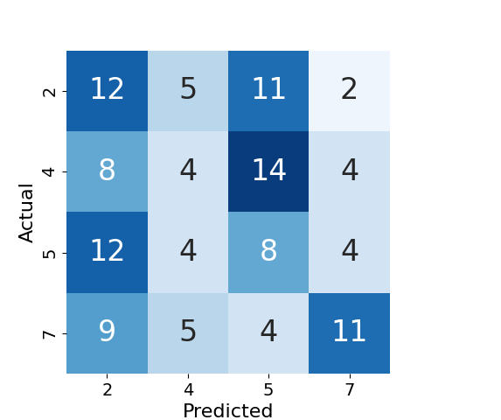
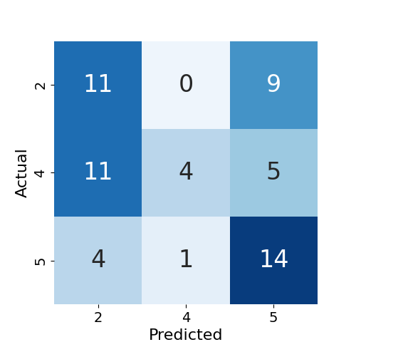
Problems with BT Model
In the final trained model, depending on the proportion in the data of $y_{A}≻y_{B}$, $y_{B}≻y_{C}$, or $y_{C}≻y_{A}$ samples:
$RM_{θ}$ underfits to samples where $y_{C}≻y_{A}$because it is overwhelmed by signal implicit in $y_{A}≻y_{B}$ and $y_{B}≻y_{C}$ samples, or,
$RM_{θ}$ fits to $y_{C}≻y_{A}$ samples but underfits to $y_{A}≻y_{B}$ or $y_{B}≻y_{C}$ samples (or possibly both) because it learns to score $y_{A}$ too low and/or $y_{C}$ too high
E.g., collaborative dialogues hide signals from reward models because participant preferences may change over time
Models aligned using pairwise reward advantage approaches fail to select the correct next utterance in a collaborative dialogue
GPT-4o next utterance predictions in collaborative dialogue sequence: Weights Task
GPT-4o next utterance predictions in collaborative dialogue sequence: DeliData

Slide 22
Bypassing the BT Model

Slide 23
Bypassing the BT Model
RLHF and DPO make a strong assumption:
Pointwise rewards can be substituted for preferences via BT modelization
When sampled preferences are deterministic, this leads to overfitting (aspects of) the preference dataset
In case where $p^{*}(y≻y^{′})=1$, BT model requires that $(RM_{θ}(x,y)-RM_{θ}(x,y^{′}))→∞$
Plug this into the closed-form solution for the optimal RLHF policy:
$\frac{p^{*}(y|x)}{p^{*}(y^{′}|x)}=0$ (i.e., $p^{*}(y_{1}|x)=0$) regardless of the value of $β$
Since $β$ is a regularization term on the KL divergence from the reference model, this assumption effectively ignores the KL term
$$p^{*}(\overset{̂}{y}|x)=\frac{1}{Z(x)}p^{PT}(\overset{̂}{y}|x)e^{\frac{1}{β}RM(x,\overset{̂}{y})}$$

Slide 24
Bypassing the BT Model
Remember that the reward model $RM_{θ}$ expresses the expected preference probability $p^{*}(y≻y^{′})$
Rewrite the closed-form optimal policy solution to make this more explicit: $p^{*}(y|x)=\frac{1}{Z(x)}p^{PT}(y|x)e^{\frac{1}{β}Ep^{*}(y≻y^{′})}$
For simplicity, remove the partition function: $p^{*}(y|x)∝p^{PT}(y|x)e^{\frac{1}{β}Ep^{*}(y≻y^{′})}$
To balance the effect of strong ({0, 1}) preferences on weight updates, consider a non-decreasing monotonic function $Ψ:[0,1]→R$
We want to introduce this in the preference probability: $p^{*}(y|x)∝p^{PT}(y|x)e^{\frac{1}{β}E[Ψ(p^{*}(y≻y^{′}))]}$
But… now, small increases in preference probabilities close to 1 have a strong effect on $E[Ψ(p^{*}(y≻y^{′}))]$
Preference instability like before, large drift from the reference policy
$Ψ$ is unbounded

Slide 25
Bypassing the BT Model
$Ψ$ only has to be non-decreasing
Let’s choose a bounded non-decreasing function: the identity function
Proof:
Let $g(y)=E[Ψ(p^{*}(y≻y^{′}))],g(y^{′})=E[Ψ(p^{*}(y^{′}≻y))]∴$if $g(y)=1,g(y^{′})=0$
$$p^{*}(y|x)∝p^{PT}(y|x)e^{\frac{1}{β}Ep^{*}(y≻y^{′})}⇒p^{*}(y|x)∝p^{PT}(y|x)e^{\frac{1}{β}g(y)}$$
For preference pair $y,y^{′}$, $\frac{p^{*}(y|x)}{p^{*}(y^{′}|x)}=\frac{p^{PT}(y|x)}{p^{PT}(y^{′}|x)}e^{\frac{1}{β}(g(y)-g(y^{′}))}$ $⇒\frac{p^{*}(y|x)p^{PT}(y^{′}|x)}{p^{*}(y^{′}|x)p^{PT}(y|x)}=e^{\frac{1}{β}(g(y)-g(y^{′}))}$ $⇒\text{log}(\frac{p^{*}(y|x)p^{PT}(y^{′}|x)}{p^{*}(y^{′}|x)p^{PT}(y|x)})=\frac{1}{β}(g(y)-g(y^{′}))$

Slide 26
Bypassing the BT Model
Simplify: let $h(y,y^{′})=\text{log}(\frac{p^{*}(y|x)p^{PT}(y^{′}|x)}{p^{*}(y^{′}|x)p^{PT}(y|x)})$
Substitute back in for $g$: $h(y,y^{′})=\frac{1}{β}(g(y)-g(y^{′}))$$⇒h(y,y^{′})=\frac{1}{β}(E[p^{*}(y≻y^{′})]-E[p^{*}(y^{′}≻y)])$
(Note that $Ψ$ goes away here because we assume $Ψ$ to be the identity function now)
$h(y,y^{′})=\frac{1}{β}(E(p^{*}(y≻y^{′})]-E(p^{*}(y^{′}≻y)])$ $⇒h(y,y^{′})-\frac{(E[p^{*}(y≻y^{′})]-E[p^{*}(y^{′}≻y)])}{β}=0$
To minimize the distance between the model’s learned scores $h$ and the true scores, use least-squares regression: $E[(h(y,y^{′})-\frac{p^{*}(y≻y^{′})-p^{*}(y^{′}≻y)}{β})^{2}]=J$
This is a loss!

Slide 27
Identity Preference Optimization
$$J(θ)=E[(h(y,y^{′})-\frac{p^{*}(y≻y^{′})-p^{*}(y^{′}≻y)}{β})^{2}]$$
Identity Preference Optimization (IPO) loss
Population loss under identity assumptions: $J(θ)=E[(h(y,y^{′})-\frac{I(y,y^{′})}{β})^{2}]$
$I(y,y^{′})=1$ if $y≻y^{′}$, $0$ otherwise

Slide 28
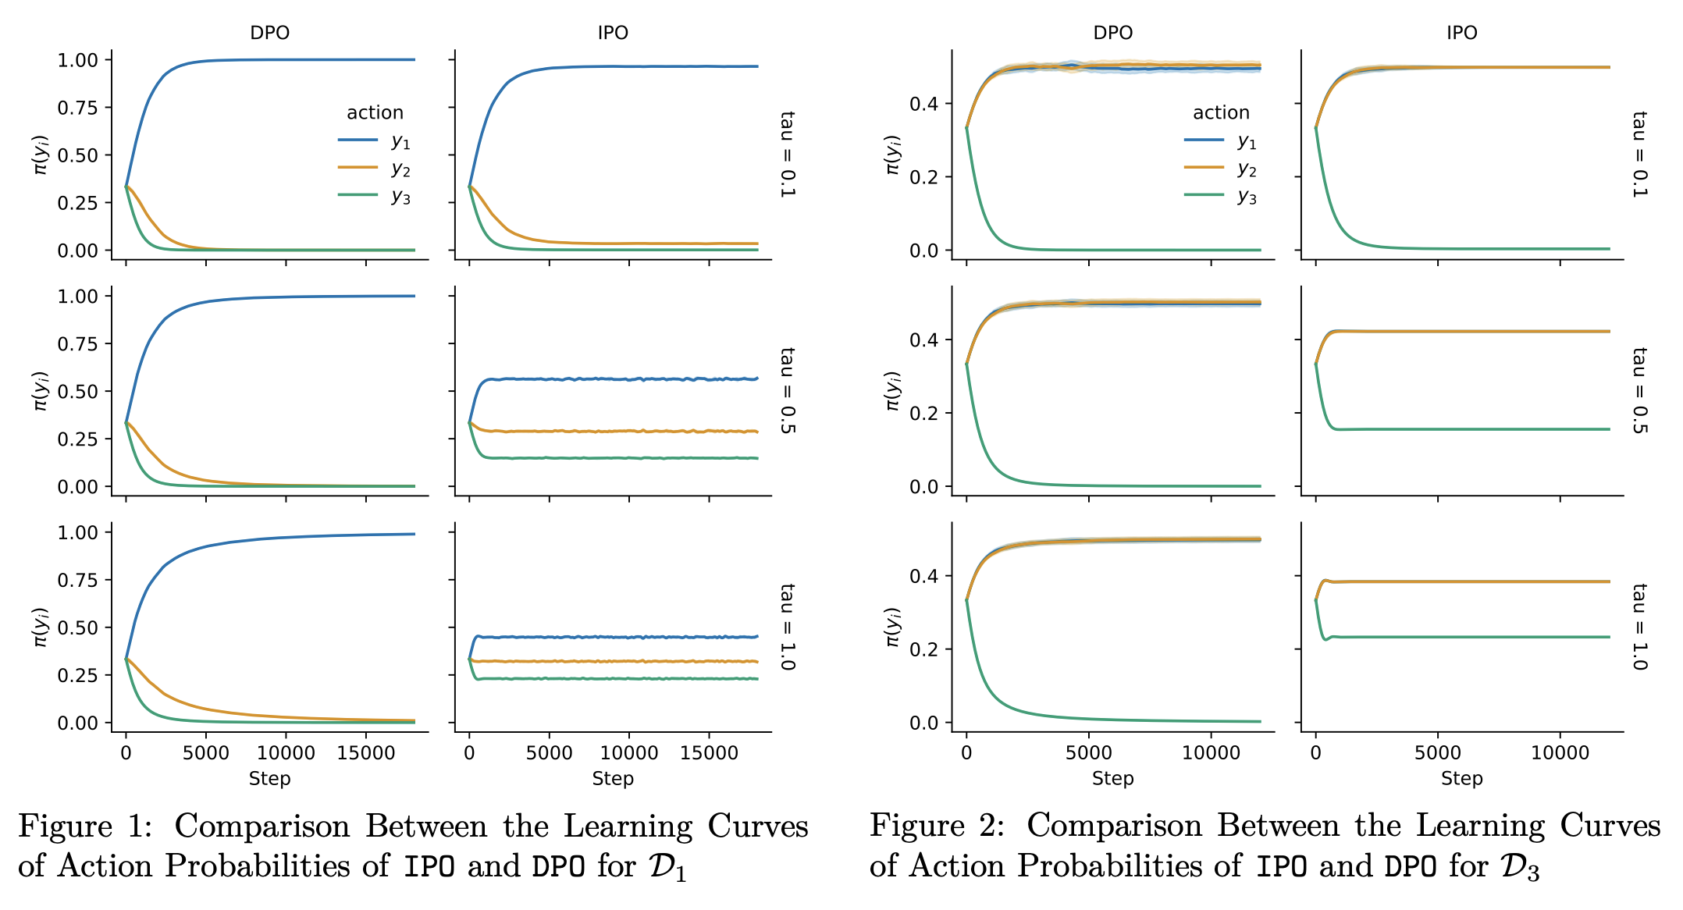
Identity Preference Optimization
What does a squared loss do?
Consider three toy datasets: $D_{1}=\{(y_{A},y_{B}),(y_{B},y_{C}),(y_{A},y_{C})\}$ (transitive), $D_{2}=\{(y_{A},y_{B}),(y_{B},y_{C}),(y_{C},y_{A})\}$ (cyclic), $D_{3}=\{(y_{A},y_{B}),(y_{B},y_{A})\}$ (non-deterministic)
Large values of $β$ keep $p$ close to $p^{PT}$
(Note: the IPO paper uses $τ$ instead of $β$ and $π/{π_{\text{ref}}}$ instead of $p/{p^{PT}}$)

Slide 29
Identity Preference Optimization
What does a squared loss do?
What about $D_{2}=\{(y_{A},y_{B}),(y_{B},y_{C}),(y_{C},y_{A})\}$ (cyclic)?
Where $β→0^{+}$, $p$ converges to deterministic optimal policy
$E[β⋅((RM_{θ}(y_{w},x)-RM_{θ}(y_{ℓ},x))-\frac{β^{-1}}{2})^{2}]→∞$, leading to large updates to steer $p$ away from $p^{PT}$
Given $p^{*}(y_{A}≻y_{B}|x)≈1$ samples and $p^{*}(y_{B}≻y_{C}|x)≈1$, IPO will still properly learn to score $y_{A}$ higher than $y_{C}$ even if they never directly compete
Preserves desirable property of DPO/RLHF while $β$ modulates distance from $p^{PT}$
However, due to the quadratic IPO objective:
When a model that has previously learned $y_{A}≻y_{C}$ encounters $p^{*}(y_{C}≻y_{A}|x)≈1$ samples, the negative reward difference will still lead to a high-magnitude value of $J$ and hence large updates
Intransitive preferences in training data lead to instability in the optimal IPO policy and unpredictable responses

Slide 30
Summary
RLHF can be time consuming, expensive, and unstable
We can prove that the RLHF objective is equivalent to offline objectives over pairwise preference datasets
Direct Preference Optimization
Optimize LM parameters directly on preference data as a binary classification problem (predict winner vs. loser)
Simple and effective, similar properties to RLHF
Offline method
$Ψ$-Preference Optimization/Identity Preference Optimization
DPO objective implicitly ignores KL-divergence term
Risks policy model drift from reference model
Introduce a bounded non-decreasing mapping regularization term on the preference probability
Least-squares regression objective

Slide 31
Are they all the same?
No!
Different advantages/pitfalls
RLHF:
Direct sampling from online data
Susceptible to explicit reward-hacking
DPO:
Trends toward more specific but verbose responses
Implicit reward hacking via verbosity
IPO:
More predictable outputs, even at high temperatures
Closeness to reference model may increase prevalence of “generic” responses

Slide 32
Plackett-Luce Model

Slide 33
Plackett-Luce Model
Let’s revisit ranked orderings
The Plackett-Luce model generalizes the BT model to ranked orderings of responses, with a preference probability defined by:
$$p^{*}(τ|y_{1},…,y_{K},x)=\overset{K}{\underset{k=1}{∏}}\frac{e^{r^{*}(x,y_{τ(k)})}}{\sum_{j=k}^{K}{e^{r^{*}(x,y_{τ(j)})}}}$$
For ranking $τ$ of responses $\{y_{1},…,y_{K}\}$
Reward model $RM_{θ}$ for $r^{*}$can be optimized using an objective function given by:
$$J(θ)=-E[\text{log}\overset{K}{\underset{k=1}{∏}}\frac{e^{RM_{θ}(x,y_{τ(k)})}}{\sum_{j=k}^{K}{e^{RM_{θ}(x,y_{τ(j)})}}}]$$
Show that Plackett-Luce Model still leads to underfitting of elements of intransitive preference cycles

Slide 34
Questions?

