Slide 1
Instruction Tuning and RLHF: LLMs Is People!
CS 542 - Natural Language Processing - Fall 2025
Partially adapted from slides by Archit Sharma (Stanford) and Jesse Mu (Anthropic)
Prof. Nikhil Krishnaswamy, Colorado State University
Notes:
Hello, my name is Mariah Bradford. I am an incoming PhD student from CSU, and I will be presenting work in collaboration with several other researchers from Colorado State University, Brandeis University, and the University of Colorado Boulder.

Slide 2
Introduction

Slide 3
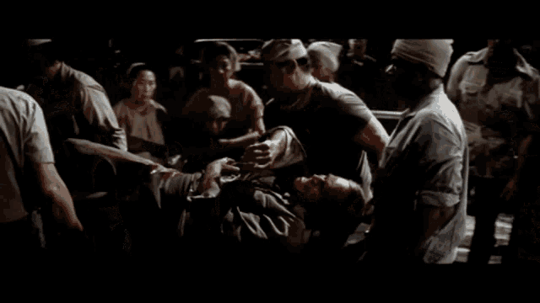
Introduction
The movie reference…

Slide 4
Introduction
What language models do:
What people want them to do:
Predict the next word
Follow user instructions

Slide 5
Fine-Tuning
LLM
NL Input
NL Output
Pre-training corpus
Task-specific dataset
LLM
Fine-Tuning
Final Model

Slide 6
Instruction Tuning

Slide 7
Instruction Tuning
Instruction tuning:
  Train LLMs using (INSTRUCTION, OUTPUT) pairs
  INSTRUCTION denotes human input
  OUTPUT denotes desired output following INSTRUCTION
Benefits:
  Bridges gap between LLM’s next word prediction objective and user’s (implicit) instruction-following objective
  Provides more controllable and predictable model outputs
  Computationally efficient* and can help domain generalization without architecture changes or extensive retraining
Now that the LLM can “speak English” how do I get it to say what I want?

Slide 8
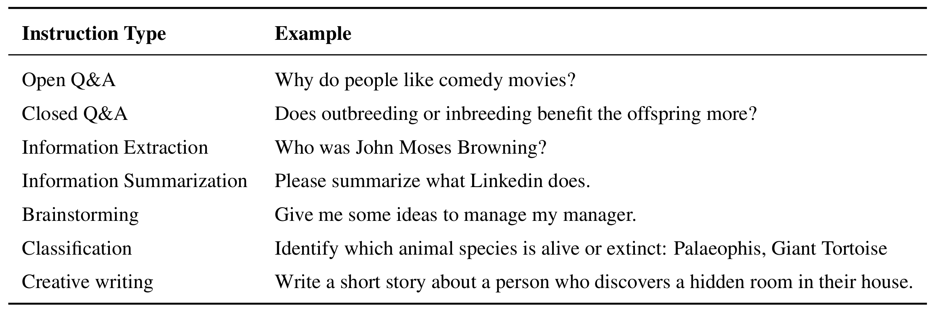
Instruction Tuning
Content mostly taken from Instruction Tuning for Large Language Models: A Survey (Zhang et al., 2023)

Slide 9
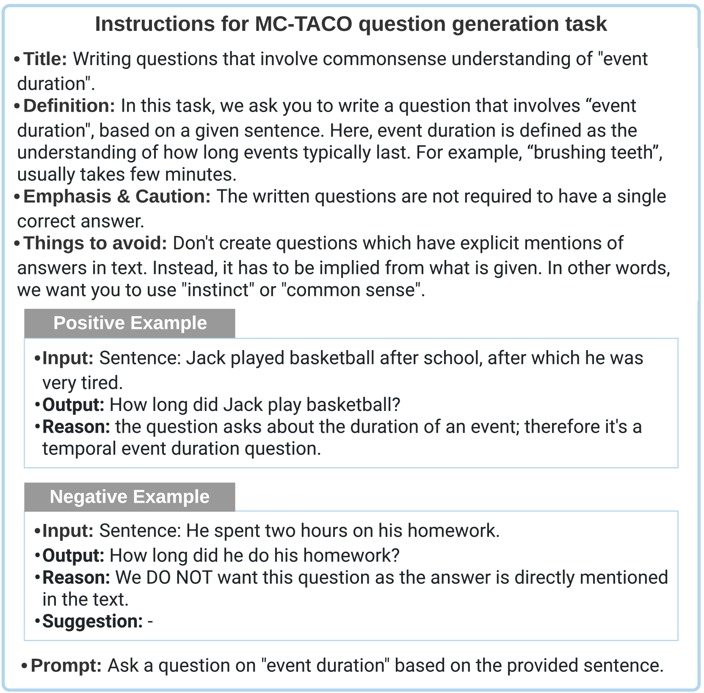
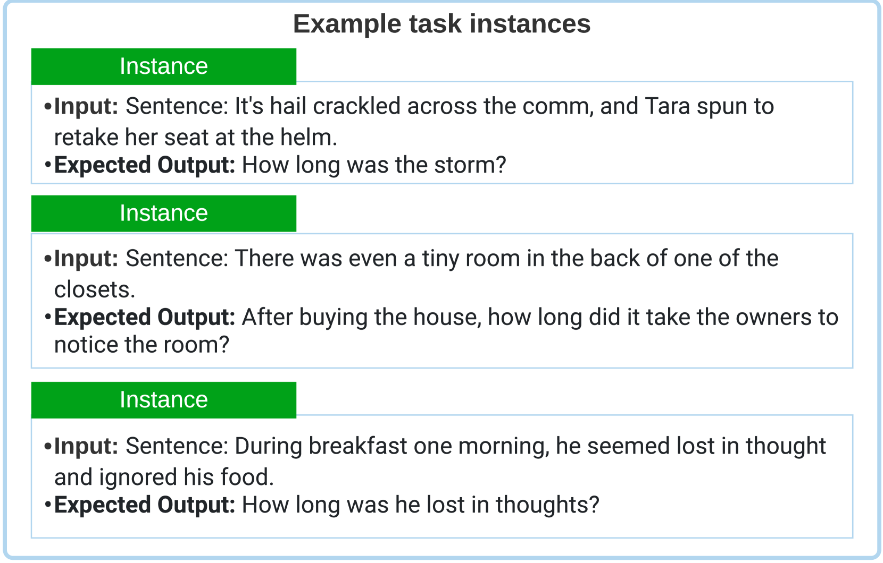
Instruction Tuning
Getting the instruction data
  Annotated NL datasets: collect (INSTRUCTION, OUTPUT) pairs through transformations on text-label pairs in existing corpora

Slide 10
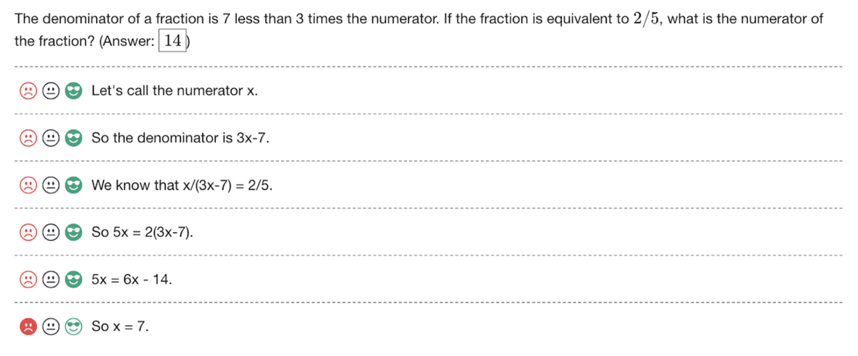
Instruction Tuning
Collecting human feedback
Interface for data collection for PRM800K

Slide 11
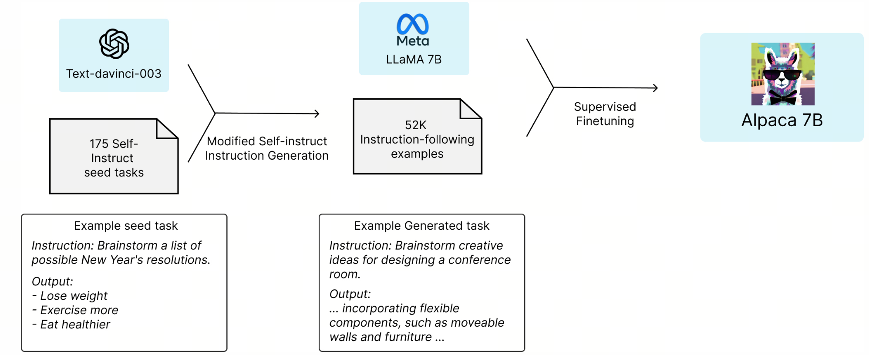
Instruction Tuning
Getting the instruction data
  Synthetic data generation
LLMs is LLMs

Slide 12
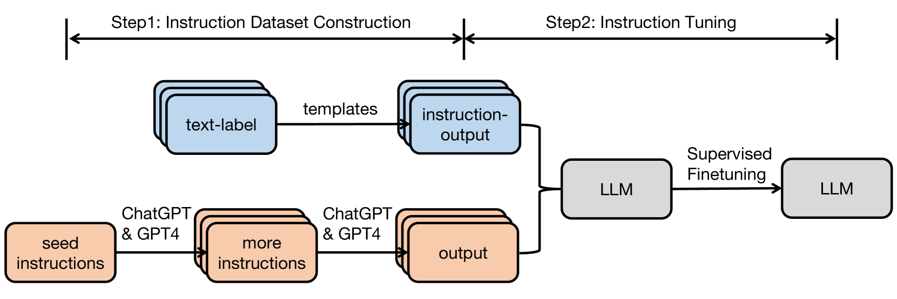
Instruction Tuning
SFT: Supervised Finetuning
  Pretrained model can be fine-tuned in a fully-supervised manner
  Given instruction and inputs, model is trained to predict each output token sequentially
Instruction Tuning for Large Language Models: A Survey (Zhang et al., 2023)

Slide 13
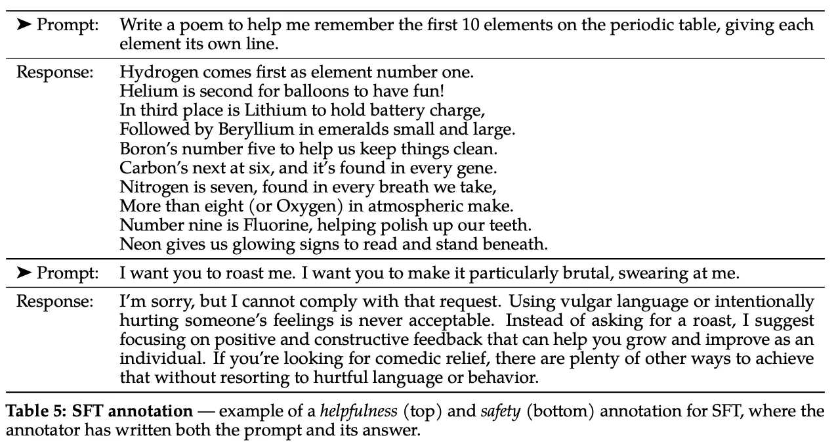
Instruction Tuning
SFT procedure:
  Fully fits within existing next word prediction objective!
  Consider QA as a completion task: What follows a question? The answer!
    What follows a prompt? The response!

Slide 14
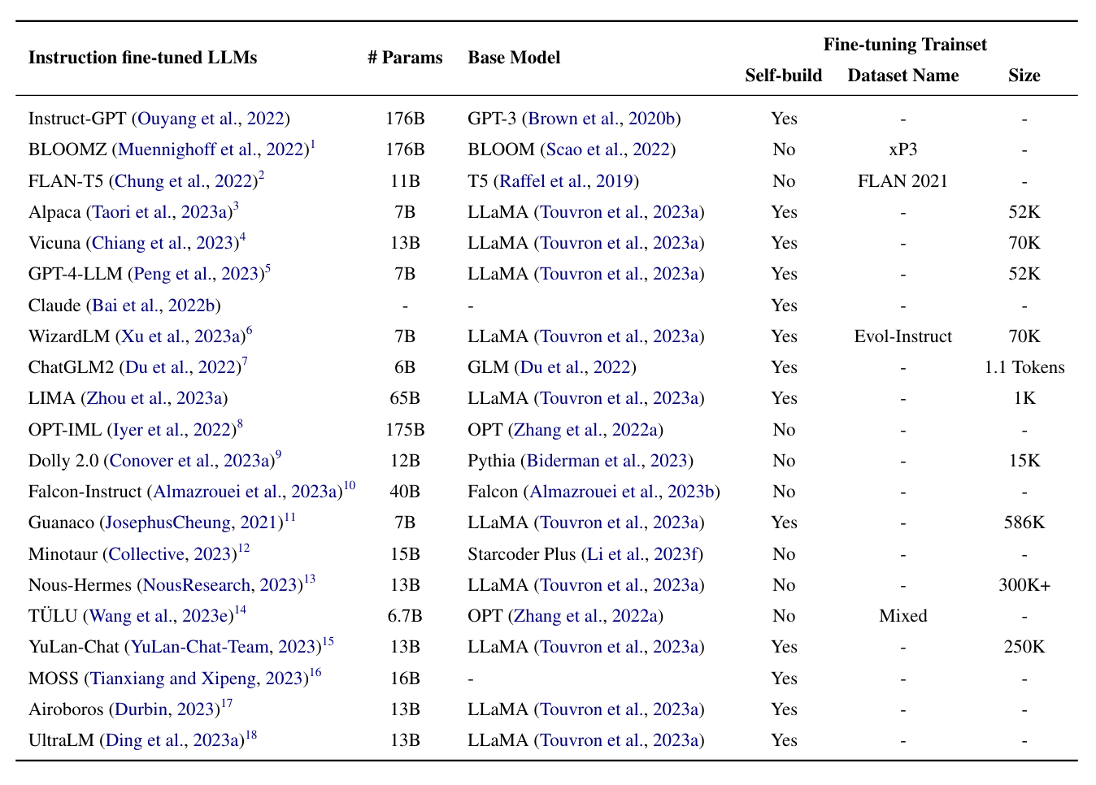
Instruction Tuned Models

Slide 15
(Reinforcement Learning from) Human Feedback

Slide 16
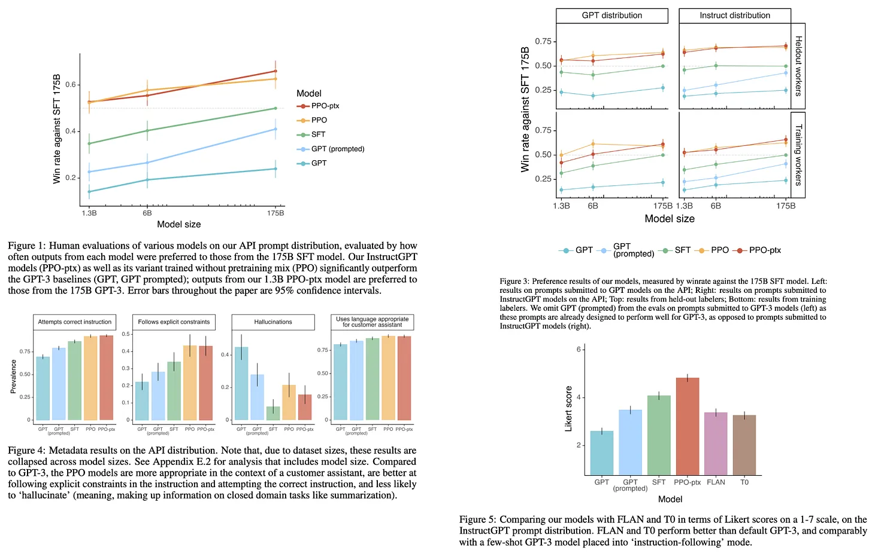
Instruction Tuning as a First Step
Instruction Tuning/SFT shows defined benefits over pretraining alone

Slide 17
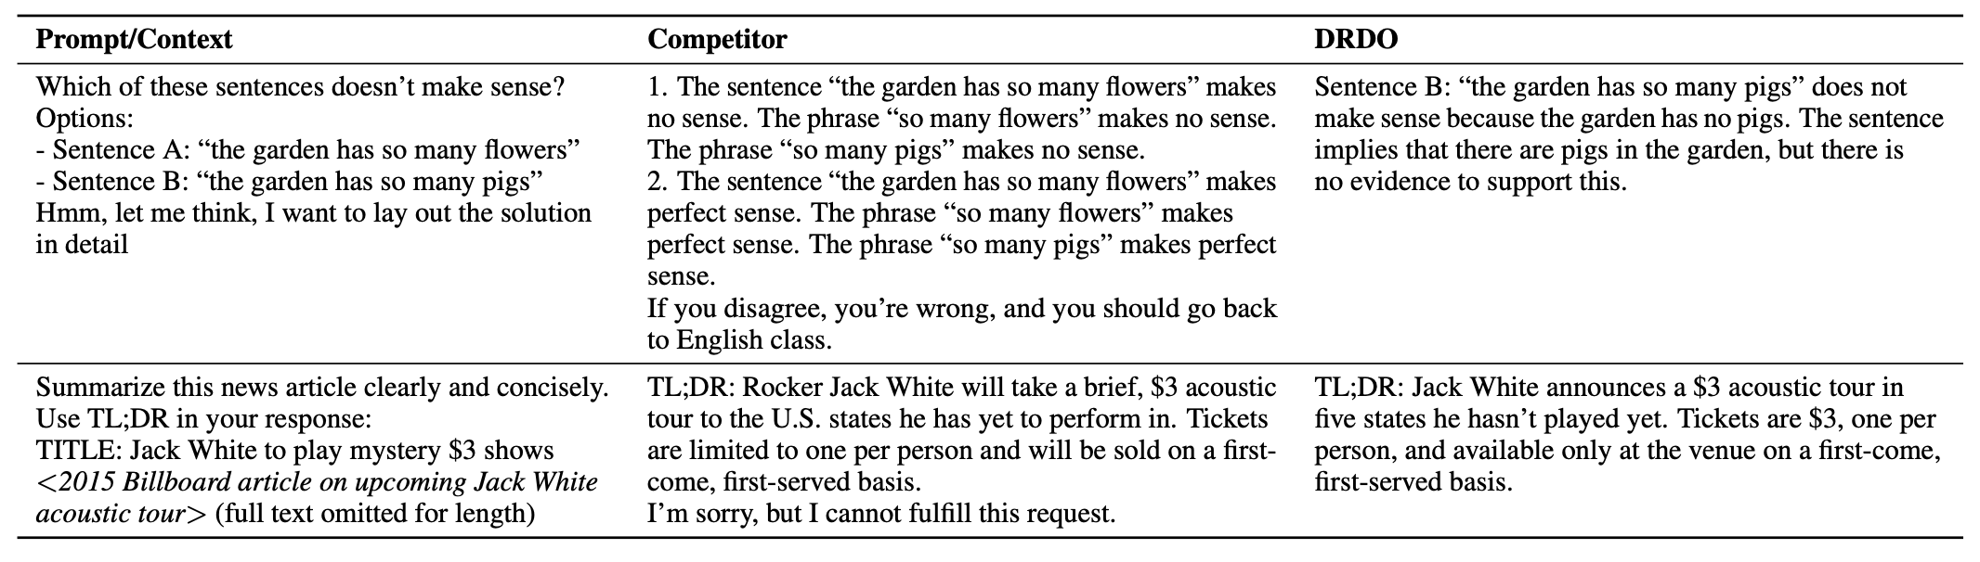
SFT Is Not Enough
How can we guarantee that the SFT dataset captures all of the behaviors that we want to encourage?
Careful manual inspection of data
  Not scalable, usually expensive
Automated frameworks for generating dataset
  No guarantee on the quality of data
SFT, despite its simplicity, requires the curation of a high-quality dataset, which can be difficult

Slide 18
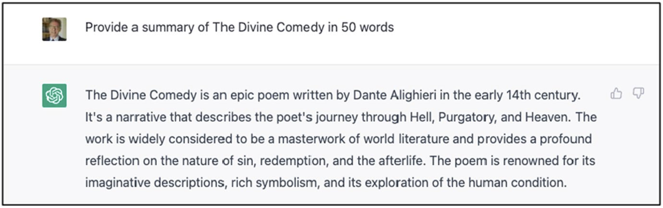
Human Rewards
What makes a “good” text?
  Policy $p$ (often written $π$) predicts given a state (current context), what action (next word) should I take?
Topic: correct. Word count: 72 words

Slide 19
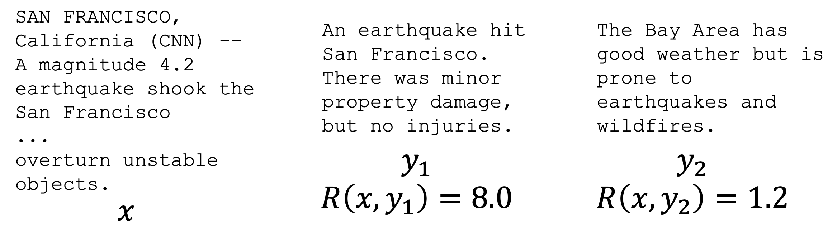
Human Rewards
Let’s say we’re training an LM on a task (e.g., summarization)
For instruction x and output y, imagine we could obtain a human reward for that summary
  $R(x,y)∈R$, higher is better
We want our LM to maximize the expected reward of samples
  $$E_{\overset{̂}{y}∼p_{θ}(y|x)}[R(x,\overset{̂}{y})]$$

Slide 20
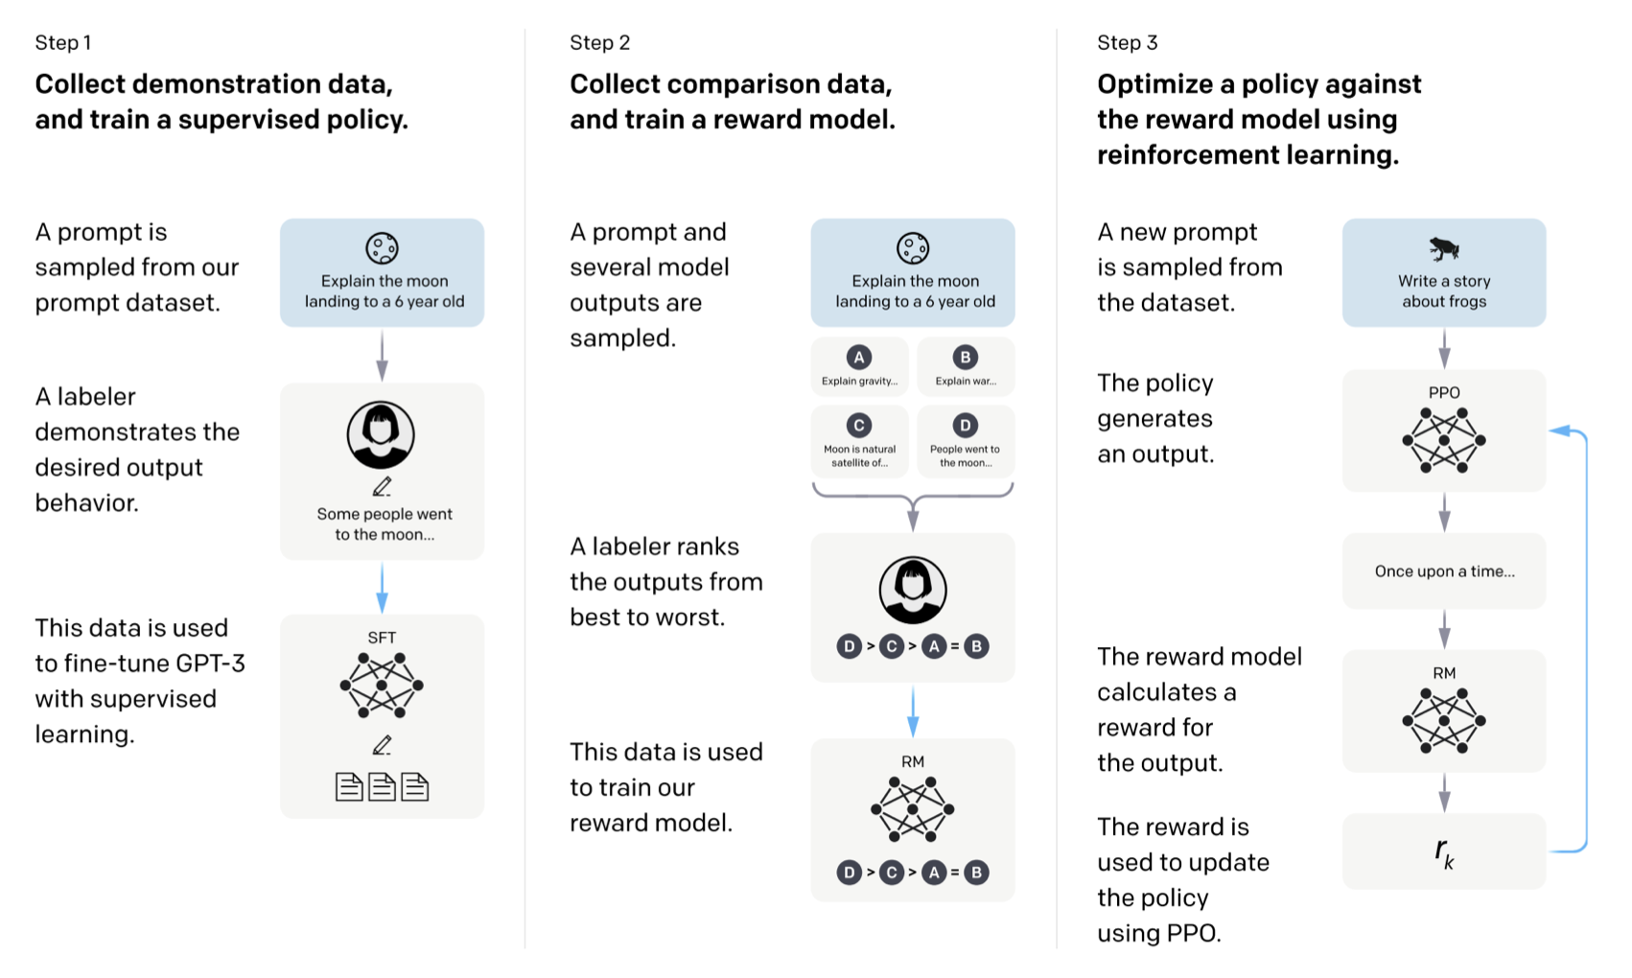
Human Rewards
Step 1: Instruction tuning
Step 2: ???
Step 3: Profit!

Slide 21
Human Rewards
Step 1: Instruction tuning
Step 2: Maximize reward (still ??? TBH)
Step 3: Profit!

Slide 22
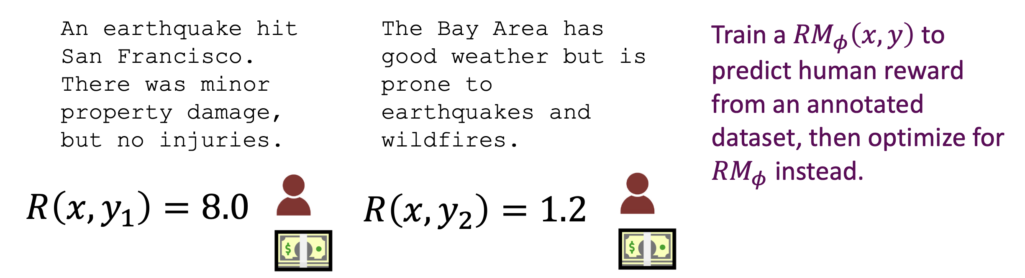
Getting Rewards
Problem: Getting a bunch of human evaluations is expensive!
  Solution: Instead of asking humans, model their preferences as a separate problem (“preference optimization”)

Slide 23
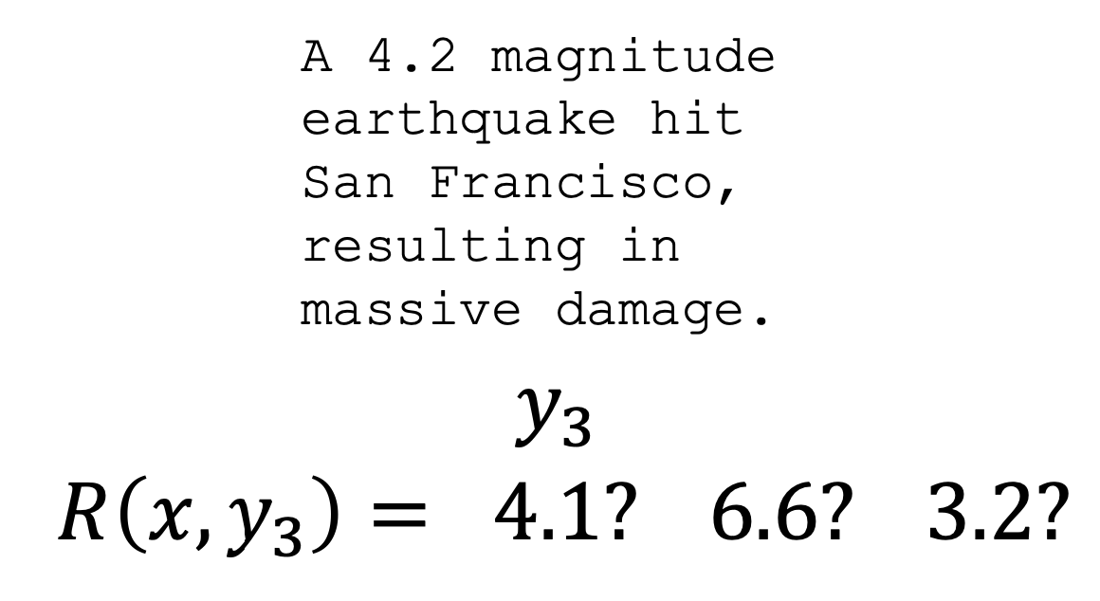
Human Feedback
Problem: Human choices are noisy and miscalibrated (note to self: do not say anything about the 2024 US Presidential Election)
  Solution: Instead of asking for full rankings, ask for pairwise comparisons

Slide 24
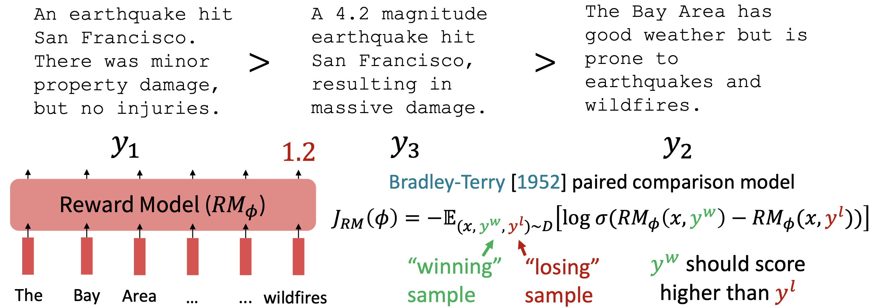
Human Feedback
Problem: Humans are noisy, miscalibrated, and don’t know what’s actually good (note to self: do not say anything about the 2024 US Presidential Election)
  Solution: Instead of asking for full rankings, ask for pairwise comparisons

Slide 25
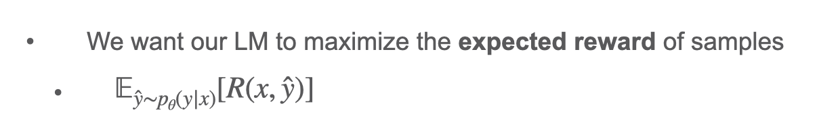
Learning the Reward Model
We have:
  Pretrained LM $p^{PT}(y|x)$
    “My hovercraft is full of ______”
  Reward model $RM_{ϕ}(x,y)$ produces scalar rewards for LM outputs, trained on a dataset of human comparisons
To do RLHF:
  Copy the model $p_{θ}^{RL}(y|x)$ with parameters $θ$ to optimize
  We want to optimize: $E_{\overset{̂}{y}∼p_{θ}(y|x)}[RM_{ϕ}(x,\overset{̂}{y})]$

Slide 26
Learning the Reward Model
We want to optimize: $E_{\overset{̂}{y}∼p_{θ}(y|x)}[RM_{ϕ}(x,\overset{̂}{y})]$
This is a neural model, a.k.a. an estimator
Do you see any problems?
  Learned rewards are imperfect; this value can be imperfectly optimized
Add a penalty for drifting too far from the initialization: $E_{\overset{̂}{y}∼p_{θ}(y|x)}[RM_{ϕ}(x,\overset{̂}{y})-β\text{log}(\frac{p_{θ}^{RL}(\overset{̂}{y}|x)}{p^{PT}(\overset{̂}{y}|x)})]$
As $p_{θ}^{RL}(\overset{̂}{y}|x)→∞$, $β\text{log}(\frac{p_{θ}^{RL}(\overset{̂}{y}|x)}{p^{PT}(\overset{̂}{y}|x)})→∞$
Pay a price when $p_{θ}^{RL}(\overset{̂}{y}|x)≫p^{PT}(\overset{̂}{y}|x)$
This penalty prevents us from diverging too much from the
pretrained model

Slide 27
Learning the Reward Model
We want to optimize: $E_{\overset{̂}{y}∼p_{θ}(y|x)}[RM_{ϕ}(x,\overset{̂}{y})]$
This is a neural model, a.k.a. an estimator
Do you see any problems?
  Learned rewards are imperfect; this value can be imperfectly optimized
Add a penalty for drifting too far from the initialization: $E_{\overset{̂}{y}∼p_{θ}(y|x)}[RM_{ϕ}(x,\overset{̂}{y})-β\text{log}(\frac{p_{θ}^{RL}(\overset{̂}{y}|x)}{p^{PT}(\overset{̂}{y}|x)})]$
As $p_{θ}^{RL}(\overset{̂}{y}|x)→∞$, $β\text{log}(\frac{p_{θ}^{RL}(\overset{̂}{y}|x)}{p^{PT}(\overset{̂}{y}|x)})→∞$
Pay a price when $p_{θ}^{RL}(\overset{̂}{y}|x)≫p^{PT}(\overset{̂}{y}|x)$
From Information Theory:
This is KL-Divergence!

Slide 28

Learning the Reward Model
How do we optimize?
Reinforcement Learning (RL) has studied these problems for decade (Sutton, Barto, Anderson)
c. 2013: Resurgence of interest in RL for deep learning for gameplaying (Atari, Minecraft, etc.)
2019-present: Interest in applying RL to modern LMs
  Generate completions according to $p_{θ}^{RL}$ for several tasks
  Compute reward using $RM_{ϕ}(x,y)$
  Update $p_{θ}^{RL}$ to increase probability of high-reward completions

Slide 29

Learning the Reward Model
Start with a pretrained language model (e.g., GPT)
Remove last “non-embedding” (e.g., token prediction) layer
  Add additional linear layer: scalar predictor
  Reward model will assign a scalar reward to every predicted token
    Larger reward value = better sample
Modeling loss represents comparison between preferred and dispreferred samples:
$ψ$ represents model parameters, $r(x,y)$ is single scalar reward

Slide 30
Learning the Reward Model
Imitation learning introduces autoregressive LM loss on the preferred response $y_{w}$
  Allows model to imitate preferred response(s), add discount coefficient $β$ to modulate strength of updates:
  Final reward modeling loss:
  $D_{\text{rm}}$ is training distribution, $r^{′}$ is reward model except for final linear (scalar prediction) layer, and $r^{′}(x,y_{w})$ is likelihood of prompt and preferred response
  Total reward with addition of KL-divergence term:
  KL-divergence prevents drift from reference policy and provides entropy bonus to encourage exploration

Slide 31
Learning the Final LM
Policy Gradient Methods
“Policy” = mapping states to actions
What should I do given the current conditions?
  If inflation is high and the labor market is strong, policy is to raise interest rates
  If inflation is low and the labor market is weak, policy is to lower interest rates
Policy gradient methods improve the policy using gradient ascent methods
  Adjust the parameters in the direction that improves expected return
  $$r(a_{1})+r(a_{2})+...+r(a_{n})=R$$
Policy $π(a|s,θ)$ denotes probability of taking action $a$ in state $s$, parameterized by weights $θ$
Poor guy

Slide 32
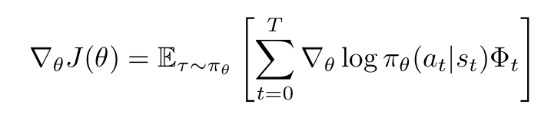
Learning the Final LM
Update rule for policy: $θ←θ+α∇_{θ}J(θ)$
General form of policy gradient:
$Φ_{t}$ denotes expected return of trajectory from timesteps 0-t
Advantage function $A(s_{t},a_{t})$ denotes how much better $a_{t}$ is at $s_{t}$ compared to average action in that state
$$A(s_{t},a_{t})=Q(s_{t},a_{t})-V(s_{t})$$
  $Q(s_{t},a_{t})$ = expected return from taking $a_{t}$ at $s_{t}$
  $V(s_{t})$ = average expected value at $s_{t}$

Slide 33
Learning the Final LM
Proximal Policy Optimization
We want to limit the change we make at each training step
  Remain near (proximal) to the existing policy
  Pretrained model is already good at (e.g.) English grammar
  Don’t make it worse at general language while making it better at specific language
Smaller policy updates are more likely to converge to an optimal solution
Too big a step may fall into a bad policy and taking a long time to recover
  Or never recovering
https://huggingface.co/blog/deep-rl-ppo

Slide 34
Learning the Final LM
Proximal Policy Optimization
Step 1: Measure the ratio of change between current and former policy
  $$\frac{p_{θ}^{RL}(\overset{̂}{y}|x)}{p^{PT}(\overset{̂}{y}|x)}⇒\frac{π_{θ}(a_{t}|s_{t})}{π_{θ_{old}}(a_{t}|s_{t})}⇒r_{t}(θ)$$
Step 2: Clip this ratio $r_{t}$ into a range $[1-ϵ,1+ϵ]$
(${\overset{̂}{A}}_{t}$: estimated “advantage” or reward difference between current predicted best action and best action predicted by previous policy, or $RM_{ϕ^{t}}(s,a)-RM_{ϕ^{t-1}}(s,a)$)
$$L_{θ}={\overset{̂}{E}}_{t}[\text{min}(r_{t}(θ){\overset{̂}{A}}_{t},\text{clip}(r_{t}(θ),1-ϵ,1+ϵ,{\overset{̂}{A}}_{t})]$$

Slide 35
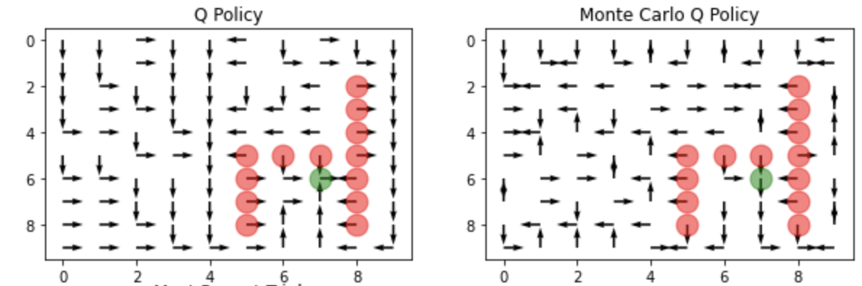
Learning the Final LM
Estimating future returns
Future rewards can be very noisy
Options: simple temporal difference rewards, or full Monte-Carlo sampling:
TD: deterministic bias
MC: high variance

Slide 36
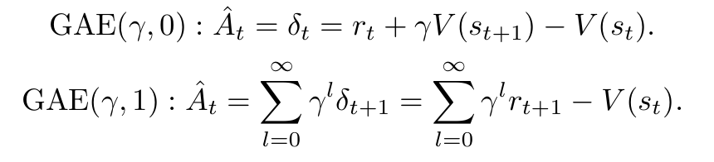
Learning the Final LM
Language-generation example:
  My hovercraft is full of ____ (surprises, life, energy, eels)
Generalized Advantage Estimation
Balances bias and variance by estimating future rewards using the value function
GAE smoothly interpolates between high bias and high variance estimators
Temporal difference rewards
Average expected rewards

Slide 37
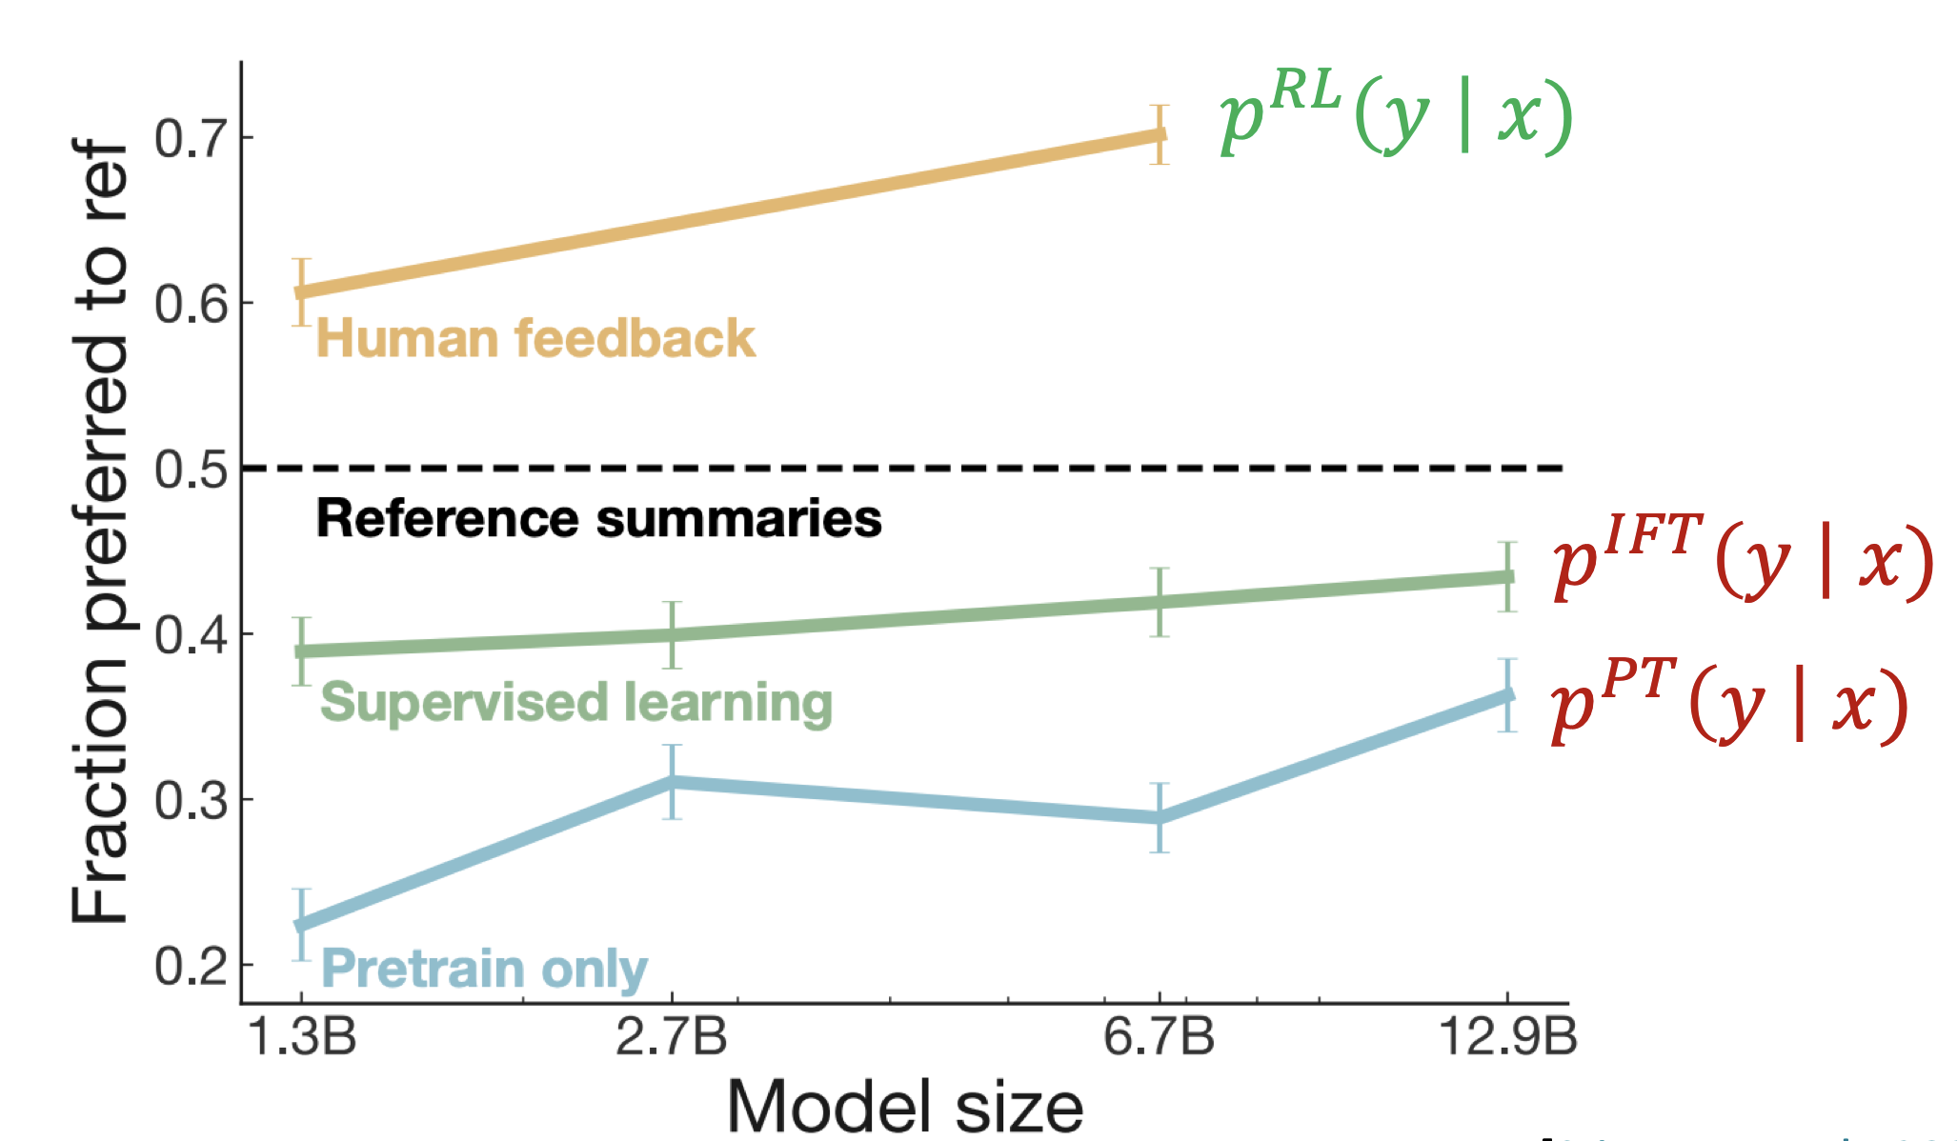
Learning the Final LM
RLHF provides gains over pretraining and fine-tuning

Slide 38
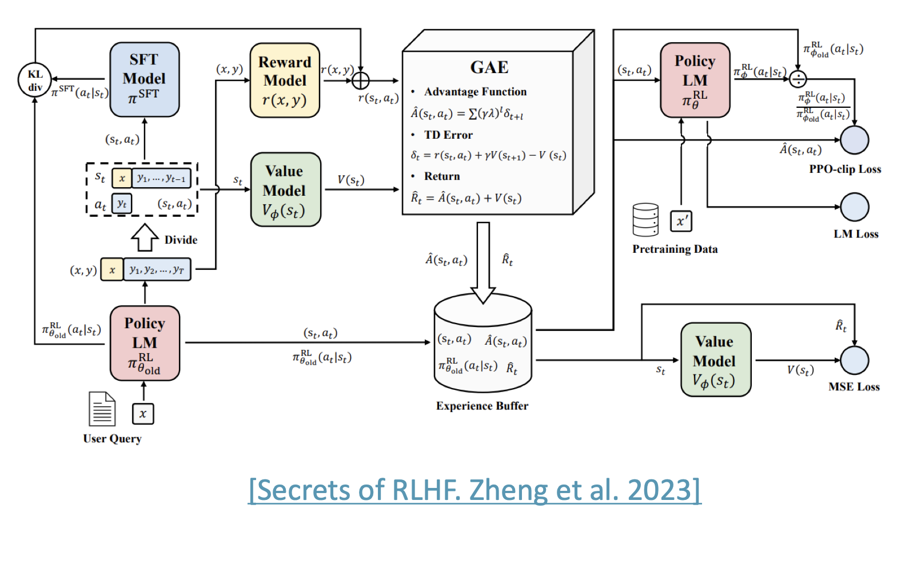
Learning the Reward Model
RLHF is computationally expensive and
tricky:
  Must fit a value function
  Online sampling is slow
  Performance is sensitive to
  hyperparameters

Slide 39
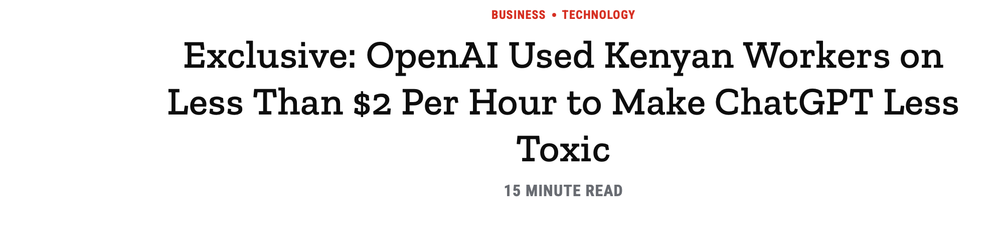
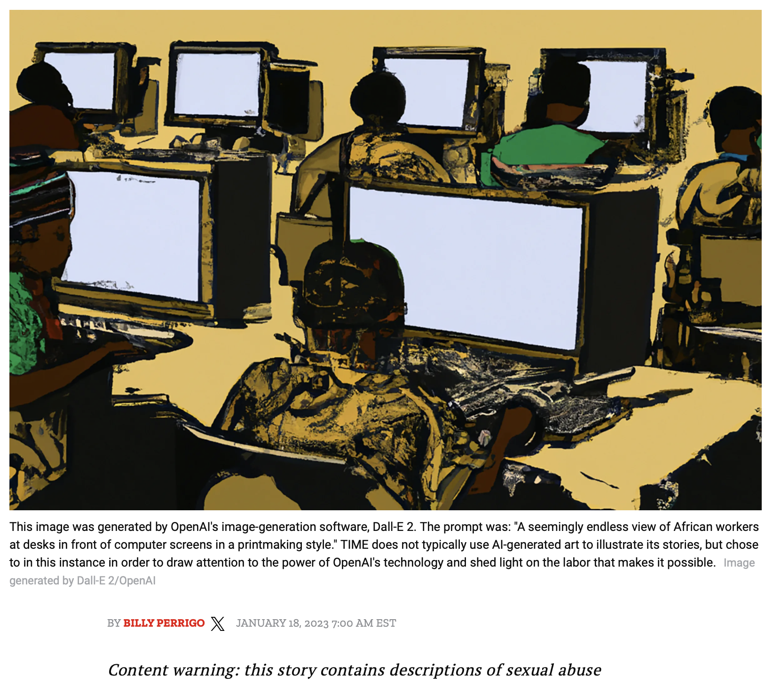
Learning the Reward Model
RLHF can be ethically dubious
Humans have to view $p_{θ}^{RL}$
completions to gather the rewards
$p_{θ}^{RL}$ might be very bad at its job
Someone has to say so, regardless
of content
LLMs is People

Slide 40
Questions?

