Slide 1
Annotation and the MATTER Cycle
CS 542 - Natural Language Processing
Adapted from “Natural Language Annotation for Machine Learning,” by James Pustejovsky and Amber Stubbs
Prof. Nikhil Krishnaswamy, Colorado State University

Slide 2
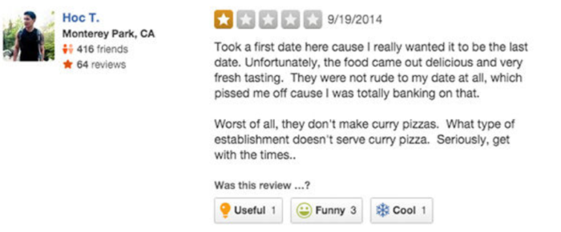
What Can We Learn from “Raw” Language?
So far, we have use different techniques for tasks like classification, sequence tagging, and parsing
For a supervised learning approach, I have to have some notion of what the output is
Annotation
Raw language

Slide 3
What Can We Learn from “Raw” Language?
Even for semi-supervised or unsupervised learning, I still need some non-linguistic information
e.g., how many states in an HMM or grammar?
How many classes can I classify into?

Slide 4
What Can We Learn from “Raw” Language?
Even “raw” data is rarely raw!
Scraped data can have coarse annotation by virtue of the source
e.g., star ratings on reviews
clicks on an ad
Annotations can be human-derived or machine-derived, human-curated
e.g., feature extractors as inputs to another pipeline

Slide 5
What Can We Learn from “Raw” Language?
Without annotation, NLP falls apart
50-80% of a Data Scientist’s job is “data wrangling” (NYT)
Collecting, preparing data
Axiomatic in NLP that if you have a representation other than plain text, go to the representation
Annotation provides the representation

Slide 6
Annotation Development Cycle
Features used for encoding a specific linguistic phenomenon must be rich enough to capture desired behavior in the trained algorithm
These linguistic descriptions are typically distilled from theoretical modeling of the phenom­enon
The descriptions in turn form the basis for the annotation values of the spec
Values themselves the features used in a development cycle for training and testing an identification or labeling algorithm over text
Based on an analysis and evaluation of system performance of a system, the model of the phenomenon may be revised for retraining and testing

Slide 7
The MATTER Cycle

Slide 8
MATTER Cycle
Model
Structural descriptions provide theoretically informed attributes derived from empirical observations over the data
Annotate
An annotation scheme assumes a feature set that encodes specific structural de­scriptions and properties of the input data
Train
The algorithm is trained over a corpus annotated with the target feature set

Slide 9
MATTER Cycle
Test
The algorithm is tested against held-out data
Evaluate
A standardized evaluation of results is conducted
Revise
The model and the annotation specification are revisited in order to make the an­notation more robust and reliable with use in the algorithm

Slide 10
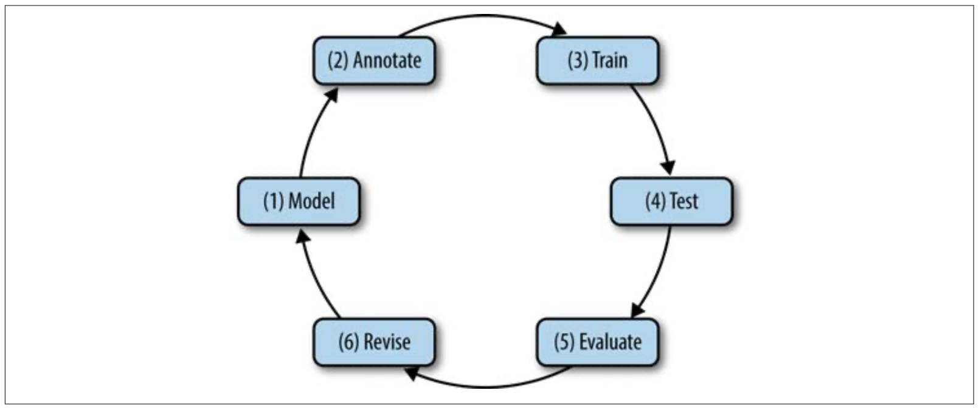
MATTER Cycle

Slide 11
Example

Slide 12
MATTER Cycle in Practice
Terms T, relations R between those terms, interpretation I
Model M can be seen as a triple <T, R, I>
T = {Named_Entity, Organization, Person, Place, Time}
R = {Named_Entity ::= Organization | Person | Place | Time}
I = {Organization = “list of organizations in a database”, Person = “list of people in a database”, Place = “list of countries, geographic locations, etc.”, Time = “all possible dates on the calendar”}
T, R, I do not need to be exhaustive!

Slide 13
MATTER Cycle in Practice
[QBC Productions]Organization Inc. of East Anglia
[QBC Productions Inc.]Organization of East Anglia
[QBC Productions Inc. of East Anglia]Organization
Each of these might look correct to an annotator, but only one actually corresponds to the correct markup in the annotation guideline
Each has a different span
Spans can be measured in words or characters

Slide 14
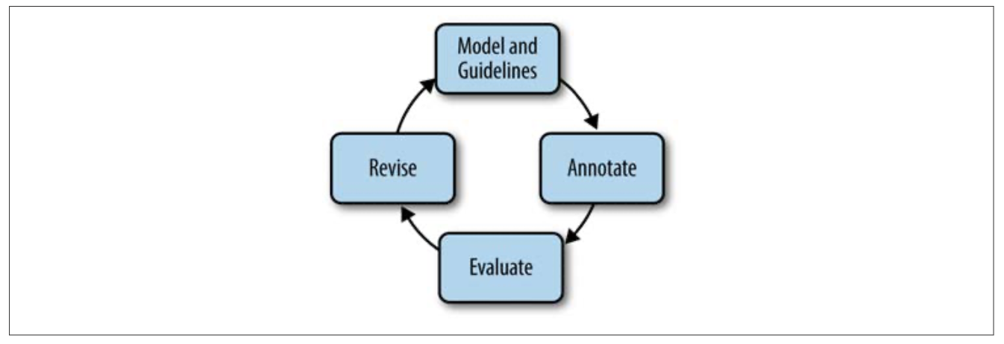
MATTER Cycle in Practice
Model-Annotate-Model-Annotate or “MAMA” cycle

Slide 15
MATTER Cycle in Practice
Best practice is to have annotations done by at least two people
More is better, of course
This creates the gold standard annotated corpus
Uses most up-to-date spec
Everything tagged correctly according to guidelines
Adjudicated using IAA

Slide 16
MATTER Cycle in Practice
Split your corpus into train, dev, and test
Train should be the largest portion
Different distributions are used for different tasks
80/10/10 is a typical distribution
Files distributed randomly throughout the class

Slide 17
MATTER Cycle in Practice
Train on train, sanity check on dev, don’t touch test until the end
Unless you’re fully vaccinated

Slide 18
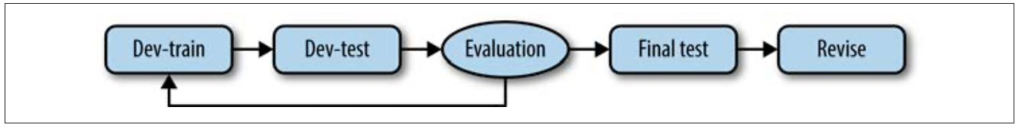
MATTER Cycle in Practice
Use dev-test (validation) set for error analysis
Once sources of error are found, tune and adjust model and retrain
Training-Evaluation Cycle

Slide 19
MATTER Cycle in Practice
Sample task: gender identification
Data: English newspaper text
Annotation: T = {Name, Male, Female, Unisex}; R = {Name ::= Male | Female | Unisex}
ML Model: Character N-grams
Training-Evaluation Cycle

Slide 20
MATTER Cycle in Practice
Model learns that female names end in vowels like A or E:
OliverMale, EmmaFemale, WilliamMale, CharlotteFemale, JamesMale, IsabelleFemale, AlexUnisex, HarperUnisex
Validation data includes Italian names, model predicts:
MarcoMale, MariaFemale, LauraFemale, FrancescoMale, GiuseppeFemale, GiuliaFemale, AndreaFemale, SimoneFemale
Training-Evaluation Cycle

Slide 21
MATTER Cycle in Practice
MarcoMale, MariaFemale, LauraFemale, FrancescoMale, GiuseppeFemale, GiuliaFemale, AndreaFemale, SimoneFemale
Oops! Maybe we should update annotation scheme
Add annotation for language of name
T = {Name, Male, Female, Unisex, Language, English, Italian, …}
R = {{Name ::= Male | Female | Unisex}, {Language ::= English | Italian | …}}
Training-Evaluation Cycle

Slide 22
MATTER Cycle in Practice
What if my data is small?
I want to make sure my dev or test sets aren’t removing too much useful information from training
k-fold cross-validation splits data into k partitions
Train on k-1 partitions, validate on 1 partition
Switch out the validation partition, repeat

Slide 23
MATTER Cycle in Practice
Precision, Recall, F-measure
Refer to Lecture 3
Important to measure these per-class
Allows you to assess which classes are commonly confused and which samples are commonly misclassified, and look at their features

Slide 24
MATTER Cycle in Practice
Once failure points are identified, the annotation must be updated
Sample task: Named Entity Recognition
Annotation: T = {Named_Entity, Organization, Person, Place, Time}, R = {Named_Entity ::= Organization | Person | Place | Time}
Evaluating the model find NEs like Easter, 9/11, or Thanksgiving are commonly misclassified
Annotation would be better by subcategorizing “Time”
Add “Event” tag

Slide 25
MATTER Cycle in Practice

Slide 26
Inter-Annotator Agreement

Slide 27
Inter-Annotator Agreement
Before you create gold standard, you need to evaluate the annotation task itself
Good IAA scores ensure your task is reproducible
Intrinsic evaluation of annotation task
Good IAA scores don’t necessarily mean that your corpus will produce good results when used to train an ML algorithm
Simply indicates your annotators agree on the task
The more data you annotate, the better your ML results are likely to be

Slide 28
Inter-Annotator Agreement
Could just count how many tags there are in the dataset and calculate how much the annotators agree on if each tag should be there
Straight percentages don’t take into account random chance agreement
If annotators randomly choose a sentiment label (e.g., on reviews) without reading the text, there’s a 50% chance they agree
Percentage-based IAA would be artificially high
To create numbers that can be compared across studies, various metrics have been de­veloped
e.g., Cohen’s Kappa, Fleiss’s Kappa, Krippendorff’s Alpha

Slide 29
Inter-Annotator Agreement
Could just count how many tags there are in the dataset and calculate how much the annotators agree on if each tag should be there
Straight percentages don’t take into account random chance agreement
If annotators randomly choose a sentiment label (e.g., on reviews) without reading the text, there’s a 50% chance they agree
Percentage-based IAA would be artificially high
To create numbers that can be compared across studies, various metrics have been de­veloped
e.g., Cohen’s Kappa, Fleiss’s Kappa, Krippendorff’s Alpha

Slide 30
Inter-Annotator Agreement
Denoted κ
Measures agreement between two annotators, while taking into account the possibility of chance agreement
$$κ=\frac{P(a)-P(e)}{1-P(e)}$$
P(a): relative observed agreement between annotators
P(e): expected agreement between annotators, if each annotator was to randomly pick a category for each annotation

Slide 31
Inter-Annotator Agreement
2 annotators: Alice and Bob, assigned labels (positive, neutral, negative) to 250 movie reviews
 |  | B | B | B
 |  | pos | neu | neg
A | pos | 54 | 28 | 3
A | neu | 31 | 18 | 23
A | neg | 0 | 21 | 72

Slide 32
Inter-Annotator Agreement
 |  | B | B | B
 |  | pos | neu | neg
A | pos | 54 | 28 | 3
A | neu | 31 | 18 | 23
A | neg | 0 | 21 | 72
Calculate P(a): actual agreement between annotators
P(a) = (54 + 18 + 72) / 250 = .576 (57.6%)
Calculate P(e): expected chance agreement
Alice used “pos” 54+28+3 = 85 times / 250 = .34
Bob used “pos” 54+31 = 85 times / 250 = .34
P(e) = .34*.34 + same calculation for other classes

Slide 33
Inter-Annotator Agreement
 |  | B | B | B
 |  | pos | neu | neg
A | pos | 54 | 28 | 3
A | neu | 31 | 18 | 23
A | neg | 0 | 21 | 72
Calculate P(a): actual agreement between annotators
P(a) = (54 + 18 + 72) / 250 = .576 (57.6%)
Calculate P(e): expected chance agreement
Alice used “pos” 54+28+3 = 85 times / 250 = .34
Bob used “pos” 54+31 = 85 times / 250 = .34
P(e) = .34*.34 + .288*.268 + .372*.392 = .1156+.077184+.145824 = .338608
$κ=\frac{P(a)-P(e)}{1-P(e)}$ = (.576-.339)/(1-.339) = .237/.661 = .359

Slide 34
Inter-Annotator Agreement
Also denoted κ
Measures agreement between three or more annotators, while taking into account the possibility of chance agreement
$$κ=\frac{P(a)-P(e)}{1-P(e)}$$
P(a): relative observed agreement between annotators
P(e): expected agreement between annotators, if each annotator was to randomly pick a category for each annotation
Fleiss’s Kappa differs in how these values are calculated

Slide 35
Inter-Annotator Agreement
5 annotators, same movie annotation task
 | pos | neu | neg | Pi
A | 85 | 72 | 93
B | 85 | 67 | 98
C | 68 | 99 | 83
D | 88 | 88 | 74
E | 58 | 120 | 72
total | 384 | 446 | 420
Pc

Slide 36
Inter-Annotator Agreement
5 annotators, same movie annotation task
We need to calculate $P_{c}$, the class probability $P_{i}$, each annotator’s agreement with other annotators, compared to all possible agreement values
Let A be the number of annotators, a be the number of annotations per annotator, k be the number of categories, c be the current category, and i be the current annotator
 | pos | neu | neg | Pi
A | 85 | 72 | 93
B | 85 | 67 | 98
C | 68 | 99 | 83
D | 88 | 88 | 74
E | 58 | 120 | 72
total | 384 | 446 | 420
Pc

Slide 37
Inter-Annotator Agreement
5 annotators, same movie annotation task
$$P_{c}=\frac{1}{Aa}\overset{A}{\underset{i=1}{∑}}a_{ic},1=\frac{1}{a}\overset{k}{\underset{c=1}{∑}}a_{ic}$$
P(pos) = (85+85+68+88+58)/(5*250) = .3072
 | pos | neu | neg | Pi
A | 85 | 72 | 93
B | 85 | 67 | 98
C | 68 | 99 | 83
D | 88 | 88 | 74
E | 58 | 120 | 72
total | 384 | 446 | 420
Pc | 0.3072 | 0.3568 | 0.336

Slide 38
Inter-Annotator Agreement
5 annotators, same movie annotation task
$$P_{i}=\frac{(∑_{c=1}^{k}a_{ic}^{2})-a}{a(a-1)}$$
P(A) = ((85²+72²+93²)-250)/(250 * 249) = ((7225+5184+8649)-250)/62250 = (21058-250)/62250 = .3343
 | pos | neu | neg | Pi
A | 85 | 72 | 93 | 0.3343
B | 85 | 67 | 98 | 0.3384
C | 68 | 99 | 83 | 0.3384
D | 88 | 88 | 74 | 0.3328
E | 58 | 120 | 72 | 0.3646
total | 384 | 446 | 420
Pc | 0.3072 | 0.3568 | 0.336

Slide 39
Inter-Annotator Agreement
5 annotators, same movie annotation task
$P(a)$ is the average of the $P_{i}$ values
$P(a)=\frac{.3343+.3384+.3384+.3328+.3646}{5}$ = 1.7085/5 = .3417
$P(e)=\overset{k}{\underset{c=1}{∑}}P_{c}^{2}$ =.3072²+.3568²+.336² = .335
 | pos | neu | neg | Pi
A | 85 | 72 | 93 | 0.3343
B | 85 | 67 | 98 | 0.3384
C | 68 | 99 | 83 | 0.3384
D | 88 | 88 | 74 | 0.3328
E | 58 | 120 | 72 | 0.3646
total | 384 | 446 | 420
Pc | 0.3072 | 0.3568 | 0.336

Slide 40
Inter-Annotator Agreement
5 annotators, same movie annotation task
$κ=\frac{P(a)-P(e)}{1-P(e)}=\frac{.3417-.335}{1-.335}$ = .0067/.665 = .010
 | pos | neu | neg | Pi
A | 85 | 72 | 93 | 0.3343
B | 85 | 67 | 98 | 0.3384
C | 68 | 99 | 83 | 0.3384
D | 88 | 88 | 74 | 0.3328
E | 58 | 120 | 72 | 0.3646
total | 384 | 446 | 420
Pc | 0.3072 | 0.3568 | 0.336

Slide 41
Inter-Annotator Agreement
κ | Agreement level
< 0 | poor
0.00-0.20 | slight
0.20-0.40 | fair
0.04-0.60 | moderate
0.60-0.80 | substantial
> 0.80 | near perfect

Slide 42
Inter-Annotator Agreement
Cohen’s Kappa and Fleiss’s Kappa can be converted into a Z-score (standard score)
Define error term $p_{z}=\overset{k}{\underset{c=1}{∑}}(\frac{1}{Aa}\overset{n}{\underset{i=1}{∑}}a_{ic})^{2}$
Define Kappa for cth category as $κ_{c}=1-\frac{∑_{i=1}^{a}a_{ic}(A-a_{ic})}{Aa(A-1)\frac{1}{Aa}∑_{i=1}^{n}a_{ic}(1-\frac{1}{Aa}∑_{i=1}^{n}a_{ic})}$

Slide 43
Inter-Annotator Agreement
Standard error of $κ_{c}=s.e.(κ_{c})=\sqrt{\frac{2}{Aa(A-1)}}$
$$z_{c}=\frac{κ_{c}}{s.e.(κ_{c})}$$
Then p-value and confidence interval can then be approximated by the standard normal distribution function over z (what is the probability of getting equal to or less than z on a normal distribution curve?)

Slide 44
Inter-Annotator Agreement
p-value won’t say your annotations are correct, only that your annotators agree more than chance
Validates reproducibility of annotation task
Coupled with good ML performance trained over that annotation, can be taken as indicator of correctness for the task

Slide 45
Weak vs. Strong Annotation

Slide 46
Weak vs. Strong Annotation
Above approaches are strong annotation
Not in the sense of particularly well-done
Refers to explicit (strong) vs. implicit (weak) encoding of information
Strong annotation relies on a structured specification
Captures a closed set of things
Models are trained over the same targets as the specification encodes

Slide 47
Weak vs. Strong Annotation
Strong annotation is hard!
Requires human effort, human expertise
Best practices include multiple annotators, IAA scores, adjudication
Not easy to adapt to new datasets
May require multiple MAMA cycles
Is there an easier way?

Slide 48
Weak vs. Strong Annotation
Doesn’t mean it’s badly done!
Conducted with minimum effort possible to scale up rapidly
Rely on correlations in the data to extract useful information
Most datasets upon which modern AI relies are weakly annotated
Toronto Book Corpus, Wikipedia, any unstructured internet text

Slide 49
Weak vs. Strong Annotation
BERT masked language modeling or next sentence prediction
“Annotation” is simply the pairing extracted from the dataset
Job of the model is the filter out dependencies
Figure out what important dependencies are
Significant effort still has to be put into making the datasets friendly to knowledge extraction
Weak annotation is usually more about data structuring than explicit notation

Slide 50
Weak vs. Strong Annotation
Good for evaluation and benchmarking
Often performance on a simple task leads to unexpected effects, with enough data and compute
Also leads to difficulty in applying the conclusions of benchmark comparisons to situations that don’t already resemble the training data
e.g., models that perform well on SQuAD or SWAG or GLUE often fall apart in live robotics situations

Slide 51
Questions?

