Slide 1
Graphical Models and CRFs
CS 542 - Natural Language Processing
Partially adapted from slides by Fei Xia, University of Washington
Prof. Nikhil Krishnaswamy, Colorado State University

Slide 2
Graphical Models

Slide 3
Graphical Models
A graphical model is a probabilistic model for which a graph denotes the conditional independence structure between random variables:
Nodes: random variables
Edges: dependency relation between random variables
Types of graphical models:
Bayesian network: directed acyclic graph (DAG)
Markov random fields: undirected graph

Slide 4
Bayesian Networks
Graph: directed acyclic graph (DAG)
Nodes: random variables
Edges: conditional dependencies
Each node X is associated with a probability function $P(X|\text{parents}(X))$

Slide 5
Bayesian Networks
P(sprinkler|rain)
Sprinkler
Rain
P(rain)
RAIN | SPRINKLER
 | T | F
T | 0.4 | 0.6
F | 0.01 | 0.99
RAIN
T | F
0.2 | 0.8
Grass Wet
P(grass wet|sprinker,rain)
SPRINKLER | RAIN | GRASS WET
 |  | T | F
F | F | 0.0 | 1.0
F | T | 0.8 | 0.2
T | F | 0.9 | 0.1
T | T | 0.99 | 0.01

Slide 6
Bayesian Networks
B
C
P(B)
P(C|A)
P(A|B,E)
A
D
P(D|E)
E
P(E)

Slide 7
Bayesian Networks
Local Markov property: each variable $x_{i}$ is conditionally independent of its non-descendants given its parent variables
$$P(x_{1},...,x_{n})=\overset{n}{\underset{i=1}{∏}}P(x_{i}|x_{1},...,x_{i-1})=\overset{n}{\underset{i=1}{∏}}P(x_{i}|\text{parents}(x_{i}))$$
Given this network
BAC, EAC, ED are all individual sequences
B
C
$$P(E,A,C)=P(C|A)P(A|B,E)P(E)P(B)$$
A
D
E

Slide 8
Bayesian Networks
$$P(A,B,C,D,E)=P(B)P(E)P(A|B,E)P(C|A)P(D|E)$$
$$P(B,E|C,D)=\frac{P(B,E,C,D)}{P(C,D)}=\frac{∑_{A}P(A,B,C,D,E)}{∑_{A}∑_{B}∑_{E}P(A,B,C,D,E)}$$
B
C
P(B)
P(C|A)
P(A|B,E)
Just marginalize out the things
you’re not interested in!
A
D
P(D|E)
E
P(E)

Slide 9
Bayesian Networks
Features are independent of each other given the class (parent)
$P(X,Y)=P(f_{1},f_{2},...,f_{n},Y)$ $=P(Y)P(f_{1}|Y)P(f_{2}|Y)...P(f_{n}|Y)$ $=P(Y)\overset{n}{\underset{k=1}{∏}}P(f_{k}|Y)$
…
Y
f1
f2
fn

Slide 10
Bayesian Networks
Output sequence depends on parent states and parent states’ parents
$$P(X_{1,n},Y_{1,n})=π(y_{1})\overset{n}{\underset{i=1}{∏}}P(y_{i+1}|y_{i})P(x_{i}|y_{i})$$
y1
y2
y3
yn
x1
x2
x3
…
xn

Slide 11
Bayesian Networks
A directed graphical model in which the output (i.e., what to be predicted) topologically precede the input (i.e., what is given as observation)
So, in HMM, the output is the hidden state sequence while the input is the observation sequence (even though the hidden states emit/output the observations)
Naive Bayes is more straightforward: features are input, class is output
Naive Bayes and HMM are generative models

Slide 12
Markov Random Field
a.k.a. “Markov Network”
Not directed
Graphical model in which a set of random variables have a Markov property:
Local Markov property: variable is conditionally independent of all other variables given its neighbors
$$P(X_{i}|X_{j},\text{neighbor}(X_{i}))=P(X_{i}|\text{neighbor}(X_{i}))$$

Slide 13

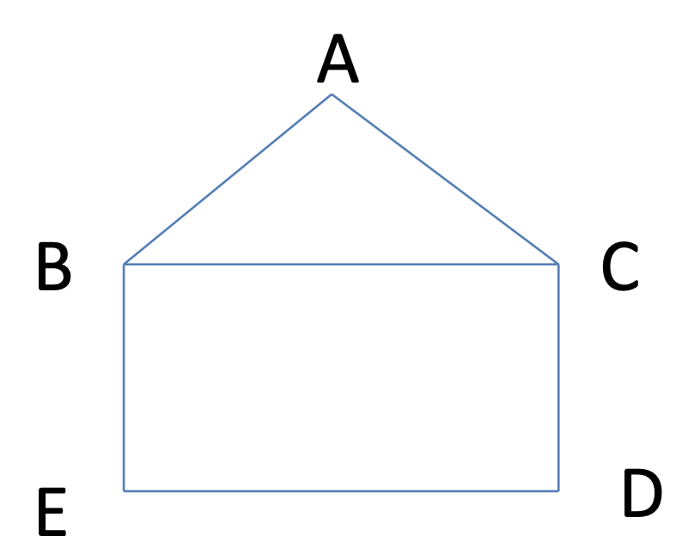
Markov Random Field
A clique in an undirected graph is a subset of its vertices such that every two vertices in the subset are connected by an edge
A maximal clique is a clique that cannot be extended by adding one more vertex
A maximum clique is a clique of the largest possible size in a given graph
clique: any set not containing (B,D) or (C,E)
maximal clique: (A,B,C)
maximum clique: (A,B,C)

Slide 14
Conditional Random Fields

Slide 15
Conditional Random Field
A graph G is composed of vertices V and edges E ($G=(V,E)$)
Let Y be a composed of vertices on the graph, e.g. B A C
B
C
A
D
E

Slide 16
Conditional Random Field
An set of observations X (inputs) conditions random variables Y (outputs)
Y is indexed by the vertices of G
Y conditioned on X obeys the local Markov property w.r.t. the graph
y2
y3
B
C
y1
A
y4
D
y5
E

Slide 17
Conditional Random Field
$P(y_{v}|X,y_{w},w≠v)=P(y_{v}|X,y_{w},w∼v)$ ($w∼v$ = $w$ and $v$ are neighbors)
y2
y3
B
C
y1
A
y4
D
y5
E

Slide 18
Conditional Random Field
CRF is a random field
Graphical model where vertices index random variables Y
Vertices obey a Markov property
In CRF, random variables conditioned on observables obeys local Markov property
But observables are a whole sequence X
So CRF is a random field globally conditioned on X

Slide 19
Conditional Random Field
Formula for CRF where Y is the hidden state (output of model) and X is the word or words around it (observed variable):
$$P(Y|X)=\frac{1}{Z(X)}\overset{T}{\underset{t=1}{∏}}e^{∑_{j=1}^{J}θ_{j}f_{j}(y_{t},y_{t-1},X,t)}$$
Looks scary

Slide 20
Conditional Random Field
Formula for CRF where Y is the hidden state (output of model) and X is the word or words around it (observed variable):
$$P(Y|X)=\frac{1}{Z(X)}\overset{T}{\underset{t=1}{∏}}e^{∑_{j=1}^{J}θ_{j}f_{j}(y_{t},y_{t-1},X,t)}$$
}
}
}
Weight
Feature
Normalization

Slide 21
Linear-Chain CRF
Sequence Labeling, e.g., POS tagging:
HMM: finds best sequence, but cannot use rich features (no feature function, raw observations only, no way to encode rich dependencies)
MaxEnt: can use rich features, but may not find best sequence
Linear-Chain CRF ≈ HMM + MaxEnt
Linear-Chain CRF ≠ MEMM

Slide 22
Linear-Chain CRF
Naive Bayes
HMM
Generative Directed Models
Generative
Sequence
General Graph
Conditional
Sequence
General Graph
MaxEnt (LR)
Linear-Chain CRFs
General CRFs

Slide 23
Linear-Chain CRF
Define a feature function, e.g.:
$$f_{j}(y_{t-1},y_{t},X,t)=\{\begin{matrix}1 & (y_{t-1}=IN)∧(y_{t}=NN)∧(x_{t}=October) \\ 0 & otherwise\end{matrix}$$
f is 1 if the previous state is “IN” (preposition) and current state is “NN” (noun) and current observation is “October,” otherwise 0

Slide 24
Linear-Chain CRF
$$F_{j}(Y,X)=\overset{T}{\underset{t=1}{∑}}f_{j}(y_{t-1},y_{t},X,t)$$
$P(Y|X)=\frac{1}{Z(X)}e^{∑_{j=1}^{J}θ_{j}F_{j}(Y,X)}$ $=\frac{1}{Z(X)}e^{∑_{j=1}^{J}(θ_{j}∑_{t=1}^{T}f_{j}(y_{t-1},y_{t},X,t))}$ $=\frac{1}{Z(X)}e^{∑_{j=1}^{J}∑_{t=1}^{T}(θ_{j}f_{j}(y_{t-1},y_{t},X,t))}$ $=\frac{1}{Z(X)}e^{∑_{t=1}^{T}∑_{j=1}^{J}(θ_{j}f_{j}(y_{t-1},y_{t},X,t))}$ $=\frac{1}{Z(X)}\overset{T}{\underset{t=1}{∏}}e^{∑_{j=1}^{J}(θ_{j}f_{j}(y_{t-1},y_{t},X,t))}$

Slide 25
Linear-Chain CRF
$P(X|Y)=\frac{1}{Z(X)}\overset{T}{\underset{t=1}{∏}}e^{∑_{j=1}^{J}(θ_{j}f_{j}(y_{t-1},y_{t},X,t))}$ $=\frac{1}{Z(X)}\overset{T}{\underset{t=1}{∏}}ϕ_{t}(y_{t-1},y_{t},X,t)$
Training: estimate $θ_{j}$
Similar to MaxEnt
Decoding: find best sequence Y
Similar to HMM (Viterbi)

Slide 26
Conditional Random Field
Graphical models
Bayesian Network (NB, HMM special cases)
Markov Random Field (MRF)
CRF - variant of MRF
Linear-Chain CRF: HMM + MaxEnt
Skip-Chain CRF: can handle long-distance dependency
$$\overset{T}{\underset{t=1}{∏}}ϕ_{t}(y_{t-1},y_{t},X,t)\underset{(u,v)∈dep}{∏}ϕ_{(u,v)}(y_{u},y_{v},X)$$
Pros: higher accuracy than HMM and MaxEnt
Cons: training and inference can be very slow

Slide 27
Conditional Random Field
Nice example of CRFs for handwriting recognition: https://towardsdatascience.com/conditional-random-fields-explained-e5b8256da776
Text classification example: https://www.analyticsvidhya.com/blog/2018/08/nlp-guide-conditional-random-fields-text-classification/

Slide 28
Questions?

