Slide 1
Viterbi Algorithm
CS 542 - Natural Language Processing
Partially adapted from slides by Vivek Srikumar (Utah) and Simone Teufel (Cambridge)
Prof. Nikhil Krishnaswamy, Colorado State University

Slide 2
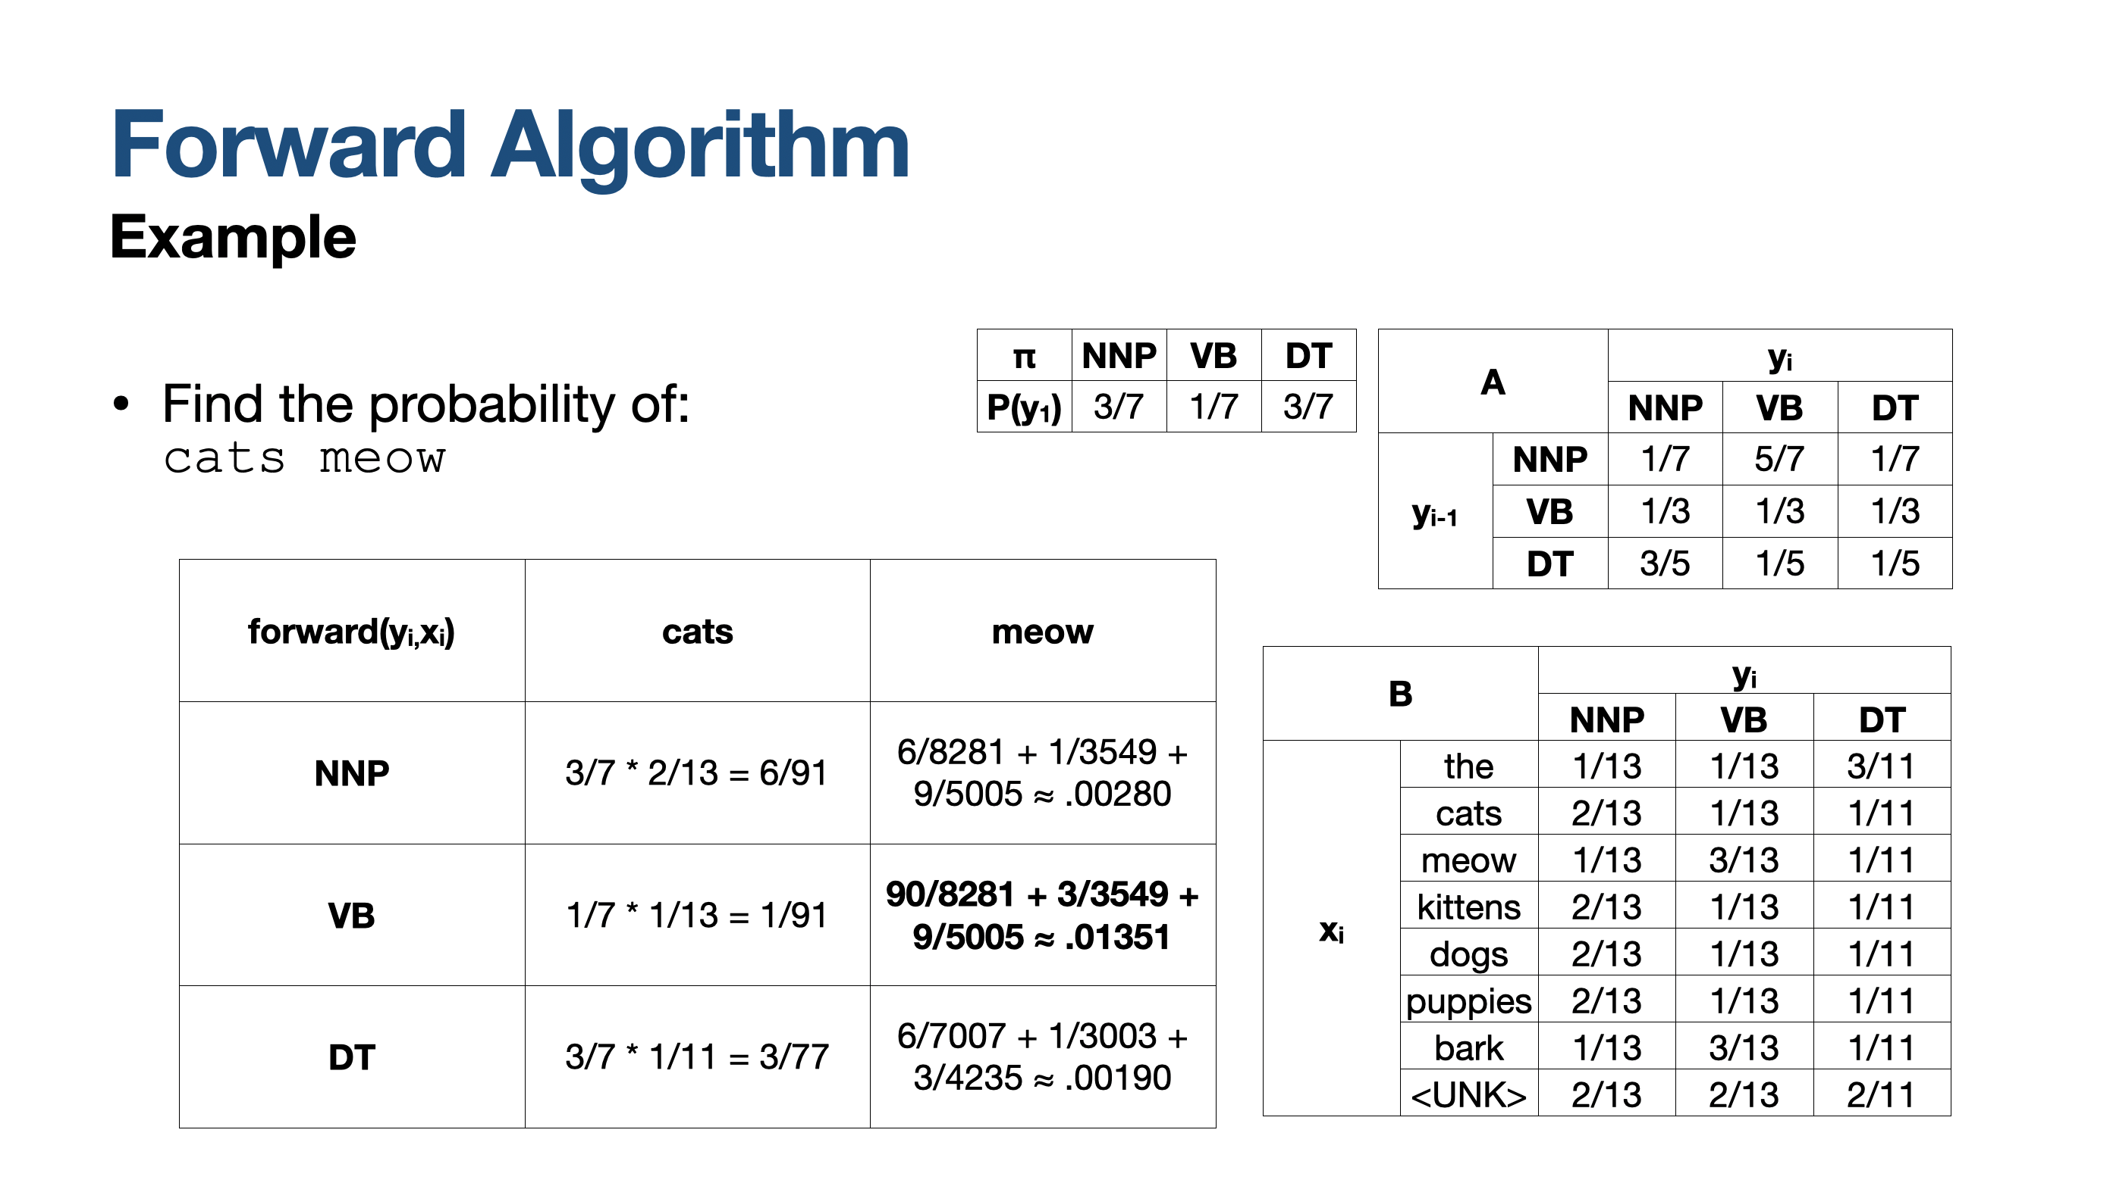
Hidden Markov Models
We now know how to calculate the probability of a sequence

Slide 3
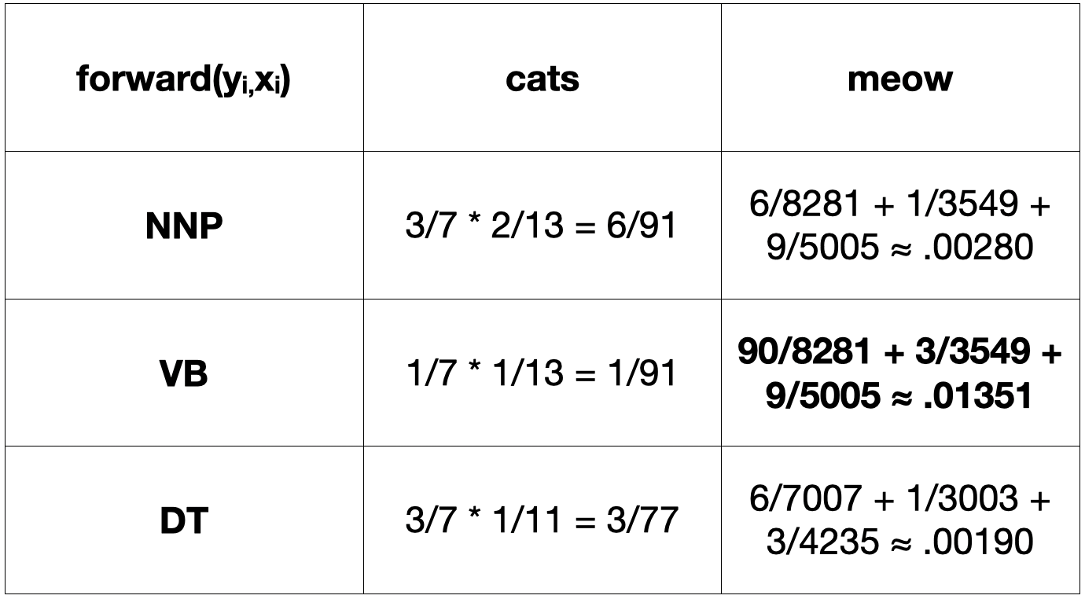
Hidden Markov Models
We also know how the sequence ends (e.g., “cats meow” ends in a verb)
But we don’t know the rest of the sequence of hidden states!
Why not just greedy search?
Construct output left to right use the highest probability state at each t
Sometimes this works!

Slide 4
Hidden Markov Models
The old man
the boat
DT
JJ
NN
DT
NN
DT
NNP
VB
“Elderly people operate the boat”

Slide 5
Hidden Markov Models
Greedy search reduces the forward trellis to a 1D table of T time steps by choosing the most probable choice Yj at every step t and moving on
At a later timestep t+k, you might find that all paths to the obvious best choice Yk have low-to-zero probability of going through Yj
Some other choice, Yj’ at t suddenly looks better but you can’t go back
Or can you?
We need to know where we came from

Slide 6
Viterbi Algorithm

Slide 7
Viterbi Algorithm
Initial: For each state s, calculate ${\text{score}}_{1}(s)=P(s)P(x_{1}|s)$ Probability of s being the first state * probability of seeing first observation given being in that state
Recursion: For i = 2 to n, for every state s, calculate ${\text{score}}_{i}(s)={\text{max}}_{y_{i−1}}P(s|y_{i−1})P(x_{i}|s){\text{score}}_{i−1}(y_{i−1})$
Termination: At final state, calculate ${\text{max}}_{y_{i−1}}P(Y,X|π,A,B)={\text{max}}_{s}{\text{score}}_{n}(s)$ The state that maximizes the probably of the state and observation sequences given the model is the state that maximized the “score” function at the last timestep

Slide 8
Viterbi Algorithm
Recursion: For i = 2 to n, for every state s, calculate ${\text{score}}_{i}(s)={\text{max}}_{y_{i−1}}P(s|y_{i−1})P(x_{i}|s){\text{score}}_{i−1}(y_{i−1})$ ${\text{score}}_{2}(s)={\text{max}}_{y_{1}}P(s|y_{1})P(x_{2}|s)P(y_{1})P(x_{1}|y_{1})$ ${\text{score}}_{3}(s)={\text{max}}_{y_{2}}P(s|y_{2})P(x_{2}|s){\text{score}}_{2}(y_{2})$ … At timestep i, I should have saved the “score” value for every state at the last timestep (i-1). For each possible state at i, its score is maximum possible value of: the transition probability from yi-1 to here * probability that I see the i-th observation here * the previously saved score of the previous state

Slide 9
Viterbi Algorithm
π: Initial Probabilities
A: Transition Probabilities
B: Emission Probabilities
Initial: For each state s, calculate ${\text{score}}_{1}(s)=P(s)P(x_{1}|s)=π_{s}B_{x_{1},s}$
Recursion: For i = 2 to n, for every state s, calculate ${\text{score}}_{i}(s)={\text{max}}_{y_{i−1}}P(s|y_{i−1})P(x_{i}|s){\text{score}}_{i−1}(y_{i−1})$ $={\text{max}}_{y_{i−1}}A_{y_{i−1}.s}B_{x_{i},s}{\text{score}}_{i−1}(y_{i−1})$
Termination: At final state, calculate ${\text{max}}_{y_{i−1}}P(Y,X|π,A,B)={\text{max}}_{s}{\text{score}}_{n}(s)$
This calculates the max probability of the final observation sequence (we’ve done this)
To get the final state sequence, we need the argmaxs, the state sequence that corresponds to this

Slide 10
Viterbi Algorithm
π: Initial Probabilities
A: Transition Probabilities
B: Emission Probabilities
This calculates the max probability of the final observation sequence (we’ve done this)
To get the final state sequence, we need the argmaxs, the state sequence that corresponds to this
Keep track of which state corresponds to the max probability at each step
Build the answer back to front using back pointers

Slide 11
Viterbi Algorithm
The best solution relies on best solution to subproblems
Memorize partial computation at each step
Examples:
Dijkstra’s pathfinding algorithm
Edit Distance
Viterbi!

Slide 12
Viterbi Algorithm
We can use dynamic programming if two conditions apply:
Optimal substructure property:
An optimal sequence $X_{1},...,X_{j},...,X_{T}$ contains inside it the sequence $X_{1},...,X_{j}$ which is also optimal
Optimal subsolutions property:
If both $X_{t}$ and $X_{u}$ are on the optimal math, and u > t, then the calculation of the probability for being in state $X_{t}$ is part of each of the many calculations for being in state $X_{u}$

Slide 13
Viterbi Algorithm
Here’s how we can save ourselves a lot of time
Because of the Limited Horizon of the HMM, we don’t need to keep a complete record of how we arrived at a certain state
For the first-order HMM, we only need to record one previous step
Just do the calculation of the probability of reaching each state once for each time step
Then memoize* this probability in a Dynamic Programming table
This reduces our effort to O(TN²)
This is for the first order HMM, which only has a memory of one previous state
*Memoization: an optimization technique used primarily to speed up computer programs by storing the results of expensive function calls and returning
the cached result when the same inputs occur again

Slide 14
Viterbi Algorithm
Memoization is done using a trellis, equivalent to a Dynamic Programming table
The trellis is (N+2)*(T+2) in size, with states j as rows and time steps t as columns
Each cell j, t records the Viterbi probability $δ_{j}(t)$, the probability of the most likely path that ends in state sj at time t:
$δ_{j}(1)=b_{j}(x_{1})$ $δ_{j}(t)=\text{max}[δ_{j}(t−1)a_{ij}b_{j}(x_{t})],\text{1 ≤}\text{i}\text{≤}\text{n}$
This probability is calculated by maximizing over the best ways of going to sj for each si
$a_{ij}$: the transition probability from si to sj
$b_{j}(x_{t})$: the probability of being in state sj and seeing observation xt

Slide 15
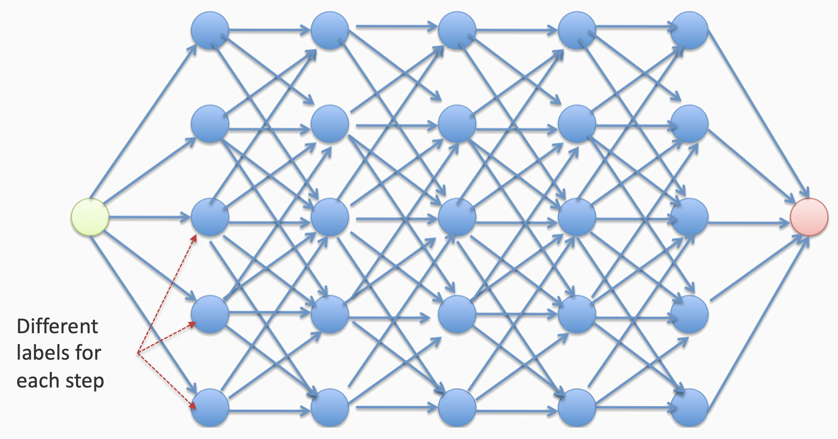
Viterbi Algorithm
Goal: to find the highest-scoring path in the trellis
As Best Path
Time steps

Slide 16
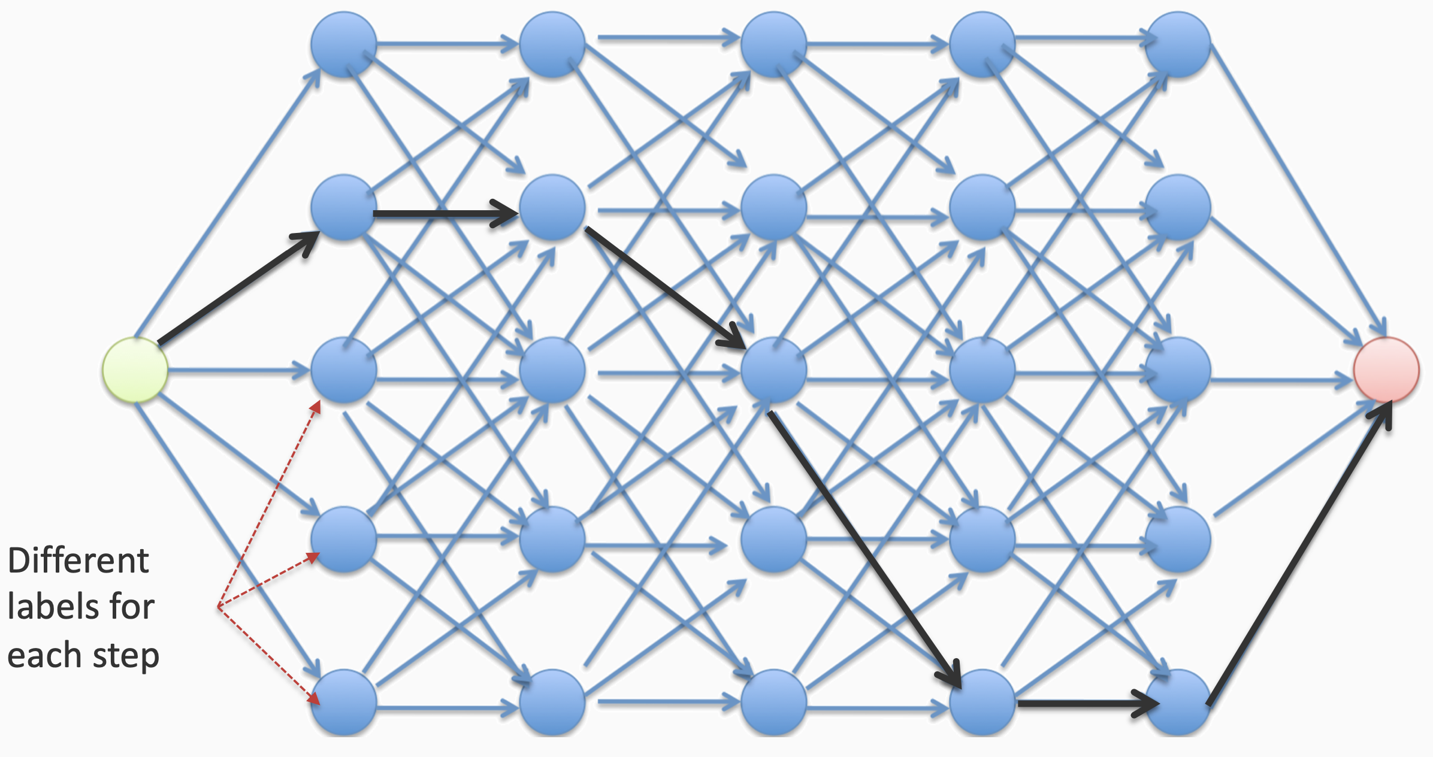
Viterbi Algorithm
Goal: to find the highest-scoring path in the trellis
As Best Path
Time steps

Slide 17
Viterbi Algorithm
Parameters:
Input sequence length (T)
Number of hidden states (N)
Memory:
Storing the table: TN (scores for all states at each timestep)
Runtime:
At each step, go over pairs of state
O(TN²)

Slide 18
Example

Slide 19
Viterbi Algorithm
π(NN) = 0.1 π(JJ) = 0.1 π(VB) = 0.1 π(DT) = 0.7
A(NN,NN) = 0.1 A(JJ,NN) = 0.6 A(VB,NN) = 0.3 A(DT,NN) = 0.5 A(NN,JJ) = 0.1 A(JJ,JJ) = 0.1 A(VB,JJ) = 0.3 A(DT,JJ) = 0.3 A(NN,VB) = 0.7 A(JJ,VB) = 0.2 A(VB,VB) = 0.1 A(DT,VB) = 0.1 A(NN,DT) = 0.1 A(JJ,DT) = 0.1 A(VB,DT) = 0.3 A(DT,DT) = 0.1
B(NN,“the”) = 0.1 B(JJ,“the”) = 0.1 B(VB,“the”) = 0.1 B(DT,“the”) = 0.7 B(NN,“old”) = 0.2 B(JJ,“old”) = 0.3 B(VB,“old”) = 0.2 B(DT,“old”) = 0.1 B(NN,“man”) = 0.4 B(JJ,“man”) = 0.3 B(VB,“man”) = 0.4 B(DT,“man”) = 0.1 B(NN,“boat”) = 0.3 B(JJ,“boat”) = 0.3 B(VB,“boat”) = 0.3 B(DT,“boat”) = 0.1

Slide 20
Viterbi Algorithm
SNN
SNN
SNN
SNN
SNN
Trellis includes all possible transitions between all states
Our goal is to find the state sequence corresponding to the highest probability at the final state
SJJ
SJJ
SJJ
SJJ
SJJ
SVB
SVB
SVB
SVB
SVB
SDT
SDT
SDT
SDT
SDT
the
old
man
the
boat

Slide 21
Viterbi Algorithm
SNN
$$δ_{j}(1)=π(s_{j})b_{j}(x_{1})$$
$δ_{j}$ at the first timestep = probability of starting in sj and that sj emits the first observation
$$δ_{NN}(1)=.01$$
SJJ
$$δ_{JJ}(1)=.01$$
SVB
$$δ_{VB}(1)=.01$$
SDT
$$δ_{DT}(1)=.49$$
the

Slide 22
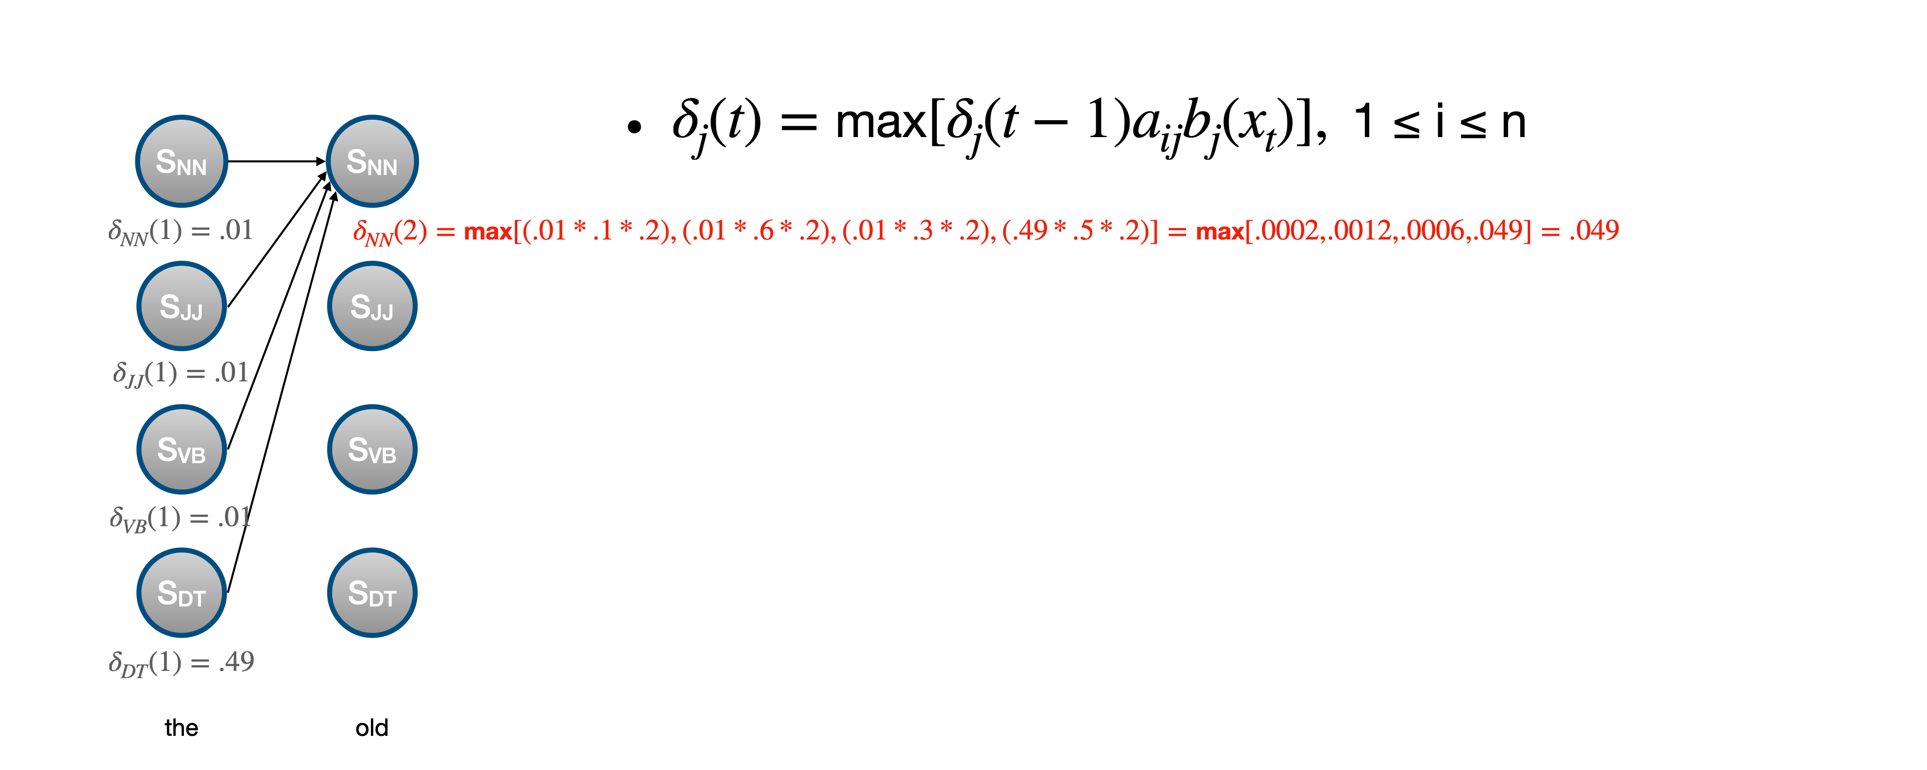
Viterbi Algorithm

Slide 23
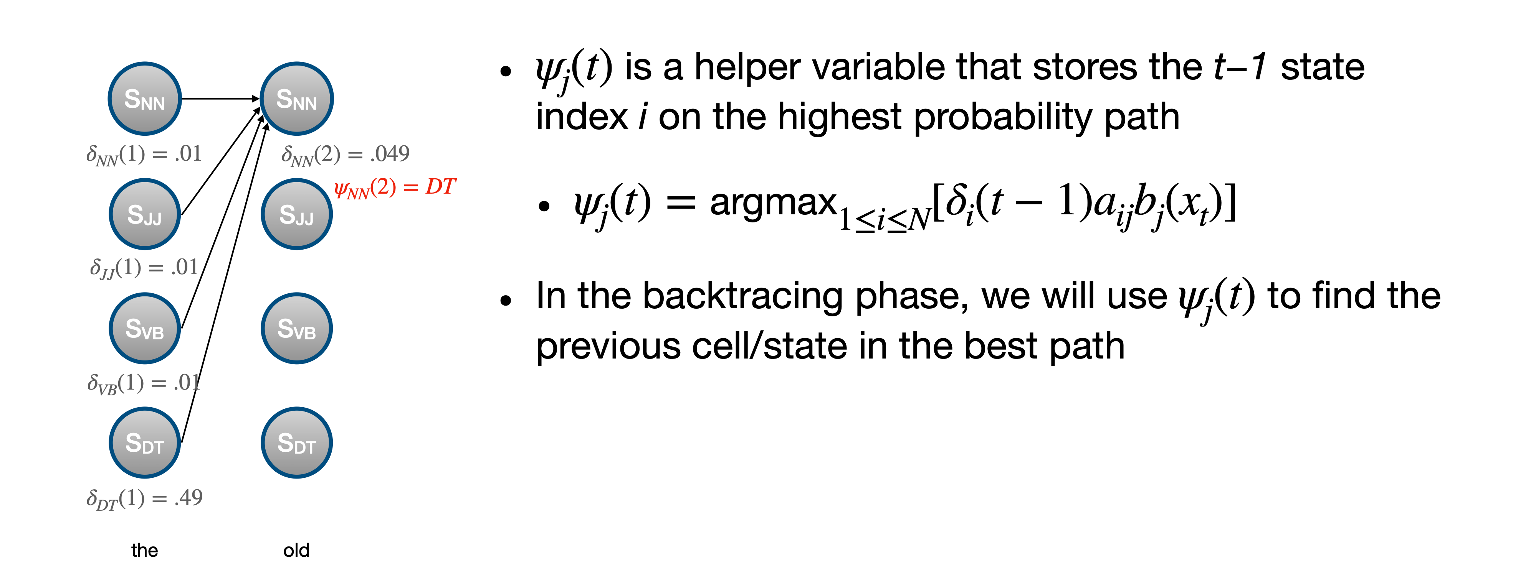
Viterbi Algorithm

Slide 24
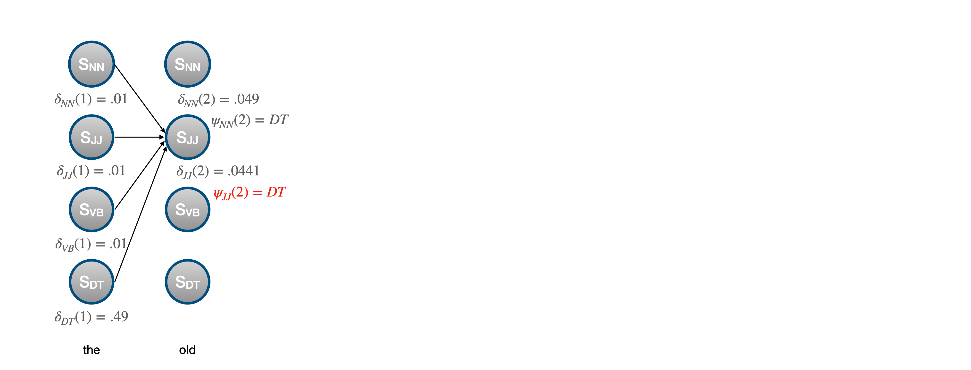
Viterbi Algorithm

Slide 25
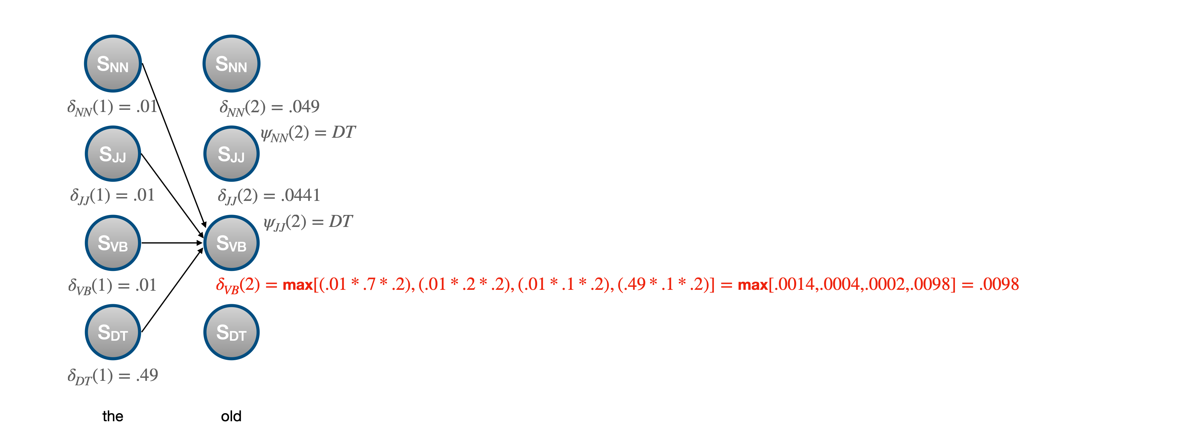
Viterbi Algorithm

Slide 26
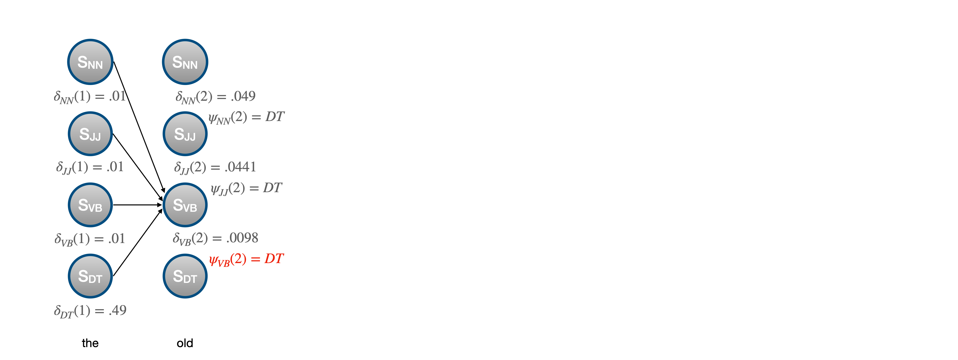
Viterbi Algorithm

Slide 27
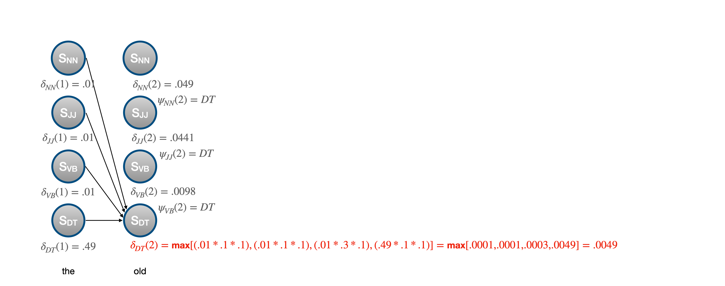
Viterbi Algorithm

Slide 28
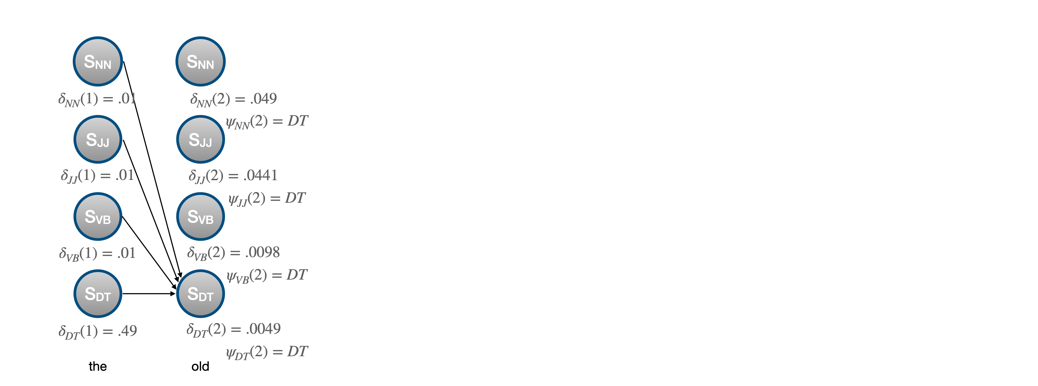
Viterbi Algorithm

Slide 29
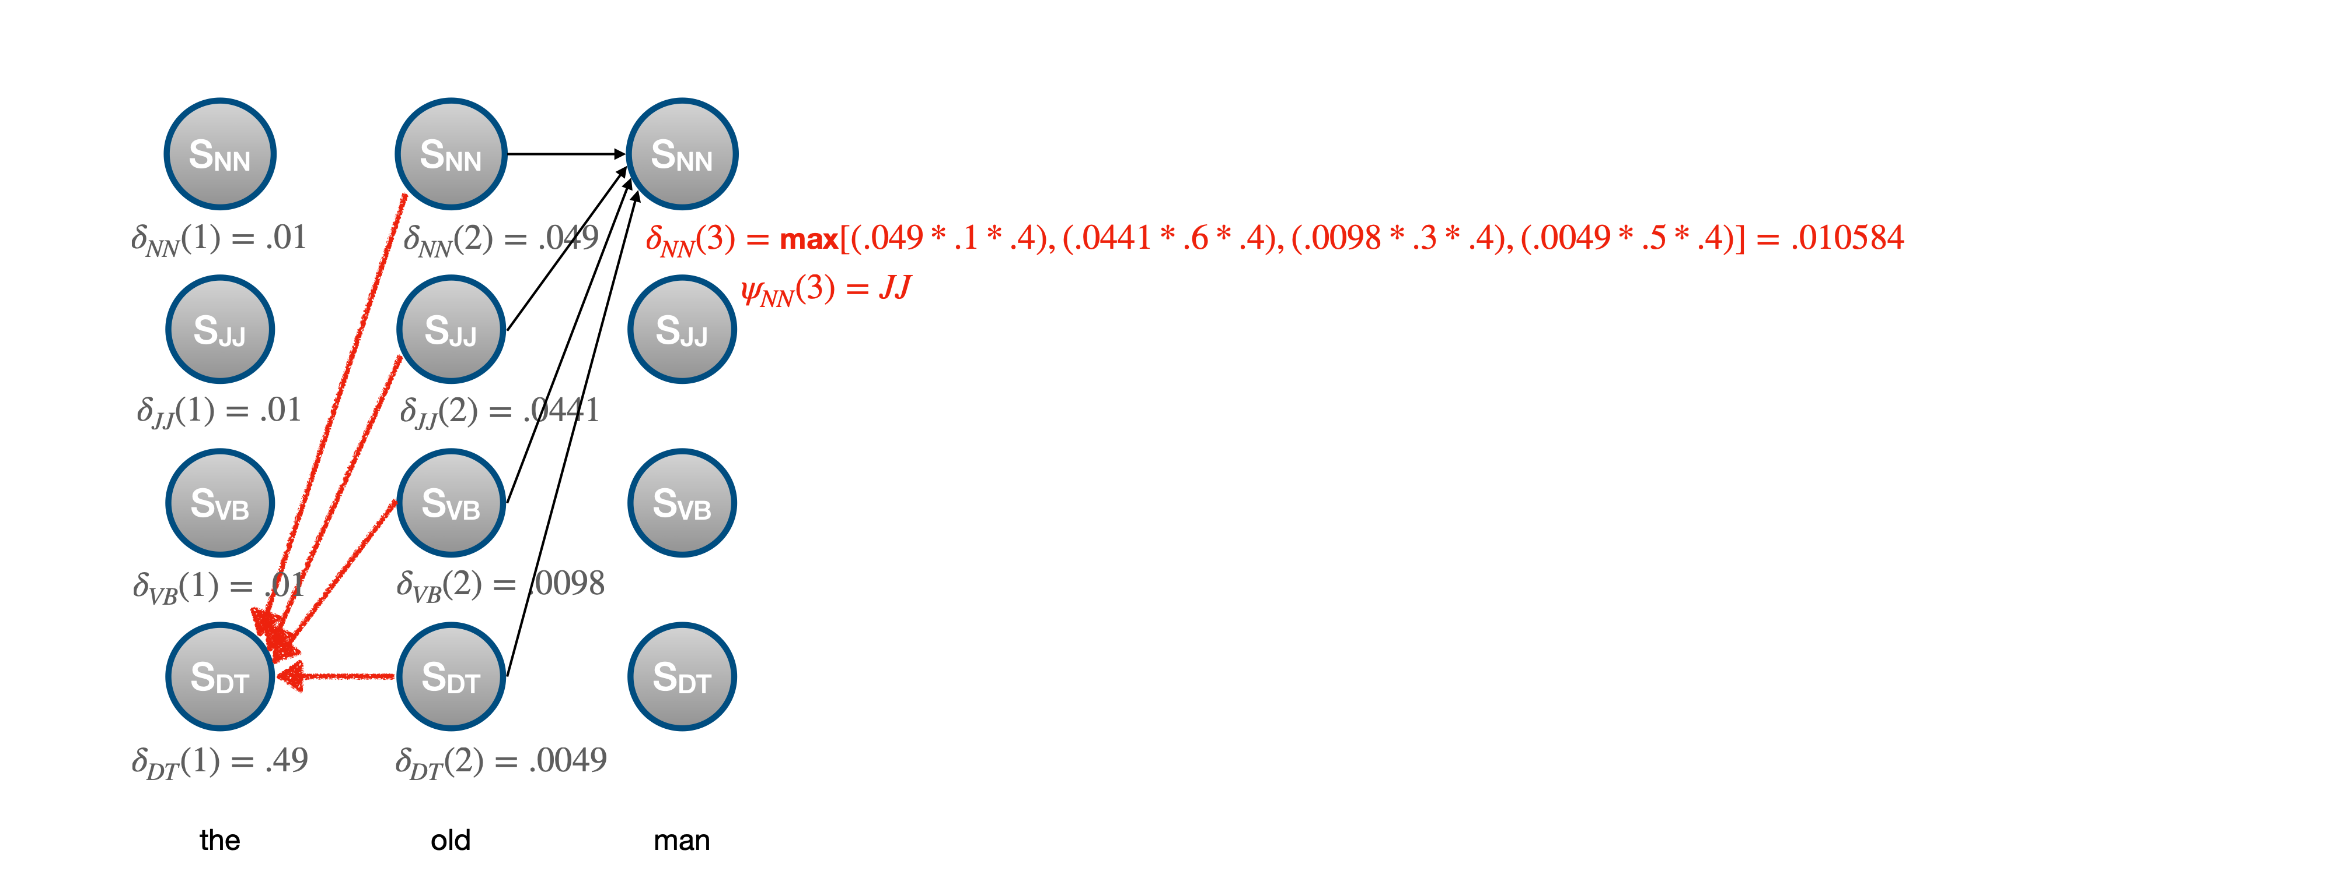
Viterbi Algorithm

Slide 30
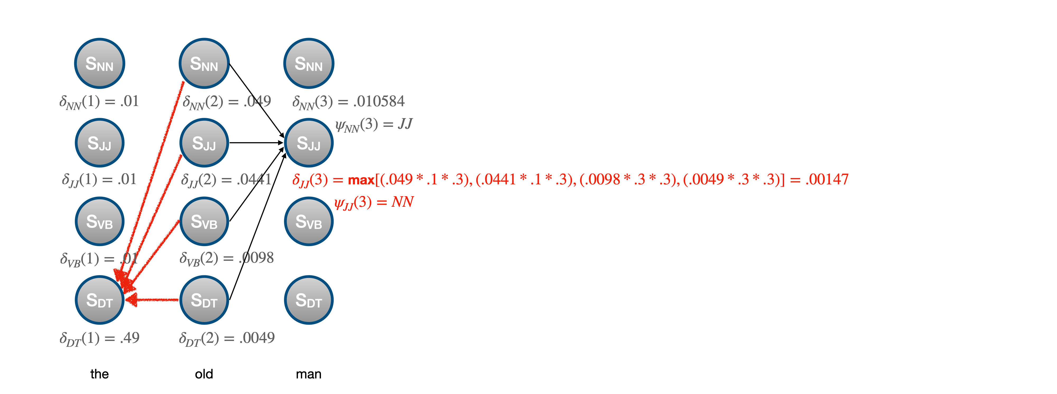
Viterbi Algorithm

Slide 31
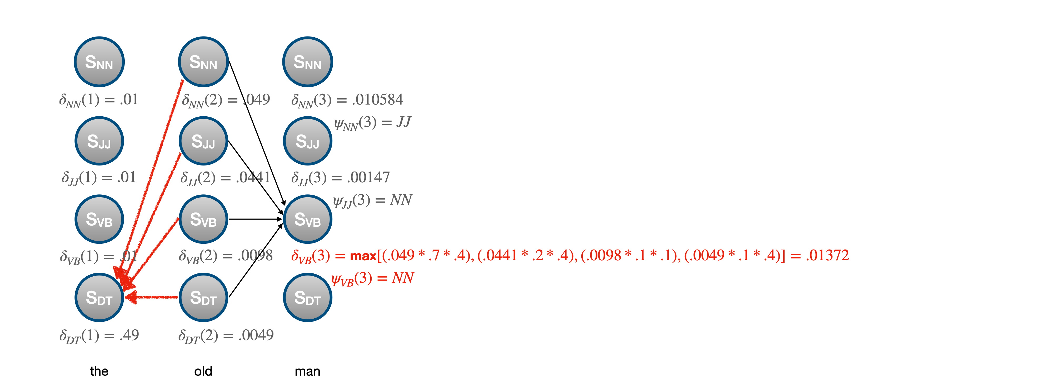
Viterbi Algorithm

Slide 32
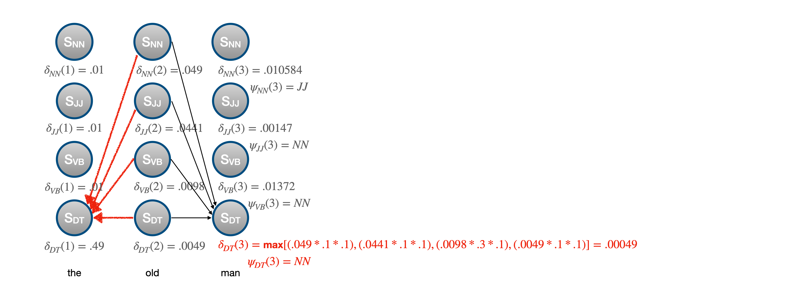
Viterbi Algorithm

Slide 33
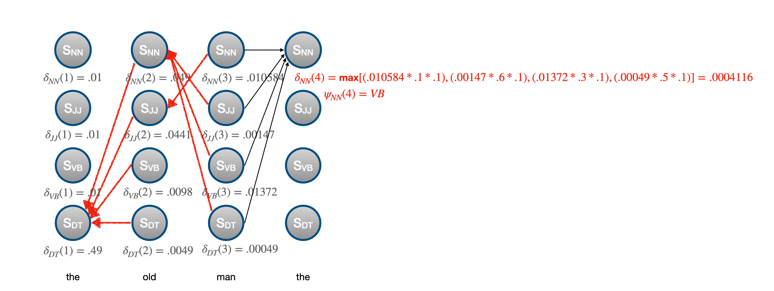
Viterbi Algorithm

Slide 34
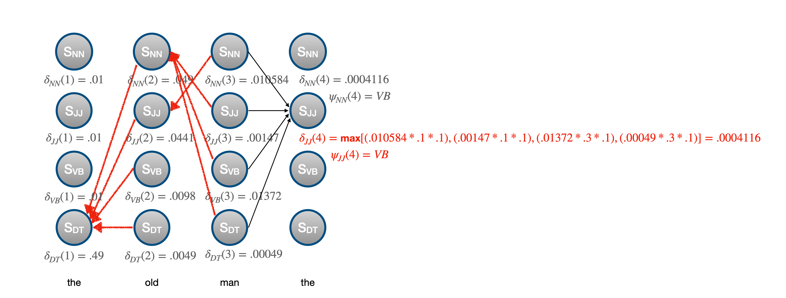
Viterbi Algorithm

Slide 35
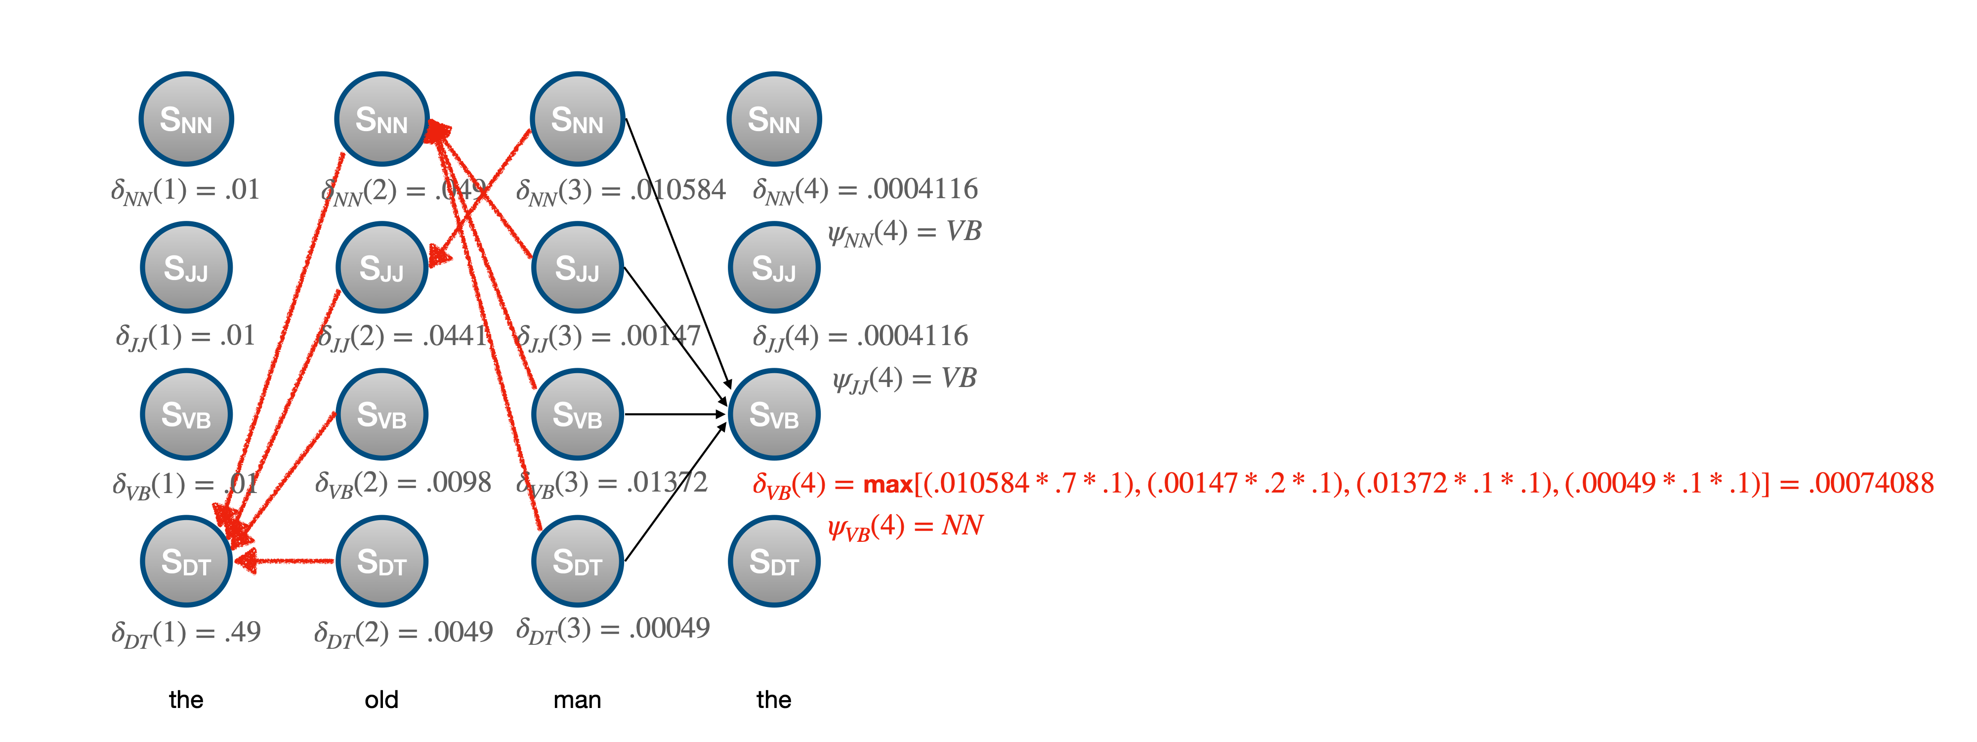
Viterbi Algorithm

Slide 36
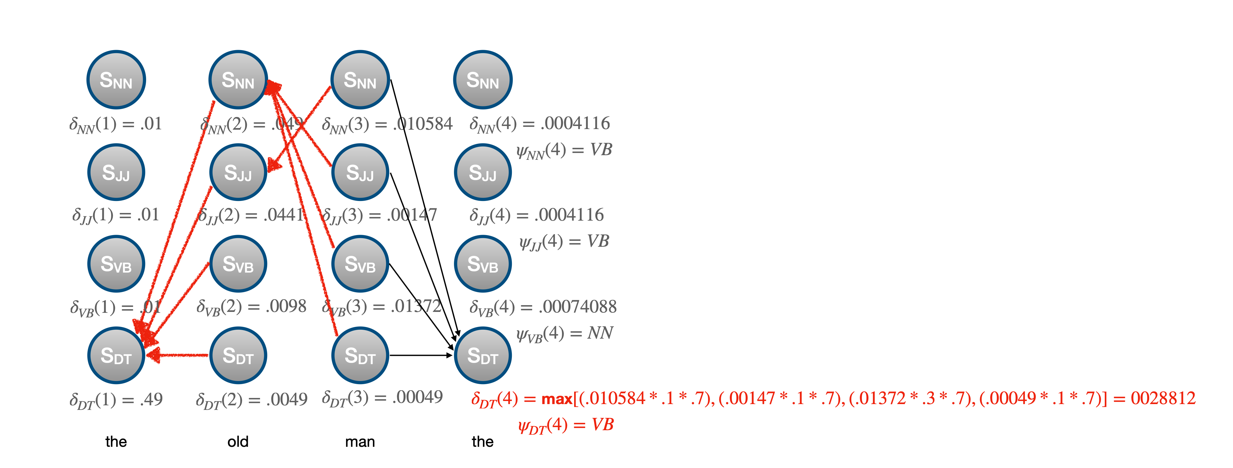
Viterbi Algorithm

Slide 37
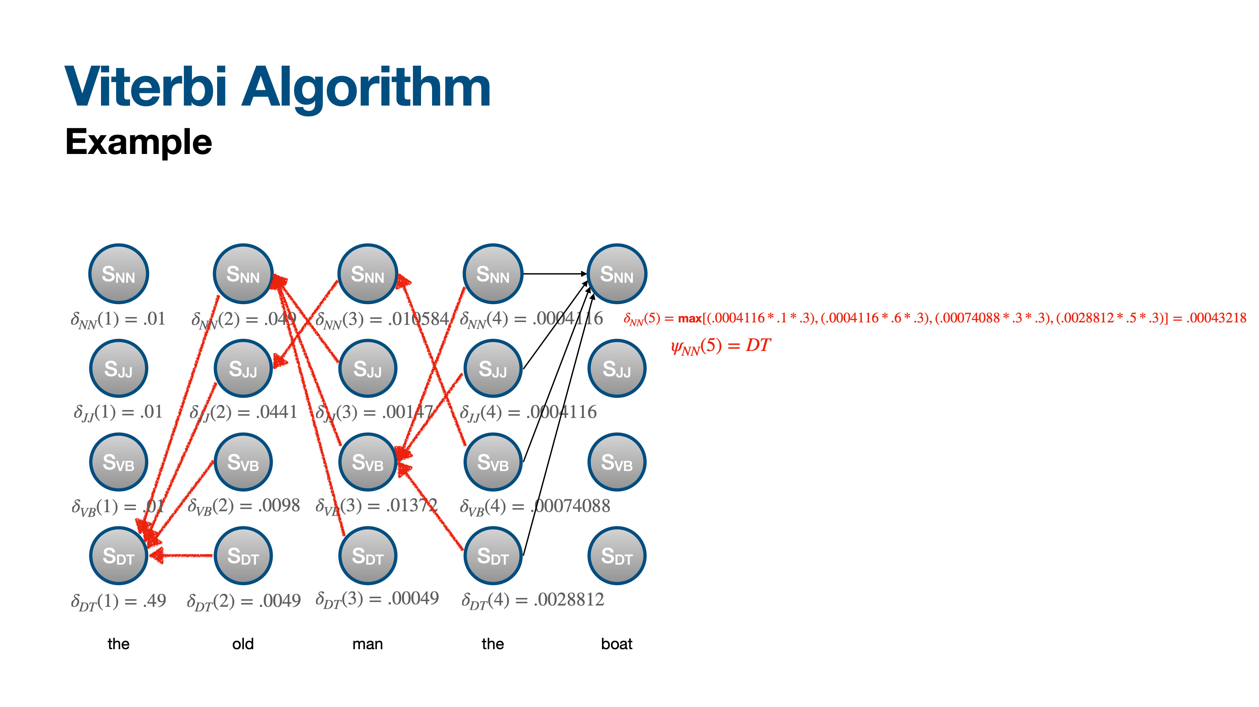
Viterbi Algorithm

Slide 38
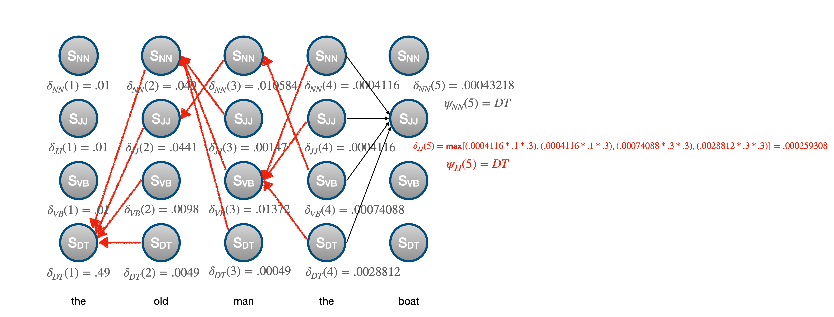
Viterbi Algorithm

Slide 39
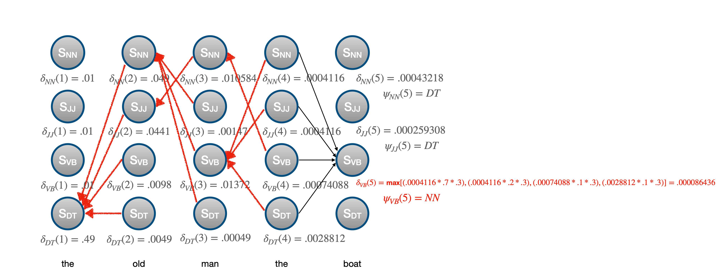
Viterbi Algorithm

Slide 40
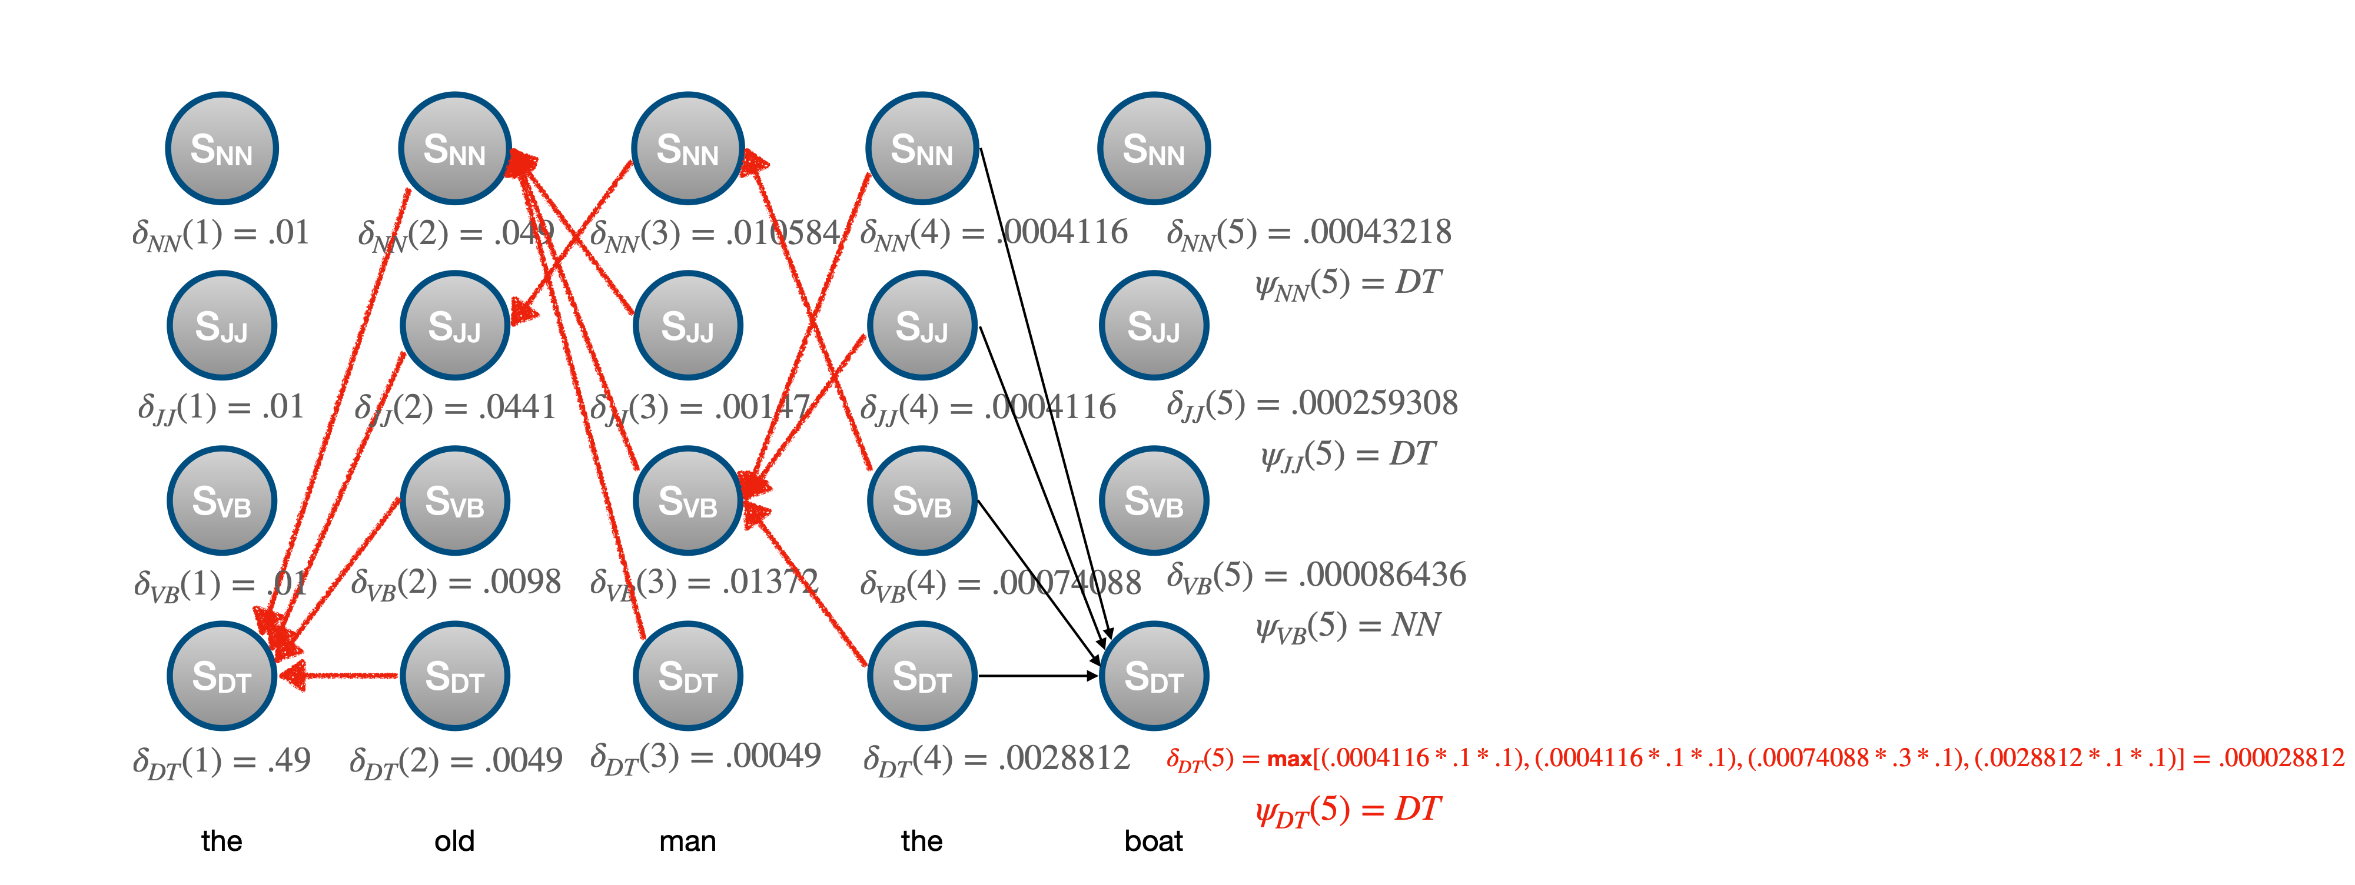
Viterbi Algorithm

Slide 41
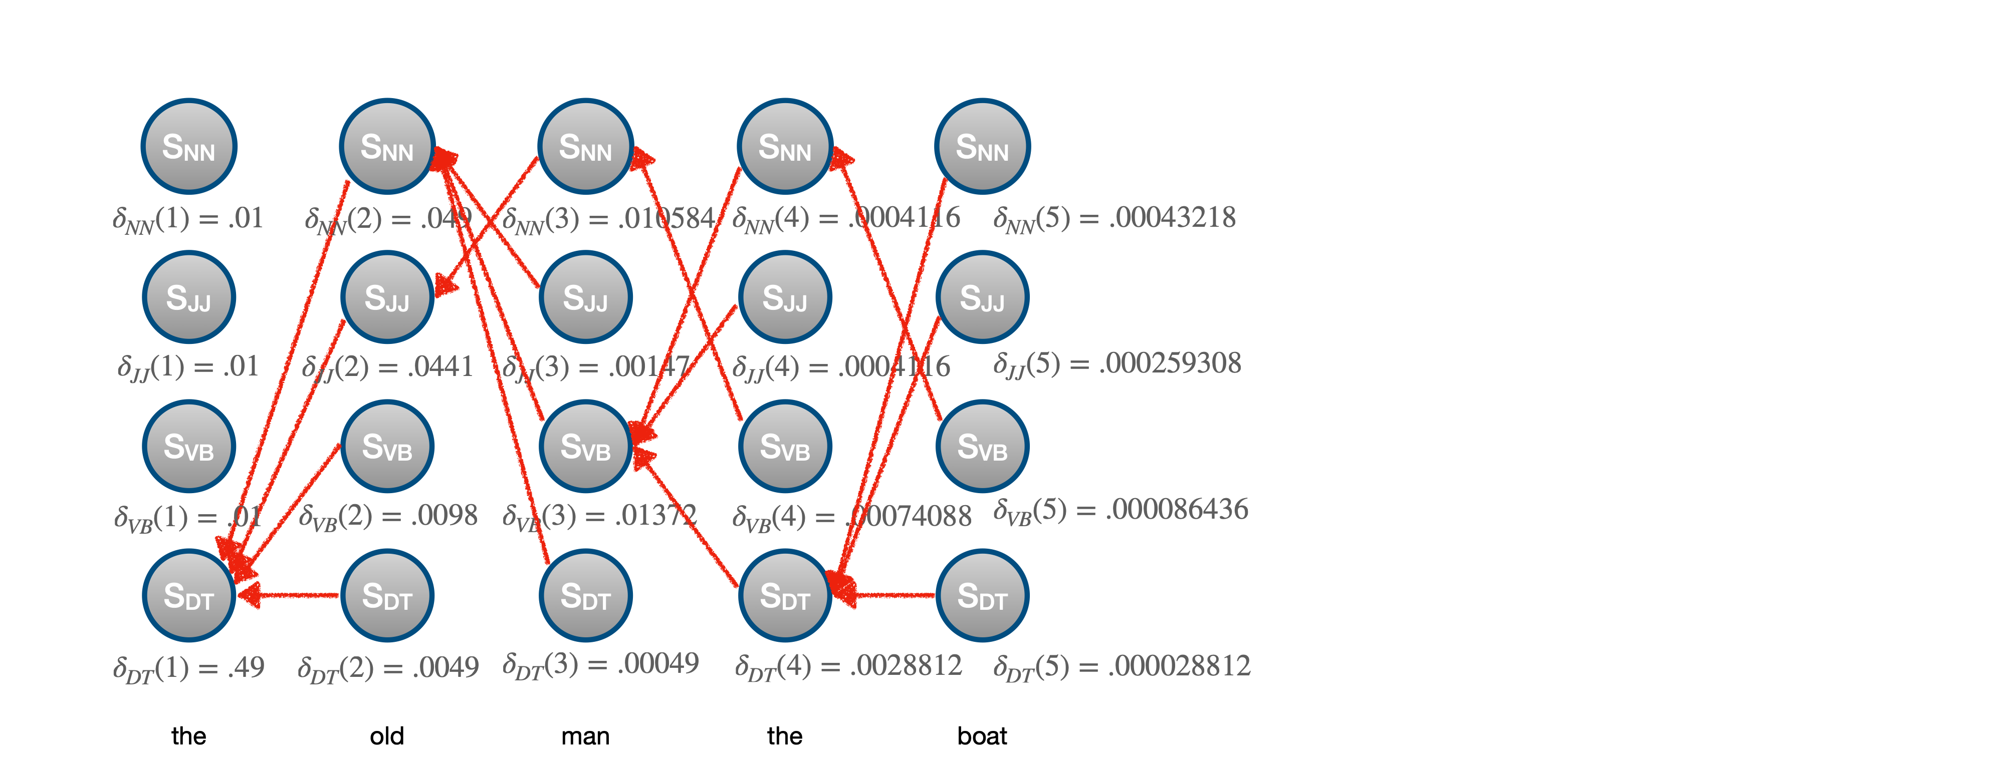
Viterbi Algorithm

Slide 42
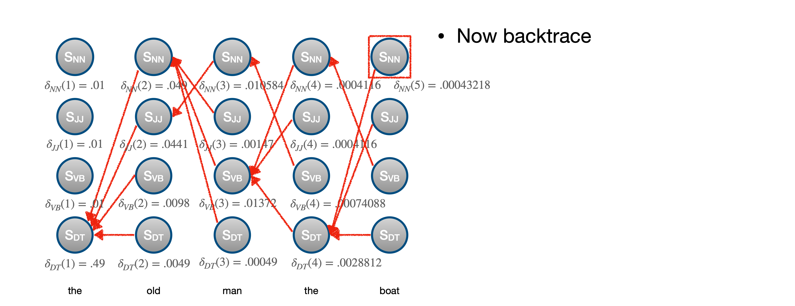
Viterbi Algorithm

Slide 43
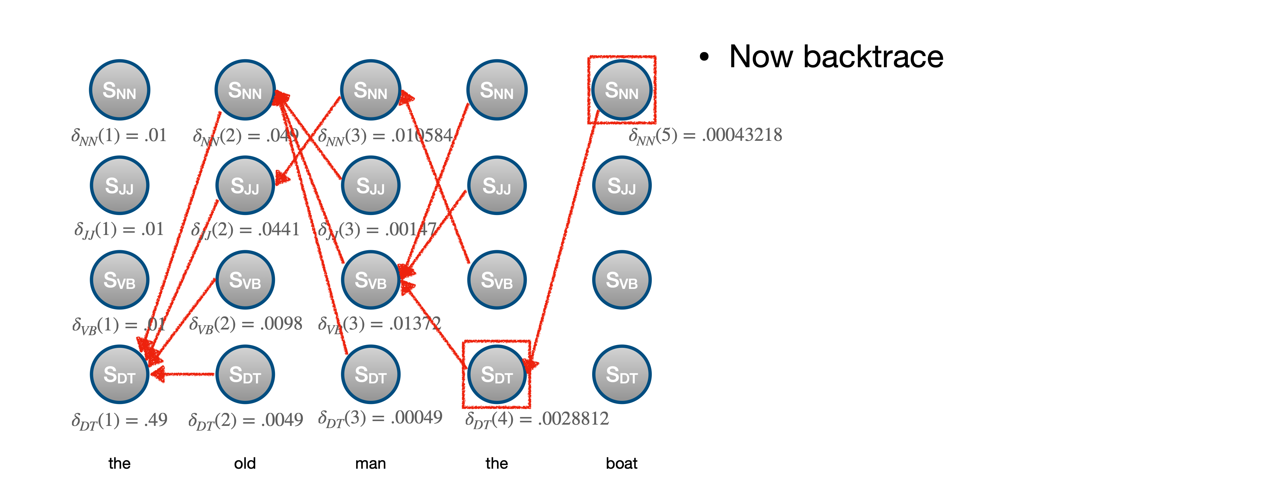
Viterbi Algorithm

Slide 44
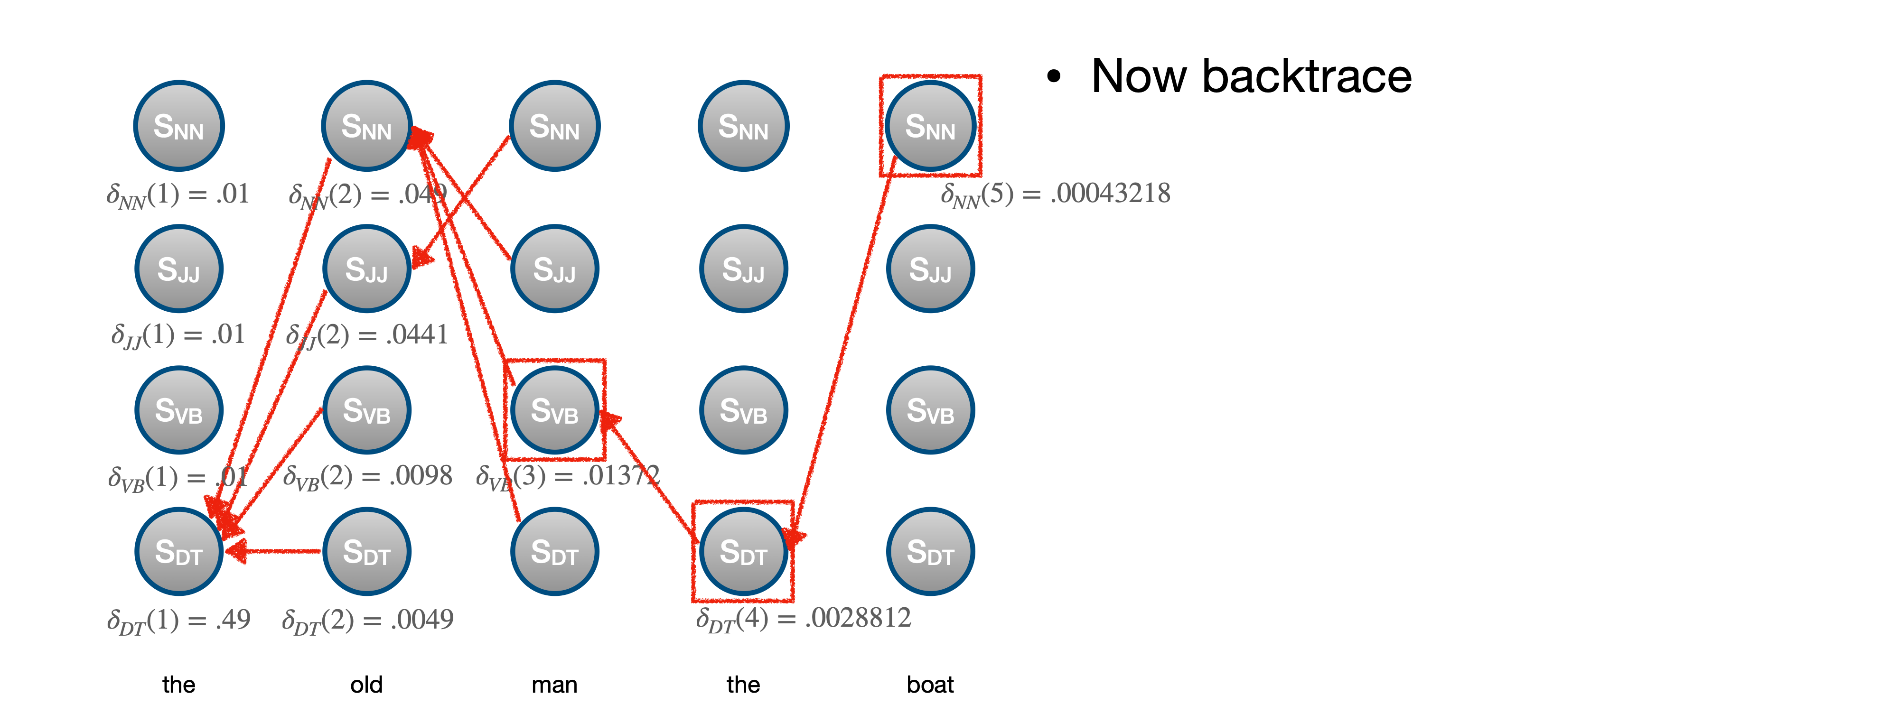
Viterbi Algorithm

Slide 45
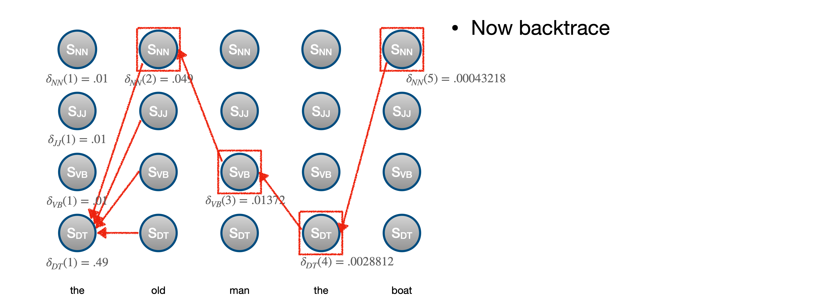
Viterbi Algorithm

Slide 46
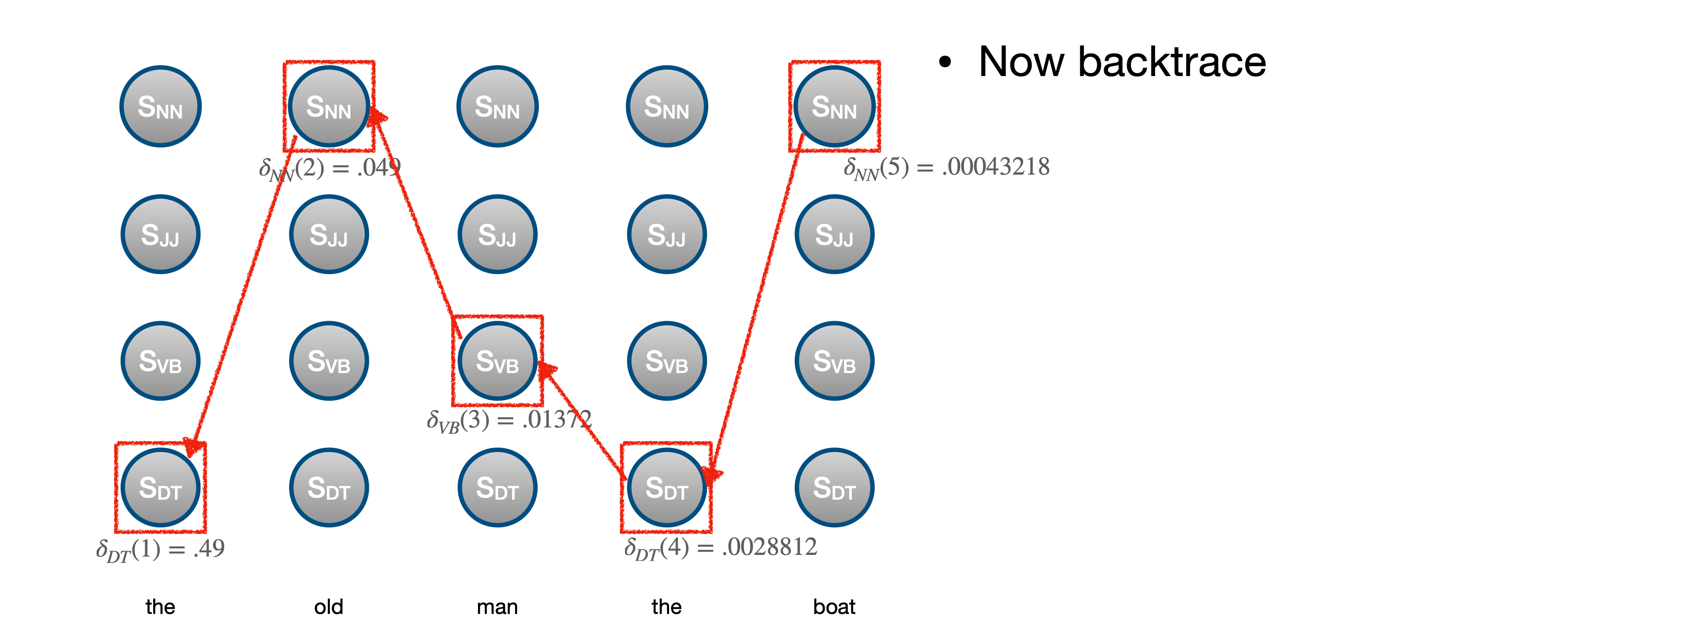
Viterbi Algorithm

Slide 47
Questions?

