Slide 1
Hidden Markov Models
CS 542 - Natural Language Processing
Partially adapted from slides by Vivek Srikumar, University of Utah
Prof. Nikhil Krishnaswamy, Colorado State University

Slide 2
Sequence Models
So far we’ve talked about generative and discriminative models for classification
But language is structured, sequenced information
Humans aren’t just classifying with language
Text is a sequence of words or letters
Videos are sequences of frames

Slide 3
Sequence Models
Even with a finite set of states, the set of unique state sequences is infinite
Our goal (for now): Define probability distributions over sequences
If $x_{1},x_{2},...,x_{n}$ is a sequence that has n tokens, we want to be able to define $P(x_{1},x_{2},...,x_{n})$
for all values of n

Slide 4
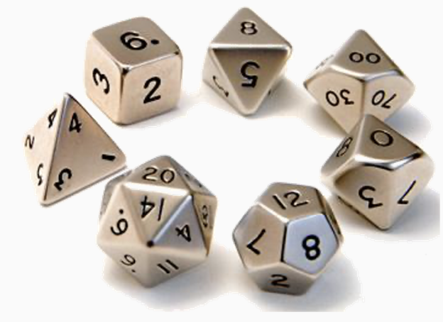
Sequence Models
$$P(x_{1},x_{2},...,x_{n})=\overset{n}{\underset{i=1}{∏}}P(x_{i}|x_{1},x_{2},...,x_{i-1})$$
Each token is dependent on every token that came before it
Simple conditioning
Each $P(x_{i}|x_{1},x_{2},...,x_{i-1})$ is a multinomial probability distribution over tokens

Slide 5
Sequence Models
What’s the problem with this strategy?
It was a bright cold day in April.
P(It was a bright cold day in April) =
P(It) x ← probability of a word starting a sentence
P(was|It) x ← probability of a word following “It”
P(a|It was) x ← probability of a word following “It was”
P(bright|It was a) x ← probability of a word following “It was a”
P(cold|It was a bright) x ← probability of a word following “It was a bright”
P(day|It was a bright cold) x ← probability of a word following “It was a bright cold”

Slide 6
Sequence Models
$$P(x_{1},x_{2},...,x_{n})=\overset{n}{\underset{i=1}{∏}}P(x_{i}|x_{1},x_{2},...,x_{i-1})$$
Each token is dependent on every token that came before it
Simple conditioning
Each $P(x_{i}|x_{1},x_{2},...,x_{i-1})$ is a multinomial probability distribution over tokens
What’s the problem with this strategy?
How many parameters do we have?
Grows with the sequence size!

Slide 7
Sequence Models
Make a modeling assumption: First-order Markov assumption
The state of the system at any time is independent of the full sequence history given the previous state
$$P(x_{i}|x_{1},x_{2},...,x_{i-1})=P(x_{i}|x_{i-1})$$
This allows us to simplify
$$P(x_{1},x_{2},x_{3},...,x_{n})=\underset{i}{∏}P(x_{i}|x_{1},x_{2},...,x_{i-1})$$
These dependencies are ignored

Slide 8
Sequence Models
Make a modeling assumption: First-order Markov assumption
The state of the system at any time is independent of the full sequence history given the previous state
$$P(x_{i}|x_{1},x_{2},...,x_{i-1})=P(x_{i}|x_{i-1})$$
This allows us to simplify
$$P(x_{1},x_{2},x_{3},...,x_{n})=\underset{i}{∏}P(x_{i}|x_{i-1})$$

Slide 9
First-Order Markov Models

Slide 10
First-Order Markov Model
Defined by two sets of probabilities
The initial state distribution: The probability that a sequence starts at a certain state j: $P(x_{1}={\text{state}}_{j})$
The state transition distribution: The probability that the system will transition to a state k at some step if it was at a state j at the previous step: $P(x_{t+1}={\text{state}}_{k}|x_{t}={\text{state}}_{j})$

Slide 11
First-Order Markov Models
If there are K tokens/states, how many parameters to we need?
It was a bright cold day in April.
P(It was a bright cold day in April) =
P(It) x ← probability of a word starting a sentence
P(was|It) x ← probability of a word following “It”
P(a|It was) x ← probability of a word following “It was”
P(bright|It was a) x ← probability of a word following “It was a”
P(cold|It was a bright) x ← probability of a word following “It was a bright”
P(day|It was a bright cold) x ← probability of a word following “It was a bright cold”
O(K²)

Slide 12
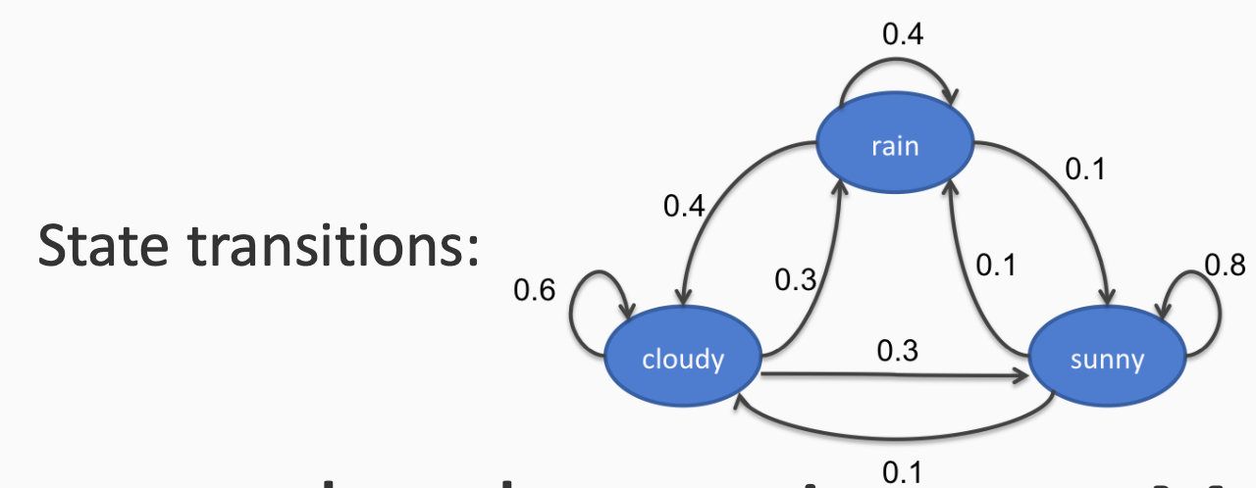
First-Order Markov Models
3 states: rainy, cloudy, sunny
Suppose observations are Markov Chains
e.g., cloudy sunny sunny rainy
Sequence probability: P(cloudy)P(sunny|cloudy)P(sunny|sunny)P(rainy|sunny)
These probabilities define the model
Can find P(any sequence)
Initial probability
Transition probabilities

Slide 13
m^{th}-Order Markov Models
A generalization of the first order Markov Model
Each state is only dependent on m previous states
e.g., P(It was a bright cold day in April) = P(It)P(was|It)P(a|It,was)P(bright|was,a)P(cold|a,bright)P(day|bright,cold)…
More parameters than first order Markov Model
But still less than storing entire history

Slide 14
Hidden Markov Models

Slide 15
Hidden Markov Models
Discrete Markov Model
States follow a Markov Chain
Each state is an observation
Hidden Markov Model
States follow a Markov Chain
States are not observed
Each state stochastically emits an observation

Slide 16
Hidden Markov Models
Given a sentence, find parts of speech of all the words
The
Fed
raises
interest
rates
DET
N
V
N
N
Other possible tags in different contexts
V
N
V
V
(I fed the dog)
(Poems interest me)
(annual raises)
(he rates movies online)
If these were the only options allowed, we will have 1×2×2×2×2 = 16 possible output sequences

Slide 17
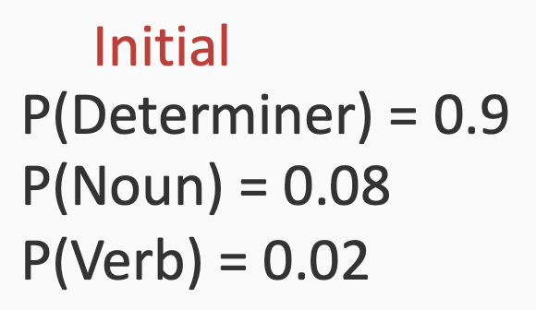
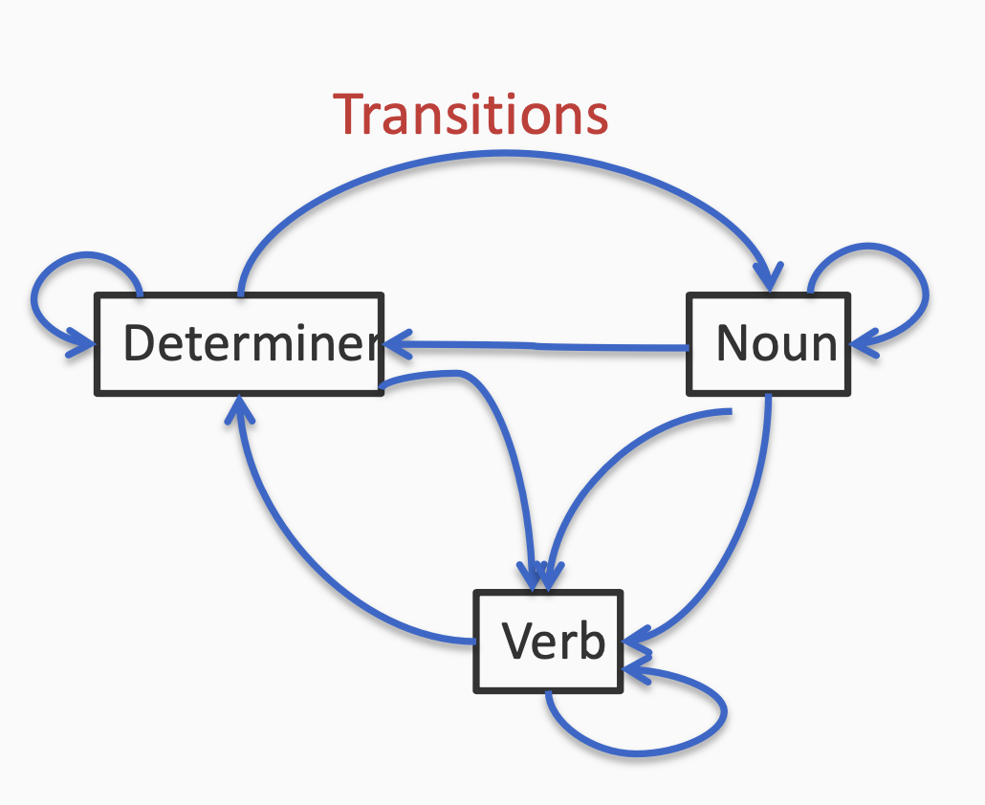
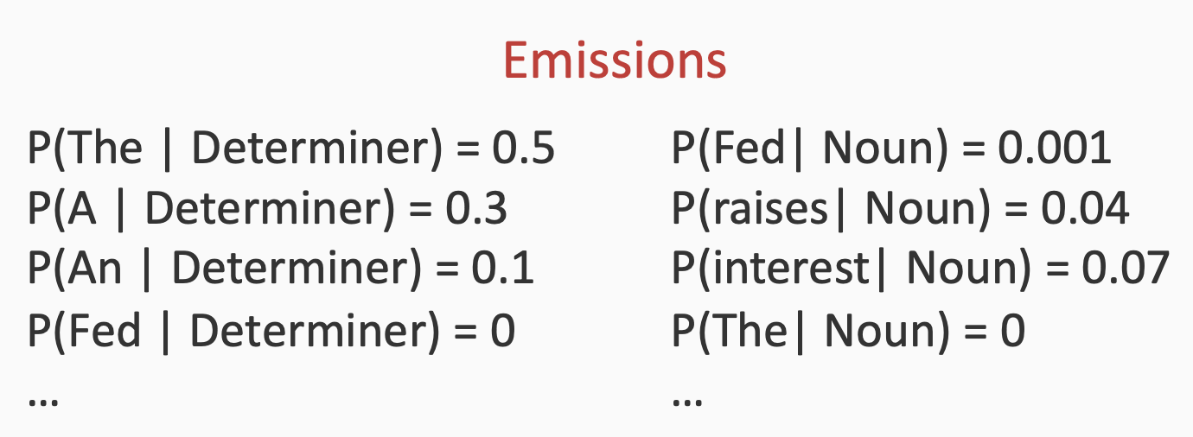
Hidden Markov Models
Initial probabilities: What is the probability that
the sequence starts in a certain state?
Given a sentence, find parts of speech of all the words
Emission probabilities: Given that the system is in a certain state,
these are probabilities that it will emit a certain observation
Each edge here is associated with a transition probability

Slide 18
Hidden Markov Models
Initial probabilities: What is the probability that
the sequence starts in a certain state?
Given a sentence, find parts of speech of all the words
Emission probabilities: Given that the system is in a certain state,
these are probabilities that it will emit a certain observation
Start
DET
N
V
N
N
Initial
The
Fed
raises
interest
rates
Each edge here is associated with a transition probability
Emission
Emission
Emission
Emission
Emission
Transition
Transition
Transition
Transition

Slide 19
Hidden Markov Models
Notation
K: Number of states
M: Number of possible observations for any state
π: Initial probability over states (K numbers)
(a ∈) A: transition probabilities (K x K matrix)
(b ∈) B: emission probabilities (K x M matrix)
Y, S, or Q: states
X or O: observations
(0 < t ≤) n: number of time steps (length of sequence)

Slide 20
Hidden Markov Models
Probability of states and observations
For states y1, y2, …, yn and observations x1, x2, …, xn
$P(x_{1},x_{2},...,x_{n},y_{1},y_{2},...,y_{n})=P(y_{1})\overset{n-1}{\underset{i=1}{∏}}P(y_{i+1}|y_{i})\overset{n}{\underset{i=1}{∏}}P(x_{i}|y_{i})$ $=π_{y_{1}}\overset{n-1}{\underset{i=1}{∏}}a_{y_{i},y_{i+1}}\overset{n}{\underset{i=1}{∏}}b_{y_{i},x_{i}}$

Slide 21
Hidden Markov Models
Goal: to identify persons, locations, and organizations in text
States
B-org O B-per I-per O O O
O O O O O B-loc I-loc
Observations
Facebook CEO Mark Zuckerberg avoided questions on
privacy at the conference in San Francisco
NER Chunking notation:
B = begin
I = inside
O = outside
org = organization
per = person
loc = location

Slide 22
Hidden Markov Models
Speech recognition
Input: Speech signal
Output: Sequence of words
Information Extraction
NER
Computational biology:
Aligning protein sequences
Labeling nucleotides in a sequence as exons, introns, etc.

Slide 23
Inference with HMMs

Slide 24
Inference with HMMs
Given an observation sequence x1, x2, …, xn and a model (π, A, B), how to efficiently calculate the probability of the observation?
Given an observation sequence x1, x2, …, xn and a model (π, A, B), how to efficiently calculate the most probable state sequence?
How to calculate (π, A, B) from observations?
Inference question

Slide 25
Inference with HMMs
Input:
A Hidden Markov Model (π, A, B)
An observation sequence X = (x1,x2,…,xn)
Output:
A state sequence Y = (y1,y2,…,yn) that corresponds to ${\text{argmax}}_{Y}P(Y|X,π,A,B)$
Maximum a posteriori inference (MAP)
Computationally:
Combinatorial optimization

Slide 26
Inference with HMMs
We want to find ${\text{argmax}}_{Y}P(Y|X,π,A,B)$
We have defined $P(x_{1},x_{2},...,x_{n},y_{1},y_{2},...,y_{n})=P(y_{1})\overset{n-1}{\underset{i=1}{∏}}P(y_{i+1}|y_{i})\overset{n}{\underset{i=1}{∏}}P(x_{i}|y_{i})$
But $P(Y|X,π,A,B)∝P(X,Y|π,A,B)$ ($=\frac{P(X,Y|π,A,B)}{P(X)}$)
And we don’t care about P(X) if we are maximizing over Y
So ${\text{argmax}}_{Y}P(Y|X,π,A,B)={\text{argmax}}_{Y}P(X,Y|π,A,B)$

Slide 27
Hidden Markov Models
The
Fed
raises
interest
rates
DET
N
V
N
N
Suppose each word could only have the following tags
V
N
V
V
1
2
2
2
2
If these were the only options allowed, we will have 1×2×2×2×2 = 16 possible output sequences

Slide 28
Hidden Markov Models
Observations:
Output: One state per observation yi = sj
K^{n} possible sequences to consider for ${\text{argmax}}_{Y}P(Y|X,π,A,B)$
x1
x2
…
xn
Suppose each observation allows any of the following K states
s1
s1
…
s1
s2
s2
…
s2
s3
s3
…
s3
.
.
.
.
.
.
.
.
.
sK
sK
…
sK

Slide 29
Hidden Markov Models
Try out every sequence
Score the sequence Y by $P(Y|X,π,A,B)$
Return highest scoring sequence
Correct but slow [O(K^{n})]
Greedy search
Construct the output left to right
For each i, select the best yi using yi-1 and xi
Fast [O(n)] but incorrect

Slide 30
Hidden Markov Models
Take advantage of the first order Markov assumption
The state for any observation is only influenced by the previous state, the next state and the observation itself
Given the adjacent labels, the others do not matter
Suggests a recursive algorithm

Slide 31
Hidden Markov Models
$$P(x_{1},x_{2},...,x_{n},y_{1},y_{2},...,y_{n})=P(y_{1})\overset{n-1}{\underset{i=1}{∏}}P(y_{i+1}|y_{i})\overset{n}{\underset{i=1}{∏}}P(x_{i}|y_{i})$$
We want assignments to the yis that maximizes this product
y1
y2
y3
yn
…
x1
x2
x3
xn

Slide 32
Hidden Markov Models
$$P(x_{1},x_{2},...,x_{n},y_{1},y_{2},...,y_{n})=P(y_{1})\overset{n-1}{\underset{i=1}{∏}}P(y_{i+1}|y_{i})\overset{n}{\underset{i=1}{∏}}P(x_{i}|y_{i})$$
$${\text{max}}_{y_{1},y_{2},...,y_{n}}P(y_{n}|y_{n-1})P(x_{n}|y_{n})...P(y_{2}|y_{1})P(x_{2}|y_{2})P(y_{1})P(x_{1}|y_{1})$$
Emission probabilities
Initial probability
Transition probabilities
y1
y2
y3
yn
…
x1
x2
x3
xn

Slide 33
Hidden Markov Models
$$P(x_{1},x_{2},...,x_{n},y_{1},y_{2},...,y_{n})=P(y_{1})\overset{n-1}{\underset{i=1}{∏}}P(y_{i+1}|y_{i})\overset{n}{\underset{i=1}{∏}}P(x_{i}|y_{i})$$
${\text{max}}_{y_{1},y_{2},...,y_{n}}P(y_{n}|y_{n-1})P(x_{n}|y_{n})...P(y_{2}|y_{1})P(x_{2}|y_{2})P(y_{1})P(x_{1}|y_{1})$ $={\text{max}}_{y_{2},...,y_{n}}P(y_{n}|y_{n-1})P(x_{n}|y_{n})...{\text{max}}_{y_{1}}P(y_{2}|y_{1})P(x_{2}|y_{2})P(y_{1})P(x_{1}|y_{1})$
y1
y2
y3
Terms that depend on y1
yn
…
x1
x2
x3
xn

Slide 34
Hidden Markov Models
$$P(x_{1},x_{2},...,x_{n},y_{1},y_{2},...,y_{n})=P(y_{1})\overset{n-1}{\underset{i=1}{∏}}P(y_{i+1}|y_{i})\overset{n}{\underset{i=1}{∏}}P(x_{i}|y_{i})$$
${\text{max}}_{y_{1},y_{2},...,y_{n}}P(y_{n}|y_{n-1})P(x_{n}|y_{n})...P(y_{2}|y_{1})P(x_{2}|y_{2})P(y_{1})P(x_{1}|y_{1})$ $={\text{max}}_{y_{2},...,y_{n}}P(y_{n}|y_{n-1})P(x_{n}|y_{n})...{\text{max}}_{y_{1}}P(y_{2}|y_{1})P(x_{2}|y_{2})P(y_{1})P(x_{1}|y_{1})$ $={\text{max}}_{y_{2},...,y_{n}}P(y_{n}|y_{n-1})P(x_{n}|y_{n})...{\text{max}}_{y_{1}}P(y_{2}|y_{1})P(x_{2}|y_{2}){\text{score}}_{1}$
y1
y2
y3
yn
…
Abstract all decisions until here
to score1
$${\text{score}}_{1}(s)=P(s)P(x_{1}|s)$$
x1
x2
x3
xn

Slide 35
Hidden Markov Models
$$P(x_{1},x_{2},...,x_{n},y_{1},y_{2},...,y_{n})=P(y_{1})\overset{n-1}{\underset{i=1}{∏}}P(y_{i+1}|y_{i})\overset{n}{\underset{i=1}{∏}}P(x_{i}|y_{i})$$
${\text{max}}_{y_{1},y_{2},...,y_{n}}P(y_{n}|y_{n-1})P(x_{n}|y_{n})...P(y_{2}|y_{1})P(x_{2}|y_{2})P(y_{1})P(x_{1}|y_{1})$ $={\text{max}}_{y_{2},...,y_{n}}P(y_{n}|y_{n-1})P(x_{n}|y_{n})...{\text{max}}_{y_{1}}P(y_{2}|y_{1})P(x_{2}|y_{2}){\text{score}}_{1}(y_{1})$ $={\text{max}}_{y_{3},...,y_{n}}P(y_{n}|y_{n-1})P(x_{n}|y_{n})...{\text{max}}_{y_{2}}P(y_{3}|y_{2})P(x_{3}|y_{3}){\text{max}}_{y_{1}}P(y_{2}|y_{1})P(x_{2}|y_{2}){\text{score}}_{1}(y_{1})$
y1
y2
y3
yn
…
x1
x2
x3
xn

Slide 36
Hidden Markov Models
$$P(x_{1},x_{2},...,x_{n},y_{1},y_{2},...,y_{n})=P(y_{1})\overset{n-1}{\underset{i=1}{∏}}P(y_{i+1}|y_{i})\overset{n}{\underset{i=1}{∏}}P(x_{i}|y_{i})$$
${\text{max}}_{y_{1},y_{2},...,y_{n}}P(y_{n}|y_{n-1})P(x_{n}|y_{n})...P(y_{2}|y_{1})P(x_{2}|y_{2})P(y_{1})P(x_{1}|y_{1})$ $={\text{max}}_{y_{2},...,y_{n}}P(y_{n}|y_{n-1})P(x_{n}|y_{n})...{\text{max}}_{y_{1}}P(y_{2}|y_{1})P(x_{2}|y_{2}){\text{score}}_{1}(y_{1})$ $={\text{max}}_{y_{3},...,y_{n}}P(y_{n}|y_{n-1})P(x_{n}|y_{n})...{\text{max}}_{y_{2}}P(y_{3}|y_{2})P(x_{3}|y_{3}){\text{score}}_{2}(y_{2})$
y1
y2
y3
yn
…
$${\text{score}}_{i}(s)={\text{max}}_{y_{i-1}}P(s|y_{i-1})P(x_{i}|s){\text{score}}_{i-1}(y_{i-1})$$
x1
x2
x3
xn

Slide 37
Hidden Markov Models
$$P(x_{1},x_{2},...,x_{n},y_{1},y_{2},...,y_{n})=P(y_{1})\overset{n-1}{\underset{i=1}{∏}}P(y_{i+1}|y_{i})\overset{n}{\underset{i=1}{∏}}P(x_{i}|y_{i})$$
${\text{max}}_{y_{1},y_{2},...,y_{n}}P(y_{n}|y_{n-1})P(x_{n}|y_{n})...P(y_{2}|y_{1})P(x_{2}|y_{2})P(y_{1})P(x_{1}|y_{1})$ $={\text{max}}_{y_{3},...,y_{n}}P(y_{n}|y_{n-1})P(x_{n}|y_{n})...{\text{max}}_{y_{n}}P(y_{3}|y_{2})P(x_{3}|y_{3}){\text{score}}_{2}(y_{2})$ $={\text{max}}_{y_{n}}{\text{score}}_{n}(y_{n})$
y1
y2
y3
yn
$${\text{score}}_{1}(s)=P(s)P(x_{1}|s)$$
…
$${\text{score}}_{i}(s)={\text{max}}_{y_{i-1}}P(s|y_{i-1})P(x_{i}|s){\text{score}}_{i-1}(y_{i-1})$$
x1
x2
x3
xn

Slide 38
Learning HMM Parameters

Slide 39
Learning HMM Parameters
Our examples so far give distributions for π, A, B
We can’t assume we’ll have these
We could calculate them
But these aren’t easily calculable from say, P(w2|w1) = P(w1,w2)/P(w1)

Slide 40
Learning HMM Parameters
Two possible scenarios:
We are given a data set D = {<Xi, Yi>} of sequences labeled with states
And we have to learn the parameters of the HMM (π, A, B)
“Supervised learning” with complete data (not really machine learning IMO)
We are given only a collection of sequences D = {Xi}
And we have to learn the parameters of the HMM (π, A, B)
Unsupervised learning with incomplete data
Expectation Maximization (e.g., Baum-Welch); subject for later

Slide 41
Learning HMM Parameters
We are given a data set D = {<Xi, Yi>} of sequences labeled with states
Each Xi is a sequence of observations and Yi is a sequence of states that correspond to Xi
Goal: Learn initial, transition, emission distributions (π, A, B)
How do we learn the parameters of the HMM?
Maximum Likelihood Principle
$$(\overset{̂}{π},\overset{̂}{A},\overset{̂}{B})={\text{max}}_{π,A,B}(D|π,A,B)={\text{max}}_{π,A,B}\underset{i}{∏}P(X_{i},Y_{i}|π,A,B)$$

Slide 42
Learning Populating HMM Parameters

Slide 43
Populating HMM Parameters
Assume the following data:
the/DT cats/NNP meow/VB kittens/NNP meow/VB the/DT dogs/NNP bark/VB puppies/NNP bark/VB
Compute the initial probability distribution π:
y1 | NNP | VB | DT
C(y1) | 2 | 0 | 2
P(y1) | 0.5 | 0 | 0.5

Slide 44
Populating HMM Parameters
π | NNP | VB | DT
P(y1) | 0.5 | 0 | 0.5
Assume the following data:
the/DT cats/NNP meow/VB kittens/NNP meow/VB the/DT dogs/NNP bark/VB puppies/NNP bark/VB
Compute the transition matrix A:
C(yi-1,yi) |  | yi
 |  | NNP | VB | DT
yi-1 | NNP | 0 | 4 | 0
 | VB | 0 | 0 | 0
 | DT | 2 | 0 | 0
P(yi|yi-1) |  | yi
 |  | NNP | VB | DT
yi-1 | NNP | 0 | 1 | 0
 | VB | 0 | 0 | 0
 | DT | 1 | 0 | 0

Slide 45
Populating HMM Parameters
π | NNP | VB | DT
P(y1) | 0.5 | 0 | 0.5
A |  | yi
 |  | NNP | VB | DT
yi-1 | NNP | 0 | 1 | 0
 | VB | 0 | 0 | 0
 | DT | 1 | 0 | 0
Assume the following data:
the/DT cats/NNP meow/VB kittens/NNP meow/VB the/DT dogs/NNP bark/VB puppies/NNP bark/VB
Compute the emission matrix B:
C(yi,xi) |  | yi
 |  | NNP | VB | DT
xi | the | 0 | 0 | 2
 | cats | 1 | 0 | 0
 | meow | 0 | 2 | 0
 | kittens | 1 | 0 | 0
 | dogs | 1 | 0 | 0
 | puppies | 1 | 0 | 0
 | bark | 0 | 2 | 0

Slide 46
Populating HMM Parameters
π | NNP | VB | DT
P(y1) | 0.5 | 0 | 0.5
A |  | yi
 |  | NNP | VB | DT
yi-1 | NNP | 0 | 1 | 0
 | VB | 0 | 0 | 0
 | DT | 1 | 0 | 0
Assume the following data:
the/DT cats/NNP meow/VB kittens/NNP meow/VB the/DT dogs/NNP bark/VB puppies/NNP bark/VB
Compute the emission matrix B:
P(xi|yi) |  | yi
 |  | NNP | VB | DT
xi | the | 0 | 0 | 1
 | cats | 0.25 | 0 | 0
 | meow | 0 | 0.5 | 0
 | kittens | 0.25 | 0 | 0
 | dogs | 0.25 | 0 | 0
 | puppies | 0.25 | 0 | 0
 | bark | 0 | 0.5 | 0

Slide 47
Populating HMM Parameters
π | NNP | VB | DT
P(y1) | 0.5 | 0 | 0.5
A |  | yi
 |  | NNP | VB | DT
yi-1 | NNP | 0 | 1 | 0
 | VB | 0 | 0 | 0
 | DT | 1 | 0 | 0
Assume the following data:
the/DT cats/NNP meow/VB kittens/NNP meow/VB the/DT dogs/NNP bark/VB puppies/NNP bark/VB
But wait, what if we see a novel word?
HMM, better do some smoothing
Let’s go back to our counts
C(yi,xi) |  | yi
 |  | NNP | VB | DT
xi | the | 0 | 0 | 2
 | cats | 1 | 0 | 0
 | meow | 0 | 2 | 0
 | kittens | 1 | 0 | 0
 | dogs | 1 | 0 | 0
 | puppies | 1 | 0 | 0
 | bark | 0 | 2 | 0
 | <UNK> | 1 | 1 | 1

Slide 48
Populating HMM Parameters
π | NNP | VB | DT
C(y1) | 2 | 0 | 2
C(yi-1,yi) |  | yi
 |  | NNP | VB | DT
yi-1 | NNP | 0 | 4 | 0
 | VB | 0 | 0 | 0
 | DT | 2 | 0 | 0
Smooth over everything Not just emission probabilities
Why?
Have to allow for, e.g., sequences that begin with VB
We’ll use +1 smoothing here
C(yi,xi) |  | yi
 |  | NNP | VB | DT
xi | the | 0 | 0 | 2
 | cats | 1 | 0 | 0
 | meow | 0 | 2 | 0
 | kittens | 1 | 0 | 0
 | dogs | 1 | 0 | 0
 | puppies | 1 | 0 | 0
 | bark | 0 | 2 | 0
 | <UNK> | 1 | 1 | 1

Slide 49
Populating HMM Parameters
Divide by sum in each row
π | NNP | VB | DT
P(y1) | 3/7 | 1/7 | 3/7
A |  | yi
 |  | NNP | VB | DT
yi-1 | NNP | 1/7 | 5/7 | 1/7
 | VB | 1/3 | 1/3 | 1/3
 | DT | 3/5 | 1/5 | 1/5
Smooth over everything Not just emission probs
Why?
Have to allow for, e.g., sequences that begin with VB
We’ll use +1 smoothing here
Divide by total count of (smoothed) states
Divide by sum in each column
B |  | yi
 |  | NNP | VB | DT
xi | the | 1/13 | 1/13 | 3/11
 | cats | 2/13 | 1/13 | 1/11
 | meow | 1/13 | 3/13 | 1/11
 | kittens | 2/13 | 1/13 | 1/11
 | dogs | 2/13 | 1/13 | 1/11
 | puppies | 2/13 | 1/13 | 1/11
 | bark | 1/13 | 3/13 | 1/11
 | <UNK> | 2/13 | 2/13 | 2/11

Slide 50
Forward Algorithm
Due to the Markov assumption, the probability of being in any state at any given time t only relies on the probability of being in each of the possible states at time t−1
Forward Algorithm: Uses dynamic programming to exploit this fact to efficiently compute observation likelihood in O(TN²) time.
Compute a forward trellis that compactly and implicitly encodes information about all possible state paths

Slide 51
Forward Algorithm
Let $α_{t}(j)$be the probability of being in state j and seeing the first t observations (by summing over all initial paths leading to j)
$$α_{t}(j)=P(x_{1},x_{2},...,x_{T},y_{t}=s_{j}|λ)$$
That is, probability of being where I am right now and seeing the part of the the observed sequence I have seen already, given the other parameters
“It was a bright cold day in April”
{
DET VB DET ADJ
If I am here
$$α_{t}(j)=P(\text{seeing this})$$

Slide 52
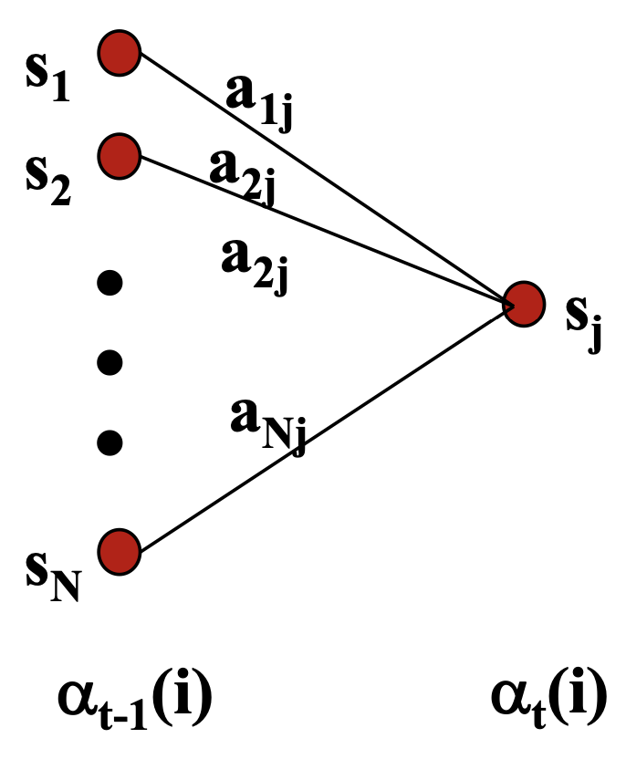
Forward Algorithm
Consider all possible ways of getting to sj at time t by coming from all possible states si and determine probability of each using transition probabilities
Sum these to get the total probability of being in state sj at time t while accounting for the first t-1 observations.
Then multiply by the probability of actually observing xt in sj

Slide 53
Forward Algorithm
$α_{t-1}(i)$: the previous forward path probability from the previous timestep
$a_{ij}$: the transition probability from previous state $y_{i}$ to current state $y_{j}$
$b_{j}(x_{t})$: the observation probability of observing $x_{t}$ given the current state $j$
$$α_{t}(j)=\underset{i}{∑}α_{t-1}(i)a_{ij}b_{j}(x_{t})$$
“The probability of being in state j and seeing the first t observations equals, for all possible previous states i, the previous forward probability for that state times the transition probability from that state i to the current state j time the probability of observing xt at the current state j”

Slide 54
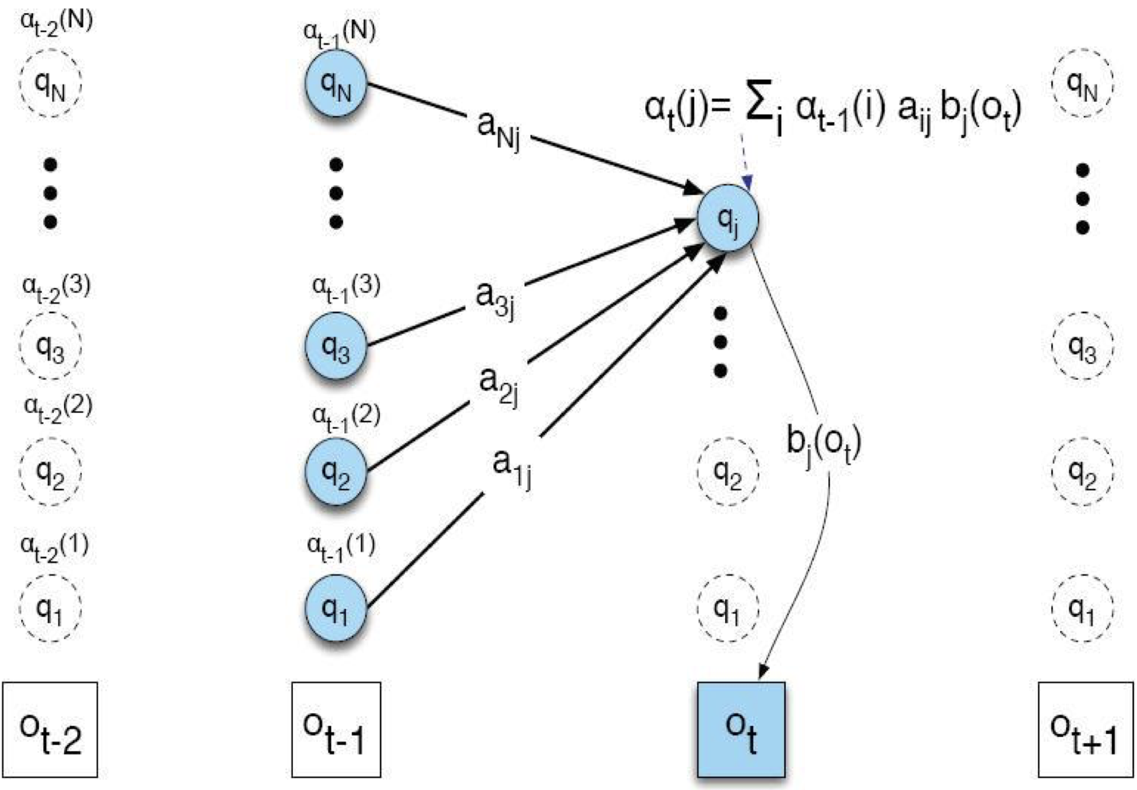
Forward Algorithm

Slide 55
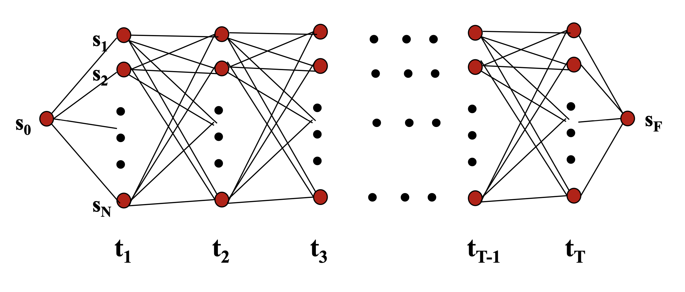
Forward Algorithm
Continue forward in time until reaching final time point T and sum probability of ending in final state sF

Slide 56
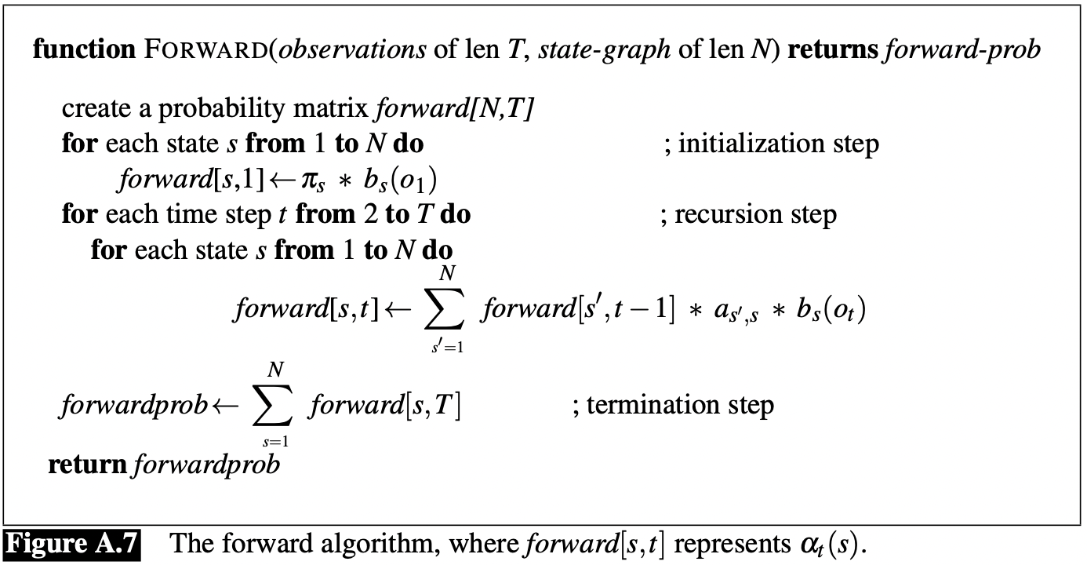
Forward Algorithm

Slide 57
Forward Algorithm
Requires only O(TN²) time to compute the probability of an observed sequence given a model
Exploits the fact that all state sequences must merge into one of the N possible states at any point in time and the Markov assumption that only the last state effects the next one

Slide 58
Forward Algorithm
π | NNP | VB | DT
P(y1) | 3/7 | 1/7 | 3/7
A |  | yi
 |  | NNP | VB | DT
yi-1 | NNP | 1/7 | 5/7 | 1/7
 | VB | 1/3 | 1/3 | 1/3
 | DT | 3/5 | 1/5 | 1/5
Find the probability of: cats meow
forward(yi,xi) | cats | meow
NNP | π(NNP)*B(cats|NNP)
VB | π(VB)*B(cats|VB)
DT | π(DT)*B(cats|DT)
B |  | yi
 |  | NNP | VB | DT
xi | the | 1/13 | 1/13 | 3/11
 | cats | 2/13 | 1/13 | 1/11
 | meow | 1/13 | 3/13 | 1/11
 | kittens | 2/13 | 1/13 | 1/11
 | dogs | 2/13 | 1/13 | 1/11
 | puppies | 2/13 | 1/13 | 1/11
 | bark | 1/13 | 3/13 | 1/11
 | <UNK> | 2/13 | 2/13 | 2/11

Slide 59
Forward Algorithm
π | NNP | VB | DT
P(y1) | 3/7 | 1/7 | 3/7
A |  | yi
 |  | NNP | VB | DT
yi-1 | NNP | 1/7 | 5/7 | 1/7
 | VB | 1/3 | 1/3 | 1/3
 | DT | 3/5 | 1/5 | 1/5
Find the probability of: cats meow
forward(yi,xi) | cats | meow
NNP | π(NNP)*B(cats|NNP) | (forward(NNP,cats)*A(NNP|NNP)*B(meow|NNP)) + (forward(VB,cats)*A(NNP|VB)*B(meow|NNP)) + (forward(DT,cats)*A(NNP|DT)*B(meow|NNP))
VB | π(VB)*B(cats|VB)
DT | π(DT)*B(cats|DT)
B |  | yi
 |  | NNP | VB | DT
xi | the | 1/13 | 1/13 | 3/11
 | cats | 2/13 | 1/13 | 1/11
 | meow | 1/13 | 3/13 | 1/11
 | kittens | 2/13 | 1/13 | 1/11
 | dogs | 2/13 | 1/13 | 1/11
 | puppies | 2/13 | 1/13 | 1/11
 | bark | 1/13 | 3/13 | 1/11
 | <UNK> | 2/13 | 2/13 | 2/11

Slide 60
Forward Algorithm
π | NNP | VB | DT
P(y1) | 3/7 | 1/7 | 3/7
A |  | yi
 |  | NNP | VB | DT
yi-1 | NNP | 1/7 | 5/7 | 1/7
 | VB | 1/3 | 1/3 | 1/3
 | DT | 3/5 | 1/5 | 1/5
Find the probability of: cats meow
forward(yi,xi) | cats | meow
NNP | π(NNP)*B(cats|NNP) | (forward(NNP,cats)*A(NNP|NNP)*B(meow|NNP)) + (forward(VB,cats)*A(NNP|VB)*B(meow|NNP)) + (forward(DT,cats)*A(NNP|DT)*B(meow|NNP))
VB | π(VB)*B(cats|VB) | (forward(NNP,cats)*A(VB|NNP)*B(meow|VB)) + (forward(VB,cats)*A(VB|VB)*B(meow|VB)) + (forward(DT,cats)*A(VB|DT)*B(meow|VB))
DT | π(DT)*B(cats|DT) | (forward(NNP,cats)*A(DT|NNP)*B(meow|DT)) + (forward(VB,cats)*A(DT|VB)*B(meow|DT)) + (forward(DT,cats)*A(DT|DT)*B(meow|DT))
B |  | yi
 |  | NNP | VB | DT
xi | the | 1/13 | 1/13 | 3/11
 | cats | 2/13 | 1/13 | 1/11
 | meow | 1/13 | 3/13 | 1/11
 | kittens | 2/13 | 1/13 | 1/11
 | dogs | 2/13 | 1/13 | 1/11
 | puppies | 2/13 | 1/13 | 1/11
 | bark | 1/13 | 3/13 | 1/11
 | <UNK> | 2/13 | 2/13 | 2/11

Slide 61
Forward Algorithm
π | NNP | VB | DT
P(y1) | 3/7 | 1/7 | 3/7
A |  | yi
 |  | NNP | VB | DT
yi-1 | NNP | 1/7 | 5/7 | 1/7
 | VB | 1/3 | 1/3 | 1/3
 | DT | 3/5 | 1/5 | 1/5
Find the probability of: cats meow
forward(yi,xi) | cats | meow
NNP | 3/7 * 2/13 = 6/91 | (6/91 * 1/7 * 1/13) + (1/91 * 1/3 * 1/13) + (3/77 * 3/5 * 1/13) = 6/8281 + 1/3549 + 9/5005
VB | 1/7 * 1/13 = 1/91 | (6/91 * 5/7 * 3/13) + (1/91 * 1/3 * 3/13) + (3/77 * 1/5 * 3/13) = 90/8281 + 3/3549 + 9/5005
DT | 3/7 * 1/11 = 3/77 | (6/91* 1/7 * 1/11) + (1/91 * 1/3 * 1/11) + (3/77 * 1/5 * 1/11) = 6/7007 + 1/3003 + 3/4235
B |  | yi
 |  | NNP | VB | DT
xi | the | 1/13 | 1/13 | 3/11
 | cats | 2/13 | 1/13 | 1/11
 | meow | 1/13 | 3/13 | 1/11
 | kittens | 2/13 | 1/13 | 1/11
 | dogs | 2/13 | 1/13 | 1/11
 | puppies | 2/13 | 1/13 | 1/11
 | bark | 1/13 | 3/13 | 1/11
 | <UNK> | 2/13 | 2/13 | 2/11

Slide 62
Forward Algorithm
π | NNP | VB | DT
P(y1) | 3/7 | 1/7 | 3/7
A |  | yi
 |  | NNP | VB | DT
yi-1 | NNP | 1/7 | 5/7 | 1/7
 | VB | 1/3 | 1/3 | 1/3
 | DT | 3/5 | 1/5 | 1/5
Find the probability of: cats meow
forward(yi,xi) | cats | meow
NNP | 3/7 * 2/13 = 6/91 | 6/8281 + 1/3549 + 9/5005 ≈ .00280
VB | 1/7 * 1/13 = 1/91 | 90/8281 + 3/3549 + 9/5005 ≈ .01351
DT | 3/7 * 1/11 = 3/77 | 6/7007 + 1/3003 + 3/4235 ≈ .00190
B |  | yi
 |  | NNP | VB | DT
xi | the | 1/13 | 1/13 | 3/11
 | cats | 2/13 | 1/13 | 1/11
 | meow | 1/13 | 3/13 | 1/11
 | kittens | 2/13 | 1/13 | 1/11
 | dogs | 2/13 | 1/13 | 1/11
 | puppies | 2/13 | 1/13 | 1/11
 | bark | 1/13 | 3/13 | 1/11
 | <UNK> | 2/13 | 2/13 | 2/11

Slide 63
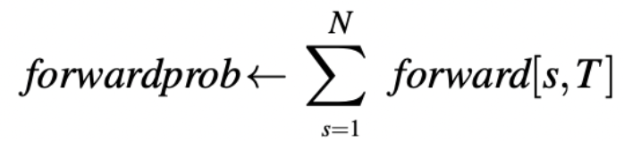
Forward Algorithm
Termination step:
π | NNP | VB | DT
P(y1) | 3/7 | 1/7 | 3/7
A |  | yi
 |  | NNP | VB | DT
yi-1 | NNP | 1/7 | 5/7 | 1/7
 | VB | 1/3 | 1/3 | 1/3
 | DT | 3/5 | 1/5 | 1/5
Find the probability of: cats meow
forward(yi,xi) | cats | meow
NNP | 3/7 * 2/13 = 6/91 | 6/8281 + 1/3549 + 9/5005 ≈ .00280
VB | 1/7 * 1/13 = 1/91 | 90/8281 + 3/3549 + 9/5005 ≈ .01351
DT | 3/7 * 1/11 = 3/77 | 6/7007 + 1/3003 + 3/4235 ≈ .00190
B |  | yi
 |  | NNP | VB | DT
xi | the | 1/13 | 1/13 | 3/11
 | cats | 2/13 | 1/13 | 1/11
 | meow | 1/13 | 3/13 | 1/11
 | kittens | 2/13 | 1/13 | 1/11
 | dogs | 2/13 | 1/13 | 1/11
 | puppies | 2/13 | 1/13 | 1/11
 | bark | 1/13 | 3/13 | 1/11
 | <UNK> | 2/13 | 2/13 | 2/11

Slide 64
Forward Algorithm
Termination step:
.00280 + .01351 + .00190 = .01821
Find the probability of: cats meow
forward(yi,xi) | cats | meow
NNP | 3/7 * 2/13 = 6/91 | 6/8281 + 1/3549 + 9/5005 ≈ .00280
VB | 1/7 * 1/13 = 1/91 | 90/8281 + 3/3549 + 9/5005 ≈ .01351
DT | 3/7 * 1/11 = 3/77 | 6/7007 + 1/3003 + 3/4235 ≈ .00190
Belief state: probability of being in a given state,
given the evidence
Here: probability of being at the end of the sequence
given previous observations

Slide 65
Forward Algorithm
π | NNP | VB | DT
P(y1) | 3/7 | 1/7 | 3/7
A |  | yi
 |  | NNP | VB | DT
yi-1 | NNP | 1/7 | 5/7 | 1/7
 | VB | 1/3 | 1/3 | 1/3
 | DT | 3/5 | 1/5 | 1/5
Find the probability of: kitties meow
forward(yi,xi) | kitties | meow
NNP | π(NNP)*B(<UNK>|NNP)
VB | π(VB)*B(<UNK>|VB)
DT | π(DT)*B(<UNK>|DT)
B |  | yi
 |  | NNP | VB | DT
xi | the | 1/13 | 1/13 | 3/11
 | cats | 2/13 | 1/13 | 1/11
 | meow | 1/13 | 3/13 | 1/11
 | kittens | 2/13 | 1/13 | 1/11
 | dogs | 2/13 | 1/13 | 1/11
 | puppies | 2/13 | 1/13 | 1/11
 | bark | 1/13 | 3/13 | 1/11
 | <UNK> | 2/13 | 2/13 | 2/11

Slide 66
Forward Algorithm
π | NNP | VB | DT
P(y1) | 3/7 | 1/7 | 3/7
A |  | yi
 |  | NNP | VB | DT
yi-1 | NNP | 1/7 | 5/7 | 1/7
 | VB | 1/3 | 1/3 | 1/3
 | DT | 3/5 | 1/5 | 1/5
Find the probability of: kitties meow
forward(yi,xi) | kitties | meow
NNP | π(NNP)*B(<UNK>|NNP) | (forward(NNP,<UNK>)*A(NNP|NNP)*B(meow|NNP)) + (forward(VB,<UNK>)*A(NNP|VB)*B(meow|NNP)) + (forward(DT,<UNK>)*A(NNP|DT)*B(meow|NNP))
VB | π(VB)*B(<UNK>|VB)
DT | π(DT)*B(<UNK>|DT)
B |  | yi
 |  | NNP | VB | DT
xi | the | 1/13 | 1/13 | 3/11
 | cats | 2/13 | 1/13 | 1/11
 | meow | 1/13 | 3/13 | 1/11
 | kittens | 2/13 | 1/13 | 1/11
 | dogs | 2/13 | 1/13 | 1/11
 | puppies | 2/13 | 1/13 | 1/11
 | bark | 1/13 | 3/13 | 1/11
 | <UNK> | 2/13 | 2/13 | 2/11

Slide 67
Forward Algorithm
π | NNP | VB | DT
P(y1) | 3/7 | 1/7 | 3/7
A |  | yi
 |  | NNP | VB | DT
yi-1 | NNP | 1/7 | 5/7 | 1/7
 | VB | 1/3 | 1/3 | 1/3
 | DT | 3/5 | 1/5 | 1/5
Find the probability of: kitties meow
forward(yi,xi) | kitties | meow
NNP | π(NNP)*B(<UNK>|NNP) | (forward(NNP,<UNK>)*A(NNP|NNP)*B(meow|NNP)) + (forward(VB,<UNK>)*A(NNP|VB)*B(meow|NNP)) + (forward(DT,<UNK>)*A(NNP|DT)*B(meow|NNP))
VB | π(VB)*B(<UNK>|VB) | (forward(NNP,<UNK>)*A(VB|NNP)*B(meow|VB)) + (forward(VB,<UNK>)*A(VB|VB)*B(meow|VB)) + (forward(DT,<UNK>)*A(VB|DT)*B(meow|VB))
DT | π(DT)*B(<UNK>|DT) | (forward(NNP,<UNK>)*A(DT|NNP)*B(meow|DT)) + (forward(VB,<UNK>)*A(DT|VB)*B(meow|DT)) + (forward(DT,<UNK>)*DT|DT)*B(meow|DT))
B |  | yi
 |  | NNP | VB | DT
xi | the | 1/13 | 1/13 | 3/11
 | cats | 2/13 | 1/13 | 1/11
 | meow | 1/13 | 3/13 | 1/11
 | kittens | 2/13 | 1/13 | 1/11
 | dogs | 2/13 | 1/13 | 1/11
 | puppies | 2/13 | 1/13 | 1/11
 | bark | 1/13 | 3/13 | 1/11
 | <UNK> | 2/13 | 2/13 | 2/11

Slide 68
Forward Algorithm
π | NNP | VB | DT
P(y1) | 3/7 | 1/7 | 3/7
A |  | yi
 |  | NNP | VB | DT
yi-1 | NNP | 1/7 | 5/7 | 1/7
 | VB | 1/3 | 1/3 | 1/3
 | DT | 3/5 | 1/5 | 1/5
Find the probability of: kitties meow
forward(yi,xi) | kitties | meow
NNP | 3/7 * 2/13 = 6/91 | (6/91 * 1/7 * 1/13) + (2/91 * 1/3 * 1/13) + (6/77 * 3/5 * 1/13) = 6/8281 + 2/3549 + 18/5005
VB | 1/7 * 2/13 = 2/91 | (6/91 * 5/7 * 3/13) + (2/91 * 1/3 * 3/13) + (6/77 * 1/5 * 3/13) = 90/8281 + 6/3549 + 18/5005
DT | 3/7 * 2/11 = 6/77 | (6/91 * 1/7 * 1/11) + (2/91 * 1/3 * 1/11) + (6/77 * 1/5 * 1/11) = 6/7007 + 2/3003 + 6/4235
B |  | yi
 |  | NNP | VB | DT
xi | the | 1/13 | 1/13 | 3/11
 | cats | 2/13 | 1/13 | 1/11
 | meow | 1/13 | 3/13 | 1/11
 | kittens | 2/13 | 1/13 | 1/11
 | dogs | 2/13 | 1/13 | 1/11
 | puppies | 2/13 | 1/13 | 1/11
 | bark | 1/13 | 3/13 | 1/11
 | <UNK> | 2/13 | 2/13 | 2/11

Slide 69
Forward Algorithm
π | NNP | VB | DT
P(y1) | 3/7 | 1/7 | 3/7
A |  | yi
 |  | NNP | VB | DT
yi-1 | NNP | 1/7 | 5/7 | 1/7
 | VB | 1/3 | 1/3 | 1/3
 | DT | 3/5 | 1/5 | 1/5
Find the probability of: kitties meow
forward(yi,xi) | kitties | meow
NNP | 3/7 * 2/13 = 6/91 | 6/8281 + 2/3549 + 18/5005 ≈ .00488
VB | 1/7 * 2/13 = 2/91 | 90/8281 + 6/3549 + 18/5005 ≈ .01616
DT | 3/7 * 2/11 = 6/77 | 6/7007 + 2/3003 + 6/4235 ≈ .00294
B |  | yi
 |  | NNP | VB | DT
xi | the | 1/13 | 1/13 | 3/11
 | cats | 2/13 | 1/13 | 1/11
 | meow | 1/13 | 3/13 | 1/11
 | kittens | 2/13 | 1/13 | 1/11
 | dogs | 2/13 | 1/13 | 1/11
 | puppies | 2/13 | 1/13 | 1/11
 | bark | 1/13 | 3/13 | 1/11
 | <UNK> | 2/13 | 2/13 | 2/11

Slide 70
Forward Algorithm
Termination step:
.00488 + .01616 + .00294 = .02398
Find the probability of: kitties meow
forward(yi,xi) | kitties | meow
NNP | 3/7 * 2/13 = 6/91 | 6/8281 + 2/3549 + 18/5005 ≈ .00488
VB | 1/7 * 2/13 = 2/91 | 90/8281 + 6/3549 + 18/5005 ≈ .01616
DT | 3/7 * 2/11 = 6/77 | 6/7007 + 2/3003 + 6/4235 ≈ .00294

Slide 71
Forward Algorithm
Find the probability of: kitties meow cats meow
.00488 + .01616 + .00294 = .02398
.00280 + .01351 + .00190 = .01821
forward(yi,xi) | kitties | meow
NNP | 3/7 * 2/13 = 6/91 | 6/8281 + 2/3549 + 18/5005 ≈ .00488
VB | 1/7 * 2/13 = 2/91 | 90/8281 + 6/3549 + 18/5005 ≈ .01616
DT | 3/7 * 2/11 = 6/77 | 6/7007 + 2/3003 + 6/4235 ≈ .00294
forward(yi,xi) | cats | meow
NNP | 3/7 * 2/13 = 6/91 | 6/8281 + 1/3549 + 9/5005 ≈ .00280
VB | 1/7 * 1/13 = 1/91 | 90/8281 + 3/3549 + 9/5005 ≈ .01351
DT | 3/7 * 1/11 = 3/77 | 6/7007 + 1/3003 + 3/4235 ≈ .00190

Slide 72
Questions?

