Slide 1
Edit Distance
CS 542 - Natural Language Processing
Based on slides by Dan Jurafsky (Stanford)
Prof. Nikhil Krishnaswamy, Colorado State University

Slide 2
Definition of Minimum Edit Distance

Slide 3
How Similar Are Two Strings?
Spelling correction: user typed “graffe”
  What did they mean?
    graf
    graft
    grail
    giraffe

Slide 4
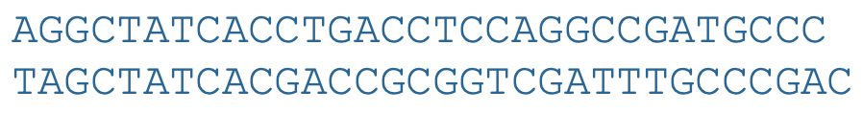
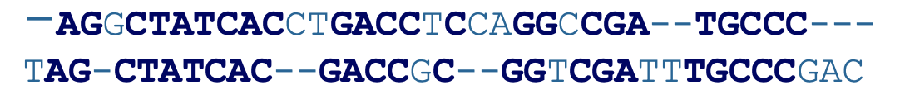
How Similar Are Two Strings?
Computational biology: align two sequences of nucleotides
resulting alignment:
Also for Machine Translation, Information Extraction, Speech Recognition

Slide 5
Edit Distance
The minimum edit distance between two strings
  is the minimum number of editing operations
    1) insertion
    2) deletion
    3) substitution
  needed to transform one into the other

Slide 6
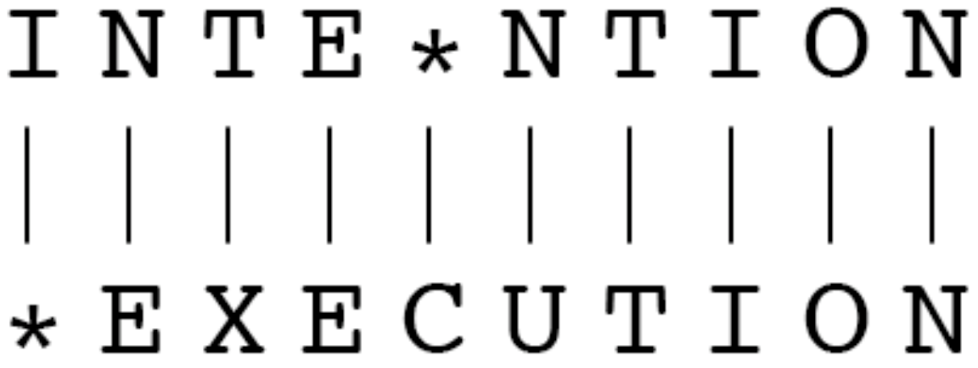
Edit Distance
Two strings and their alignment

Slide 7
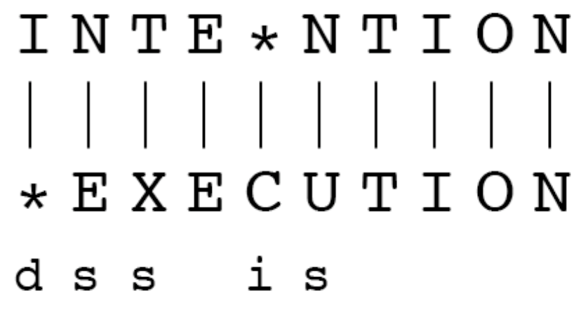
Edit Distance
If each operation has as cost of 1
  Edit distance is 5
If substitutions cost 2 (deletion+insertion)
  Edit distance is 8 (Levenshtein distance)

Slide 8
Edit Distance
Given a sequence of bases
An alignment
Given two sequences, align each letter to a letter or a gap

Slide 9
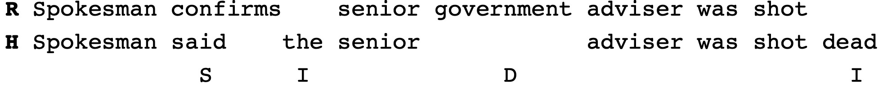
Edit Distance
Evaluation of machine translation and speech recognition
Named Entity Extraction and Entity Coreference
  IBM Inc. announced today
  IBM profits
  Colorado State President Amy Parsons announced yesterday
  for CSU President Amy Parsons

Slide 10
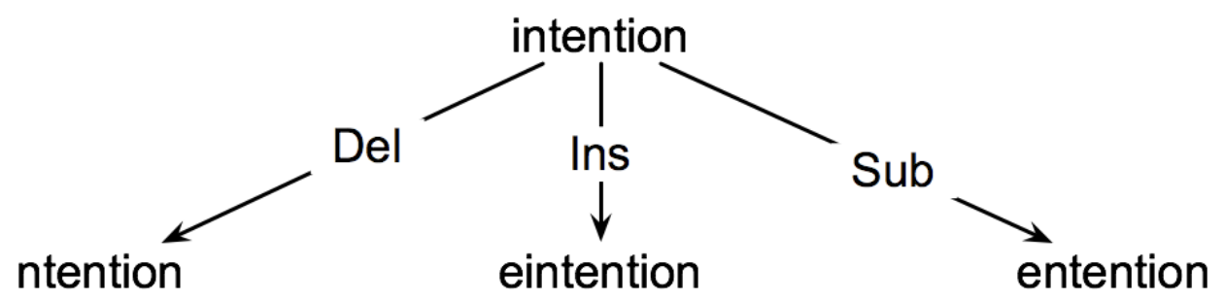
Edit Distance
Searching for a path (sequence of edits) from start string to final string:
  Initial state: the word we’re transforming
  Operators: insert, delete, substitute
  Goal state: the word we’re trying to get to
  Path cost: what we want to minimize: the number of edits

Slide 11
Edit Distance
The space of all edit sequences is huge!
  We can’t afford to navigate naïvely
  Lots of distinct paths wind up at the same state
  We don’t have to keep track of all of them
  Just the shortest path to each of those revisited states
    cf. pathfinding, A*

Slide 12
Edit Distance
For two strings: X (length n), and Y (length m)
D(i,j)
  the edit distance between X[1..i] and Y[1..j]
    i.e., the first i characters of X and the first j characters of Y
  The edit distance between X and Y is thus D(n,m)

Slide 13
Computing Minimum Edit Distance

Slide 14
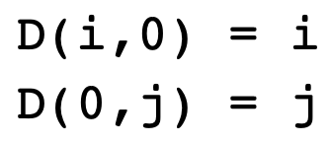
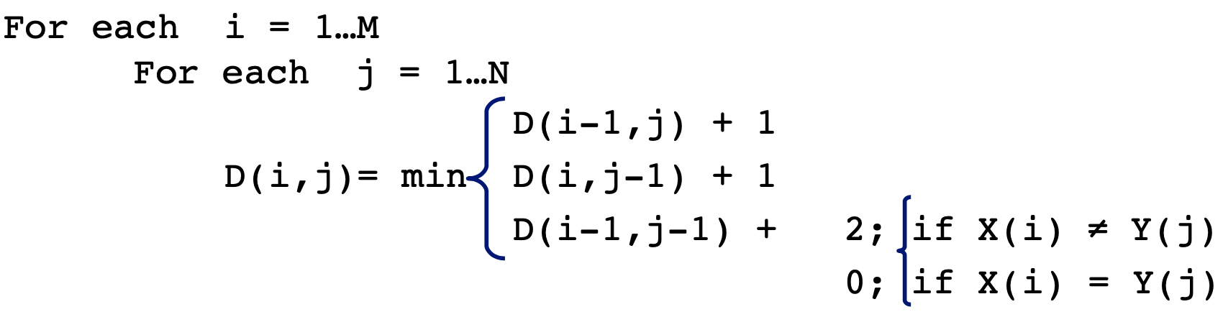
Defining Minimum Edit Distance
Initialization
Recurrence Relation
Termination

Slide 15
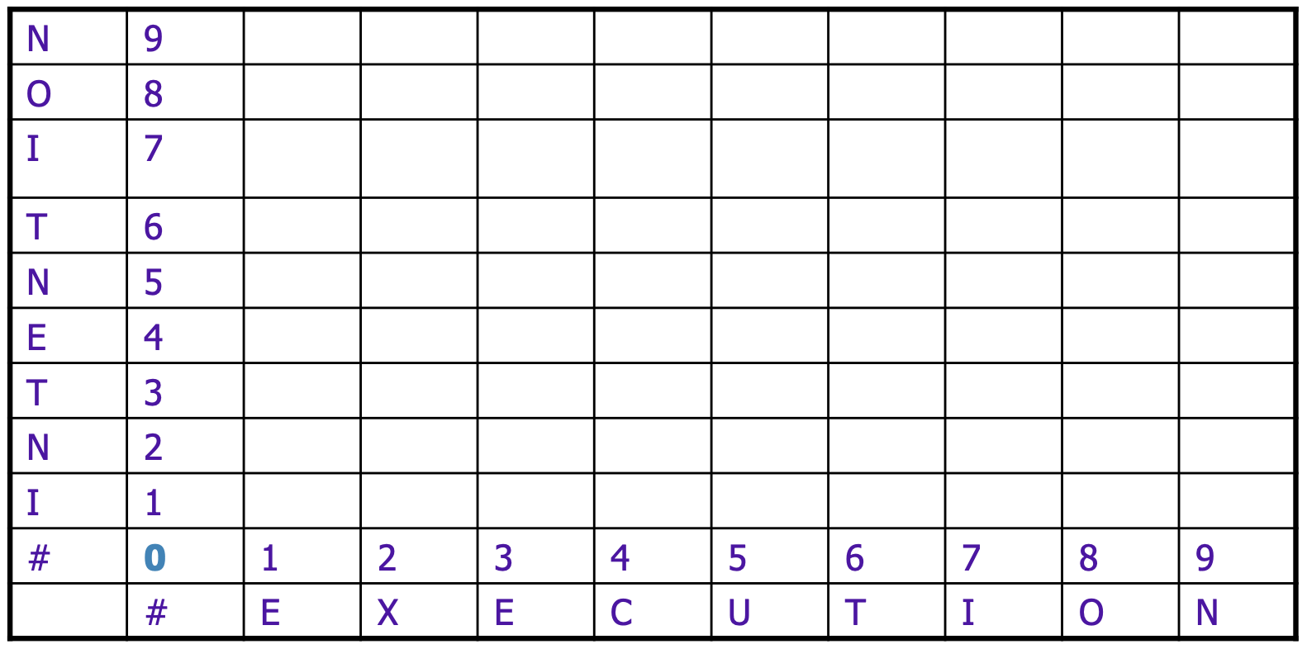
Edit Distance Table

Slide 16
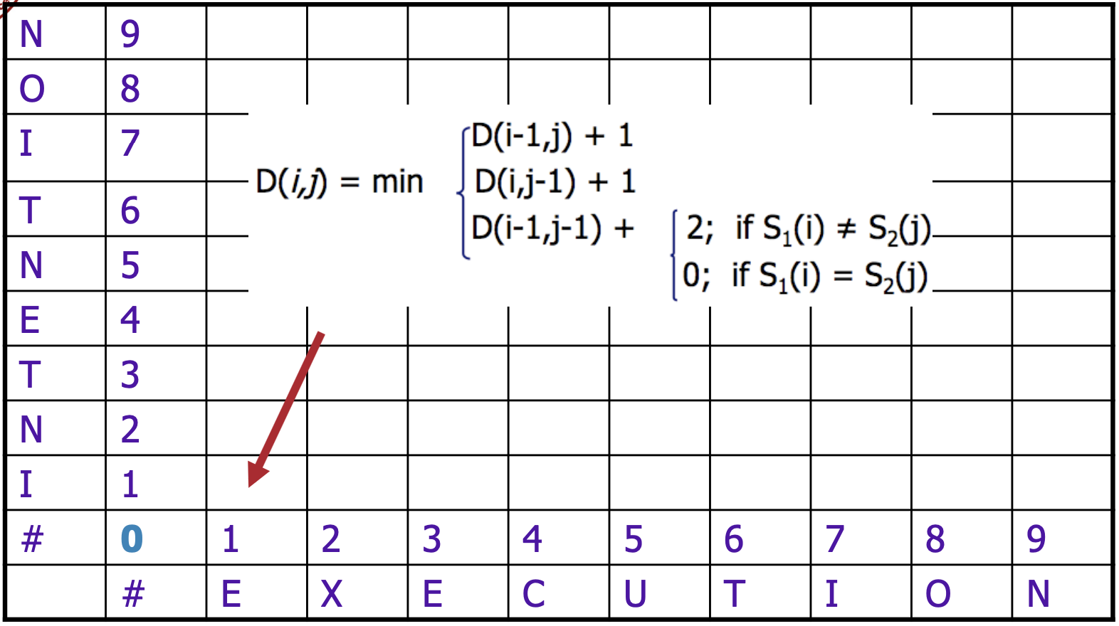
Edit Distance Table

Slide 17
Edit Distance Table

Slide 18
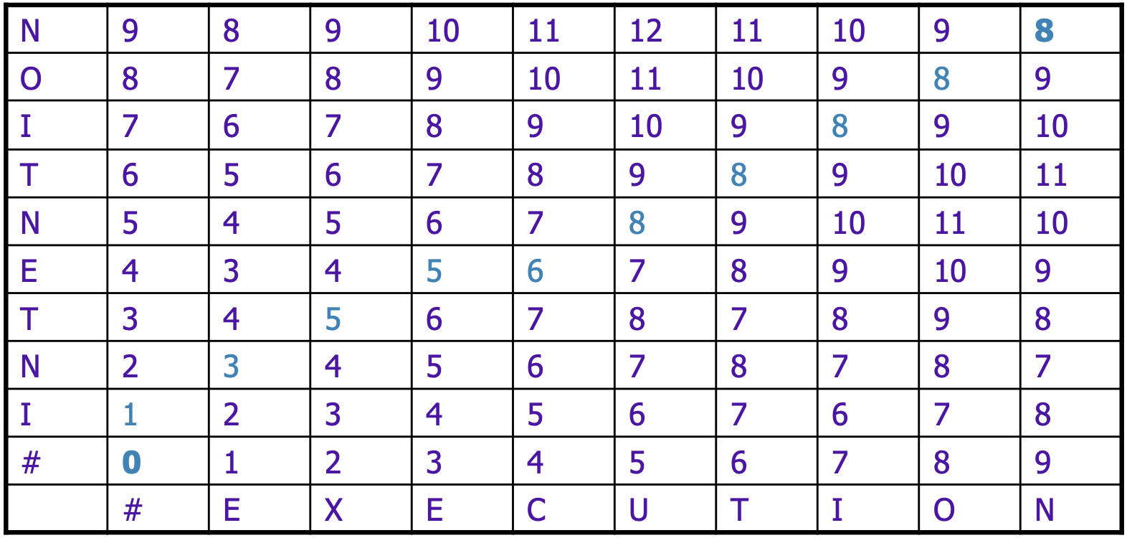
Edit Distance Table

Slide 19
Backtrace to Compute Alignment

Slide 20
Computing Alignment
Edit distance isn’t sufficient
  We often need to align each character of the two strings to each other
We do this by keeping a “backtrace”
Every time we enter a cell, remember where we came from
When we reach the end
  Trace back the path from the upper right corner to read off the alignment

Slide 21
Computing Alignment

Slide 22
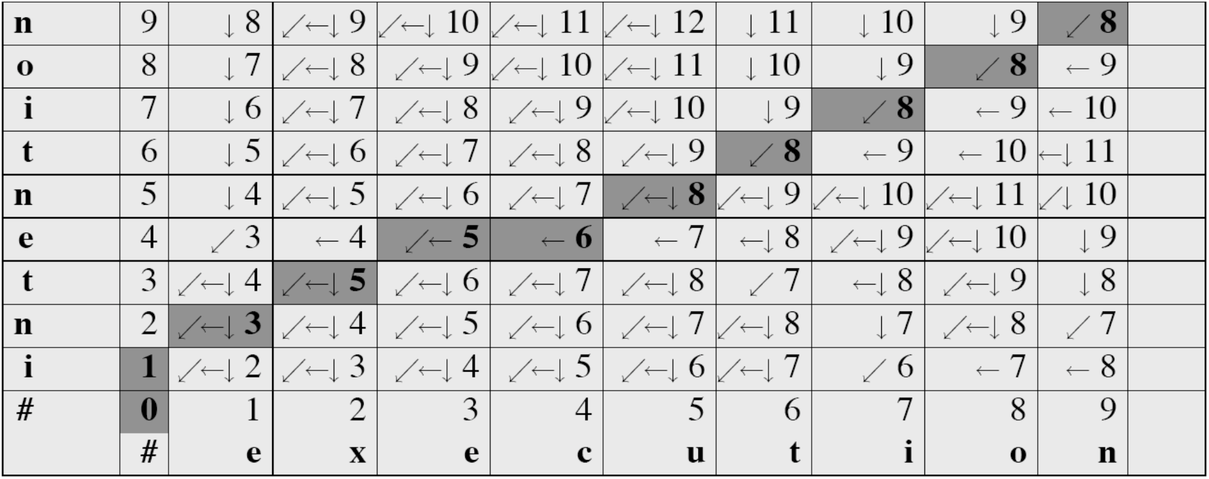
Computing Alignment

Slide 23
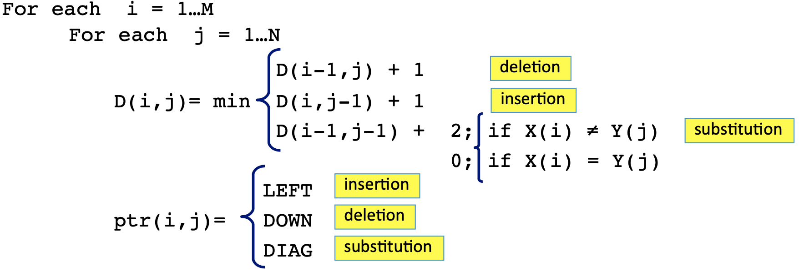
Adding Backtrace to Edit Distance
Recurrence Relation

Slide 24
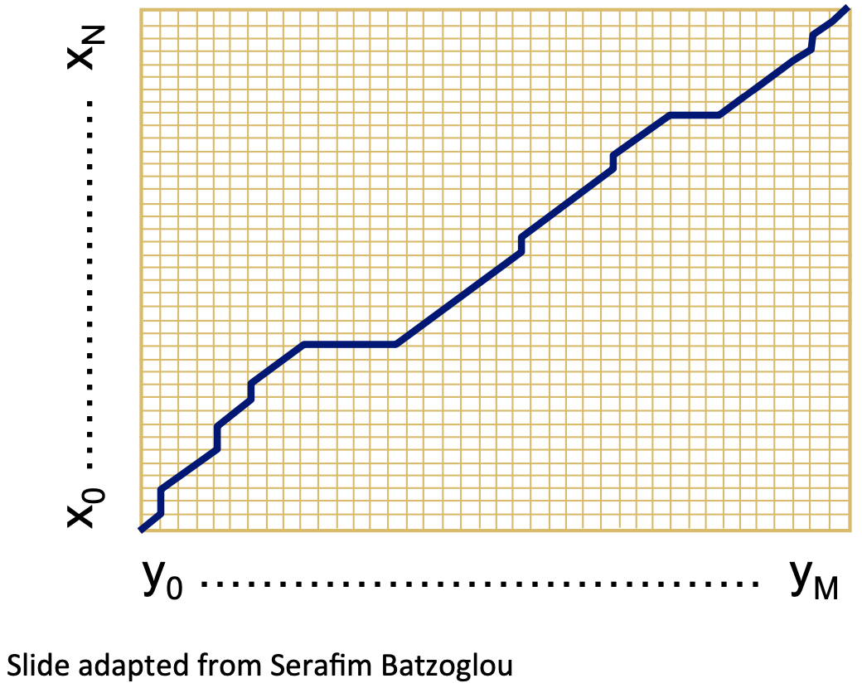
The Distance Matrix
Every non-decreasing path
  from (0,0) to (M,N)
  corresponds to an alignment of the two sequences
An optimal alignment is composed of optimal subalignments

Slide 25
Result of Backtrace
Two strings and their alignment

Slide 26
Edit Distance Performance
Time:
  O(nm)
Space:
  O(nm)
Backtrace:
  O(n+m)

Slide 27
Weighted Minimum Edit Distance

Slide 28
Weighted Edit Distance
Why would we add weights to the computation?
  Spelling Correction: some letters are more likely to be mistyped than others
  Biology: certain kinds of deletions or insertions are more likely than others

Slide 29
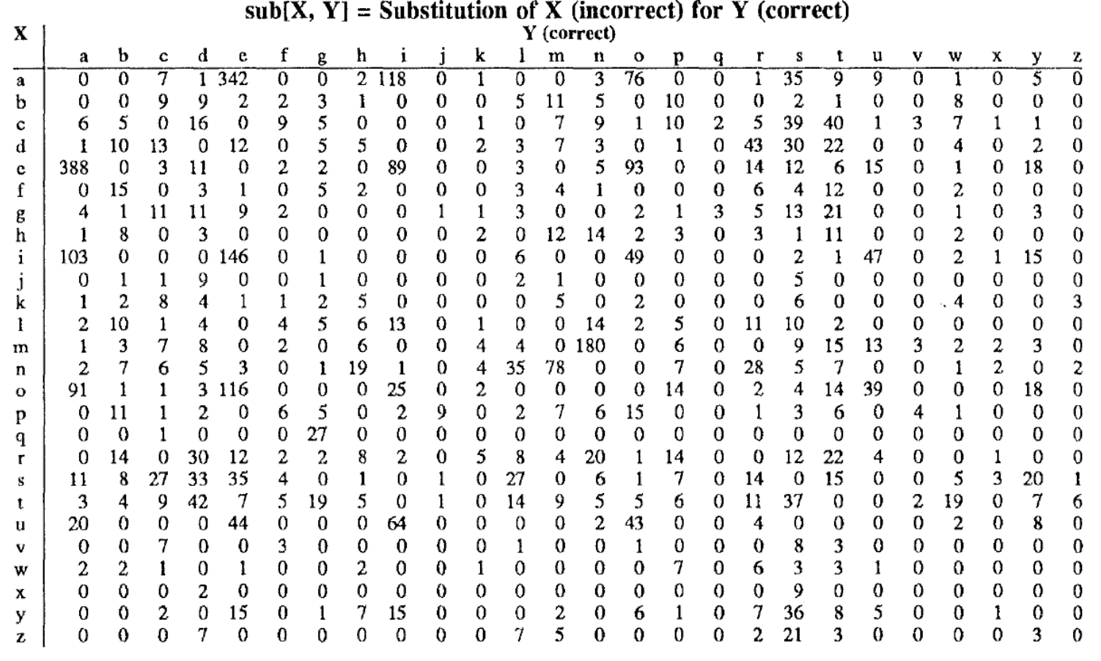
Weighted Edit Distance

Slide 30
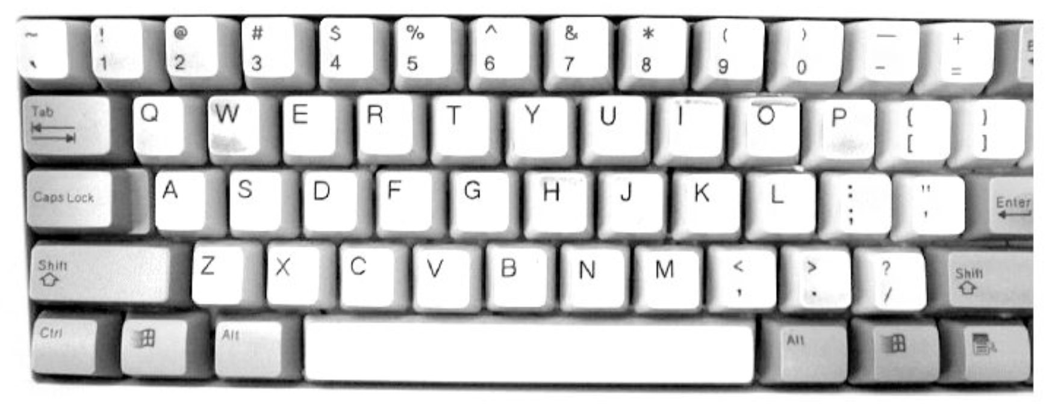

Slide 31
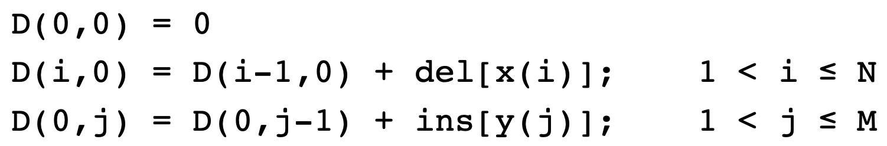
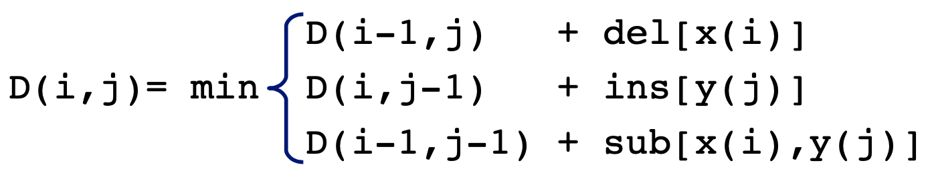
Weighted Minimum Edit Distance
Initialization
Recurrence Relation
Termination

Slide 32
Other Edit Distances
Phonetic edit distance
  Convert text to pronunciation representation (e.g., IPA: p → /p^{h}/), and compute edit distance
Feature-based edit distance
  Convert pronunciation to features (e.g., p → /p^{h}/ → [-voiced, -plosive, +aspirated]) and compute edit distance
Hamming edit distance
  Substitution cost = Hamming distance (minimum number of substitutions to change string A into string B)

Slide 33
Other Edit Distances
Class-based edit distance
  Characters/features are grouped into classes (e.g., Dolgo Prime phoneme classes) and edit distance is calculated between the classes
Edit distance can be probabilistically weighted by likelihood of specific edit
Normalizing edit distance over multiple edits: divide by max len of two strings

Slide 34
Dynamic Programming

Slide 35
Edit Distance: A Dynamic Programming Problem
“An optimal alignment is composed of optimal subalignments”
  So why not globally break down the problem into smaller problems?
  If I find the best solution to each smaller problem, I’ll find the best solution to the bigger problem
  Edit distance has a naturally recursive structure

Slide 36
Edit Distance: A Dynamic Programming Problem
Edit distance has a naturally recursive structure
Given sequence A and B, 3 options:
  insert the first character of B, and perform an optimal alignment of A and the tail of B
  delete the first character of A, and perform the optimal alignment of the tail of A and B
  replace the first character of A with the first character of B, and perform optimal alignments of the tails of A and B
Now you have A’, B’, repeat

Slide 37
Where did the name “dynamic programming” come from?
“…The 1950s were not good years for mathematical research. [the] Secretary of Defense ...had a pathological fear and hatred of the word, research... I decided therefore to use the word, “programming”.
I wanted to get across the idea that this was dynamic, this was multistage... I thought, let’s ... take a word that has an absolutely precise meaning, namely dynamic... it’s impossible to use the word, dynamic, in a pejorative sense. Try thinking of some combination that will possibly give it a pejorative meaning. It’s impossible.
Thus, I thought dynamic programming was a good name. It was something not even a Congressman could object to.”
Richard Bellman, “Eye of the Hurricane: an autobiography,” 1984

Slide 38
More on Edit Distance
Jurafsky and Martin, Ch. 2, Sec. 5

Slide 39
Questions?

