Slide 1
Model Training with Gradient Descent
CS 542 - Natural Language Processing
Partially based on slides by Dan Jurafsky (Stanford) and Jim Martin (University of Colorado)
Prof. Nikhil Krishnaswamy, Colorado State University

Slide 2
How To Classify
Given: input X, weight W, bias b
Compute $z=WX+b$
Then pass it through the sigmoid function: $\frac{1}{1-e^{-(WX+b)}}$ (binomial classification)
Or the softmax function: $\frac{e^{W_{i}X_{i}+b_{i}}}{\sum_{j=1}^{k}{e^{W_{j}X_{j}+b_{j}}}}$ (multinomial classification)
And treat it as a probability
Highest probability wins

Slide 3
How To Classify
Sigmoid vs. softmax
Sigmoid and softmax are equivalent when k = 2
  k = 2 ~ k = 1 (C or ¬C)
$\frac{1}{1-e^{-(WX+b)}}$ is faster to compute
I know X
Where do I get W and b?

Slide 4
Learning in Logistic Regression

Slide 5
Learning in Logistic Regression
Note: these examples will assume binomial classification (and therefore sigmoid)
Supervised classification: we know the correct label y (either 0 or 1) for each x
What the system produces is an estimate, ŷ
We want to set W and b to minimize the distance between our estimate ŷ^{(i)} and the true y^{(i)}
We need a distance estimator: a loss function or a cost function
We need an optimization algorithm to update W and b to minimize the loss

Slide 6
Learning in Logistic Regression
A loss function:
  We will use cross-entropy loss (CE loss or log loss)
An optimization algorithm:
  We will use stochastic gradient descent (SGD)

Slide 7
Cross-Entropy Loss

Slide 8
Cross-Entropy Loss
We want to know how far the classifier output:
  $$\overset{̂}{y}=σ(WX+b)$$
is from the true output
  y ∈ {0,1}
Difference is L(ŷ, y) = how much ŷ differs from true y
  L here stands for “loss”
  Previously we used it to mean “likelihood” (confusing, I know, not my choice)

Slide 9
Cross-Entropy Loss
A case of conditional maximum likelihood estimation
We choose parameters W, b
  that maximize the log probability of the true y labels in the training data
  given the observations X

Slide 10
Cross-Entropy Loss
Goal: maximize probability P(y|x) of the correct label y
Since there are only 2 discrete outcomes (0 or 1), we can express P(y|x) (what we want to maximize) as:
  $$P(y|x)={\overset{̂}{y}}^{y}(1-\overset{̂}{y})^{1-y}$$
  If y = 0: $P(y|x)={\overset{̂}{y}}^{0}(1-\overset{̂}{y})^{1-0}=1(1-\overset{̂}{y})^{1}=1-\overset{̂}{y}$
  If y = 1: $P(y|x)={\overset{̂}{y}}^{1}(1-\overset{̂}{y})^{1-1}=\overset{̂}{y}(1-\overset{̂}{y})^{0}=\overset{̂}{y}$

Slide 11
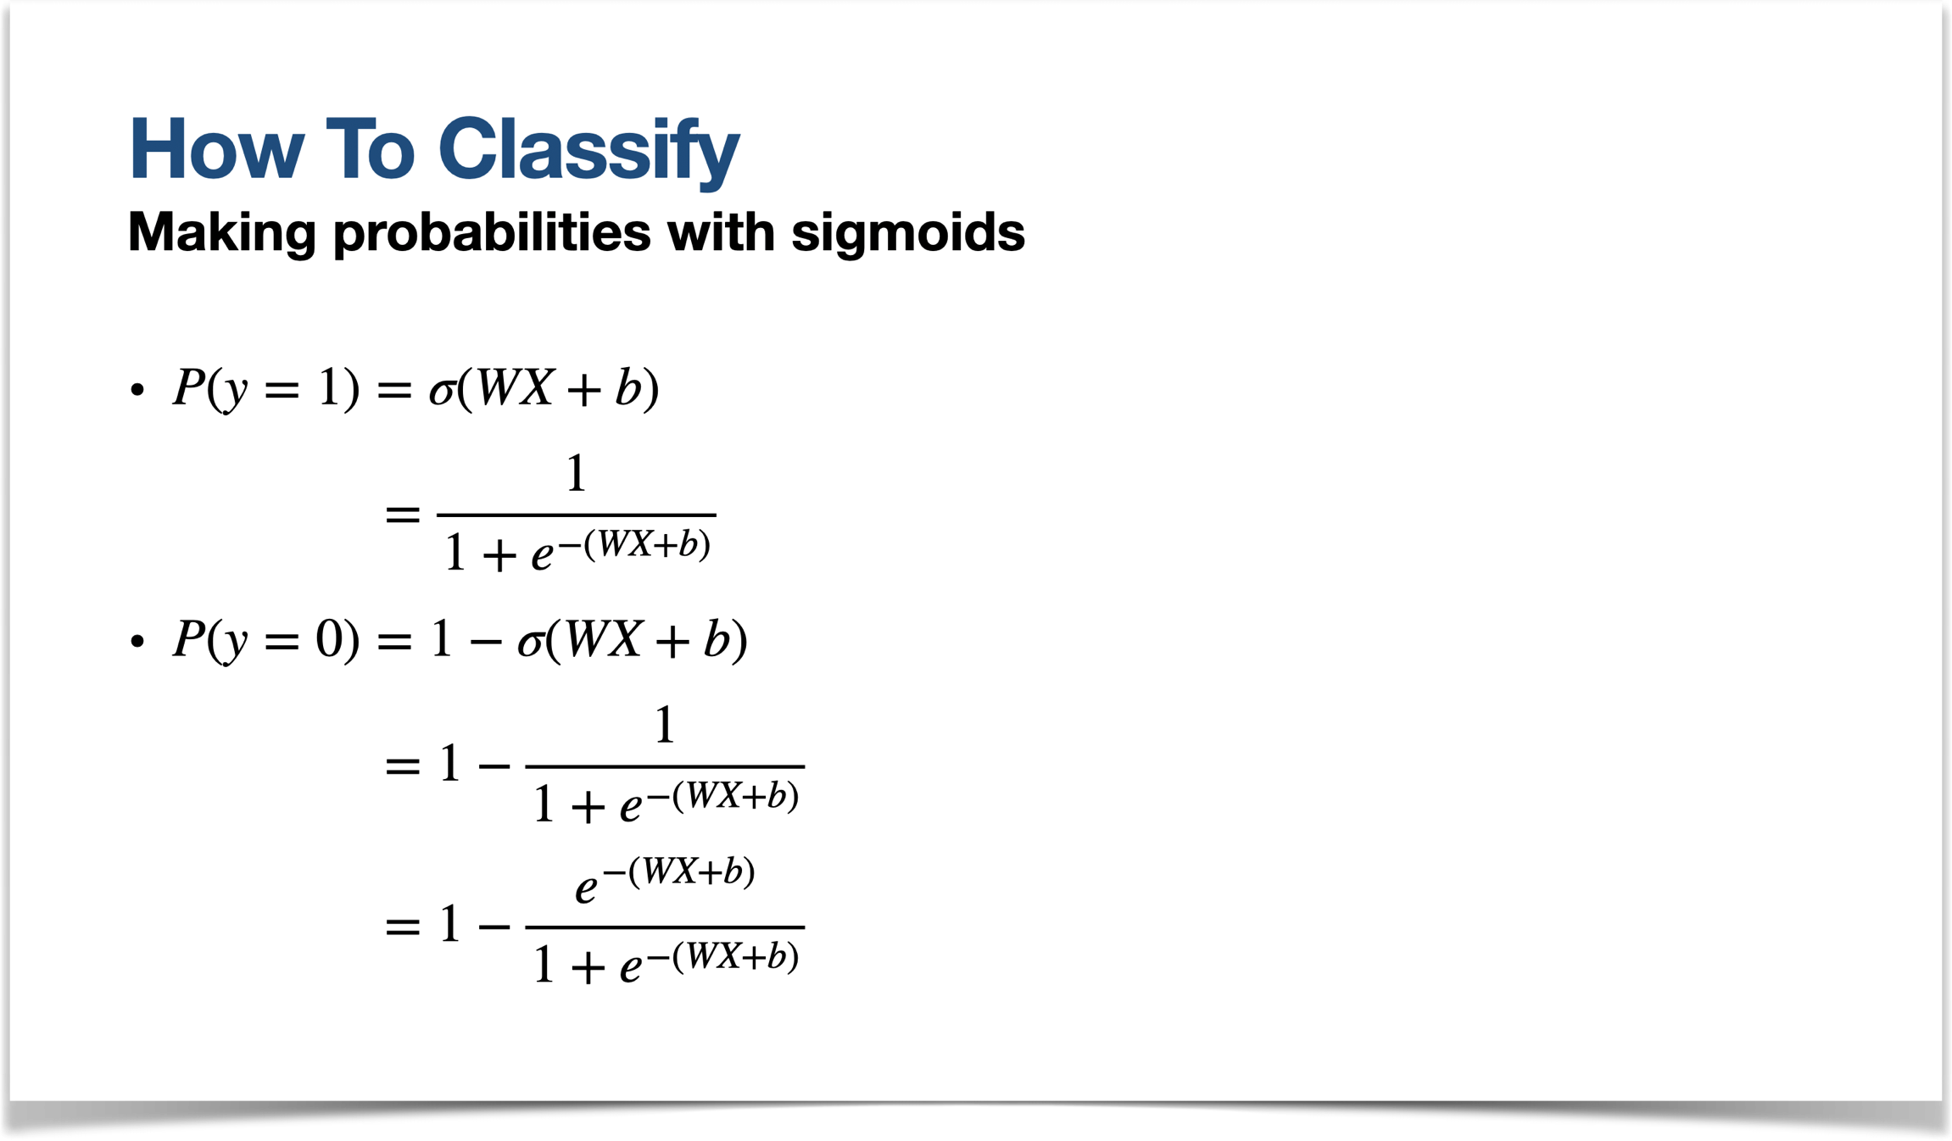
This works because…

Slide 12
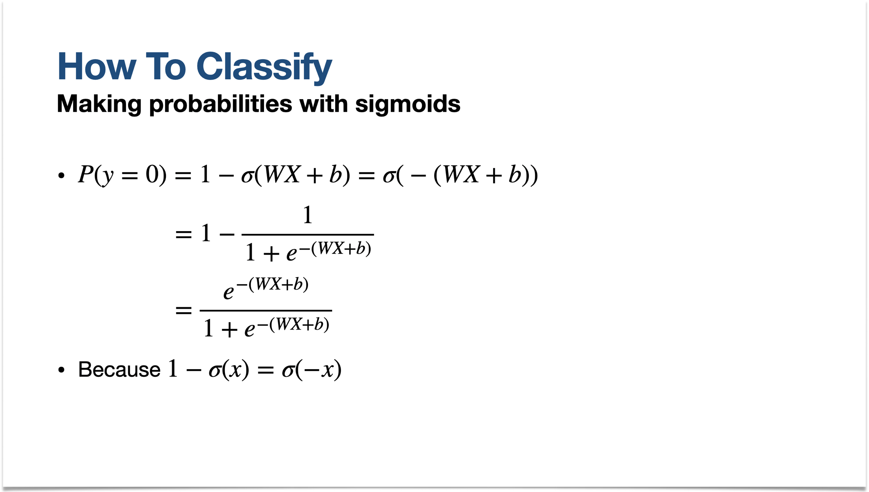
This works because…

Slide 13
This also works with softmax because…
Softmax outputs probabilities that sum to 1
P(y|x) + (1-P(y|x)) = 1
1-P(y|x) is a “safe assumption” of the other category’s probability
  If it’s not one thing it’s the other

Slide 14
Cross-Entropy Loss
Goal: maximize probability P(y|x) of the correct label y
Maximize: $P(y|x)={\overset{̂}{y}}^{y}(1-\overset{̂}{y})^{1-y}$
It’s mathematically handy to take the log of both sides:
  $$logP(y|x)=log[{\overset{̂}{y}}^{y}(1-\overset{̂}{y})^{1-y}]=y*log(\overset{̂}{y})+(1-y)*log(1-\overset{̂}{y})$$
Values that maximize log P(y|x) will also maximize P(y|x)

Slide 15
Cross-Entropy Loss
Goal: maximize probability P(y|x) of the correct label y
Maximizing probability = minimizing loss
Maximize: $y*log(\overset{̂}{y})+(1-y)*log(1-\overset{̂}{y})$
Flip the sign to turn this into a loss (something to minimize):
Cross-entropy loss formula for L(ŷ, y):
  $$L_{CE}(\overset{̂}{y},y)=-[y*log(\overset{̂}{y})+(1-y)*log(1-\overset{̂}{y})]$$

Slide 16
Cross-Entropy Loss
Goal: maximize probability P(y|x) of the correct label y
ŷ is our prediction so let’s rewrite in terms of W, X, and b:
$$L_{CE}(\overset{̂}{y},y)=-[y*log(σ(WX+b))+(1-y)*log(1-σ(WX+b))]$$

Slide 17
Cross-Entropy Loss
It's hokey . There are virtually no surprises , and the writing is second-rate .
So why was it so enjoyable ? For one thing , the cast is
great . Another nice touch is the music . I was overcome with the urge to get of the couch and start dancing . It sucked me in , and it'll do the same to you .
We want loss to be:
  smaller if the model estimate is close to correct
  bigger if the model is confused
Suppose the true label if y=1 (positive)

Slide 18
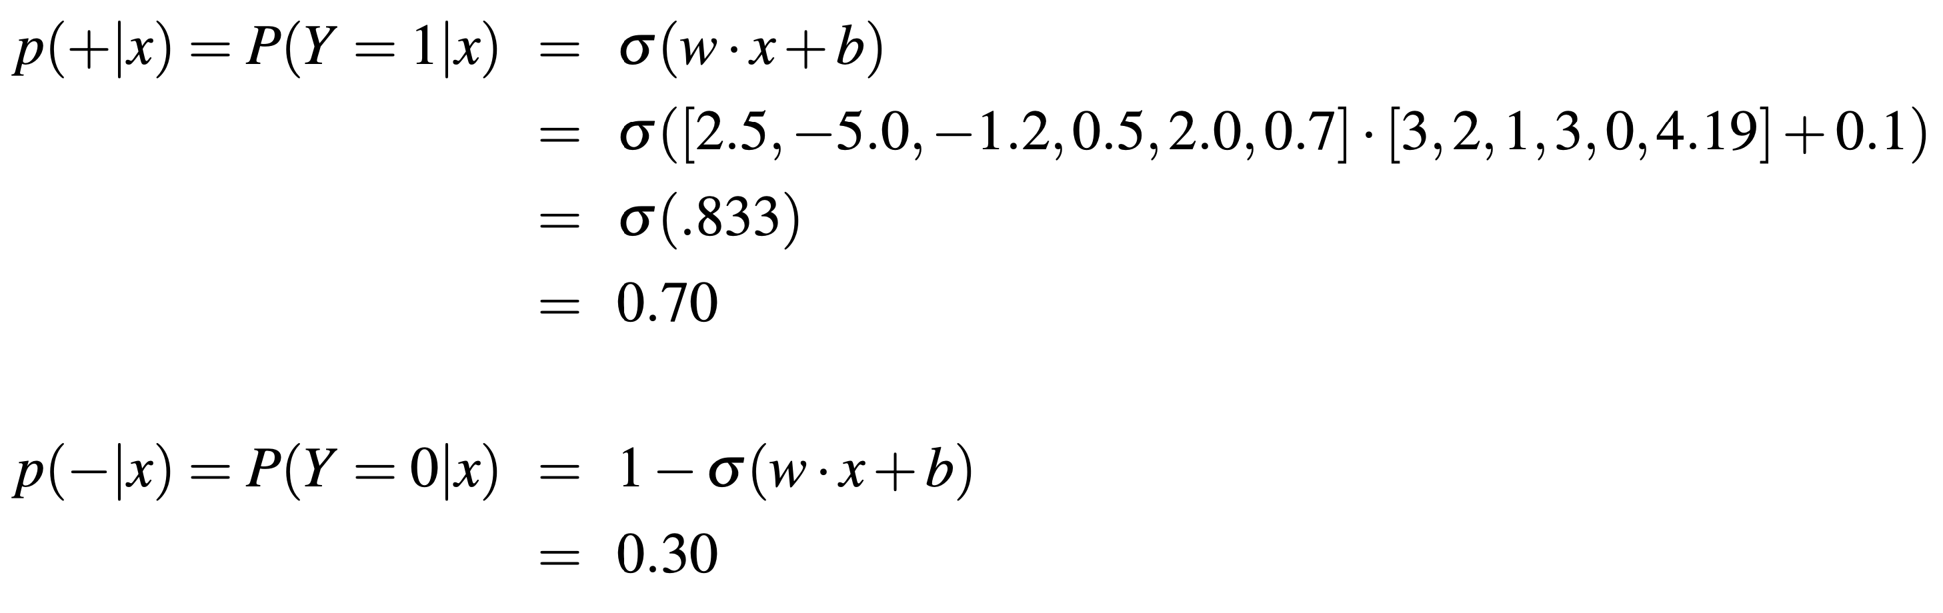
Cross-Entropy Loss
We will use the same values from Lecture 7
True value is y=1; how well is our model doing?
Pretty well!

Slide 19
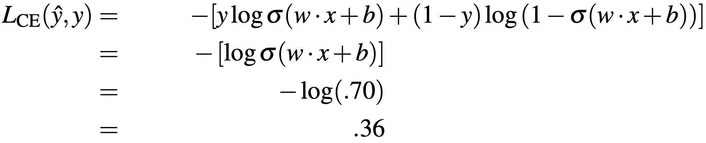
Cross-Entropy Loss
What’s the loss?

Slide 20
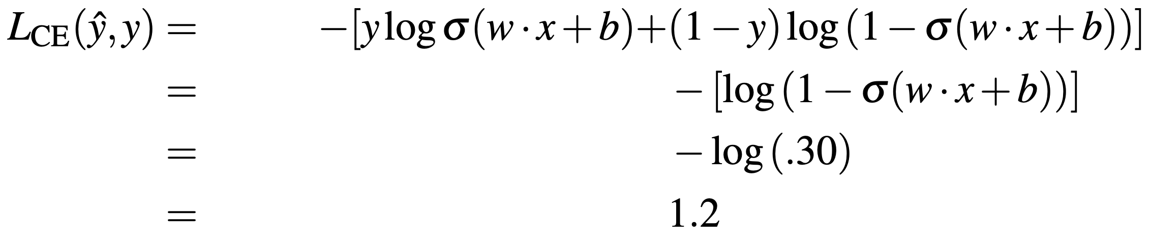
Cross-Entropy Loss
Suppose instead the true value were y=
What’s the loss?

Slide 21
Cross-Entropy Loss
So, the loss when the model was right:
Is less than the loss when the model was wrong!

Slide 22
Stochastic Gradient Descent

Slide 23
Stochastic Gradient Descent
Loss function is parametrized by weights $Θ=(W,b)$
Bias is also a weight
A weight not associated with a specific feature
We want the weights that minimize the loss, averaged over all samples:
  $$\overset{̂}{Θ}={argmin}_{Θ}\frac{1}{m}\overset{m}{\underset{i=1}{∑}}L_{CE}(f(x^{(i)};Θ),y^{(i)})$$
  (In words): The best weights are the weights that minimize the average of the cross-entropy loss of some function of the input samples and the weights relative to the output samples
  (that function is the prediction function WX+b where $Θ=(W,b)$)

Slide 24

Stochastic Gradient Descent
How do I get to the bottom of this canyon?
Look around 360°
Find the direction of steepest slope
Go that way

Slide 25
Stochastic Gradient Descent
For logistic regression, loss function is convex
  Convex function has only 1 minimum
  SGD starting from one point is guaranteed to find the minimum
    Loss function for neural network is non-convex
    Why?

Slide 26
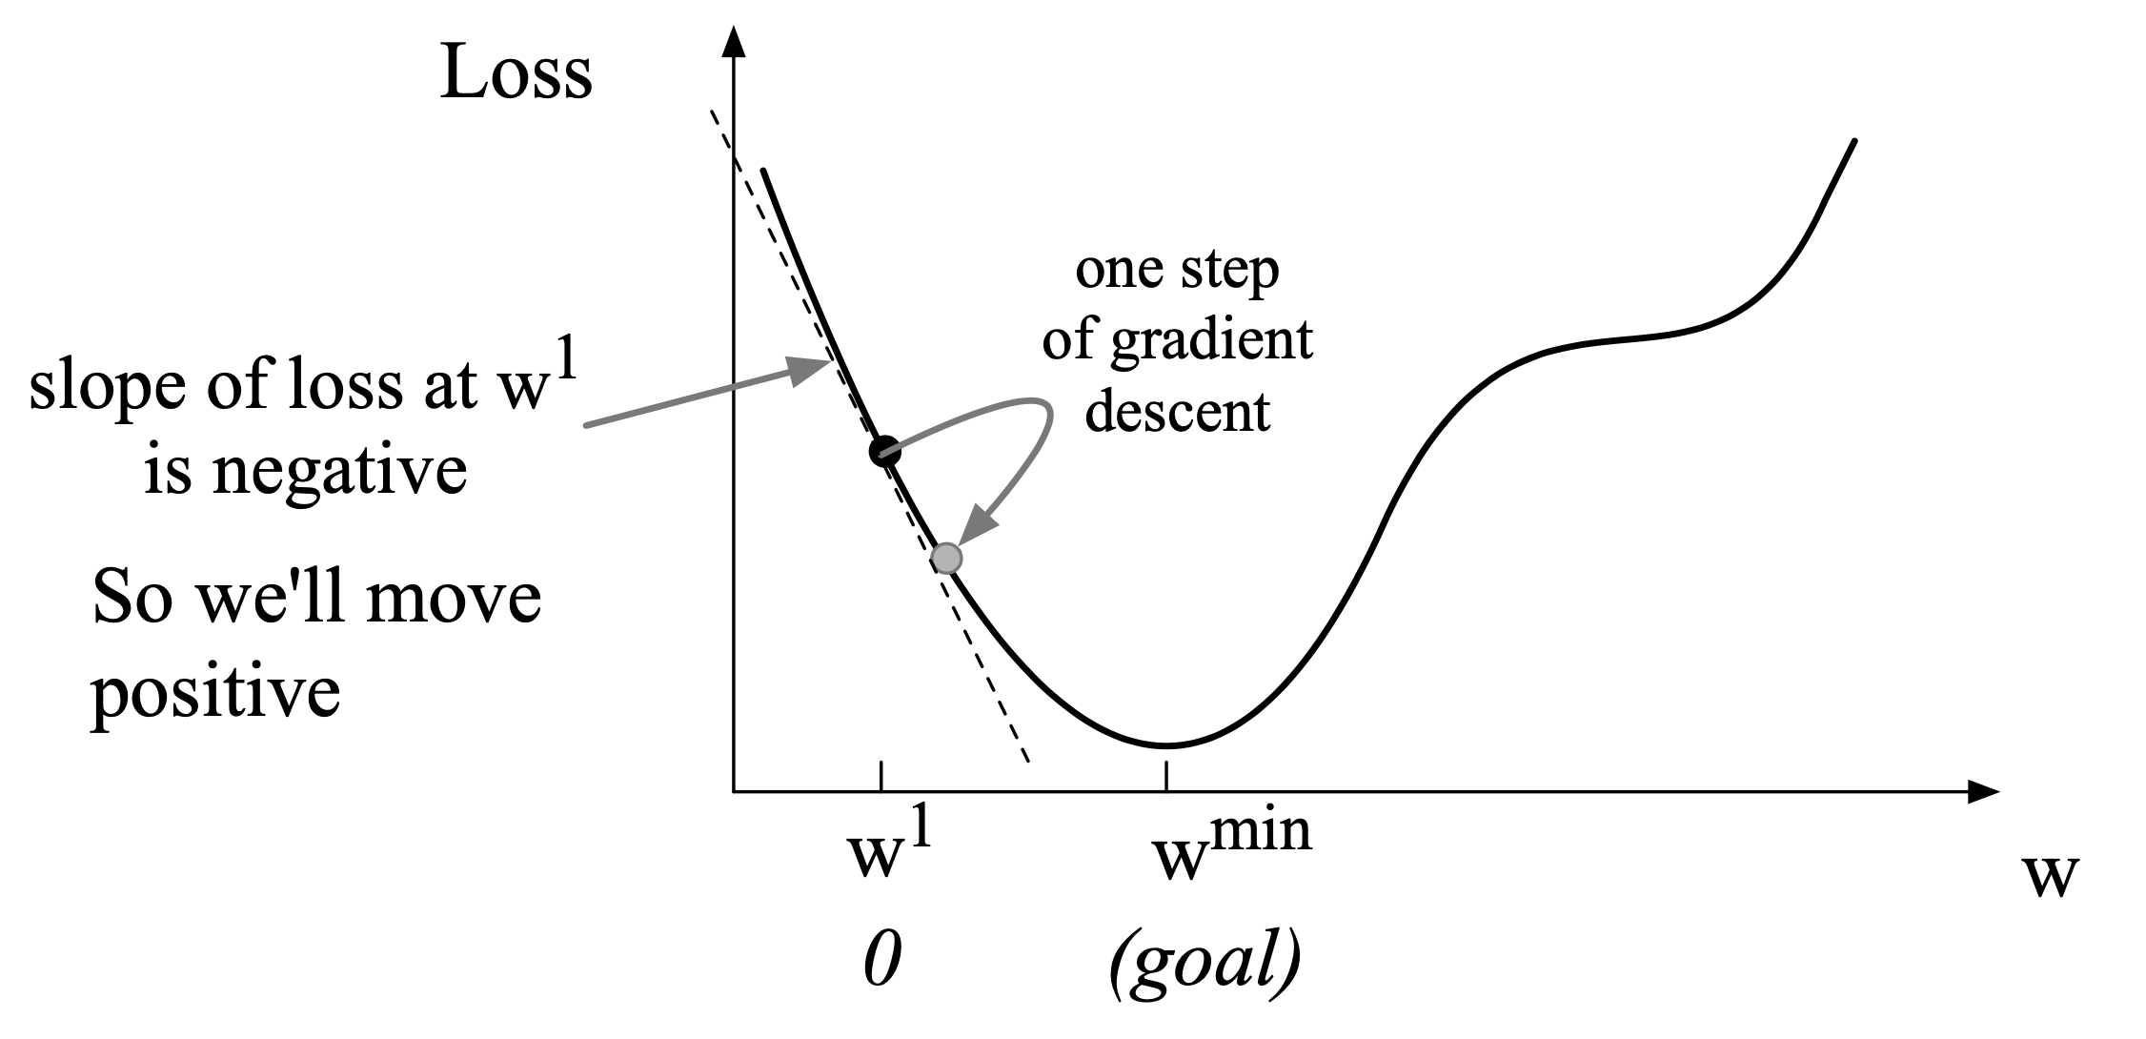
Stochastic Gradient Descent
For a single scalar w:
  Given current w, should we make it bigger or smaller?
  Move w in the direction opposite the slope of the function at x=w

Slide 27
Stochastic Gradient Descent
What’s a gradient? (this was on HW0)
The gradient of a function of many variables is a vector pointing in the direction of the greatest increase in a function
  Basically slope in high dimensions
Right here, the greatest increase goes

Slide 28
Stochastic Gradient Descent
Gradient Descent: Find the gradient of the loss function at the current point and move in the opposite direction
Since the gradient describes direction of greatest increase, gradient descent will always move against that

Slide 29
Stochastic Gradient Descent
How much do we move?
The value of the gradient (slope in the 2D example) = $\frac{d}{dw}f(x;w)η$
$η$ is the learning rate: how big do I want my steps to be?
  Higher $η$ moves w faster
$$w^{t+1}=w^{t}-η\frac{d}{dw}f(x;w)$$

Slide 30
Stochastic Gradient Descent
Pretty easy to visualize in 2 dimensions, but our loss function may be n-dimensional
We want to know where in the N-dimensional space (of the N parameters that make up $Θ$ [= (w,b)]) we should move
The gradient is just such a vector; it expresses the directional components of the sharpest slope along each of the N dimensions

Slide 31
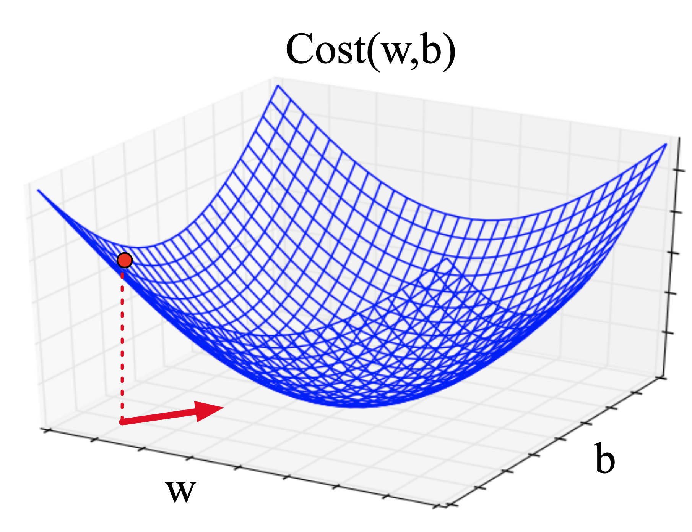
Stochastic Gradient Descent
Imagine w and b as 2 weight vectors
Visualize the gradient vector at the red
point
It has 2 dimensions shown in the X-Y
plane
Real gradients are much longer
  Lots and lots of weights

Slide 32
Stochastic Gradient Descent
For each dimension w_{i} the gradient component i tells us the slope with respect to that variable
  “How much would a small change in w_{i} influence the total loss function L?”
  We express the slope as a partial derivative $∂$ of the loss $∂w_{i}$
  Gradient is then defined as a vector of these partials
Partial derivative ($∂$) of a function with several variables (as loss is)
  takes the derivative with respect to that variable while holding others constant

Slide 33
Stochastic Gradient Descent
We’ll represent ŷ as $f(x;Θ)$ to make dependence on $Θ$ more obvious:
  $$∇_{Θ}L(f(x;Θ),y)=[\frac{∂}{∂w_{1}}L(f(x;Θ),y),\frac{∂}{∂w_{2}}L(f(x;Θ),y),...,\frac{∂}{∂w_{n}}L(f(x;Θ),y)]$$
Final equation for updating $Θ$ based on the gradient is:
  $$Θ_{t+1}=Θ_{t}-η∇L(f(x;Θ),y)$$

Slide 34
Stochastic Gradient Descent
The loss function:
  $$L_{CE}(\overset{̂}{y},y)=-[y\text{log}σ(WX+b)+(1-y)\text{log}(1-σ(WX+b))]$$
Derivative of this function:
  $$\frac{∂L_{CE}(\overset{̂}{y},y)}{∂w_{j}}=[σ(WX+b)-y]x_{j}$$
  See Jurafsky and Martin 5.8 for derivation

Slide 35
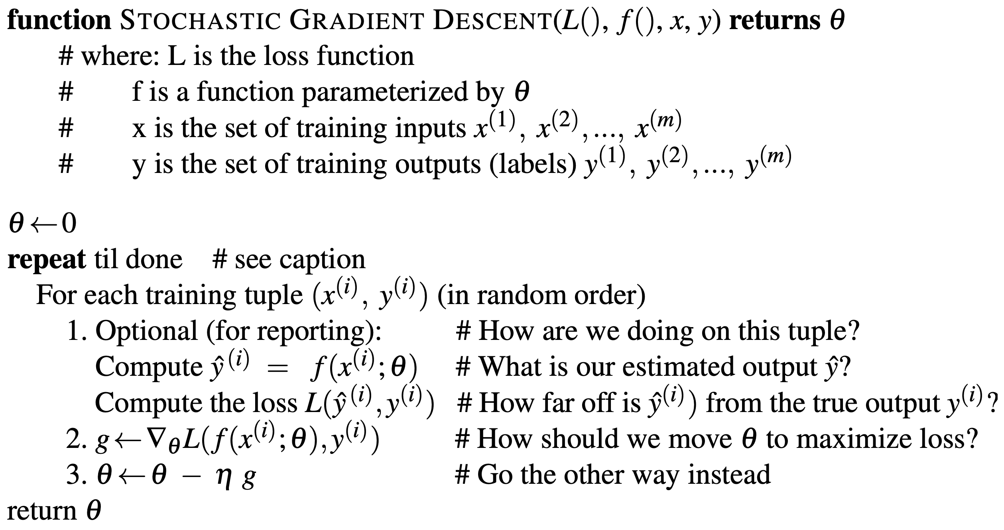
Stochastic Gradient Descent

Slide 36
Stochastic Gradient Descent
$f(X;Θ)$ is a function parametrized by X and $Θ$
  This is why we call weights “parameters”
  A 17-trillion parameter model would be a model with 17 trillion weights
But then, what’s $η$ in $Θ_{t+1}=Θ_{t}-η∇L(f(x;Θ),y)$?
Remember, SGD operations will be contained within some other learning function that actually performs the updates
$η$ (learning rate) is an argument of this function

Slide 37
Stochastic Gradient Descent
$η$ (learning rate) is a hyperparameter
  Too high: learner will take big steps and might keep jumping back and for the across the minimum
  Too low: learner will take too long
Hyperparameters are chosen by the algorithm designer to aid in finding the best parameters
$Θ$ might not get us to the exact minimum of the loss function, but we want to get as close as possible

Slide 38
SGD Example and Minibatching

Slide 39
One Step of Gradient Descent
A mini-sentiment example, where the true y=1 (positive)
Two features:
  x₁ = 3 (count of positive lexicon words)
  x₂ = 2 (count of negative lexicon words)
Assume 3 parameters (2 weights and 1 bias) in Θ⁰ are zero:
  w₁ = w₂ = b = 0
  η = 0.1

Slide 40
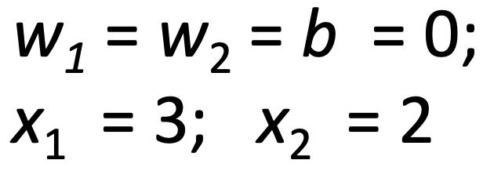
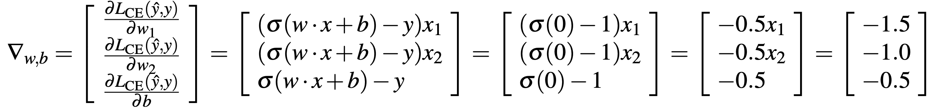
One Step of Gradient Descent
Update step is:
  $$Θ_{t+1}=Θ_{t}-η∇L(f(x;Θ),y)$$
  Where $\frac{∂L_{CE}(\overset{̂}{y},y)}{∂w_{j}}=[σ(WX+b)-y]x_{j}$
Gradient vector has 3 dimensions:

Slide 41
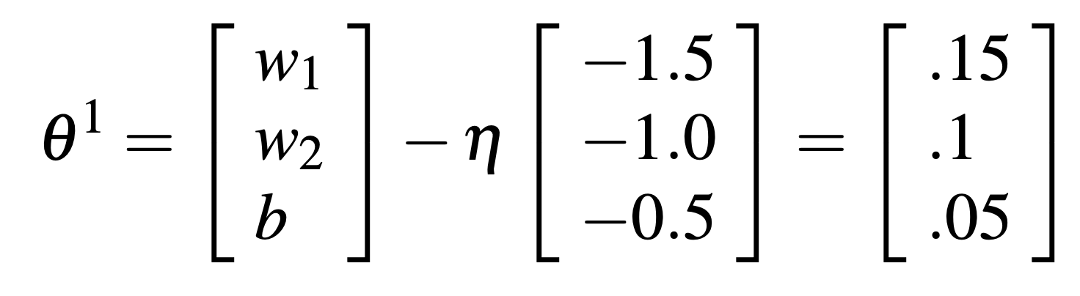

One Step of Gradient Descent
Now that we have a gradient, we compute the new parameter vector Θ¹ by moving Θ⁰ in the direction opposite the gradient
$Θ_{t+1}=Θ_{t}-η∇L(f(x;Θ),y)$; η = 0.1
Enough negative examples would eventually turn w2 negative

Slide 42
Minibatch Training
Stochastic gradient descent chooses a single random example at a time
That can result in choppy movements
More common to compute gradient over batches of training instances
Batch training: entire dataset
Mini-batch training: m examples (512, or 1024)
More details on mini-batching (read for PA1!): Jurafsky and Martin, Chapter 5, Section 4.4

Slide 43
Regularization

Slide 44
Regularization
A model that perfectly matched the training data has a problem
It will also overfit to the data, modeling noise
  A random word that perfectly predicts y (it happens to only occur in one class) will get a very high weight
  Failing to generalize to a test set without this word
A good model should be able to generalize

Slide 45
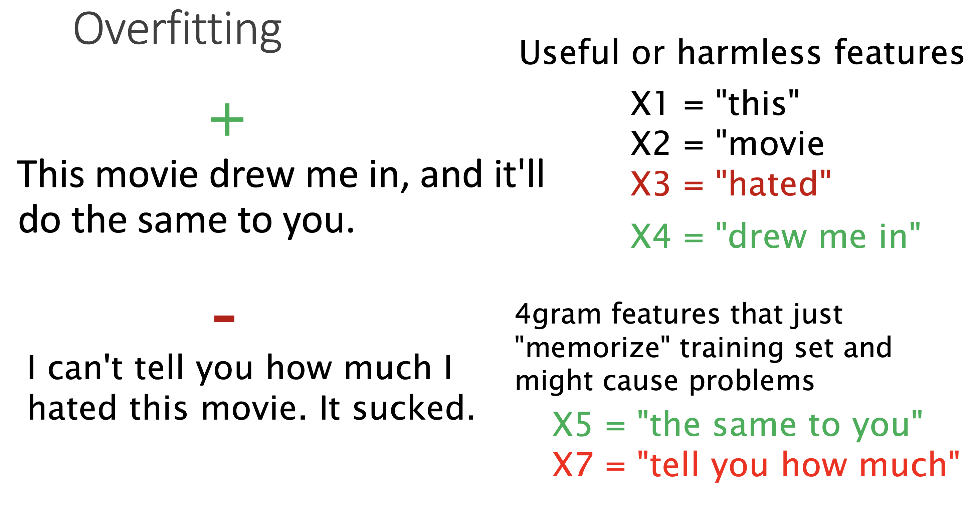
Regularization

Slide 46
Regularization
4-gram features over tiny data will just memorize the data
  100% accuracy on training set
Will be surprised by novel 4-grams in the test data
  Remember how easy it is to find novel 4-grams?
  Low accuracy on testing data

Slide 47
Regularization
Models that are too powerful can overfit the data
  Fitting the details of the training data so exactly that the model doesn't generalize well to the test set
How to avoid overfitting?
  Dropout in neural networks
  Regularization in logistic regression

Slide 48
Regularization
Add a regularization term, $R(Θ)$ to the loss function
  Function below written as maximizing logprob rather than minimizing loss:
  $$\overset{̂}{Θ}={\text{argmax}}_{Θ}\overset{m}{\underset{i=1}{∑}}\text{log}P(y^{(i)}|x^{(i)})-αR(Θ)$$
  Idea: choose an $R(Θ)$ that penalizes large weights
    A large weight signals a very strong correlation between class and feature
    Fitting the data well with lots of big weights is not as good as fitting the data less well, but with smaller weights

Slide 49
Regularization
$R(Θ)$ = sum of the squares of the weights
= $∥Θ∥_{2}^{2}=\overset{n}{\underset{i=1}{∑}}θ_{i}^{2}$
So called because this the square of the L2 Norm $∥Θ∥_{2}$, the Euclidean distance of $Θ$ to the origin
L2 regularized objective function:
  $$\overset{̂}{Θ}={\text{argmax}}_{Θ}[\overset{m}{\underset{i=1}{∑}}\text{log}P(y^{(i)}|x^{(i)})]-α\overset{n}{\underset{j=1}{∑}}θ_{j}^{2}$$

Slide 50
Regularization
$R(Θ)$ = sum of the absolute value of the weights
= $∥Θ∥_{1}=\overset{n}{\underset{i=1}{∑}}θ_{i}$
Named after the L1 Norm $∥Θ∥_{1}$, the Manhattan distance of $Θ$ to the origin
L1 regularized objective function:
  $$\overset{̂}{Θ}={\text{argmax}}_{Θ}[\overset{m}{\underset{i=1}{∑}}\text{log}P(y^{(i)}|x^{(i)})]-α\overset{n}{\underset{j=1}{∑}}θ_{j}^{}$$

Slide 51
Questions?

