Slide 1
From Naive Bayes to Logistic Regression
CS 542 - Natural Language Processing
Partially based on slides by Dan Jurafsky (Stanford) and Jim Martin (University of Colorado)
Prof. Nikhil Krishnaswamy, Colorado State University

Slide 2

Why Is My Daughter Son Crying?
He’s hungry
His diaper is dirty
He’s tired
He’s gassy
He doesn’t like his car seat
¯\_(ツ)_/¯

Slide 3
Why Is My Son Crying?
He’s hungry (Oo-ah *cough* oo-ah!)
His diaper is dirty (Waaaah! Waaaah!)
He’s tired (Ah-ooh! Ah-ooh!)
He’s gassy (Errh! Errh!)
He doesn’t like his car seat (Aaaaaa!)
¯\_(ツ)_/¯ (incoherent screaming)

Slide 4
Why Is My Son Crying?
Build a model of different cries
P(emotion|cry) ∝ P(cry|emotion)P(emotion)
P(hungry) = 0.5, P(diaper) = 0.2, P(gas) = 0.1, etc.
Run all models, see which fits best
Highest probability wins

Slide 5
Why Is My Son Crying?
Oo-ah! *cough* Aa-ooh!
Just try to distinguish one cry from another
He coughs when he’s hungry!
Let’s ignore everything else

Slide 6
Discriminative Classifiers
Naive Bayes:
$$\overset{̂}{c}={\text{argmax}}_{c∈C}P(d|c)P(c)$$
Logistic Regression:
$$\overset{̂}{c}={\text{argmax}}_{c∈C}P(c|d)$$
Don’t really care about the prior probability (base rate) of the class)
Advantages/disadvantages of this approach?
Likelihood
Prior
Posterior

Slide 7
Discriminative Classifiers
In Naive Bayes, if P(ck) >> P(all other c) this can bias the probabilities toward ck
(see positive/negative examples from NB lecture)
Logistic regression doesn’t have this problem
But what if my sample is unbalanced?

Slide 8
Discriminative Classifiers
If I have a lot more “hungry” cries than other cries in my data
If I just assume he’s hungry I have a good chance of being right
(I did this)
When doing SGD, may get stuck in local optimum
Effectively learning prior probability

Slide 9
Discriminative Classifiers
$$\overset{̂}{c}={\text{argmax}}_{c∈C}P(d|c)P(c)←\text{generative way}$$
$$\overset{̂}{c}={\text{argmax}}_{c∈C}P(c|d)←\text{discriminative way}$$
$$P(c|d)∝P(d|c)P(c)$$
I’m still estimating the same thing, I’m just going about it in a slightly different way

Slide 10
Discriminative Classifiers
What do I mean by that?
Logistic regression makes predictions, sees how wrong it was, updates its prediction
Goal is to get better at discriminating classes (cf. linear regression - goal is to get better at fitting a line)
Naive Bayes (generative) doesn’t do this
Underlying distribution is taken to be a strong prior

Slide 11
Discriminative Classifiers
MaxEnt: usual LR classifier in NLP
Principle of Maximum Entropy: most representative probability distribution is the one with the most entropy
H(X|Y): How little does knowing Y tell me about X?
The more this is, the more representative my distribution of classes is of reality
MaxEnt = multinomial logistic regression
MaxEnt and LR usually considered interchangeable in NLP (rarely just have two classes)

Slide 12
Discriminative Classifiers
Given m input/output pairs (x^{(i),}y^{(i)}):
A feature representation of the input. For each input observation x(i), a vector of features [x₁, x₂, ... , x_{n}]. Feature i for input x^{(j)} is x_{i}, more completely x_{i}^{(j)}, or sometimes f_{i}(x).
A classification function that computes ŷ, the estimated class, via p(y|x), like the sigmoid or softmax functions.
An objective function for learning, like cross-entropy loss.
An algorithm for optimizing the objective function like stochastic gradient descent (SGD).

Slide 13
Discriminative Classifiers
Training: we learn weights w and b using stochastic gradient descent and cross-entropy loss
Test: Given a test example x we compute p(y|x) using learned weights w and b, and return whichever label y is highest probability

Slide 14
Classification in Logistic Regression

Slide 15
Text Classification
Input:
a document x
a fixed set of classes C = {c₁, c₂,..., c_{J}}
Output:
a predicted class y ∈ C

Slide 16
Binary Classification in Logistic Regression
Given a series of input/output pairs:
(x^{(i)}, y^{(i)})
For each observation x^{(i)}
We represent x^{(i)} by a feature vector [x₁, x₂,..., x_{n}]
We compute an output: a predicted class y ∈ {0,1}

Slide 17
Features in Logistic Regression
For feature x_{i}, weight w_{i} tells how important x_{i} is
x_{i} ="review contains ‘awesome’”: w_{i} = +10
x_{j} ="review contains ‘abysmal’": w_{j} = -10
x_{k} =“review contains ‘mediocre’”: w_{k} = -2

Slide 18
Logistic Regression for One Observation x
Input observation: vector X = [x₁, x₂,..., x_{n}]
Weights: one per feature: W = [w₁, w₂,..., w_{n}]
Sometimes we call the weights θ = [θ₁, θ₂,..., θ_{n}]
Output: a predicted class y ∈ {0,1}
(multinomial logistic regression, i.e., MaxEnt: y ∈ {0, 1, 2, 3, 4})

Slide 19
How To Classify
For feature x_{i}, weight w_{i} tells how important x_{i} is
(we also have bias b)
What is bias?
Sum up all the weighted features and the bias
$$z=(\overset{n}{\underset{i=1}{∑}}w_{i}x_{i})+b$$
$$z=WX+b$$
If this sum is high, y = 1; if sum is low, y = 0

Slide 20
How To Classify
We need to formalize “sum is high”
Our classifier should give us a probability, like Naive Bayes did
Model should tell us:
p(y=1|x;θ)
p(y=0|x;θ)

Slide 21
How To Classify
But z isn’t a probability, it’s just a number!
$$z=WX+b$$
Solution: use a function of z that goes from 0 to 1:
$$y=σ(z)=\frac{1}{1+e^{-z}}$$

Slide 22
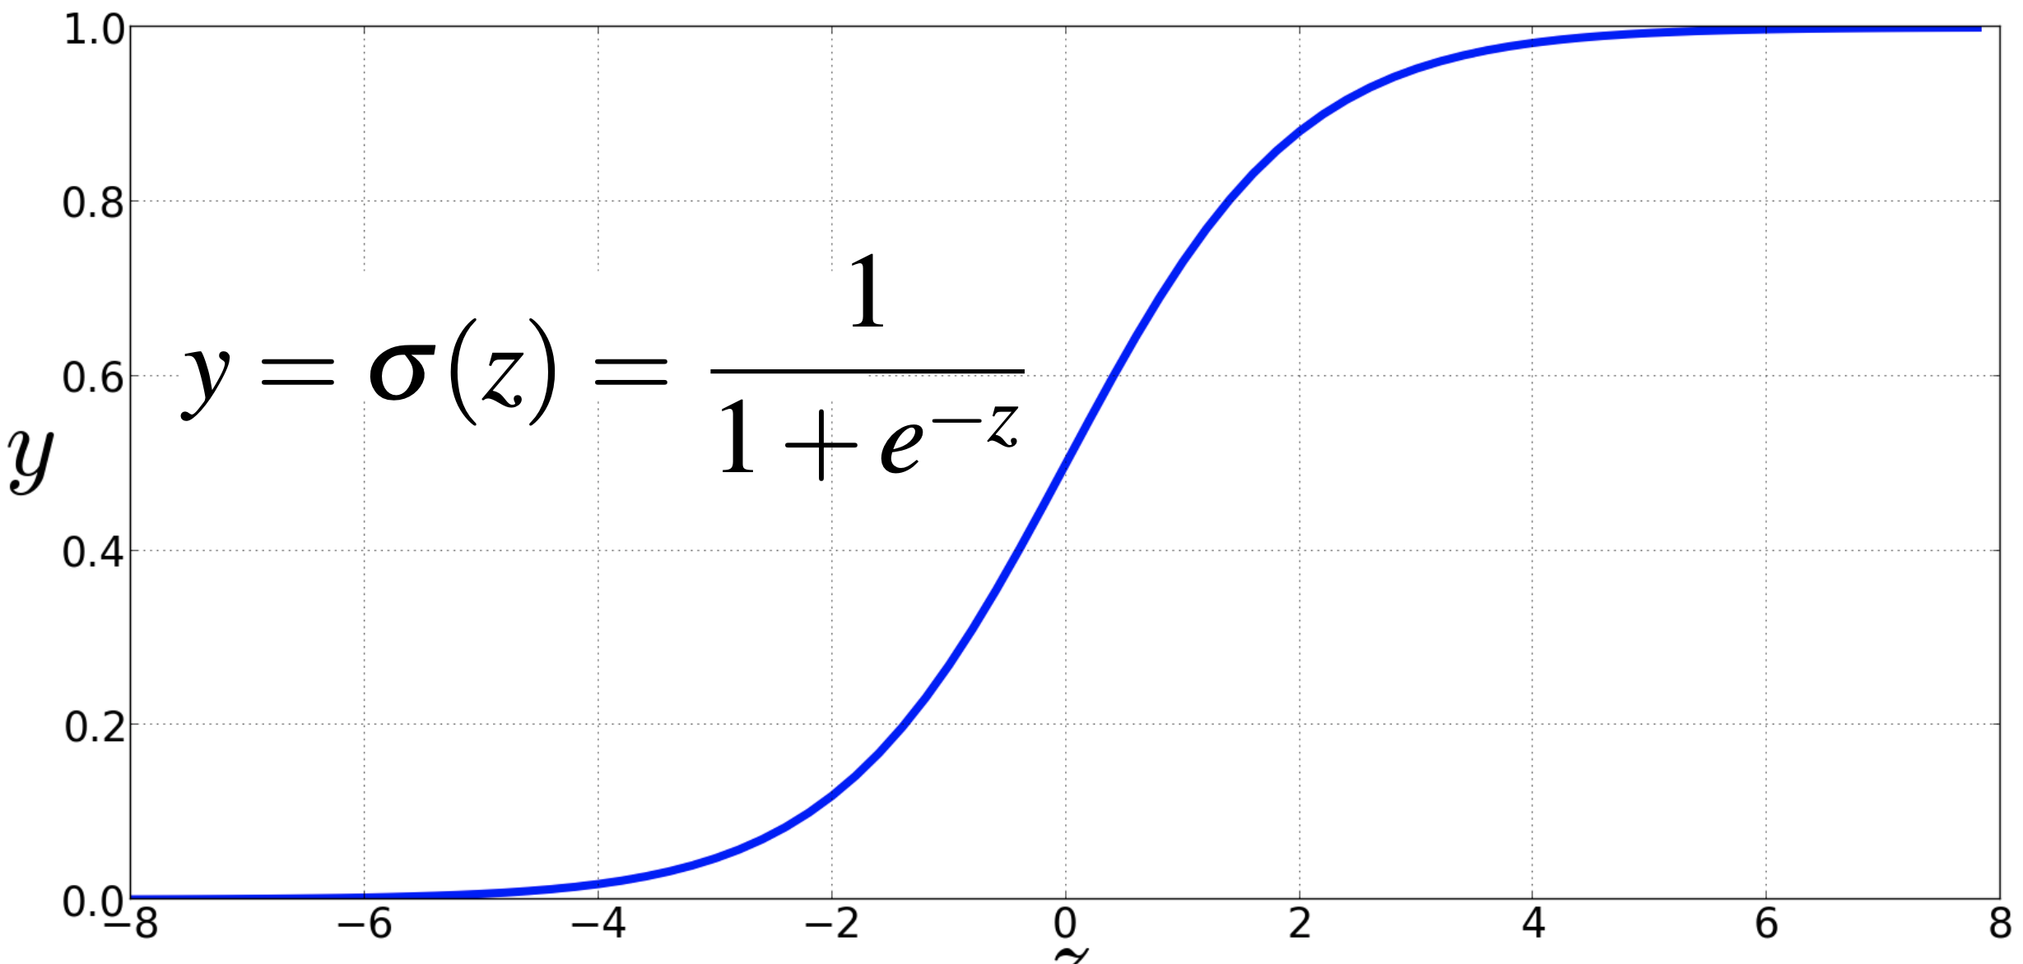
How To Classify

Slide 23
How To Classify
Compute $WX+b$
Then pass it through the sigmoid function: $σ(WX+b)$
And treat it as a probability
Higher probability wins
Remember, this is binomial

Slide 24
How To Classify
$$P(y=1)=σ(WX+b)$$
$=\frac{1}{1+e^{-(WX+b)}}$
$$P(y=0)=1-σ(WX+b)$$
$=1-\frac{1}{1+e^{-(WX+b)}}$
$=1-\frac{e^{-(WX+b)}}{1+e^{-(WX+b)}}$

Slide 25
How To Classify
$$P(y=0)=1-σ(WX+b)=σ(-(WX+b))$$
$=1-\frac{1}{1+e^{-(WX+b)}}$
$=\frac{e^{-(WX+b)}}{1+e^{-(WX+b)}}$
Because $1-σ(x)=σ(-x)$

Slide 26
How To Classify
ŷ = 1 if P(y=1|x) > 0.5 if WX+b > 0
= 0 otherwise if WX+b ≤ 0
ŷ = 1 if P(y=1|x) > 0.5
= 0 otherwise
0.5 is called the decision boundary
P(y=1)
WX+b

Slide 27
A Text Example

Slide 28
A Text Example
It's hokey . There are virtually no surprises , and the writing is second-rate . So why was it so enjoyable ? For one thing , the cast is great . Another nice touch is the music . I was overcome with the urge to get of the couch and start dancing . It sucked me in , and it'll do the same to you .

Slide 29
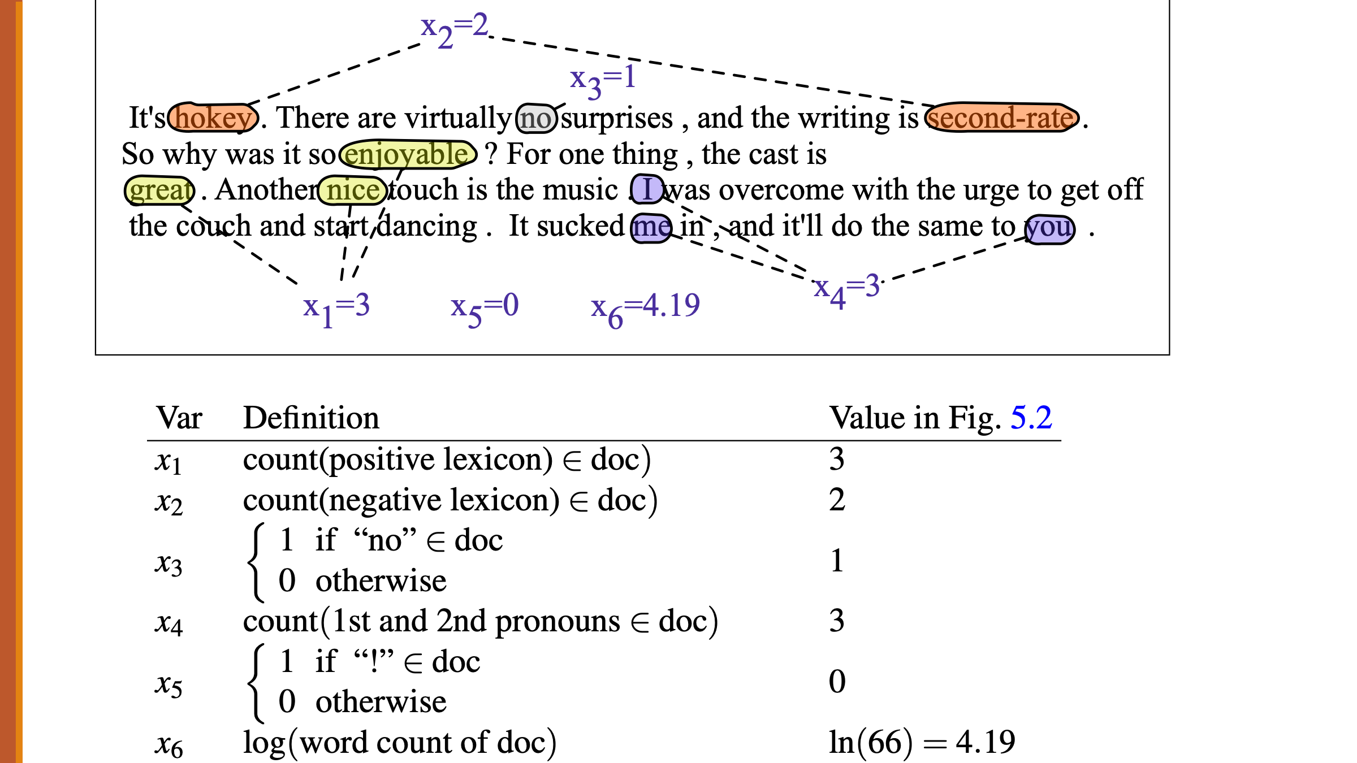
A Text Example

Slide 30
A Text Example
Var | Definition | Value
x1 | count(positive lexicon) | 3
x2 | count(negative lexicon) | 2
x3 | 1 if “no” in doc, else 0 | 1
x4 | count(1st and 2nd pronouns) | 3
x5 | 1 if “!” in doc, else 0 | 0
x6 | log(word count) | 4.19
w = [2.5, -5.0, -1.2, 0.5, 2.0, 0.7], b = 0.1

Slide 31
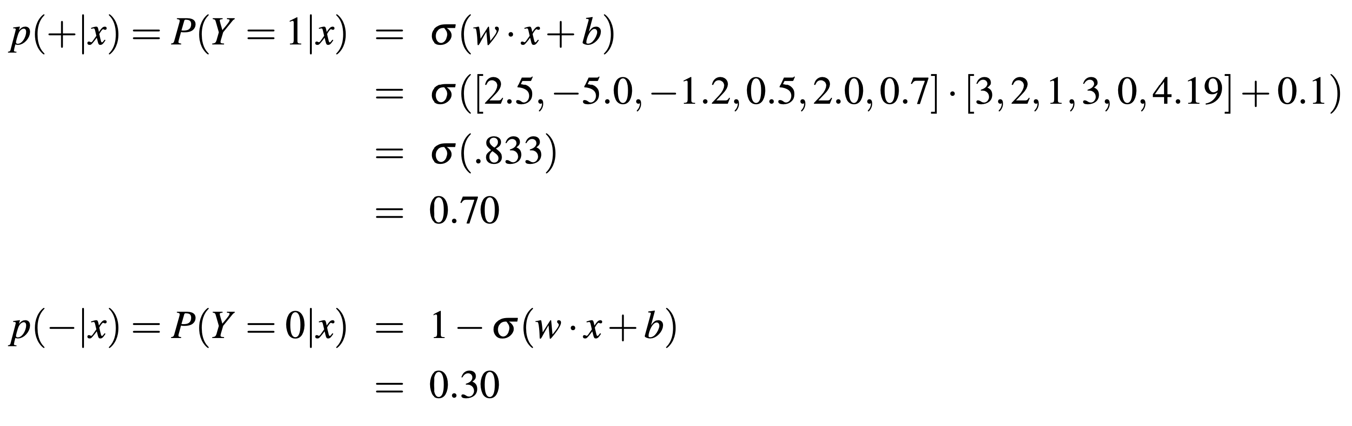
A Text Example

Slide 32
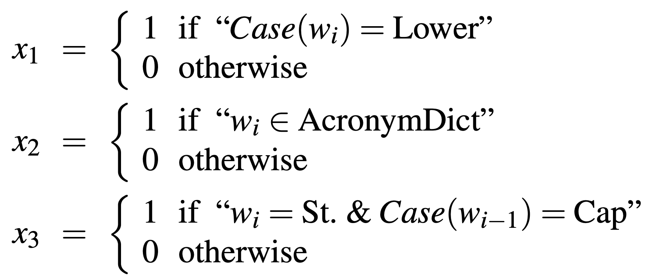
Features for any classification task
This ends in a period. The house at 465 Main St. is new.
End of sentence
Not end of sentence

Slide 33
Summary

Slide 34
Classification In (Binary) Logistic Regression
Given:
a set of classes: (+ sentiment, - sentiment)
a vector X of features: [x1, x2, …, xn]
x1 = count(“awesome”)
x2 = log(word count)
a vector W of weights: [w1, w2, …, wn]
wi for each feature xi
$$P(y=1)=σ(WX+b)$$
$=\frac{1}{1+e^{-(WX+b)}}$

Slide 35
Multinomial Logistic Regression
(MaxEnt)

Slide 36
Multinomial Logistic Regression
Often we need more than 2 classes
Positive/negative/neutral
Parts of speech (noun, verb, adjective, adverb, preposition, etc.)
Classify emergency texts into different actionable classes
If >2 classes we use multinomial logistic regression (a.k.a. MaxEnt)

Slide 37
Multinomial Logistic Regression
Principle of Maximum Entropy: most representative probability distribution is the one with the most entropy
Only true in the context of stated prior data (e.g., something that expresses something testable)
Data must be precisely stated and offer testable propositions
Therefore, we must maximize the likelihood that the data I have actually actually represents underlying state (i.e., class distribution)
Because we don’t use the prior distribution a la Naive Bayes

Slide 38
Multinomial Logistic Regression
Maximizing the likelihood of my class distribution
In a classifier, equivalent to finding the weights that maximize the data likelihood
$$L(W)=\overset{N}{\underset{n=1}{∏}}\overset{K}{\underset{k=1}{∏}}P(C=k|x_{n})^{t_{n,k}}$$

Slide 39
Multinomial Logistic Regression
$$L(W)=\overset{N}{\underset{n=1}{∏}}\overset{K}{\underset{k=1}{∏}}P(C=k|x_{n})^{t_{n,k}}$$
Where:
W = weights
N = # samples (n = sample index)
K = # classes (k = class index)
x = features (xn = features of sample n)

Slide 40
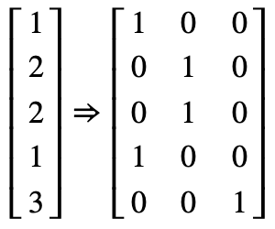
Multinomial Logistic Regression
$$L(W)=\overset{N}{\underset{n=1}{∏}}\overset{K}{\underset{k=1}{∏}}P(C=k|x_{n})^{t_{n,k}}$$
Where:
What’s t?
t = class labels represented as indicator variables

Slide 41
Multinomial Logistic Regression
$$L(W)=\overset{N}{\underset{n=1}{∏}}\overset{K}{\underset{k=1}{∏}}P(C=k|x_{n})^{t_{n,k}}$$
If there are K = 3 classes, and sample n belongs to class 2:
$$P(C=1|x_{n})^{t_{n,1}}×P(C=2|x_{n})^{t_{n,2}}×P(C=3|x_{n})^{t_{n,3}}$$
$$=P(C=1|x_{n})^{0}×P(C=2|x_{n})^{1}×P(C=3|x_{n})^{0}$$
$$=1×P(C=2|x_{n})^{1}×1$$
$$=P(C=2|x_{n})$$

Slide 42
Multinomial Logistic Regression
The probability of everything must still sum to 1
P(positive|doc) + P(negative|doc) + P(neutral|doc) = 1
How would sigmoid deal with ≥3 classes?
$σ(x)+(1-σ(x))=1$ ❌
We need a generalization of sigmoid

Slide 43
Multinomial Logistic Regression
If we represent P(C = k|X) as a value that will sum to 1 for all K…
$$P(C=k|X)=\frac{f(X;W_{k})}{∑_{m=1}^{K}f(X;W_{m})}$$
Don’t know what f looks like yet, let’s try $e^{z}$
$$σ(z)=\frac{1}{1+e^{-z}}=\frac{1}{1+\frac{1}{e^{z}}}=\frac{1}{\frac{e^{z}+1}{e^{z}}}=\frac{e^{z}}{1+e^{z}}=\frac{e^{z}}{e^{0}+e^{z}}$$

Slide 44
Multinomial Logistic Regression
$$σ(z)=\frac{1}{1+e^{-z}}=\frac{1}{1+\frac{1}{e^{z}}}=\frac{1}{\frac{e^{z}+1}{e^{z}}}=\frac{e^{z}}{1+e^{z}}=\frac{e^{z}}{e^{0}+e^{z}}$$
So if z = WX+b, $\frac{e^{WX+b}}{e^{0}+e^{WX+b}}$
In a multinomial case rewrite W to be Wk (weights of class k), $\frac{e^{W_{k}X+b}}{e^{0}+e^{W_{k}X+b}}$
Therefore if K = 2, sigmoid and $\frac{e^{x^{T}w_{k}}}{\sum_{m=1}^{K}{e^{x^{T}w_{m}}}}$ are equivalent

Slide 45
Multinomial Logistic Regression
$\frac{e^{x^{T}w_{k}}}{\sum_{m=1}^{K}{e^{x^{T}w_{m}}}}$ is the generalization of sigmoid called softmax
Takes a vector z = [z1, z2, ..., zk] of k arbitrary values (= WX+b)
Outputs a probability distribution
each value in the range [0,1]
all the values summing to 1

Slide 46
Softmax Function
Turns a vector z = [z₁, z₂, ... , z_{k}] of k arbitrary values into probabilities
$$\text{softmax}(z_{i})=\frac{e^{z_{i}}}{\sum_{j=1}^{k}{e^{z_{j}}}},1≤i≤k$$
Denominator $\sum_{i=1}^{k}{e^{z_{i}}}$ normalizes all values into probabilities
$$\text{softmax}(z)=[\frac{e^{z_{1}}}{\sum_{i=1}^{k}{e^{z_{i}}}},\frac{e^{z_{2}}}{\sum_{i=1}^{k}{e^{z_{i}}}},...,\frac{e^{z_{k}}}{\sum_{i=1}^{k}{e^{z_{i}}}}]$$

Slide 47
Softmax Function
Turns a vector z = [z₁, z₂, ... , z_{k}] of k arbitrary values into probabilities
z = [0.6, 1.1, -1.5, 1.2, 3.2, -1.1]
$$\text{softmax}(z)=[\frac{e^{z_{1}}}{\sum_{i=1}^{k}{e^{z_{i}}}},\frac{e^{z_{2}}}{\sum_{i=1}^{k}{e^{z_{i}}}},...,\frac{e^{z_{k}}}{\sum_{i=1}^{k}{e^{z_{i}}}}]$$
= [0.055, 0.09, 0.0067, 0.1, 0.74, 0.01]

Slide 48
Softmax in MaxEnt
$$P(C=k|X)=\frac{e^{W_{k}X+b_{k}}}{\sum_{m=1}^{K}{e^{W_{m}X+b_{m}}}}$$
Input is still the dot product between weight vector W and input vector X
But now we’ll need separate weight vectors for each of the K classes

Slide 49
Features in Binomial LR vs. MaxEnt
Binary: positive weight $→$ y = 1, negative weight $→$ y = 0
x5 = 1 if “!” $∈$ doc, 0 otherwise
w5 = 3.0
Multinomial: separate weights for each class
Feature | Definition | w5,+ | w5,- | w5,0
f(x5) | 1 if “i” in doc, else 0 | 3.5 | 3.1 | -5.3

Slide 50
Logistic Regression Classification
N samples with D features
N x D matrix
K classes
[N x D] * [D x K] → [N samples x K classes]
This N x K matrix will be the probabilities that each sample n falls into class k

Slide 51
Logistic Regression Classification
This N x K matrix will be the probabilities that each sample n falls into class k
In reality, a little more detailed
For instance, where’d the softmax function go?
[N x K] = samples times weights
Exponentiate this: e^{[N x K]} = [m1, …, mk]
[m1, …, mk] / ∑ [m1, …, mk] = probabilities
↑ this was softmax

Slide 52
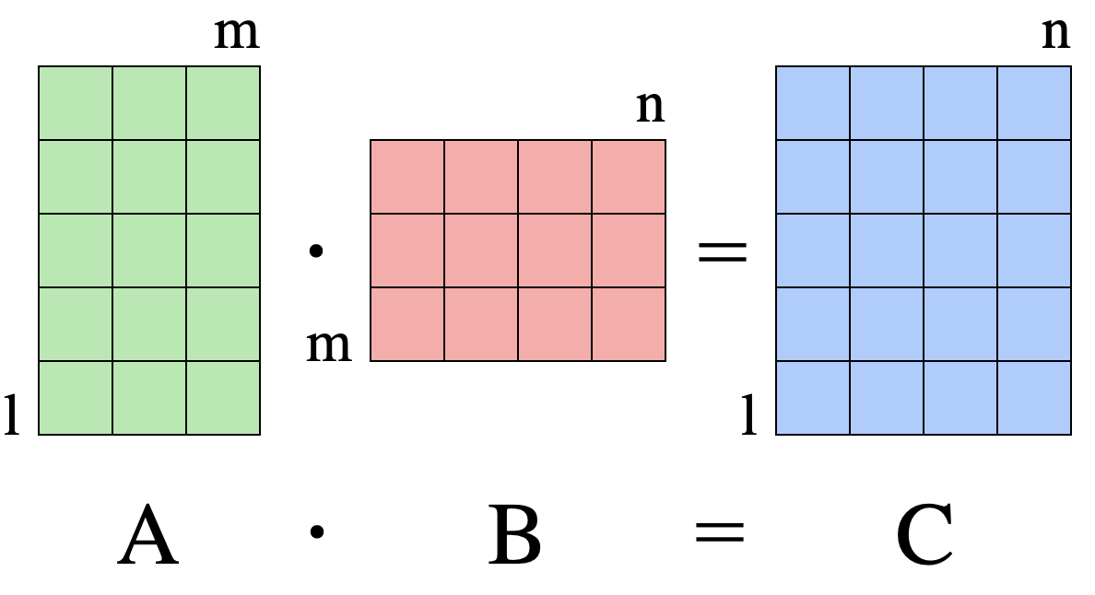
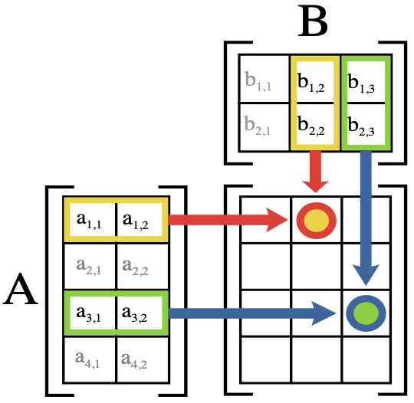
Logistic Regression Classification
$$c_{ij}=a_{i1}b_{1j}+a_{i2}b_{2j}+...+a_{in}b_{nj}=\overset{n}{\underset{k=1}{∑}}a_{ik}b_{kj},\text{for}i=1...l,j=1...n$$
11
12
13
11
12
13
14
21
22
23
11
12
13
14
21
22
23
24
31
32
33
21
22
23
24
31
32
33
34
41
42
43
31
32
33
34
41
42
43
44
51
52
53
51
52
53
54

Slide 53
Logistic Regression Classification
WEIGHTS: 23 x 2
01 [[-1.33662836 1.33662836]
02 [ 0.25351384 -0.25351384]
03 [ 0.18852403 -0.18852403]
04 [ 0.04441542 -0.04441542]
05 [ 0.47054092 -0.47054092]
06 [ 0.37194772 -0.37194772]
07 [-0.39724649 0.39724649]
08 [ 0.28623189 -0.28623189]
09 [-0.39889845 0.39889845]
10 [-0.20806667 0.20806667]
11 [-0.16107482 0.16107482]
12 [ 0.17950654 -0.17950654]
13 [-0.10749871 0.10749871]
14 [-0.77602484 0.77602484]
15 [ 0.17974903 -0.17974903]
16 [ 0.23394029 -0.23394029]
17 [-0.26650939 0.26650939]
18 [ 0.11994883 -0.11994883]
19 [ 0.11850228 -0.11850228]
20 [-0.39391128 0.39391128]
21 [-0.17640759 0.17640759]
22 [-0.4197881 0.4197881 ]
23 [-0.82719814 0.82719814]]
SAMPLE: 1 x 23
[ 1. -0.91671401 -0.81568509 -0.20886499 -0.55539321 -0.37855695
-0.5319708 -0.49536815 -0.53204818 -0.75422907 -0.71994586 -0.72789214
-0.69290061 -0.72262735 -0.72790753 -0.48593662 0.86953643 -0.88720042
0.71635469 -0.22697257 -0.35942295 -0.9958485 -0.22112429]
x
=
[-0.8189753 0.8189753]
e
[-0.8189753 0.8189753]
=
[0.4408832 2.26817445]
[0.4408832 2.26817445]
÷
0.4408832 + 2.26817445 = 2.7090576449999504
—————
[0.16274412 0.83725588]
0.16274412 + 0.83725588 = 1
✅
argmax([0.16274412, 0.83725588]) = 1

Slide 54
Questions?

