Slide 1
N-gram Modeling
CS 542 - Natural Language Processing
Partially based on slides by Dan Jurafsky (Stanford) and Jim Martin (University of Colorado)
Prof. Nikhil Krishnaswamy, Colorado State University

Slide 2
Remember this?
Remember, P(A,B) = P(A|B)P(B)
  P(“les idées vertes incolores dorment furieusement”|English sentence)P(English sentence) = P(“les idées vertes incolores dorment furieusement”,English sentence)
  I simply try to find the English sentence that co-occurs most frequently with the French sentence

Slide 3
Remember this?
Remember, P(A,B) = P(A|B)P(B)
  P(“les idées vertes incolores dorment furieusement”|English sentence)P(English sentence) = P(“les idées vertes incolores dorment furieusement”,English sentence)
  I simply try to find the English sentence that co-occurs most frequently with the French sentence
  What of one of the two sentences never occurs in my corpus?
  P(“les idées vertes incolores dorment furieusement”|English sentence)P(English sentence) = 0 or undefined!

Slide 4
So what do I do?

Slide 5
Probabilistic Language Models
Machine translation:
  P(high winds tonight) > P(large winds tonight)
Spelling correction:
  P(about fifteen minutes from) > P(about fifteen minuets from)
Speech recognition:
  P(I saw a van) >> P(eyes awe of Anne)
+ Summarization, question answering, etc.

Slide 6
Probabilistic Language Models
P(W) = P(w1,w2,w3,w4,w5,…,wn)
Probability of an upcoming word:
  P(w5|w1,w2,w3,w4)
A model that computes either P(W) or P(wn|w1,w2,…,wn-1) is called a language model
  A better term might be probabilistic grammar, but language model or LM is standard

Slide 7
Probabilistic Language Models
How do we compute this joint probability?
  P(its, water, is, so, transparent, that)
Let’s use the Chain Rule of Probability!

Slide 8
The Chain Rule
Definition of conditional probability: P(B|A) = P(B,A)/P(A)
Rewriting: P(B,A) = P(B|A) * P(A) = P(A,B) = P(A) * P(B|A)
With more variables: P(A,B,C,D) = P(A) * P(B|A) * P(C|A,B) * P(D|A,B,C)
Generalized Chain Rule:
  P(x1,x2,x3,…,xn) = P(x1) * P(x2|x1) * P(x3|x1,x2) * … * P(xn|x1,x2,…,xn-1)

Slide 9
The Chain Rule
$$P(w_{1},w_{2},...,w_{n})=\underset{i}{∏}P(w_{i}|w_{1}.w_{2},...,w_{i-1})$$
P(“its water is so transparent”) = P(its) * P(water|its) * P(is|its water) * P(so|its water is) * P(transparent|its water is so)
How do we estimate these probabilities?
P(X|Y) = C(X,Y)/C(Y) so could we just count and divide?
P(the|its water is so transparent that) = C(its water is so transparent that, the)/C(its water is so transparent that)?

Slide 10
The Chain Rule
P(the|its water is so transparent that) = C(its water is so transparent that, the)/C(its water is so transparent that)?
No!
Too many possible sentences!
We’ll never see enough data to estimate exactly this

Slide 11
Markov Assumption
Simplifying assumption:
  P(the|its water is so transparent that) ≈ P(the|that)
2nd order Markov:
  P(the|its water is so transparent that) ≈ P(the|transparent that)
In other words, we approximate each component of the product
$$P(w_{1},w_{2},...,w_{n})≈\underset{i}{∏}P(w_{i}|w_{i-k},...,w_{i-1})$$
$$P(w_{i}|w_{1},w_{2},...,w_{i-1})≈\underset{i}{∏}P(w_{i}|w_{i-k},...,w_{i-1})$$

Slide 12
N-gram models
$$P(w_{1},w_{2},...,w_{n})≈\underset{i}{∏}P(w_{i})$$
Some automatically generated sentences from a unigram model:
  fifth an of futures the an incorporated a a the inflation most dollars quarter in is mass
  thrift did eighty said hard ‘m july bullish
  that or limited the

Slide 13
N-gram models
$$P(w_{1},w_{2},...,w_{n})≈P(w_{i}|w_{i-1})$$
Some automatically generated sentences from a bigram model:
  texaco rose one in this issue is pursuing growth in a boiler house said mr. gurria mexico ’s motion control proposal without permission from five hundred fifty five yen
  outside new car parking lot of the agreement reached
  this would be a record november

Slide 14
N-gram models
We can extend to trigrams, 4-grams, 5-grams, etc.
In general this is an insufficient model of language, because language has long-term dependencies
  “The computer which I had just put into the machine room on the fifth floor crashed”
But we can often get away with N-gram models
The paper describes the section of a new one in section that I can see the results from a few

Slide 15
N-gram models
Guess: At what value of N does a given N-gram start to become unique in a corpus?

Slide 16
Estimating N-gram Probabilities

Slide 17
Estimating Bigram Probabilities
Maximum Likelihood Estimate
$$P(w_{i}|w_{i-1})=\frac{count(w_{i-1},w_{1})}{count(w_{i-1})}$$

Slide 18
Estimating Bigram Probabilities
<s> I am Sam </s>
<s> Sam I am </s>
<s> I do not like green eggs and ham </s>
$$P(w_{i}|w_{i-1})=\frac{count(w_{i-1},w_{1})}{count(w_{i-1})}$$
P(I|<s>) = 2/3 = .6667
P(Sam|<s>) = 1/3 = .3333
P(am|I) = 2/3 = .6667
P(</s>|Sam) = 1/2 = .5
P(Sam|am) = 1/2 = .5
P(do|I) = 1/3 = .33

Slide 19
Estimating Bigram Probabilities
can you tell me about any good cantonese restaurants close by
mid priced thai food is what I’m looking for
tell me about chez panisse
can you give me a listing of the kinds of food that are available
i'm looking for a good place to eat breakfast
when is caffe venezia open during the day

Slide 20
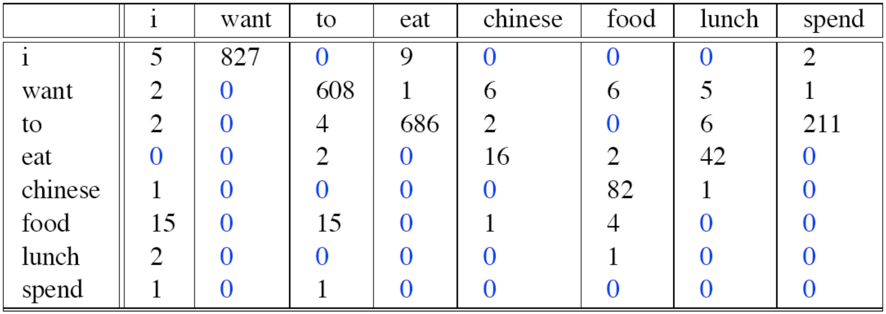
Estimating Bigram Probabilities
Raw bigram counts (out of 9222 sentences):

Slide 21
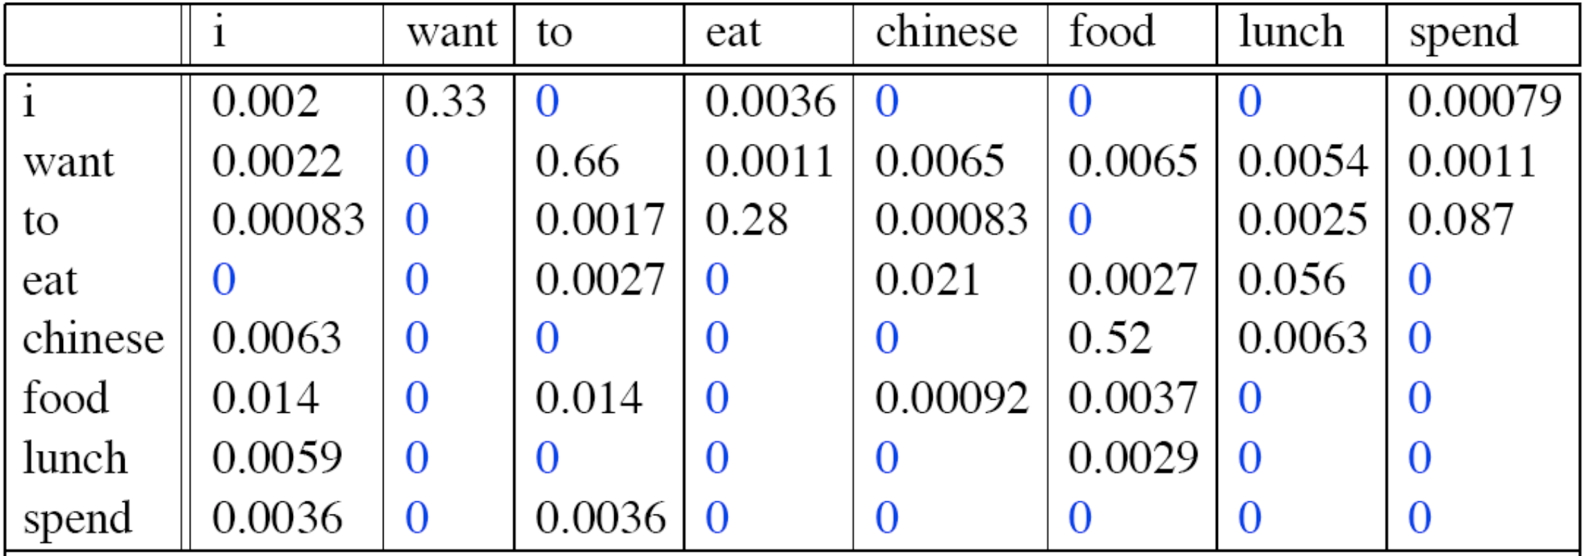
Estimating Bigram Probabilities
Raw bigram probabilities:
  Normalize by unigrams:
  Result:

Slide 22
Estimating Bigram Probabilities
Bigram estimates of sentence probabilities:
  P(<s>I want English food</s>) = P(I|<s>) * P(want|I) * P(English|want) * P(food|English) * P(</s>|food) ≈ .000031

Slide 23
Estimating Bigram Probabilities
P(english|want) ≈ .0011
P(chinese|want) ≈ .0065
P(to|want) ≈ .66
P(eat|to) ≈ .28
P(food|to) = 0
P(want|spend) = 0
P(I|<s>) ≈ .25

Slide 24
Estimating Bigram Probabilities
Do everything in log space
  Avoid underflow
  Adding is faster than multiplying
$$log(p_{1}×p_{2}×p_{3}×p_{4})=logp_{1}+logp_{2}+logp_{3}+logp_{4}$$

Slide 25
N-gram Modeling Toolkits
SRILM
  http://www.speech.sri.com/projects/srilm/
KenLM
  https://kheafield.com/code/kenlm/

Slide 26
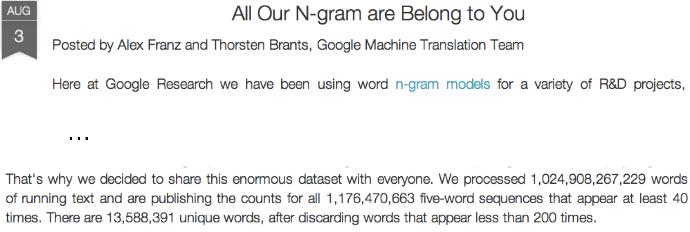
N-gram Modeling Toolkits

Slide 27
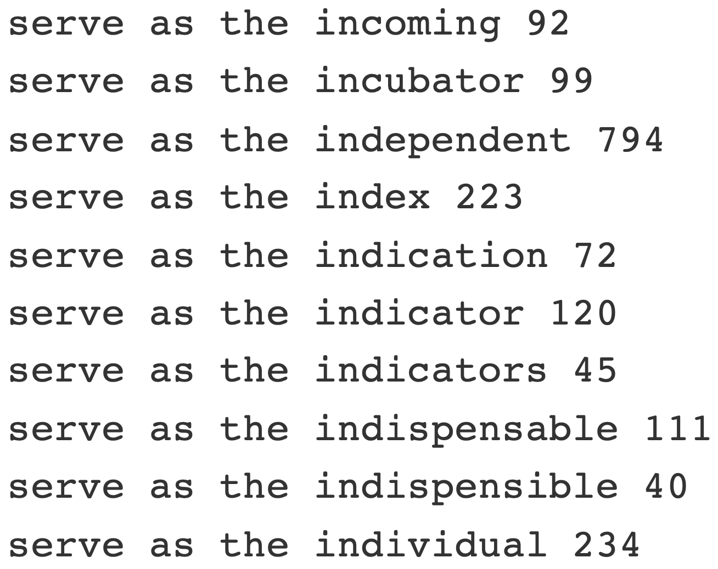
N-gram Modeling Toolkits
https://ai.googleblog.com/2006/08/all-our-n-gram-are-belong-to-you.html
https://books.google.com/ngrams

Slide 28
Evaluation and Perplexity

Slide 29
How Good Is Our Model?
Does our LM prefer good sentences to bad ones?
  Assign higher probability to “real” or “frequently observed” sentences than to “ungrammatical” or “rarely observed” sentences?
We train parameters of our model on a training set
We test the model’s performance on data we haven’t seen
  Test set: unseen dataset that is different from our training set
  Evaluation metric: tells us how well our model does on the test set

Slide 30
How Good Is Our Model?
Best evaluations for comparing models A and B
  Place each models in a task
    e.g., spelling correction, speech recognition, machine translation
  Run task, get accuracy for A and B, e.g.,
    How many misspelled words corrected?
    How many words translated correctly?
  Compare accuracy for A and B

Slide 31
How Good Is Our Model?
Time consuming
  Days or weeks
So…
  Use intrinsic evaluation: perplexity
  Bad approximation
    unless test data looks just like training data
    Generally useful only in pilot experiments
  Good to think with

Slide 32
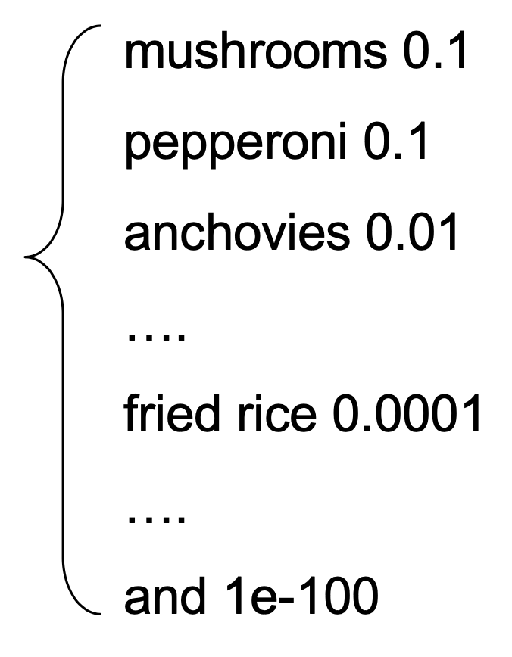
Perplexity
The Shannon Game: how well can we predict the next word?
  I always order pizza with cheese and _____
  The 33rd President of the US was _____
  I saw a _____
  Unigrams are terrible at this. Why?
A better model of text is one which assigns a higher probability to the word that actually occurs

Slide 33
Perplexity
The best language model is one that best predicts an unseen test set
Gives the highest P(sentence)
Perplexity is the inverse probability of the test set, normalized by the number of words:
$$PP(W)=P(w_{1},w_{w},...,w_{N})^{-\frac{1}{N}}$$
$=\sqrt[N]{\frac{1}{P(w_{1},w_{2},...,w_{N})}}$

Slide 34
Perplexity
$$PP(W)=P(w_{1},w_{w},...,w_{N})^{-\frac{1}{N}}$$
$=\sqrt[N]{\frac{1}{P(w_{1},w_{2},...,w_{N})}}$
Chain rule: $PP(W)=\sqrt[N]{\prod_{i=1}^{N}{\frac{1}{P(w_{i}|w_{1},...,w_{i-1})}}}$
For bigrams: $PP(W)=\sqrt[N]{\prod_{i=1}^{N}{\frac{1}{P(w_{i}|w_{i-1})}}}$
Minimizing perplexity is the same as maximizing probability

Slide 35
Perplexity
Perplexity is weighted equivalent branching factor
How hard is the task of recognizing digits 0, 1, 2, 3, 4, 5, 6, 7, 8, 9?
  Perplexity - 10
How hard is recognizing names of Microsoft employees?
  Perplexity - 181,000

Slide 36
Perplexity
Image a call-routing system that gets 120K calls must recognize:
  “Operator” (occurs in 1/4 calls)
  “Sales” (1/4 calls)
  “Technical Support (1/4 calls)
  30,000 different names (each occurs once in the 120K calls)
Get perplexity of this sequence of 120K by multiplying 120K individual probs (90K of which are 1/4 and 30K of which are 1/120K), take the inverse, and then take the 120Kth root
  PP = ((1/4)^90000 * (1/120K)^30000)^(-1/120K) this looks like a nightmare!
Can arithmetically simplify to four values: PP = (1/4 * 1/4 * 1/4 * 1/120K)^(-1/4) ≈ 52.6

Slide 37
Perplexity as Branching Factor
Assume a sequence containing random digits
What is the perplexity of this sequence according to a model that assigns P = 1/10 to each digit?
$$PP(W)=P(w_{1},w_{2},...,w_{N})^{-\frac{1}{N}}$$
$=({\frac{1}{10}}^{10})^{-\frac{1}{10}}$
        $={\frac{1}{\sqrt[10]{{10}^{10}}}}^{-1}$
$=\sqrt[10]{{10}^{10}}$
$=10$

Slide 38
Perplexity
Training 38 million words, testing 1.5 million words, WSJ
N | Unigram | Bigram | Trigram
Perplexity | 962 | 170 | 109

Slide 39
Generalization and Zeros

Slide 40
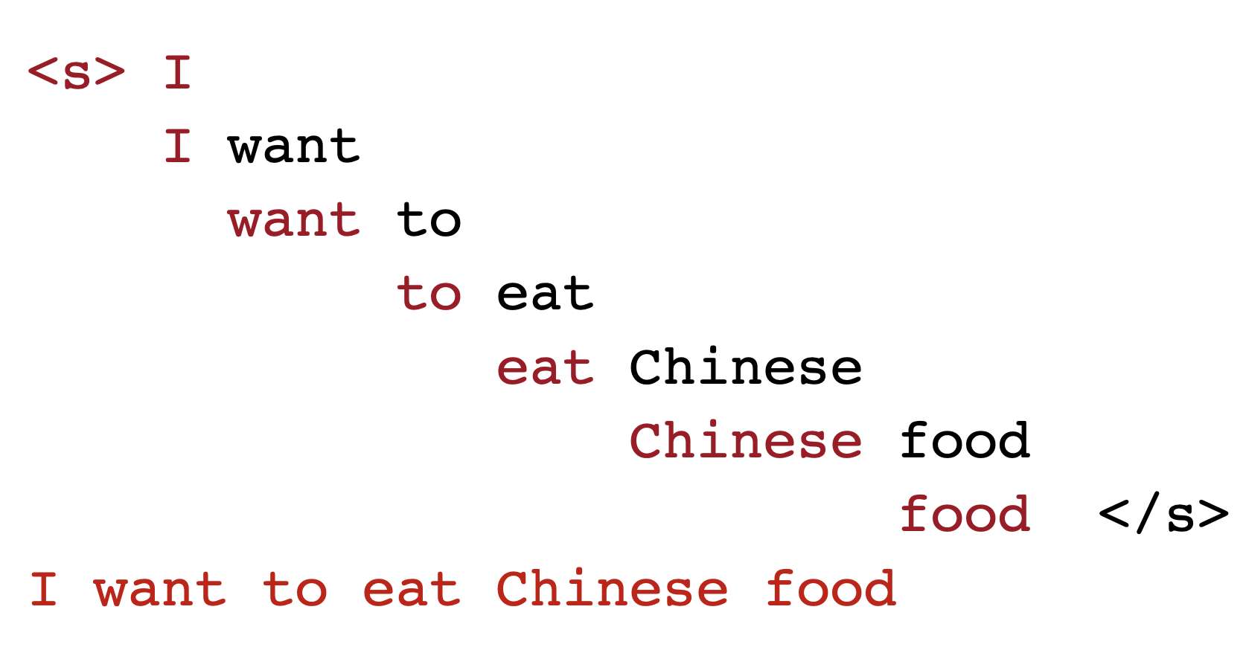
The Shannon Visualization Method
Choose a random bigram
e.g., (<s>,w) according to its probability
Now choose a random bigram (w,x)
according to its probability
So on until we choose </s>
Then string the words together

Slide 41
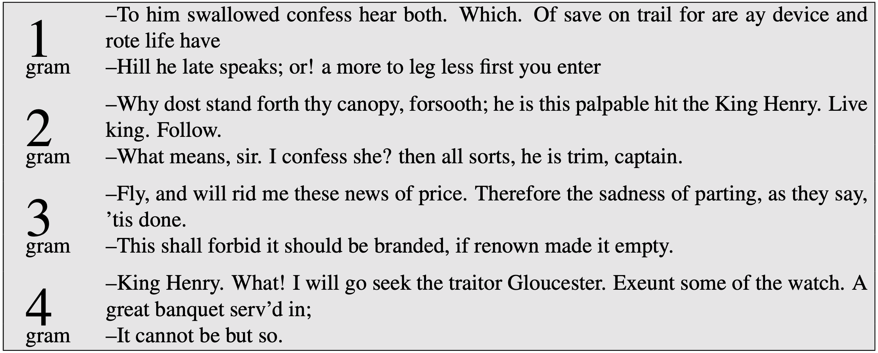
Approximating Shakespeare

Slide 42
Shakespeare As a Corpus
N = 884,647 tokens
Vocab (V) = 29,066
Shakespeare produces 300K bigram types out of V² = 8.44 x 10⁸ possible bigrams
  300,000/844 million ≈ 0.000355
  So 99.965% of all possible bigrams appear 0 times in the corpus
4-grams: no creative combinations
  What comes out looks like Shakespeare because it is!
  Exeunt some of the watch (R+J 5.3)

Slide 43
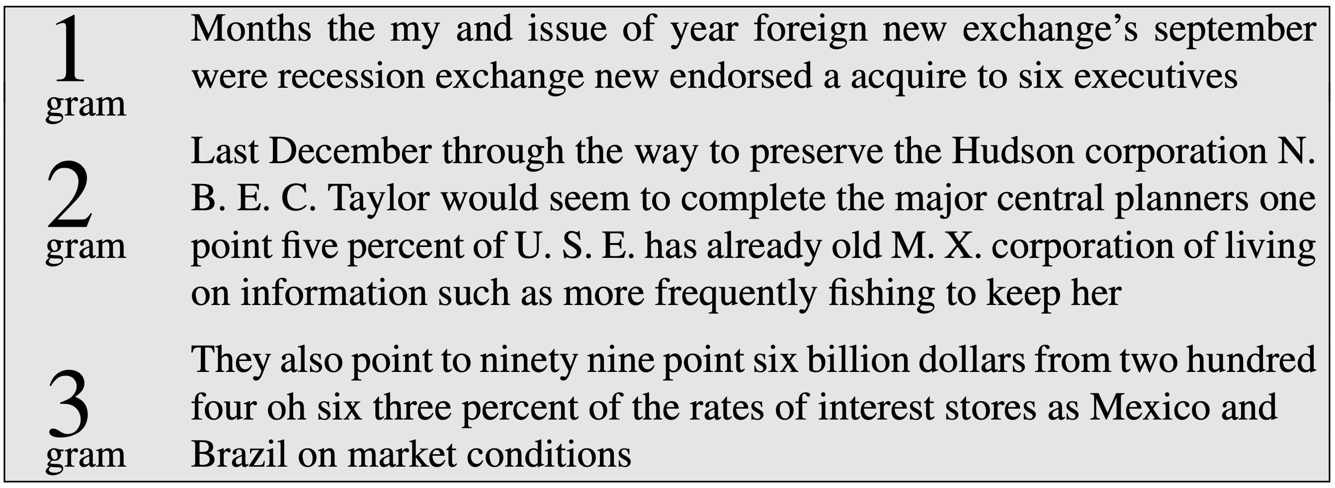
WSJ Is Not Shakespeare

Slide 44
What Data Produced These Trigrams?
They also point to ninety nine point six billion dollars from two hundred four oh six three percent of the rates of interest stores as Mexico and gram Brazil on market conditions
This shall forbid it should be branded, if renown made it empty.
“You are uniformly charming!” cried he, with a smile of associating and now and then I bowed and they perceived a chaise and four to wish for.

Slide 45
Perils of Overfitting
N-grams only work well for word prediction if the test corpus looks like the training corpus
  Real life doesn’t work that way!
  We need to train robust models that generalize!
  One kind of generalization: Zeros!
  Things that don’t ever occur in the training set but occur in the test set

Slide 46
Zeros
Training Set | Testing Set
… denied the allegations | … denied the offer
… denied the reports | … denied the loan
… denied the claims
… denied the request
P(“offer”|“denied”, “the”) = 0

Slide 47
Zero Probability Bigrams
Bigrams with 0 probability
  mean that we will assign 0 probability to the whole test set!
So cannot compute perplexity
$$PP(W)=\sqrt[N]{\prod_{i=1}^{N}{\frac{1}{P(w_{i}|w_{i-1})}}}⇒\sqrt[N]{\prod_{i=1}^{N}{\frac{1}{0}}}$$
Cannot divide by 0!

Slide 48
Smoothing

Slide 49
Laplace (Add-one) Smoothing

Slide 50
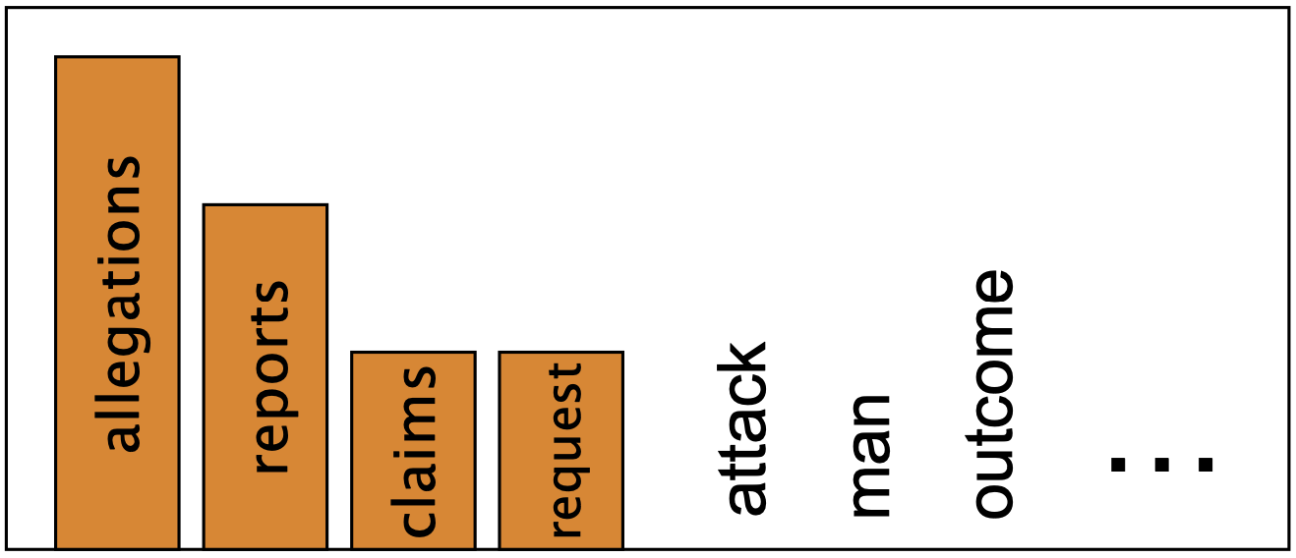
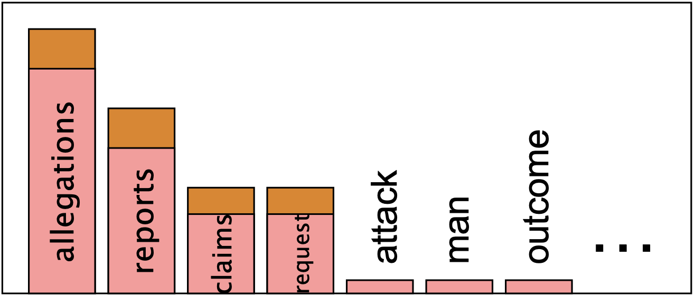
Intuition of Smoothing
When we have sparse statistics
Steal probability mass to generalize better
P(w | “denied”, “the”)
3 allegations
2 reports
1 claims
1 requests
7 TOTAL
P(w | “denied”, “the”)
2.5 allegations
1.5 reports
0.5 claims
0.5 requests
2 other
7 TOTAL

Slide 51
Add-one Smoothing
Pretend we saw each word one more time than we really did!
  Add one to all counts
  MLE Estimate
    $$P_{MLE}(w_{1}|w_{i-1})=\frac{c(w_{i-1},w_{i})}{c(w_{i-1})}$$
  Add-one Estimate
    $$P_{Add-1}(w_{1}|w_{i-1})=\frac{c(w_{i-1},w_{i})+1}{c(w_{i-1})+V}$$
Why do we add V here?

Slide 52
Add-one Smoothing
The maximum likelihood estimate
  of some parameter of a model M from a training set T
  maximizes the likelihood of the training set T given the model M
Suppose the word “bagel” occurs 400 times in a corpus of a million words
What is the probability that a random word from some other text will be “bagel”?
MLE estimate is 400/1,000,000 = .0004
This may be a bad estimate for some other corpus
  But it is the estimate that makes it most likely that “bagel” will occur 400 times in a million word corpus

Slide 53
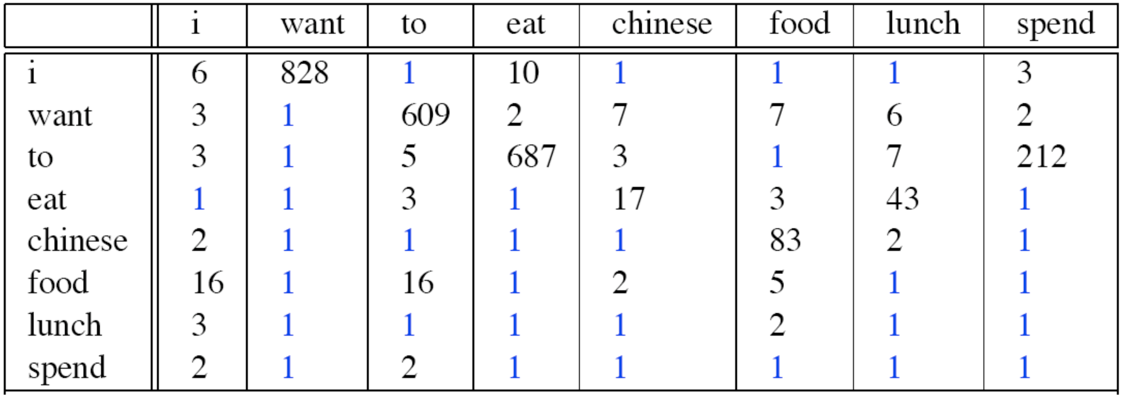
Add-one Smoothing

Slide 54
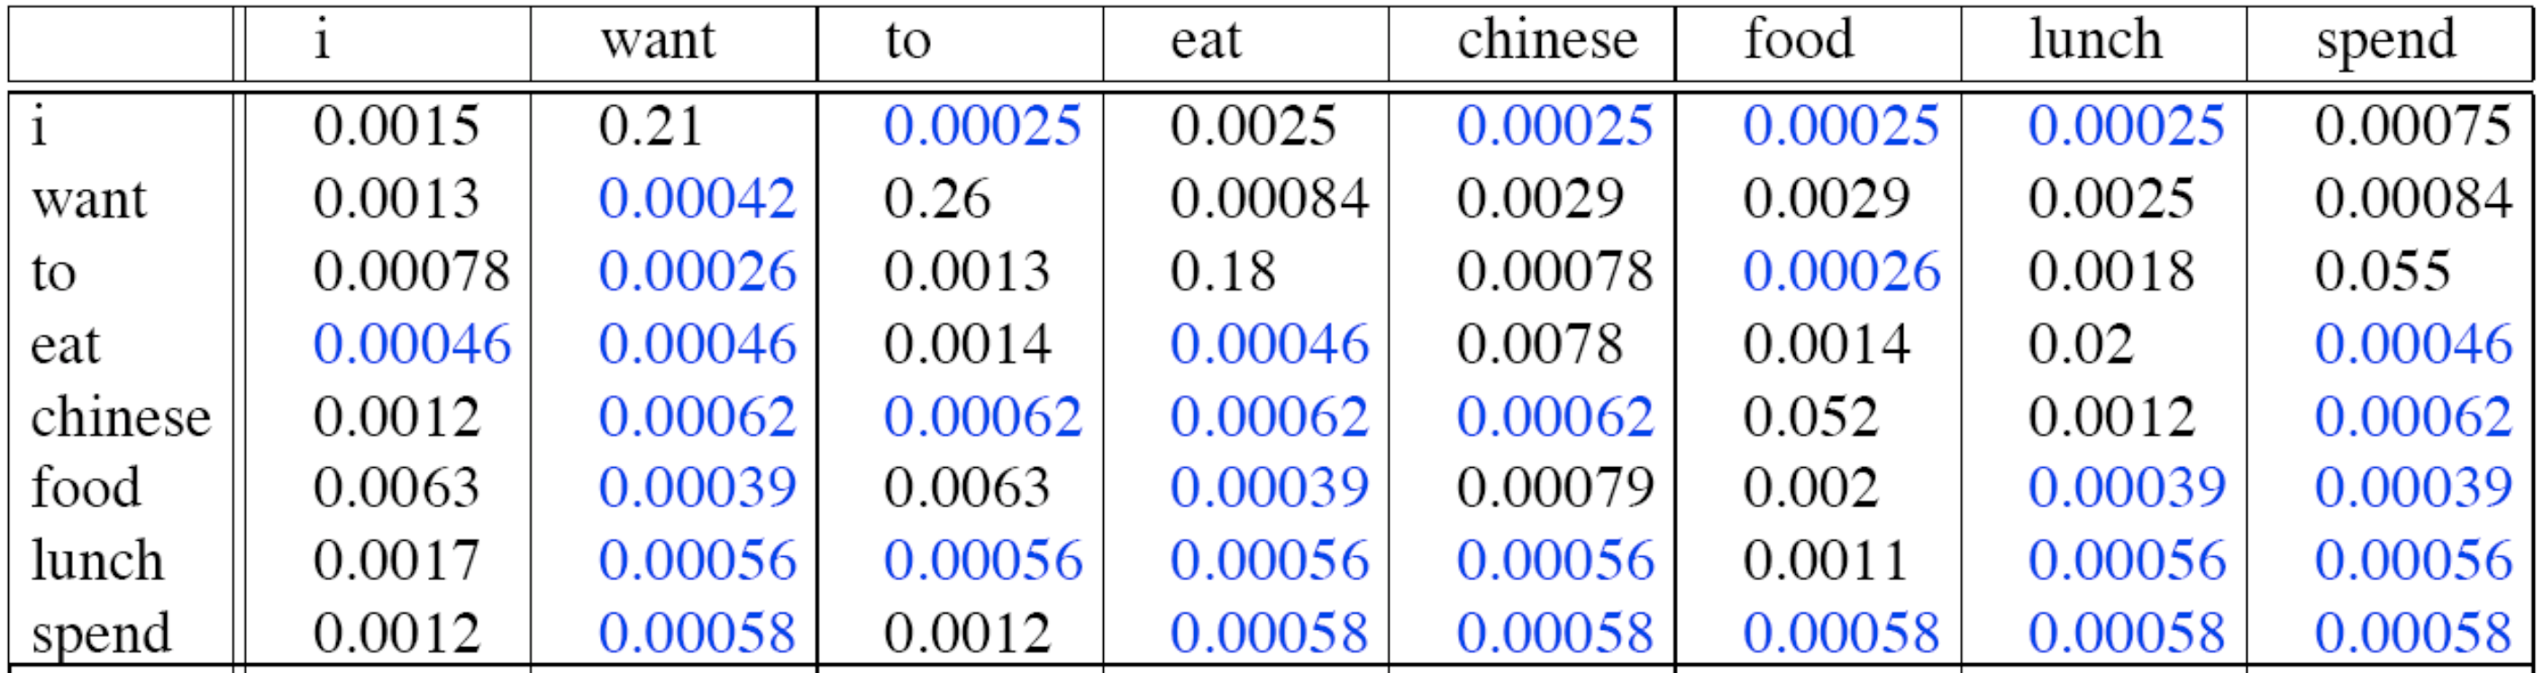
Add-one Smoothing
$$P^{*}(w_{n}|w_{n-1})=\frac{c(w_{n-1},w_{n})+1}{c(w_{n-1})+V}$$

Slide 55
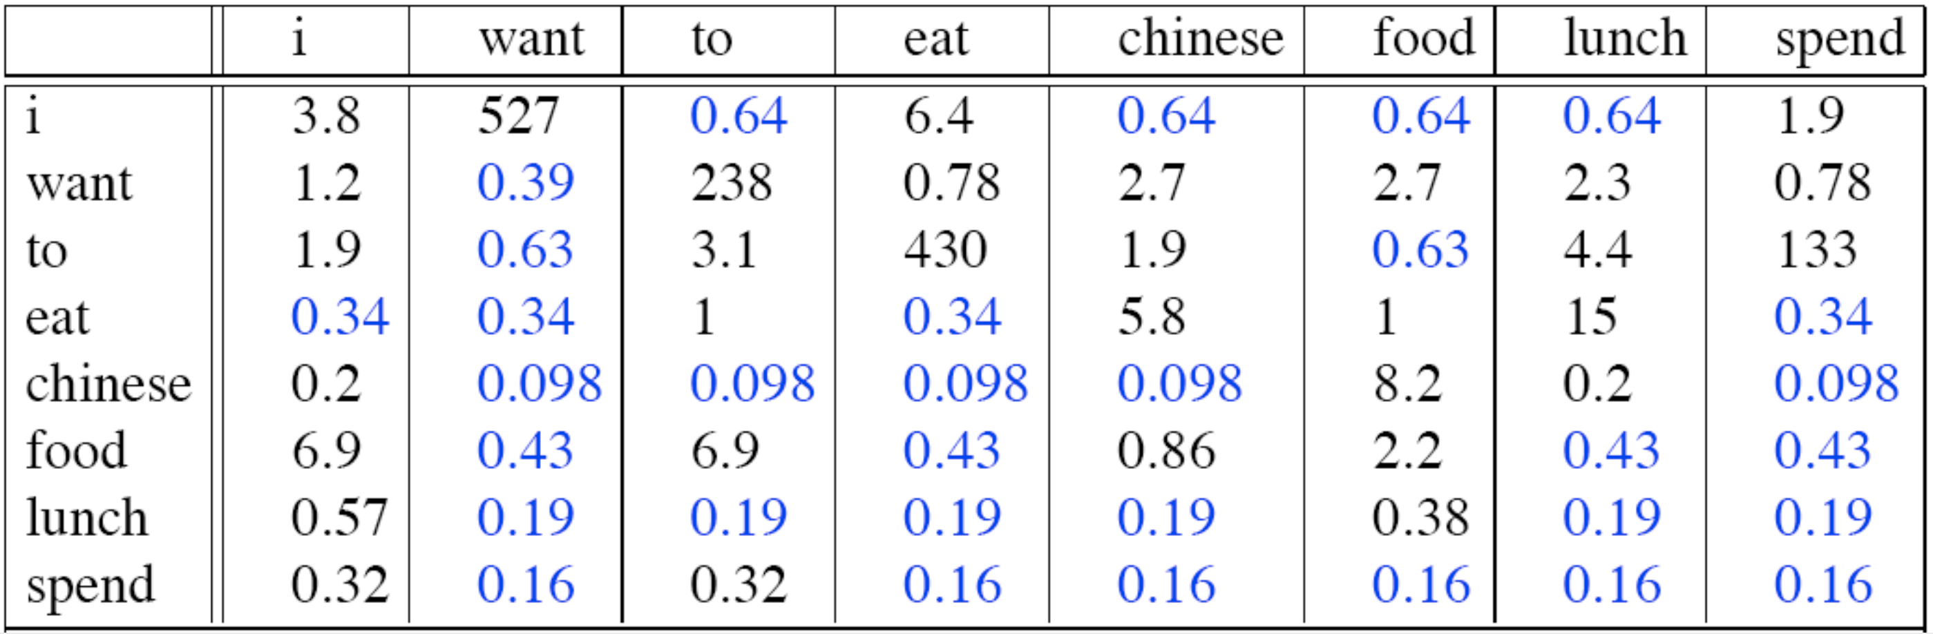
Add-one Smoothing
$$c^{*}(w_{n},w_{n-1})=\frac{[c(w_{n-1},w_{n})+1]×c(w_{n})}{c(w_{n-1})+V}$$

Slide 56
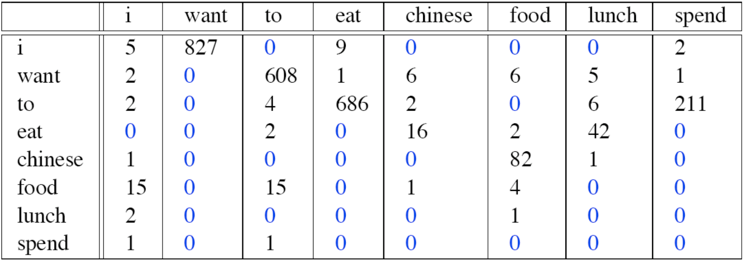
Add-one Smoothing

Slide 57
Blunt Instrument
Add-1 isn’t used for N-grams
  We will look at better models
Add-1 is used to smooth other NLP models
  Text classifications
  Domains where number of 0s isn’t so huge

Slide 58
Interpolation and Backoff

Slide 59
Interpolation and Backoff
Condition on less context for contexts you haven’t learned much about
Backoff:
  Use, e.g., trigram if you have good evidence
  Otherwise use bigram, otherwise unigram, with discount penalties
Interpolation:
  Mix unigram, bigram, trigram
Interpolation works better

Slide 60
Linear Interpolation
Simple interpolation:
  $\overset{̂}{P}(w_{n}|w_{n-2},w_{n-1})=λ_{1}P(w_{n}|w_{n-2},w_{n-1})+λ_{2}P(w_{n}|w_{n-1})+λ_{3}P(w_{n})$, $\underset{i}{∑}λ_{i}=1$
Lambdas conditional on context:
  $\overset{̂}{P}(w_{n}|w_{n-2},w_{n-1})=$
  $λ_{1}(w_{n-2}^{n-1})P(w_{n}|w_{n-2},w_{n-1})+λ_{2}(w_{n-2}^{n-1})P(w_{n}|w_{n-1})+λ_{3}(w_{n-2}^{n-1})P(w_{n})$

Slide 61

How to set the lambdas?
Choose λs to maximize probability of held-out data:
  Fix N-gram probabilities (on training data)
  Then search for λs that give highest probability of held-out set:
  $$logP(w_{1},...,w_{n}|M(λ_{1},...,λ_{k}))=\underset{i}{∑}logP_{M(λ_{1},...,λ_{k})}(w_{i}|w_{i-1})$$

Slide 62
Unknown Words
If we know all the words in advance
  Vocabulary V is fixed
  Closed vocabulary task
Often we don’t know this
  Out Of Vocabulary = OOV words
  Open vocabulary task

Slide 63
Unknown Words
Instead: create an unknown word token <UNK>
  Training of <UNK> probabilities
    Create a fixed lexicon L of size V
    At text normalization phase, any training word not in L changed to <UNK>
    Now we train its probabilities like a normal word
  At testing time
    If text input: Use <UNK> probabilities for any word not in training

Slide 64
At Scale
Pruning
  Store only N-grams with count > threshold
    Remove singletons of higher-order N -grams
  Entropy-based pruning
    Remove N-grams of entropy > threshold

Slide 65
At Scale
Efficiency
  Efficient data structures like tries
  Bloom filters: approximate language models
  Store words as indices, not strings
    Huffman coding to fit large numbers of words into two bytes
  Quantize probabilities (4-8 bits instead of 8-byte floats)

Slide 66
At Scale
“Stupid Backoff” (Brants et al., 2007)
No discounting, just use relative frequencies
$$S(w_{i}|w_{i-k+1}^{i-1})=\frac{c(w_{i-k+1}^{i})}{c(w_{i-k+1}^{i-1})}\text{if}c(w_{i-k+1}^{i})>0$$
$$S(w_{i}|w_{i-k+1}^{i-1})=.4S(w_{i}|w_{i-k+2}^{i-1})\text{otherwise}$$
$$S(w_{i})=\frac{c(w_{i})}{N}$$

Slide 67
Summary
Laplace (Add-1) smoothing:
  OK for text categorization, not for language modeling
Most commonly-used method:
  Extended Interpolated Kneser-Ney
For very large N-gram corpora:
  “Stupid Backoff” (no discounting, just use relative frequencies)

Slide 68
Advanced Language Modeling
Discriminative models:
  Choose n-gram weights to improve a task, not to fit the training set
Parsing-based models
Caching Models
  Recently used words are more likely to appear
  $$P_{CACHE}(w|history)=λP(w_{i}|w_{i-2},w_{i-1})+(1-λ)\frac{c(w∈history)}{|history|}$$
  These turned out to perform very poorly for speech recognition (why?)

Slide 69
Kneser-Ney Smoothing

Slide 70
Kneser-Ney Smoothing
Absolute discounting: just subtract a little from each count
Suppose we wanted to subtract a little from a count of 4 to save probability mass for the zeros
  How much to subtract ?

Slide 71
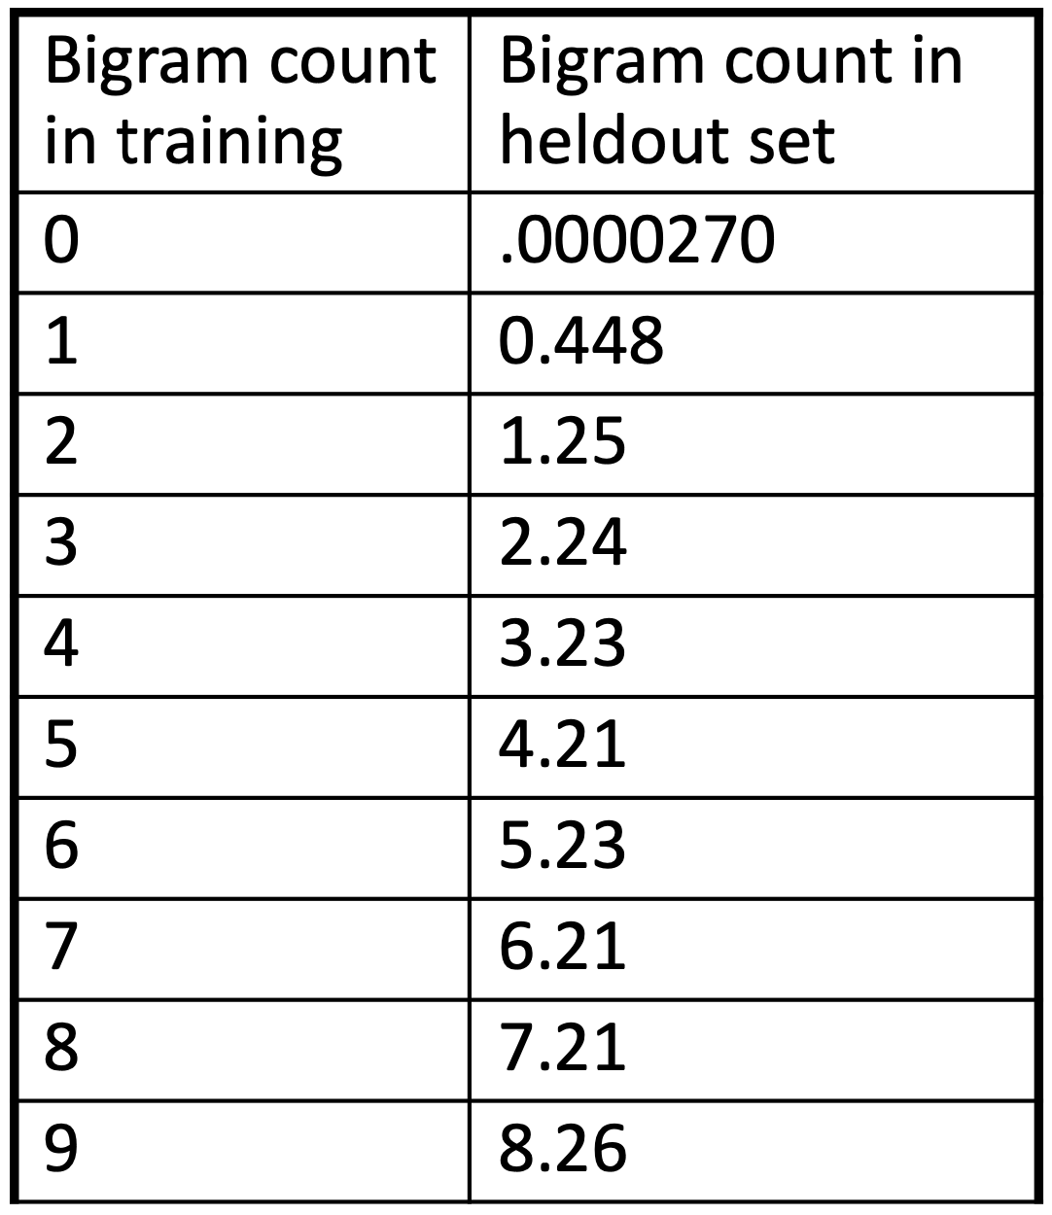
Kneser-Ney Smoothing
Divide up 22 million words of AP Newswire
  Training and held-out set
  For each bigram in the training set
  see the actual count in the held-out set!
It sure looks like c* ≈ (c - .75)!

Slide 72
Kneser-Ney Smoothing
Let’s save time and just subtract .75 (or some constant d)!
$$P_{AbsoluteDiscounting}(w_{i}|w_{i-1})=\frac{c(w_{i-1},w_{i})-d}{c(w_{i-1})}+λ(w_{i-1})P(w_{i})$$
(Optional: keep different d values for counts of 1 and 2 - see previous table)
Should we really just use the regular unigram (P(wi))?
discounted bigram
interpolation weight
unigram

Slide 73
Kneser-Ney Smoothing
glasses
Kong
I can’t read without my _________
“glasses” vs. “Kong”
c(“Kong”) > c(“glasses”)
  But “Kong” always follows “Hong” (or maybe “King”)
The unigram (“Kong”) is useful exactly when we haven’t seen the bigram!
Instead of P(w) “how likely is w?”
  PCONTINUATION(w): “how likely is w as a novel continuation?

Slide 74
Kneser-Ney Smoothing
PCONTINUATION(w): “how likely is w as a novel continuation?
  For each word, count the number of bigram types it completes
  Every bigram type was a novel continuation the first time it was seen
  $$P_{CONTINUATION}(w_{i})∝|\{w_{i-1}:c(w_{i-1},w_{i})>0\}|$$
  “The probability of wi as a novel continuation is proportional to…
    …the number of occurrences of wi-1 such that wi-1 and wi occur together more than 0 times.”

Slide 75
Kneser-Ney Smoothing
How many time does wi appear as a novel continuation?
  $$P_{CONTINUATION}(w_{i})∝|\{w_{i-1}:c(w_{i-1},w_{i})>0\}|$$
Normalize by the total number of word bigram types
  $$|\{(w_{j-1},w_{j}):c(w_{j-1},w_{j})>0\}|$$
$$P_{CONTINUATION}(w_{i})=\frac{|\{w_{i-1}:c(w_{i-1},w_{i})>0\}|}{|\{(w_{j-1},w_{j}):c(w_{j-1},w_{j})>0\}|}$$

Slide 76
Kneser-Ney Smoothing
Alternative metaphor: the number of word types seen to precede wi
  $$|\{w_{i-1}:c(w_{i-1},w_{i})>0\}|$$
Normalized by the number of words preceding all words
  $$P_{CONTINUATION}(w_{i})=\frac{|\{w_{i-1}:c(w_{i-1},w_{i})>0\}|}{∑_{w^{′}}|\{w_{i-1}^{′}:c(w_{i-1}^{′},w^{′})>0\}|}$$
A frequent word (e.g., Kong) in only one (or two) contexts (Hong, King) will have a low continuation probability

Slide 77
Kneser-Ney Smoothing
San + Francisco ✅
Francisco + Ortega ✅
San + Ortega ❌
So, PCONTINUATION(Francisco) < PCONTINUATION(Ortega) (or most other last names)
This is because “San Francisco” is such a common bigram
  The “Hong Kong” of Californian cities
Other first names don’t have this issue (especially those that don’t follow “San”)

Slide 78
Kneser-Ney Smoothing
$$P_{KN}(w_{i}|w_{i-1})=\frac{max(c(w_{i-1},w_{i})-d,0)}{c(w_{i-1})}+λ(w_{i-1})P_{CONTINUATION}(w_{i})$$
λ is normalizing constant; the probability mass we’ve discounted
  $$λ(w_{i-1})=\frac{d}{c(w_{i-1})}|\{w_{i}:c(w_{i-1},w_{i})>0\}|$$
# word types that can follow wi-1
= # word types we discounted
= # times we applied normalized discount
normalized discount

Slide 79
Kneser-Ney Smoothing
$$P_{KN}(w_{i}|w_{i-n+1}^{i-1})=\frac{max(c_{KN}(w_{i-n+1}^{i})-d,0)}{c_{KN}(w_{i-n+1}^{i-1})}+λ(w_{i-n+1}^{i-1})P_{KN}(w_{i}|w_{i-n+2}^{i-1})$$
$$c_{KN}(⋅)=count(⋅)\text{for the highest order N}$$
$$c_{KN}(⋅)=continuation_count(⋅)\text{for lower order N}$$
Continuation count = number of unique single word contexts for •

Slide 80
Questions?

