Slide 1
Bayes’ Theorem
CS 542 - Natural Language Processing
Prof. Nikhil Krishnaswamy, Colorado State University

Slide 2
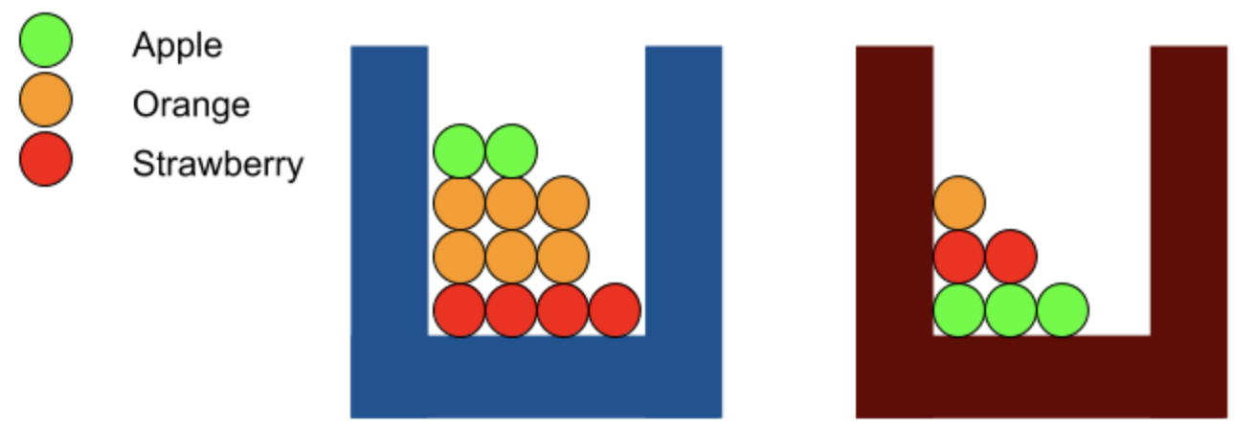
Boxes of Fruit
 | Apple | Orange | Strawberry | ∑
Blue jar | 2 | 6 | 4 | 12
Red jar | 3 | 1 | 2 | 6
Count of fruit in each jar

Slide 3
Boxes of Fruit
 | Apple | Orange | Strawberry | ∑
Blue jar | 2 | 6 | 4 | 12
Red jar | 3 | 1 | 2 | 6
 | Apple | Orange | Strawberry | ∑
Blue jar | 0.167 | 0.5 | 0.333 | 1
Red jar | 0.5 | 0.167 | 0.333 | 1
Count of fruit in each jar
Probabilities of pulling a given fruit from a given jar

Slide 4
Boxes of Fruit
P(blue jar) | P(red jar)
0.6 | 0.4
 | Apple | Orange | Strawberry | ∑
Blue jar | 2 | 6 | 4 | 12
Red jar | 3 | 1 | 2 | 6
 | Apple | Orange | Strawberry | ∑
Blue jar | 0.1 | 0.3 | 0.2 | 0.6
Red jar | 0.2 | 0.067 | 0.133 | 0.4
Count of fruit in each jar
Joint probabilities of choosing a jar and pulling a given fruit from that jar
[= P(choosing jar J)*P(pulling fruit F from jar J)]

Slide 5
Bayes’ Theorem
P(F = orange,J = blue) = P(F = orange|J = blue)P(J = blue)
Since
  P(F = orange,J = blue) = P(J = blue,F = orange)
and
  P(J = blue,F = orange) = P(J = blue|F = orange)P(F = orange)
we know
  P(J = blue|F = orange)P(F = orange) = P(F = orange|J = blue)P(J = blue)

Slide 6
Bayes’ Theorem
P(J = blue|F = orange)P(F = orange) = P(F = orange|J = blue)P(J = blue)
Dividing both sides by P(F = orange) gives us
Bayes’ Rule: $P(J=\text{blue}|F=\text{orange})=\frac{P(F=\text{orange}|J=\text{blue})P(J=\text{blue})}{P(F=\text{orange})}$
Simplified: $P(\text{blue}|\text{orange})=\frac{P(\text{orange}|\text{blue})P(\text{blue})}{P(\text{orange})}$
General form: $P(A|B)=\frac{P(B|A)P(A)}{P(B)}$

Slide 7
Bayes’ Theorem
$$P(A|B)=\frac{P(B|A)P(A)}{P(B)}$$
Posterior probability ($P(A|B))$ = prior probability $(P(A))$ times evidence ($\frac{P(B|A)}{P(B)}$)
Prior probability $(P(A))$ = initial degree of belief in A (i.e., base rate of A)
Evidence ($\frac{P(B|A)}{P(B)}$) = support B provides for A (= probability of B given A divided by initial degree of belief in B)

Slide 8
Bayes’ Theorem
If I know the posterior probability of one event given another, I can flip them
$$P(A|B)=\frac{P(B|A)P(A)}{P(B)}$$
Multiply both sides by $P(B)$
$$P(A|B)P(B)=P(B|A)P(A)$$
Divide both sides by $P(A)$
$$\frac{P(A|B)P(B)}{P(A)}=P(B|A)$$

Slide 9
Bayes’ Theorem
Relationship between conditional probabilities of two events
$$\frac{P(A|B)P(B)}{P(A)}=\frac{P(B|A)P(A)}{P(B)}$$
Back to our boxes of fruit…

Slide 10


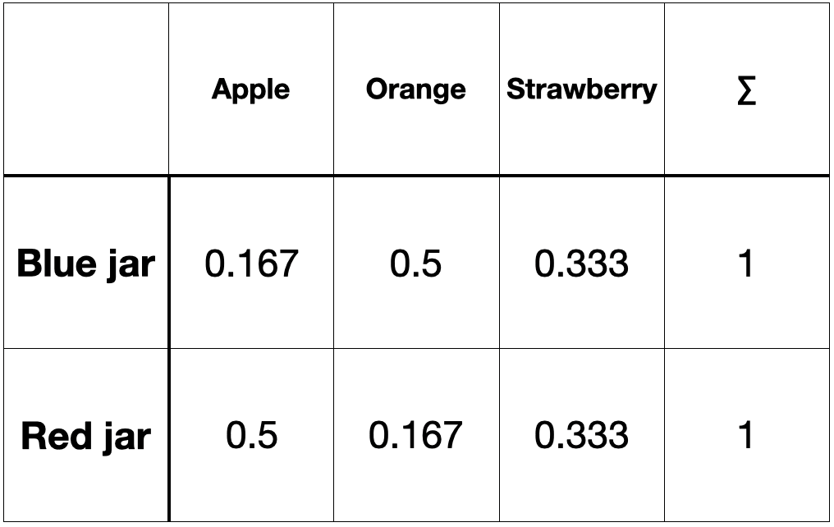
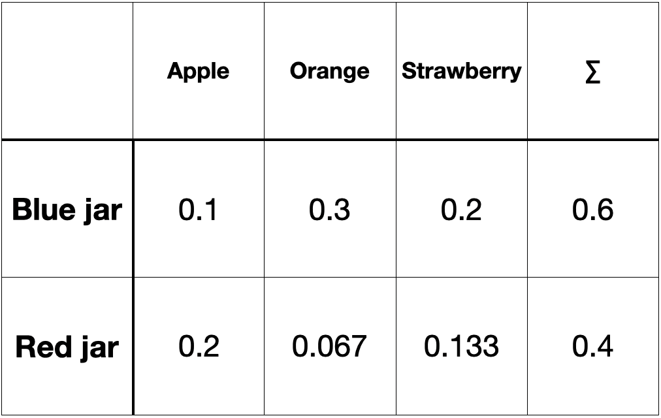


Bayes’ Theorem
$$P(J=\text{blue}|F=\text{orange})=\frac{P(F=\text{orange}|J=\text{blue})P(J=\text{blue})}{P(F=\text{orange})}$$
  We know all terms on right except P(F = orange)
Conditional probability table
Joint probability table

Slide 11



Bayes’ Theorem
$$P(J=\text{blue}|F=\text{orange})=\frac{P(F=\text{orange}|J=\text{blue})P(J=\text{blue})}{P(F=\text{orange})}$$
  We know all terms on right except P(F = orange)
How do I know which one to sum over?
Conditional probability table
Joint probability table

Slide 12



Bayes’ Theorem
$$P(J=\text{blue}|F=\text{orange})=\frac{P(F=\text{orange}|J=\text{blue})P(J=\text{blue})}{P(F=\text{orange})}$$
  You do not have to die!
  Sum over the joint probabilities because only the sum of joint probabilities are guaranteed to sum to 1!
Conditional probability table
Joint probability table

Slide 13
Bayes’ Theorem in NLP

Slide 14
Who Cares?
Example: machine translation
Shannon’s noisy channel model: what is the intended word given the “scrambled” word that was received?
“Scrambling” → translation
∴ P(English sentence|“les idées vertes incolores dorment furieusement”) = P(“les idées vertes incolores dorment furieusement”|English sentence)P(English sentence) / P(“les idées vertes incolores dorment furieusement”)

Slide 15
Who Cares?
P(English sentence|“les idées vertes incolores dorment furieusement”) = P(“les idées vertes incolores dorment furieusement”|English sentence)P(English sentence) / P(“les idées vertes incolores dorment furieusement”)
P(“les idées vertes incolores dorment furieusement”) is constant (base rate of sentence occurrence in French)
P(English sentence|“les idées vertes incolores dorment furieusement”) ∝ P(“les idées vertes incolores dorment furieusement”|English sentence)P(English sentence) / P(“les idées vertes incolores dorment furieusement”)

Slide 16
Who Cares?
Now I’m just trying to maximize:
  P(English sentence|“les idées vertes incolores dorment furieusement”)
Which is the same as maximizing:
P(“les idées vertes incolores dorment furieusement”|English sentence)P(English sentence)
So what do I do?
Remember, P(A,B) = P(A|B)P(B)
  P(“les idées vertes incolores dorment furieusement”|English sentence)P(English sentence) = P(“les idées vertes incolores dorment furieusement”,English sentence)
  I simply try to find the English sentence that co-occurs most frequently with the French sentence

Slide 17
Mutual Information
If two events co-occur frequently, they probably share some information
“Rocks fall” + “everyone dies” co-occur frequently
  P(“rocks fall”) = 1, P(“everyone dies”) = .9
  Doesn’t necessarily follow that if P(“everyone dies”) = 1 ~ High P(“rocks fall”)
Why?
  Dependencies may occur between two events

Slide 18
Mutual Information
What is the base rate of “everyone dies”?
If P(“everyone dies”) is very low
  P(“everyone dies”|“rocks fall”) = P(“rocks fall”|“everyone dies”)P(“everyone dies”) / P(“rocks fall”)
  P(“everyone dies”|“rocks fall”) may be low regardless of the other values
  P(“everyone dies”|“rocks fall”) depends on P(“rocks fall”|“everyone dies”)
  Maximizing P(A|B) = P(B|A)*C means simultaneously finding the right values of A and B s.t. P(A|B) = max(P(A|B))

Slide 19
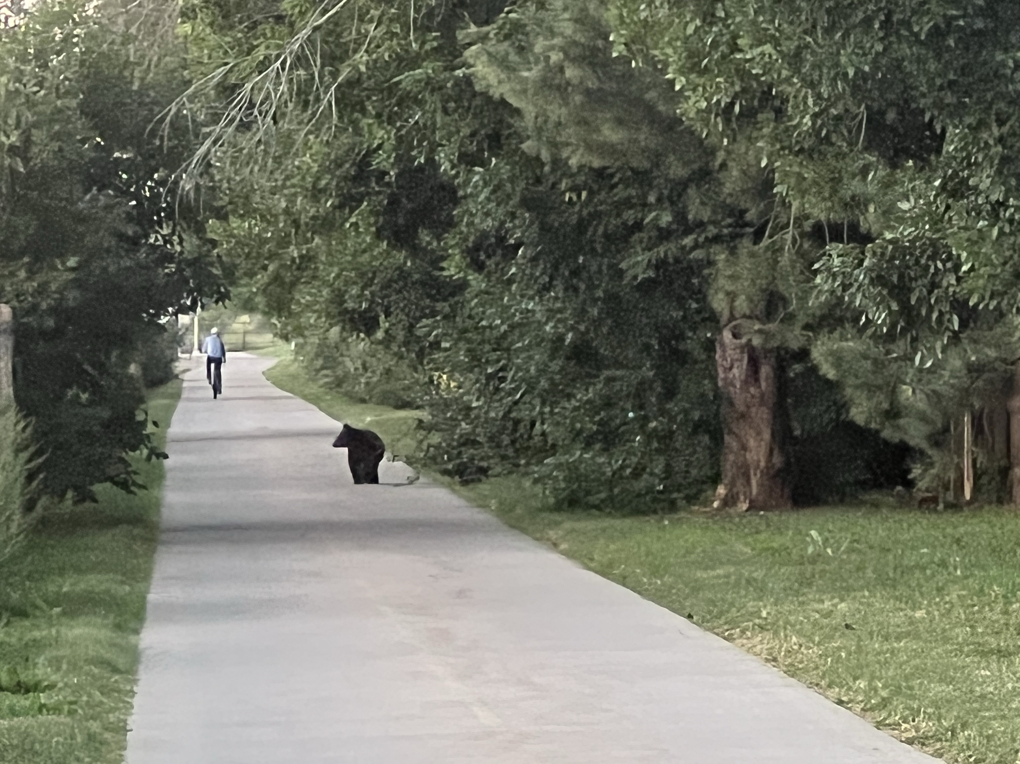

Slide 20
Questions?

