Slide 1
Linguistics in the Age of AI
CS 542 - Natural Language Processing
Prof. Nikhil Krishnaswamy, Colorado State University
Partially adapted from slides from James Pustejovsky, Brandeis University

Slide 2
How Linguists Collect Data

Slide 3
Investigate hypotheses by consulting native speakers’ intuitions
Most linguists assume that people can distinguish strings of words that are sentences of their language from strings of words that are not sentences of their language
So imagine that you are a machine or a classifier that takes a sentence as input, and returns “accept” or “reject” as output
Automata
√ The student read a book
* Student the a book read

Slide 4
Grammaticality
A string of words that you recognize as a sentence in your native language is grammatical
A string of words that you do not recognize as a sentence in your native language is ungrammatical
When you decide whether a sentence is grammatical or ungrammatical, this is called giving a grammaticality judgment
Ungrammatical sentences are preceded by an asterisk or star (*)
Sometimes called starred sentences
If native speakers can’t decide whether the sentence is grammatical or ungrammatical, it is preceded by a combination of stars and question marks

Slide 5
Grammatical ≠ Meaningful
It is unlikely that Pat will succeed.
It is improbable that Pat will succeed.
Pat is unlikely to succeed.
*Pat is improbable to succeed.
This could be meaningful, but most people consider it to be ungrammatical
They saw Pat with Chris.
They saw Pat and Chris.
Who did they see Pat with?
*Who did they see Pat and?
Again, this could be meaningful, but it is ungrammatical.

Slide 6
A Brief History

Slide 7
A Brief History
Two foundational paradigms
automaton, probabilistic or information-theoretic model
1: Turing’s work first led to McCulloch-Pitts neuron (McCulloch and Pitts, 1943)
a simplified model of the neuron as a kind of computing element that could be described in terms of propositional logic
And then to Kleene (1951, 1956) on finite state automata and regular expressions
Shannon (1948) applied probabilistic models of discrete Markov processes to automata for language

Slide 8
A Brief History
Chomsky (1956), drawing the idea of a finite state Markov process from Shannon’s work, first considered finite-state machines as a way to characterize a grammar, and defined a finite-state language as a language generated by a finite-state grammar
These early models led to the field of formal language theory, which used algebra and set theory to define formal languages as sequences of symbols
This includes the context-free grammar, first defined by Chomsky (1956) for natural languages but independently discovered by Backus (1959) and Naur et al. (1960) in their descriptions of the ALGOL programming language

Slide 9
A Brief History
2: Shannon’s metaphor of the noisy channel and decoding for the transmission of language through media like communication channels and speech acoustics
Shannon entropy (equivalent to thermodynamic or Gibbs’ entropy) measures the information content of a channel (i.e., a language)
Shannon was first to measure entropy of English using probabilistic techniques
Sound spectrograph was developed in 1946 (Koenig et al., 1946), foundational work was done in instrumental phonetics
Laid the groundwork for first machine speech recognizers of the 1950s

Slide 10
A Brief History
1950s-early ’60s: “Speech and Language Processing” (SLP) had clearly split into two camps
Symbolic and stochastic
Symbolic lines of research:
The first was the work of Chomsky and others on formal language theory and generative syntax throughout the late 1950s and early to mid 1960s, and the work of many linguistics and computer scientists on parsing algorithms, initially top-down and bottom-up and then via dynamic programming
One of the earliest complete parsing systems was Zellig Harris’s Transformations and Discourse Analysis Project (TDAP), which was implemented between June 1958 and July 1959 at the University of Pennsylvania (Harris, 1962)

Slide 11
A Brief History
Symbolic lines of research:
The second line of research was the new field of artificial intelligence
Summer, 1956: John McCarthy, Marvin Minsky, Claude Shannon, and Nathaniel Rochester brought together a group of researchers for a two-month workshop on what they decided to call artificial intelligence (AI)
Although AI always included a minority of researchers focusing on stochastic and statistical algorithms (include probabilistic models and neural nets), the major focus of the new field was the work on reasoning and logic typified by Newell and Simon’s work on the Logic Theorist and the General Problem Solver
At this point early natural language understanding systems were built
These were simple systems that worked in single domains mainly by a combination of pattern matching and keyword search with simple heuristics for reasoning and question-answering
By the late 1960s more formal logical systems were developed

Slide 12
A Brief History
The stochastic paradigm took hold mainly in departments of statistics and of electrical engineering
By the late 1950s the Bayesian method was beginning to be applied to the problem of optical character recognition
Bledsoe and Browning (1959) built a Bayesian system for text-recognition that used a large dictionary and computed the likelihood of each observed letter sequence given each word in the dictionary by multiplying the likelihoods for each letter
Mosteller and Wallace (1964) applied Bayesian methods to the problem of authorship attribution on The Federalist Papers
The 1960s also saw the rise of the first serious testable psychological models of human language processing based on transformational grammar, as well as the first on-line corpora: the Brown corpus of American English, a 1 million word collection of samples from 500 written texts from different genres (newspaper, novels, non- fiction, academic, etc.), which was assembled at Brown University in 1963–64 (Kučera and Francis, 1967; Francis, 1979; Francis and Kučera, 1982), and William S. Y. Wang’s 1967 DOC (Dictionary on Computer), an on-line Chinese dialect dictionary

Slide 13
A Brief History
The next period saw an explosion in research in SLP and the development of a number of research paradigms that still dominate the field
The stochastic paradigm played a huge role in the development of speech recognition algorithms in this period
particularly the use of the Hidden Markov Model and the metaphors of the noisy channel and decoding, developed independently by Jelinek, Bahl, Mercer, and colleagues at IBM’s Thomas J. Watson Research Center, and by Baker at Carnegie Mellon University, who was influenced by the work of Baum and colleagues at the Institute for Defense Analyses in Princeton
AT&T’s Bell Laboratories was also a center for work on speech recognition and synthesis; see Rabiner and Juang (1993) for descriptions of the wide range of this work

Slide 14
A Brief History
Natural Language Understanding took off during this period
Terry Winograd’s SHRDLU system, which simulated a robot embedded in a world of toy blocks (Winograd, 1972)
able to accept natural language text commands (Move the red block on top of the smaller green one) of a hitherto unseen complexity and sophistication
His system was also the first to attempt to build an extensive (for the time) grammar of English, based on Halliday’s systemic grammar
Winograd’s model made it clear that the problem of parsing was well-enough understood to begin to focus on semantics and discourse models
Roger Schank and his colleagues and students (the Yale School) built a series of language understanding programs that focused on human conceptual knowledge such as scripts, plans and goals, and human memory organization (Schank and Albelson, 1977; Schank and Riesbeck, 1981; Cullingford, 1981; Wilensky, 1983; Lehnert, 1977)
This work often used network-based semantics (Quillian, 1968; Norman and Rumelhart, 1975; Schank, 1972; Wilks, 1975a, b; Kintsch, 1974) and began to incorporate Fillmore’s notion of case roles (Fillmore, 1968) into their representations (Simmons, 1973)
The logic-based and natural-language understanding paradigms were unified on systems that used predicate logic as a semantic representation, such as the LUNAR question-answering system (Woods, 1967, 1973)

Slide 15
A Brief History
This next decade saw the return of two classes of models which had lost popularity in the late 1950s and early 1960s, partially due to theoretical arguments against them such as Chomsky’s influential review of Skinner’s Verbal Behavior (Chomsky, 1959)
The first class was finite-state models, which began to receive attention again after work on finite-state phonology and morphology by Kaplan and Kay (1981) and finite- state models of syntax by Church (1980)
The second trend in this period was what has been called the “return of empiricism”; most notably here was the rise of probabilistic models throughout speech and language processing, influenced strongly by the work at the IBM Thomas J. Watson Research Center on probabilistic models of speech recognition
These probabilistic methods and other such data-driven approaches spread into part-of- speech tagging, parsing and attachment ambiguities, and connectionist approaches from speech recognition to semantics
This period also saw considerable work on natural language generation

Slide 16
A Brief History
By the last five years of the millennium it was clear that the field was vastly changing
First, probabilistic and data-driven models had become quite standard throughout NLP
Algorithms for parsing, part-of-speech tagging, reference resolution, and discourse processing all began to incorporate probabilities, and employ evaluation methodologies borrowed from speech recognition and information retrieval
Second, increases in the speed and memory of computers had allowed commercial exploitation of a number of subareas of speech and language processing, in particular speech recognition and spelling and grammar checking
Speech and language processing algorithms began to be applied to Augmentative and Alternative Communication (AAC)
Finally, the rise of the Web emphasized the need for language-based information retrieval and information extraction

Slide 17
A History of Data

Slide 18
Rationalists vs. Empiricists
Chomsky emphasized “creativity” of language, as manifested in recursive generative rules
SàNP VP, VPàVP NP
Empiricists emphasize common language patterns (e.g., collocations) and predictability of language
“[A]bout half of the letters or words we choose in writing or speaking (although we are not ordinarily aware of it) are really controlled by the statistical structure of the language.” - Warren Weaver, pioneer of MT (1949)

Slide 19
Rationalists vs. Empiricists
Chomsky (1957):
I think that we are forced to conclude that grammar is autonomous and independent of meaning
Corpus linguist John Sinclair (1991):
It is folly to decouple lexis and syntax, or either of those and semantics. The realization of meaning is far more explicit than is suggested by abstract grammars. The model of a highly generalized formal syntax, with slots into which fall neat lists of words, is suitable only in rare uses and specialized texts. By far the majority of text is made of the occurrence of common words in common patterns. Most everyday words do not have an independent meaning, or meanings, but are components of a rich repertoire of multi-word patterns that make up text.

Slide 20
Rationalists vs. Empiricists
Language is something in people’s minds – a set of rules and principles that allows them to make grammaticality judgments and produce and understand sentences that they have never heard before
i-language or internal language
We study i-language asking people to give grammaticality judgments
A corpus (a collection of texts or speech) is e-language, or external language
It is not the object of study

Slide 21
Rationalists vs. Empiricists
Corpora are objects of study
We study language by examining patterns in corpora (collections of text or speech)

Slide 22
Rationalists vs. Empiricists
Infinite, creative capacity
People can produce and understand sentences that have never been uttered before
They are not repeating memorized patterns, but applying productive rules
Leads people to wonder about things that don’t exist in a corpus: *Who did you see Pat and?
Probability is not grammaticality: grammatical sentences may have very low probability
Probability reflects facts about the world, but grammaticality is independent of context
Clyde is an African elephant
Clyde is a pink elephant

Slide 23
Rationalists vs. Empiricists
Frequency of occurrence in a corpus is easier to measure reliably than a grammaticality judgment
Many ungrammatical sentences turn out to be acceptable in the right context
Identifying the right context turns out to be an interesting question that does not arise in the rationalist approach
I gave her the book
I gave the book to her

Slide 24
Structuralist Tradition
Language can be explained in probabilistic, behaviorist terms
Languages are diverse systems learned from the environment
Aim was to describe the diversity of linguistic behavior
Analyze linguistic structure in formal terms – producing formal descriptions of grammar (including phonetics, morphology, syntax, etc.)

Slide 25
Early Computational Models
Empirical and statistical methods were popular in the 1950s
Shannon's information-theoretic approach to language
All of us were convinced that speech, in English or any other language, was a Markov process. From this to the conviction that ... the set of all English sentences can be generated by a Markov source was only a small step. (Bar-Hillel, 1975)
Early machine translation efforts of 1950s and 1960s

Slide 26
Chomsky Battles the Corpus Linguists
Popularity of empirical and statistical methods faded in the 1960s under the ‘cognitive revolution’
Chomsky’s mentalistic, generative approach to language revolutionized linguistics and cognitive science in the 20th century
Influential Events
Chomsky’s Syntactic Structures (1957) and Aspects of the Theory of Syntax (1965)
Chomsky & Miller’s critiques of statistical language models
Chomsky's critique of Skinner's Verbal Behavior

Slide 27
Chomsky Battles the Corpus Linguists
I had no personal interest in the experimental studies and technological advances. [...] As for machine translation and related enterprises, this seemed to me pointless, as well as probably quite hopeless. [...] I could not fail to be aware of the ferment and excitement [in the early 1950s]. But I felt myself no part of it. (Chomsky, 1975)

Slide 28
Syntactic Structures
From now on I will consider a language to be a set (finite or infinite) of sentences, each finite in length and constructed out of a finite set of elements.
The fundamental aim in the linguistic analysis of a language L is to separate the grammatical sequences which are the sentences of L from the ungrammatical sequences which are not sentences of L and to study the structure of the grammatical sequences.
On what basis do we actually go about separating grammatical sequences from ungrammatical sequences?

Slide 29
Syntactic Structures
First, it is obvious that the set of grammatical sentences cannot be identified with any. . . finite and somewhat accidental corpus of observed utterances. . .
Second, the notion “grammatical” cannot be identified with “meaningful” or “significant” in any semantic sense.
Sentences (1) and (2) are equally nonsensical, but any speaker of English will recognize that only the former is grammatical.
(1) Colorless green ideas sleep furiously. (2) Furiously sleep ideas green colorless.

Slide 30
Syntactic Structures
Third, the notion “grammatical in English” cannot be identified in any way with the notion “high order of statistical approximation to English.” It is fair to assume that neither sentence (1) nor (2) (nor indeed any part of these sentences) has ever occurred in an English discourse.
Hence, in any statistical model for grammaticalness, these sentences will be ruled out on identical grounds as equally ‘remote’ from English. Yet (1), though nonsensical, is grammatical, while (2) is not.

Slide 31
Syntactic Structures
Evidently, one’s ability to produce and recognize grammatical utterances is not based on notions of statistical approximation and the like. . . I think that we are forced to conclude that grammar is autonomous and independent of meaning, and that probabilistic models give no particular insight into some of the basic problems of syntactic structure.

Slide 32
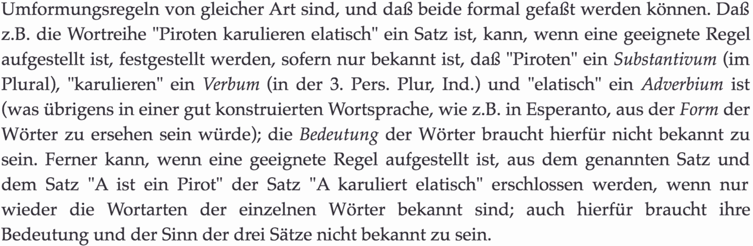
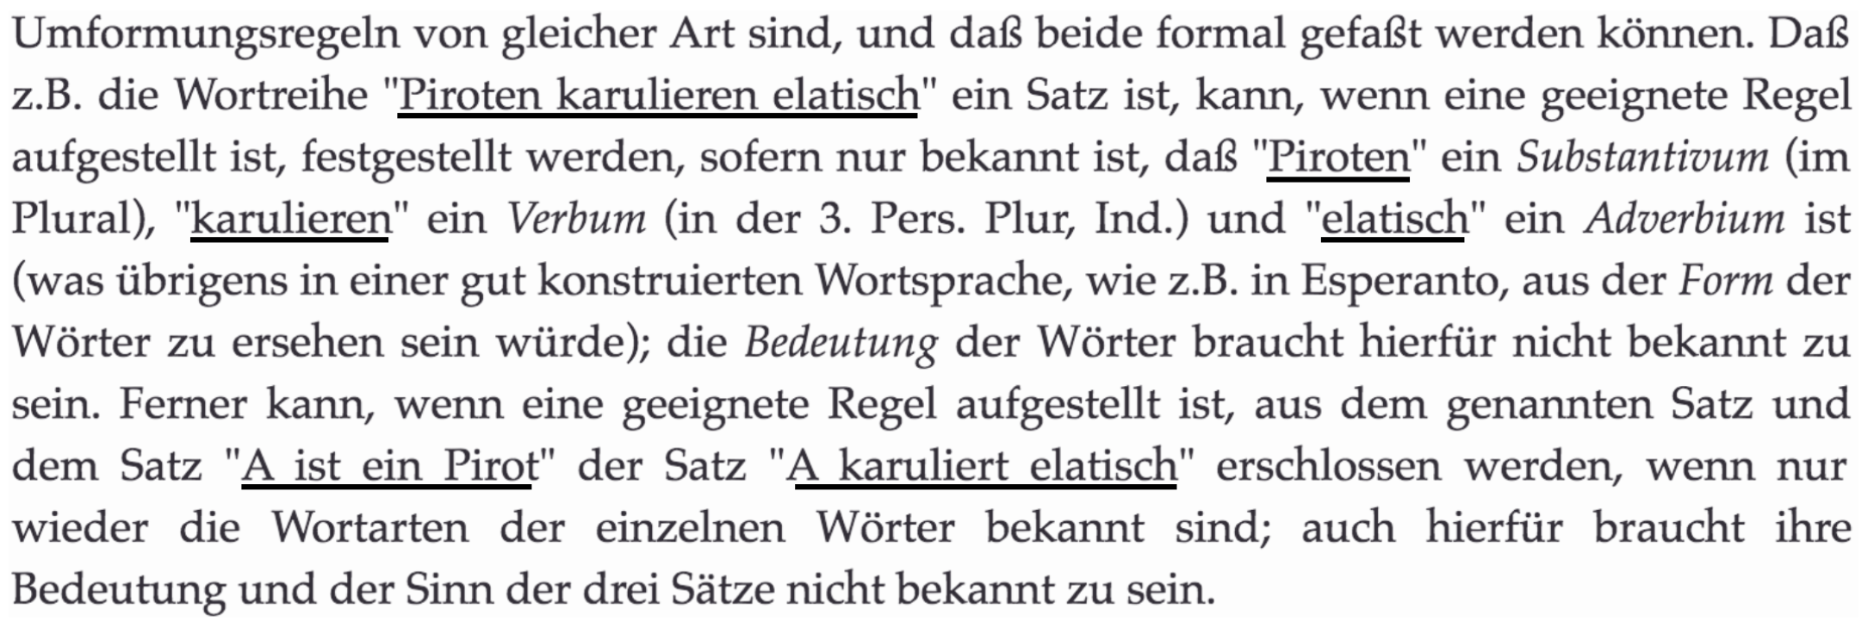
Logical Structure of Language
Carnap, 1934
“Pirots karulize elatically.”

Slide 33
Chomsky’s Claim
. . . in any statistical model for grammaticalness, these sentences will be ruled out on identical grounds as equally ‘remote’ from English.
This claim is false—all modern statistical models of language can assign probabilities to previously- unseen utterances.
Whether or not these probabilities are accurate is up for debate, but for two distinct novel utterances, they would not be the same.

Slide 34
Learning With Data

Slide 35
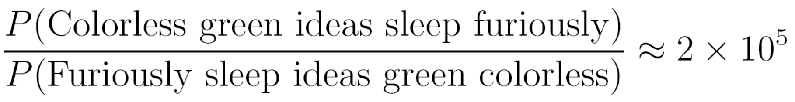
Refuting Chomsky
Language users must be able to generalize beyond their input
Statistical inference can be used to study such generalization
Pereira (2000) used a class-based bigram model to model (1) and (2) before:
Maybe probabilities aren’t such a useless model of language knowledge after all

Slide 36
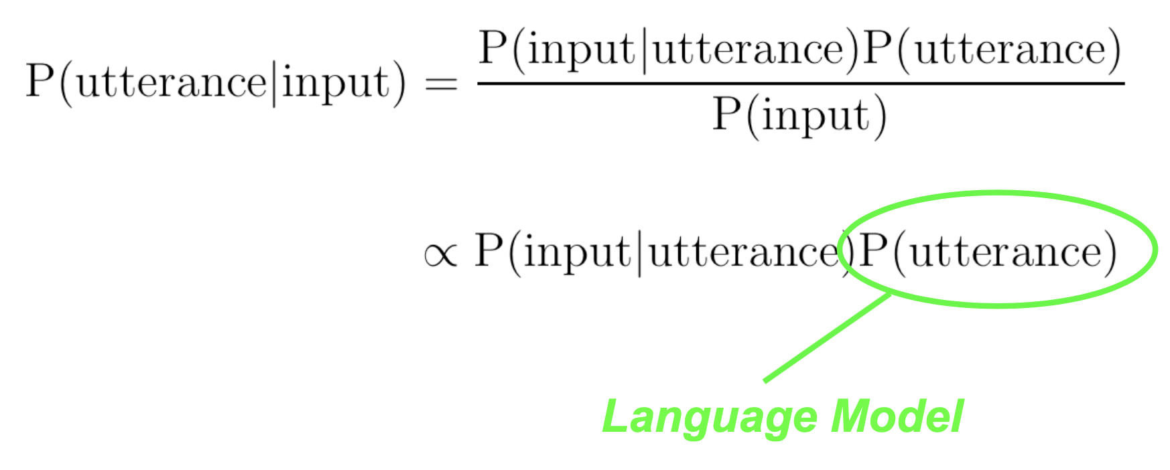
Language and Probability
Language models are core component of many applications where task is to recover an utterance from an input
An “easy” way to do this is through Bayes’ rule:

Slide 37
Language and Probability
We want to predict a sentence given an input sequence:
The noisy channel approach: $s^{*}=argmax_{s}P(s|a)$
Build a generative model of production (encoding)
$$P(a,s)=P(s)P(a|s)$$
To decode, we use Bayes’ rule to write
$$s^{*}=argmax_{s}P(s|a)$$
$=argmax_{s}P(s)P(a|s)/P(a)$
$=argmax_{s}P(s)P(a|s)$
Now, we have to find a sentence maximizing this product
Why is this progress?
This predicts what to expect as input

Slide 38
Language and Probability
It is quite typical for researchers to use any collection of texts for linguistic analysis
Often proceed opportunistically: whatever data comes in handy is used
However, the term corpus usually implies the following characteristics:
sampling/representativeness
finite size
machine-readable form
a standard reference
(time-bound)

Slide 39
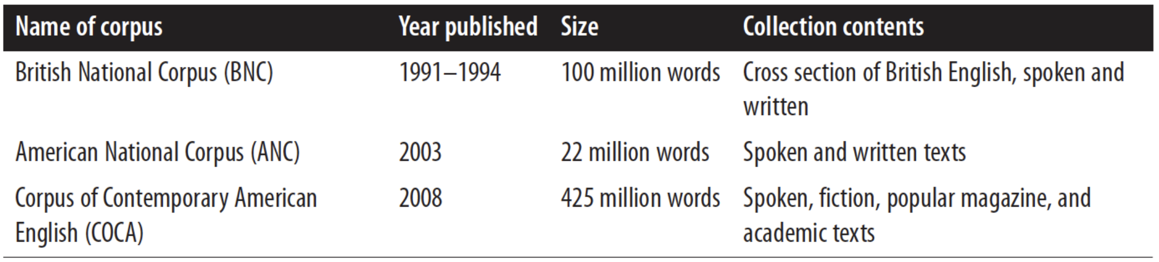
Language and Probability
It is quite typical for researchers to use any collection of texts for linguistic analysis
Often proceed opportunistically: whatever data comes in handy is used
However, the term corpus usually implies the following characteristics:
sampling/representativeness
finite size
machine-readable form
a standard reference
(time-bound)

Slide 40
Revisiting Method and Theory

Slide 41
Method in Linguistics
Sapir, Bloomfield, Hockett, Wells (Structural analysis)
Discovery procedure allows for the emergence of grammatical patterns and constructions in a dataset
Chomsky, Bar-Hillel (Transformational Grammars)
Descriptive procedure allows for the generation of grammatical patterns
Chomsky (Generative Grammar 1962- present)
Explanatory model allows for the generation of best grammatical patterns

Slide 42
The Absence of Data
Chomsky revolutionized the field of linguistics in the 1950s
Generation through recursive functions allows one to create your own corpus
Experiment with new datasets that are not attested in actual “found data”
Now with LLMs, we can generate our own datasets on phenomena of interest

Slide 43
The Absence of Theory
Big Data and statistical modeling have largely dominated the fields of CL and AI, both theoretical and applied
LLMs can bootstrap new data based on previous data
Deep Learning seems positioned to obviate theory completely
This will not happen: machine learning and deep learning make theoretical assumptions in both the data preparation and feature selection and engineering phase of training
Theory is more relevant than ever before

Slide 44
Conclusion
Linguistics is now both a theoretical and experimental discipline
The scope of observed data for language study and theorizing is richer and broader than ever
Linguistic corpora and captured media datasets will enable contextualized and embodied interpretation of linguistic utterances
LLMs (if used carefully) enable the development of more expressive and broader theories of language and communication

Slide 45
Questions?

