Slide 1
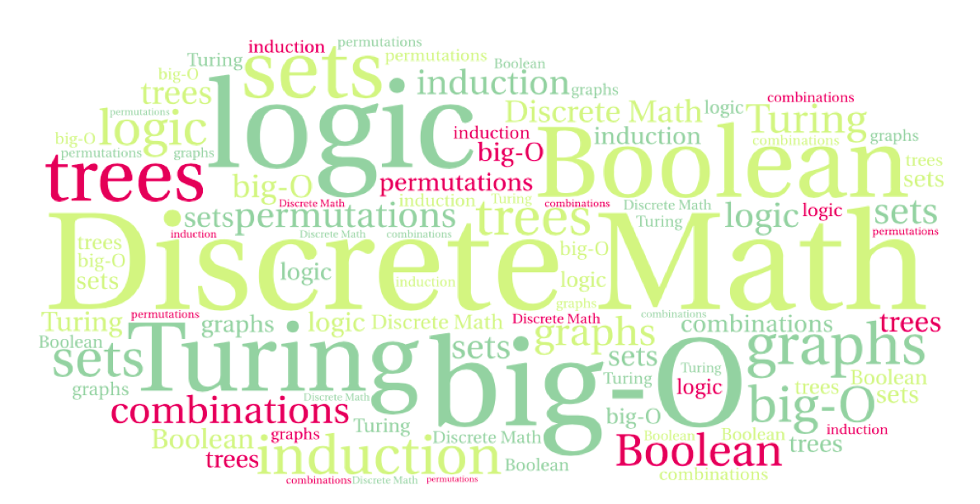
CS 220: Discrete Structures and their Applications
binary relations
zybooks 9.1-9.2

Slide 2
binary relations
A – set of students
B – set of courses
R – pairs (a,b) such that student a is enrolled in course b
R = {(chris, cs220), (mike,cs520),…}
A – set of cities
B – set of US states
R – (a,b) such that city a is in state b
R = {(Denver, CO), (Laramie, WY),…}

Slide 3
binary relations
Definition: A binary relation between two sets A and B is a subset R of A x B.
Recall that A x B = { (a,b) | a ∈ A and b ∈ B}
For a ∈ A and b ∈ B, the fact that (a, b) ∈ R is denoted by aRb.
Example:
For x ∈ R and y ∈ Z define xCy if |x - y| ≤ 1

Slide 4
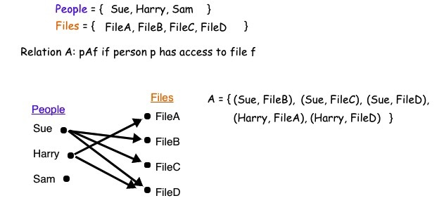
binary relations
a graphical representation of a relation

Slide 5
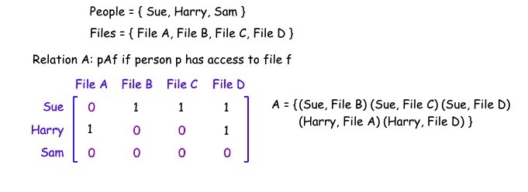
binary relations
the same binary relation can be represented as a matrix:
A 2-d array of numbers with |A| rows and |B| columns. Each row corresponds to an element of A and each column corresponds to an element of B. For a ∈ A and b ∈ B, there is a 1 in row a, column b, if aRb and 0 otherwise.

Slide 6
counting binary relations
A binary relation from A to B is a subset of A x B
Given sets A and B with sizes n and m, the number of elements in A x B is nm, and the number of binary relations from A to B is 2^{nm}
WHY?
Notes:
n in A * m in B (matrix with n*m booleans)
Each can be 0|1

Slide 7
functions as relations
A function f from A to B assigns an element of B to each element of A.
Difference between relations and functions?
Notes:
(a1,b1) precludes (a1,b2) in a function, but not in a relation

Slide 8
binary relations on a set
A binary relation on a set A is a subset of A x A.
The set A is called the domain of the binary relation.
Graphical representation of a binary relation on a set:
self loop

Slide 9
binary relations on a set
Example: relations on the set of integers
R₁ = {(a,b) | a ≤ b}
R₂ = {(a,b) | a > b}
R₃ = {(a,b) | a = b + 1}

Slide 10
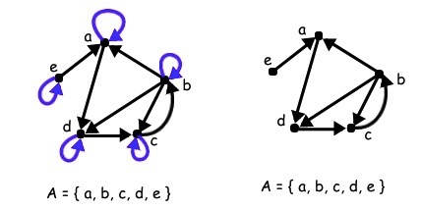
properties of binary relations
Let R be a relation on a set A
The relation R is reflexive if for every x ∈ A, xRx.
Example: the less-or-equal to relation on the positive integers
The relation R is anti-reflexive if for every x ∈ A, it is not true that xRx.

Slide 11
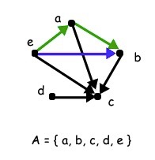
properties of binary relations
Let R be a relation on a set A.
The relation R is transitive if for every x,y, z ∈ A, xRy and yRz imply that xRz.
Example: the ancestor relation
Notes:
<, >

Slide 12
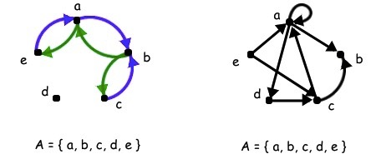
properties of binary relations
Let R be a relation on a set A.
The relation R is symmetric if for every x,y ∈ A, xRy implies that yRx.
Example:
R = {(a, b) : a,b are actors that have played in the same movie}
The relation R is anti-symmetric if for every x,y ∈ A, xRy and yRx imply that x = y.

