Slide 1
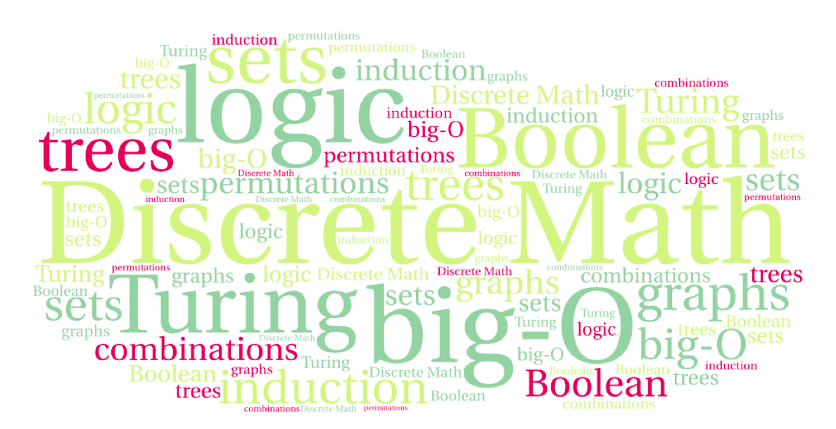

CS 220: Discrete Structures and their Applications
Sets
zybooks sections 4.1-4.7

Slide 2
intersection/union of many sets
applying the intersection/union operations to large numbers of sets:

Slide 3
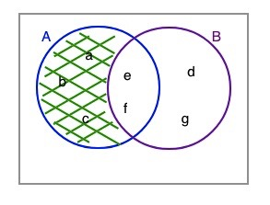
set difference
The difference of sets A and B is the set containing those elements that are in A but not in B.
A - B = { x | x ∈ A and x ∉ B }.
Example: {a, b, c, e, f} – {d, e, f, g} = {a, b, c}

Slide 4
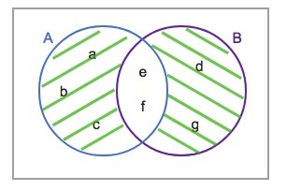
symmetric difference
The difference operation is not commutative since it is not necessarily the case that A - B = B - A.
Check this in the diagram
The symmetric difference between two sets, A and B, denoted A ⊕ B, is the set of elements that are a member of exactly one of A and B, but not both.
Also defined as:
A ⊕ B = ( A - B ) ∪ ( B - A )
Check it again

Slide 5
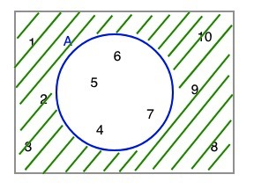
set complement
The universal set: the set of all elements in some domain (e.g. positive integers)
The complement of a set A is the set of all elements in the universal set U that are not elements of A.
Notation:
An alternative definition: U - A

Slide 6
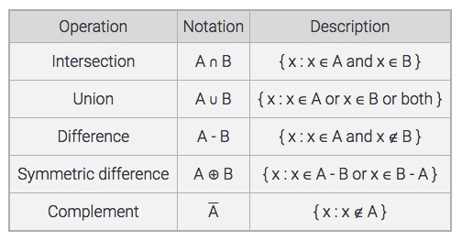
summary of set operations

Slide 7
expressing sets operations using logic
x ∈ A ∩ B ↔ (x ∈ A) ∧ (x ∈ B)
x ∈ A ∪ B ↔ (x ∈ A) ∨ (x ∈ B)
x ∈ ↔ ¬(x ∈ A)
The sets U and ∅ correspond to the constants true (T) and false (F):
x ∈ ∅ ↔ F
x ∈ U ↔ T

Slide 8
DeMorgan's laws for sets
We can use the laws of propositional logic to derive corresponding set identities:
Result:
Notes:
Show Venn diagram to demonstrate that!

Slide 9
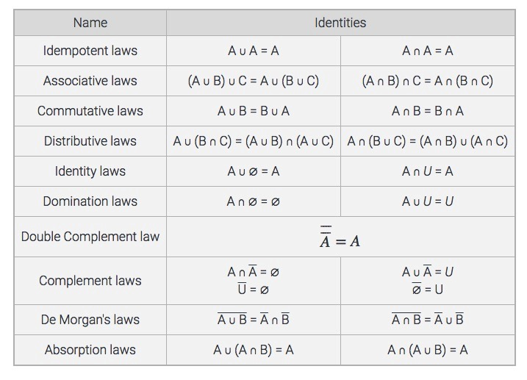
set identities

Slide 10
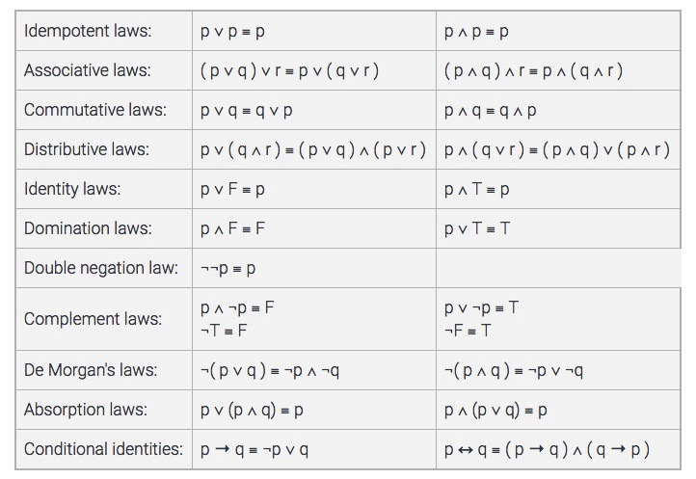
Every set identity has
a corresponding rule of
propositional logic

Slide 11

partitions
Two sets, A and B, are said to be disjoint if their intersection is empty (A ∩ B = ∅ ).
A collection of sets, A₁, A₂, ..., A_{n}, is pairwise disjoint if every pair of sets is disjoint i.e., A_{i} ∩ A_{j} = ∅ when i ≠ j.
A partition of a non-empty set A is a collection of non-empty subsets of A such that each element of A is in exactly one of the subsets.
A₁, A₂, ...,A_{n} is a partition for a non-empty set
A if:
A_{i} ⊆ A for all i.
A_{i} ≠ ∅
A₁, A₂, ...,A_{n} are pairwise disjoint.
A = A₁ ∪ A₂ ∪ ... ∪ A_{n}

Slide 12
partitions
practice question:
Suppose that every student is assigned a unique 8-digit ID number.
A_{i} : the set of students whose ID number begins with the digit i.
Assume that for each digit i, there is at least one student whose ID starts with i.
Do the sets A₀, …, A₉ form a partition of the set of students?
Notes:
Yes, see previous slide

Slide 13
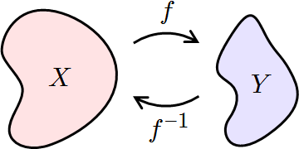
Inverse functions
We want to define the inverse of a function f: a function f⁻¹ that “undoes” the action of f.
Example: the square root undoes the action of f(x) = x².
What properties does f need to have for an inverse to exist?
  one-to-one?
  onto?

Slide 14
Inverse functions
Let f: X → Y be a bijection. The inverse of f is the function f⁻¹ : Y → X that assigns to an element y in Y the element x in X such that f(x) = y, i.e., f⁻¹(y) = x when f(x) = y.
f
x=f⁻¹(y)
y=f(x)
X
Y
f⁻¹

Slide 15
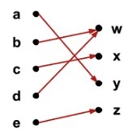
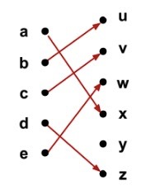
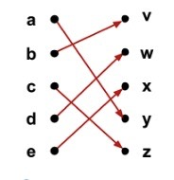
Inverse functions
Let f: X → Y be a bijection. The inverse of f is the function f⁻¹ : Y → X that assigns to an element y in Y the element x in X such that f(x) = y, i.e., f⁻¹(y) = x when f(x) = y.
Do these functions have an inverse?

Slide 16
Inverse functions
Are the following functions invertible?
f: {0, 1}³→{0, 1}³. f takes the input string and reverses the bits. For example, f(011) = 110.
f: {0, 1}³→{0, 1}³. f takes the input string x, removing the first bit of x, and adding the bit to the end of x. For example, f(011) = 110.
f: {0, 1}³→{0, 1}³. f takes the input string and replaces the first bit by 1. For example, f(001) = 101 and f(110) = 110.

Slide 17
Composition of functions
Let f and g be functions f: X → Y and g: Y → Z.
The composition of g with f, denoted g□f, is the function
(g□f) : X → Z, such that (g□f)(x) = g(f(x)) for all x ∈ X.
g
f
X
Y
Z
g □f

Slide 18
Composition of functions
Order of composition matters!
Let f(x) = 2x + 3, g(x) = 3x + 2
(f□g)(x) = f(g(x)) = f(3x + 2) = 2(3x + 2) + 3 = 6x + 7
(g□f)(x) = g(f(x)) = g(2x + 3) = 3(2x + 3) + 2 = 6x + 11

Slide 19
Composition of functions
What is (f⁻¹□f)(x) and (f□f⁻¹)(y) ?

Slide 20
The identity function
The identity function on A, denoted I_{A}: A → A, is defined as I_{A}(a) = a, for all a ∈ A.
The identity function always maps a set onto itself and maps every element to itself.
If a function f from A to B has an inverse, then f composed with its inverse is the identity function.
If f(a) = b, then f⁻¹(b) = a, and (f^{f-1}□f)(a) = f⁻¹(f(a)) = f⁻¹(b) = a.
Let f: A → B be a bijection. Then f⁻¹□f = I_{A} and f□f⁻¹ = I_{B}.

Slide 21
Cartesian products and functions
A function with multiple arguments has a cartesian product as its domain.
Example:
  min maps R x R to R
  min(5.3, 10) = 5.3

Slide 22
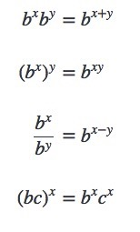
exponents and logarithms
The exponential function exp_{b} : R → R⁺ is defined as:
exp_{b}(x)=b^{x}
where b is a positive real number and b ≠ 1.
The parameter b is called the base of the exponent.
The input x is called the exponent.
Properties of exponents:

Slide 23
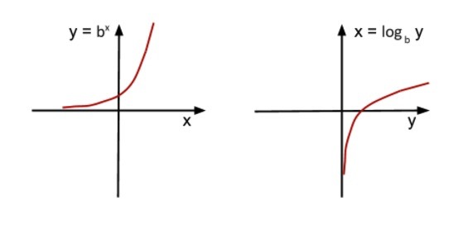
the logarithm function
The exponential function is one-to-one and onto, and therefore has an inverse.
The logarithm function is the inverse of the exponential function. For real number b > 0 and b ≠ 1, log_{b}: R⁺ → R is defined as:
b^{x}=y ⇔ log_{b}y=x
The parameter b is called the base of the logarithm

Slide 24
Logarithms and programming
Binary search
define the steps, explain how many steps
Merge sort
define the steps, explain how many steps
Quick sort?

