Slide 1
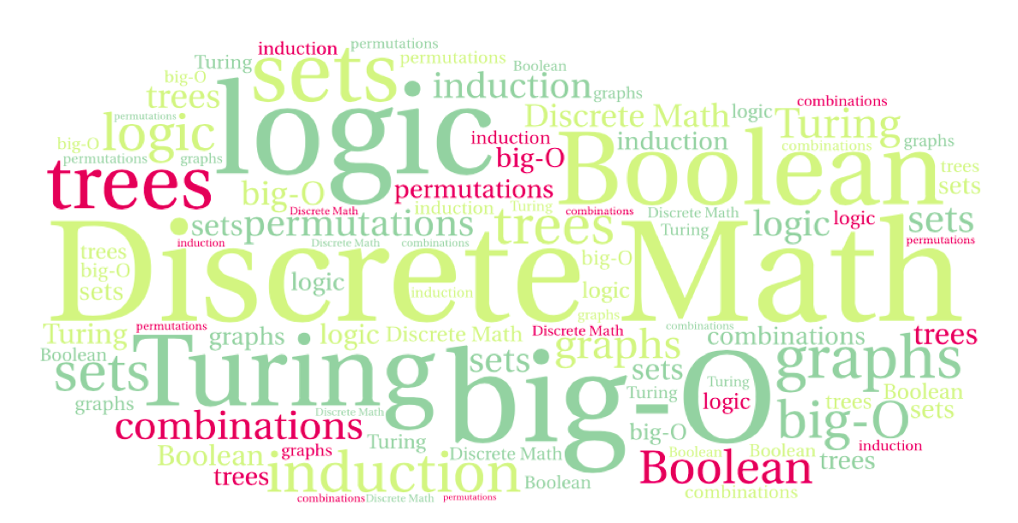
CS 220: Discrete Structures and their Applications
Propositional Logic
Sections 1.1-1.2 in zybooks

Slide 2
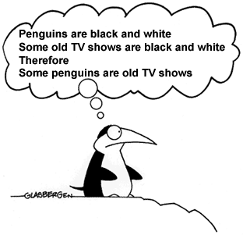
Logic in computer science
Used in many areas of computer science:
Booleans and Boolean expressions in programs
Reasoning about programs, proving program correctness
Artificial intelligence (AI)
Theorem provers
Hardware design

Slide 3
Propositional Logic
A proposition is a statement that is either true or false.
Examples of propositions:
Two plus two is four.
Toronto is the capital of Canada.
There is an infinite number of primes.
Not propositions:
What time is it?
Have a nice day!
A proposition's truth value is a value indicating whether the proposition is true or false.
Notes:
proposition: statement of fact

Slide 4
Propositional variables
We can use propositional variables to represent propositions.
Examples:
p: January has 31 days.
q: February has 33 days.

Slide 5
Conjunction
Example:
p: January has 31 days.
q: February has 33 days.
p ∧ q: January has 31 days and February has 33 days.

Slide 6
There are many ways of saying that in English!
Define the propositional variables p and h as:
p: Sam is poor.
h: Sam is happy.
There are many ways to express the proposition p ∧ h in English:
Sam is poor and he is happy.
Sam is poor, but he is happy.
Despite the fact that he is poor, Sam is happy.
Although Sam is poor, he is happy.

Slide 7
Compound propositions: the conjunction
In Java and Python propositions are logical expressions, that can form compound propositions using logical operators such as and, or, and not.
For example in Python you can write something like:
>>> (5 >= 0) and (5 <= 10)
We do the same in propositional logic, except we have different notations for the operators. Don’t be intimidated by notation!
Let p and q be propositions. The conjunction of p and q is denoted by p ∧ q.
p ∧ q is true if both p and q are true.
In English, this is the statement “p and q”

Slide 8
Formal definition of the conjunction operator
We can define an operator using its truth table.
A truth table shows the truth value of a compound proposition for every possible combination of truth values for the variables contained in it.
p | q | p ∧ q
T | T | T
T | F | F
F | T | F
F | F | F

Slide 9
The disjunction operator
The disjunction operation is denoted by ∨.
The proposition p ∨ q is read "p or q” .
p ∨ q is true if either one of p or q is true, or if both are true, and is false otherwise.
Notice that T ∨ T = T. We call ∨ the “inclusive or” operator.
p | q | p ∨ q
T | T | T
T | F | T
F | T | T
F | F | F

Slide 10
Exclusive OR (XOR)
When a parent tells their child – “you can have chocolate or a lollypop”, they likely mean that the child can have one of the two but NOT both. This corresponds to the ”exclusive or” logical operator.
p | q | p ⊕ q
T | T | F
T | F | T
F | T | T
F | F | F
The exclusive or of logical statements p and q is denoted by p ⊕ q

Slide 11
Negation
Let p be a proposition.
The negation of p is denoted by ¬p
In English, this is the statement “not p”
p | ¬p
T | F
F | T

Slide 12
Summary of operator truth tables
p | q | p ∧ q | p ∨ q | p ⊕ q | ¬p
T | T | T | T | F | F
T | F | F | T | T | F
F | T | F | T | T | T
F | F | F | F | F | T

Slide 13
Truth Tables in Python
a | b | a and b | a or b | a^b | not a
True | True | True | True | False | False
True | False | False | True | True | False
False | True | False | True | True | True
False | False | False | False | False | True
Notice the different notation for the operators.
Here a and b are Boolean (bool) variables.

Slide 14
Compound propositions
Let’s evaluate a proposition composed of multiple operations such as:
(p ∨ (¬q)) ∧ r
where the variables have the values: p:F, q:F, r:F
(F ∨ (¬F)) ∧ F
(F ∨ T) ∧ F
(T) ∧ F
F

Slide 15
Compound propositions
In the absence of parentheses how do we evaluate this proposition?
p ∨ ¬q ∧ r
Possible choices:
(p ∨ ¬q) ∧ r
p ∨ (¬q ∧ r)
p ∨ ¬(q ∧ r)

Slide 16
Compound propositions
In the absence of parentheses how do we evaluate this proposition?
p ∨ ¬q ∧ r
Possible choices:
(p ∨ ¬q) ∧ r
p ∨ (¬q ∧ r)
p ∨ ¬(q ∧ r)
Like in arithmetic, operators have precedence:
Negation (¬)
Conjunction (∧)
Disjunction (∨)

Slide 17
Exclusive or
Question: What does a⊕b⊕c mean?
1. (a⊕b) ⊕c
2. a⊕(b⊕c)
3. 1 and 2 are the same
How do you know?
Can you describe what a⊕b⊕c computes?
Can you generalize that?
Notes:
Build truth table
parity

Slide 18
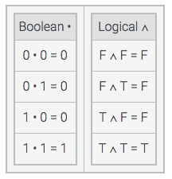
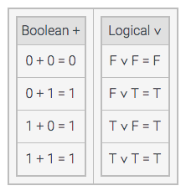
Arithmetic and Logic
The operator precedence in logic mirrors that of arithmetic:
Negation (¬) Unary Minus (-)
Conjunction (∧) Multiplication (*)
Disjunction (∨) Addition (+)
In fact, when you do arithmetic over the bits 0 and 1, there is a correspondence between conjunction and multiplication, and disjunction and addition (but 1+1=1).
Notes:
Not exactly identical (bits, not numbers) You will explore this correspondence more in CS270, when you discuss logical circuits.

Slide 19
Compound propositions
When constructing the truth table for a compound proposition such as ¬q ∧ ( p ∨ r ) it is helpful to use intermediate columns.
Do it:
p | q | r | ¬q | ( p ∨ r ) | ¬q ∧ ( p ∨ r )
T | T | T
T | T | F
T | F | T
T | F | F
F | T | T
F | T | F
F | F | T
F | F | F

Slide 20
Compound propositions
When constructing the truth table for a compound proposition such as ¬q ∧ ( p ∨ r ) it is helpful to use intermediate columns:
p | q | r | ¬q | ( p ∨ r ) | ¬q ∧ ( p ∨ r )
T | T | T | F | T | F
T | T | F | F | T | F
T | F | T | T | T | T
T | F | F | T | T | T
F | T | T | F | T | F
F | T | F | F | F | F
F | F | T | T | T | T
F | F | F | T | F | F

Slide 21
Compound propositions
p | q | ¬q | p ∨¬q | p ∧ q | (p ∨¬q) ∨ (p ∧ q)
T | T
T | F
F | T
F | F

Slide 22
Compound propositions
p | q | ¬q | p ∨¬q | p ∧ q | (p ∨¬q) ∨ (p ∧ q)
T | T | F | T | T | T
T | F | T | T | F | T
F | T | F | F | F | F
F | F | T | T | F | T

Slide 23
From English to propositional logic
Consider the following pieces of identification a person might have in order to apply for a credit card:
B: Applicant presents a birth certificate.
D: Applicant presents a driver's license.
M: Applicant presents a marriage license.
Write a logical expression for the requirements under the following conditions:
The applicant must present either a birth certificate, or a driver's license, or a marriage license.
Notes:
A xor B xor C

Slide 24
From English to propositional logic
Consider the following pieces of identification a person might have in order to apply for a credit card:
B: Applicant presents a birth certificate.
D: Applicant presents a driver's license.
M: Applicant presents a marriage license.
Write a logical expression for the requirements under the following conditions:
The applicant must present at least two of the following forms of identification: birth certificate, driver's license, marriage license.
Notes:
A and B or A and C or B and C

Slide 25
From English to propositional logic
Consider the following pieces of identification a person might have in order to apply for a credit card:
B: Applicant presents a birth certificate.
D: Applicant presents a driver's license.
M: Applicant presents a marriage license.
Write a logical expression for the requirements under the following conditions:
Applicant must present either a birth certificate or both a driver's license and a marriage license.
Notes:
A or B and C

Slide 26
How many rows in that truth table?
p | q | r | ( p ∨ r ) ∧ ¬q
T | T | T | F
T | T | F | F
T | F | T | T
T | F | F | T
F | T | T | F
F | T | F | F
F | F | T | T
F | F | F | F
How many rows are there in a truth table with 3 variables?
With 4 variables, 5? n?

Slide 27
Exercises
Describe in words when the expression p ∨ q ∨ r ∨ s ∨ t is true and when it is false.
Describe in words when the expression p ∧ q ∧ r ∧ s ∧ t is true and when it is false.
Notes:
At least one of them is T
At least one of them is F

Slide 28
A puzzle
Knights and knaves.
An island has two types of inhabitants: knights, who always tell the truth, and knaves, who always lie.
You encounter two people, A and B.
A says: “B is a knight”
B says: “The two of us are opposite types”
Can you figure out what A and B are? Discuss
Notes:
Assume knight(A) then knight(B) but then contradiction so not(knight(A))
So knave(A) therefore knave(B), therefore B lies (OK)

Slide 29
A puzzle
Knights and knaves.
An island has two types of inhabitants: knights, who always tell the truth, and knaves, who always lie.
You encounter two people, A and B.
A says: “We are both knaves”
Can you figure out what A and B are?
What “proof rule” did you (implicitly?) use?
we’ll come back to proof rules
Notes:
Assume knight(A), then knave(A) contradiction, therefore knave(A) therefore knight(B)
Proof by contradiction

