Slide 1
Fun and Games with Graphs

Slide 2
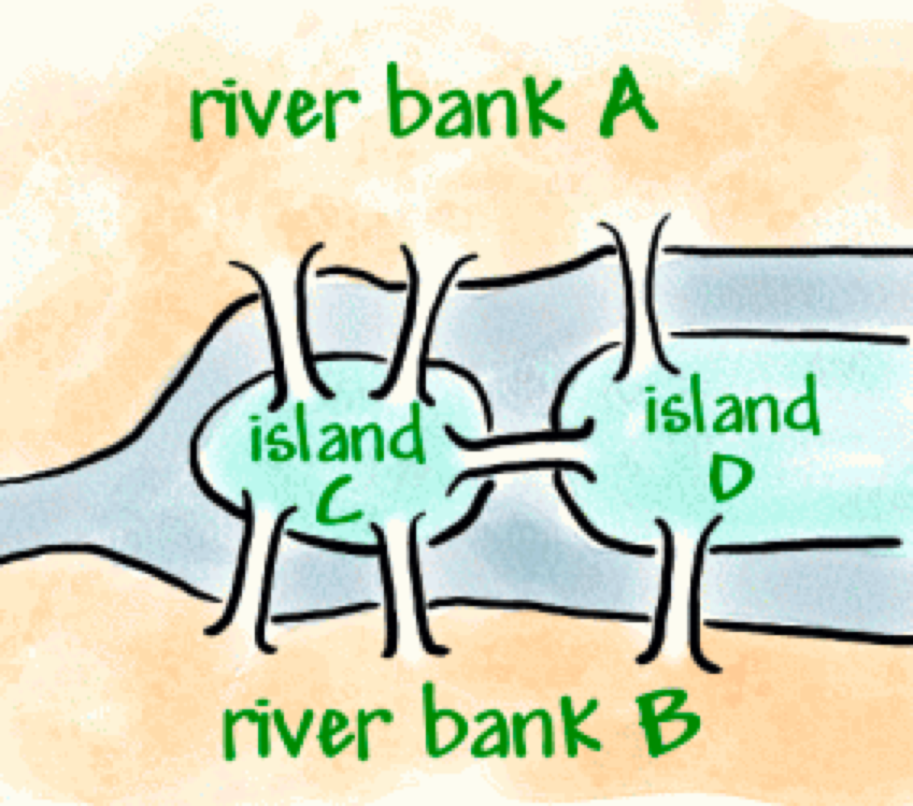
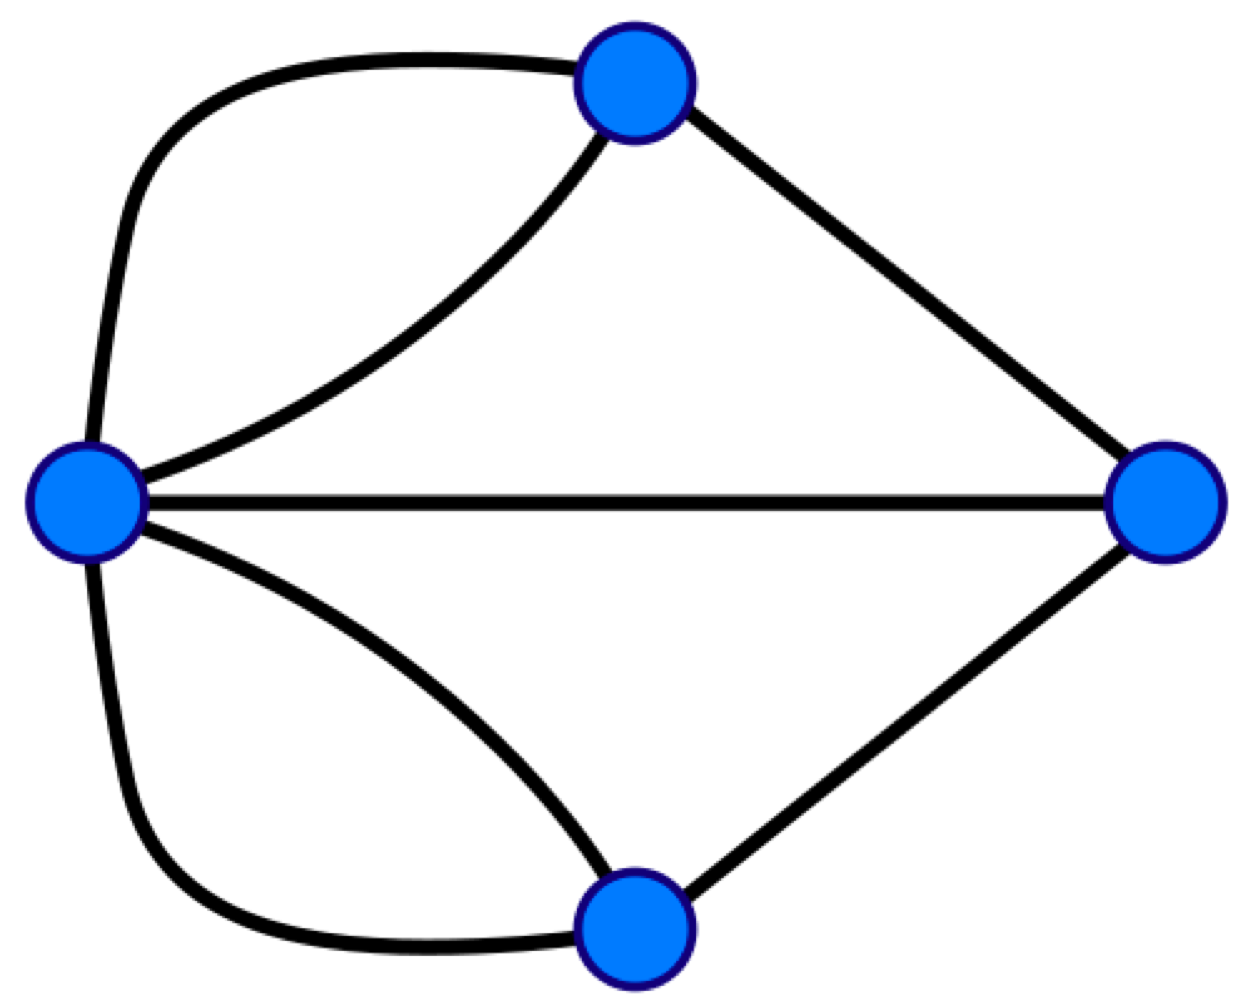
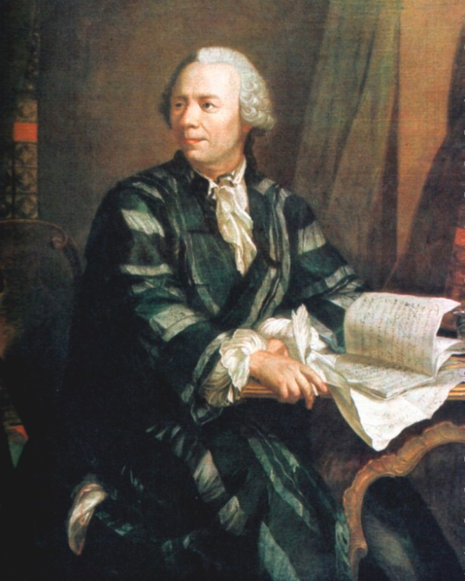
Bridges of Konigsberg Problem
Euler
Is it possible to travel across every bridge
without crossing any bridge more than once?
http://yeskarthi.wordpress.com/2006/07/31/euler-and-the-bridges-of-konigsberg/

Slide 3
Eulerian paths/circuits
Eulerian path: a path that visits each edge in the graph once
Eulerian circuit: a cycle that visits each edge in the graph once
Is there a simple criterion that allows us to determine whether a graph has an Eulerian circuit or path?
Notes:
Euler’s theorem (1736) was the first use of graph (network) theory.

Slide 4
Example: Does any graph have an Eulerian path?
a
b
G₁
d
c
e
a
b
a
b
e
e
G₂
G₃
d
c
d
c
Notes:
G1 yes a,d,c,a,b,e,c,b
G2 no
G3 – yes a,e,c,d,e,b,a

Slide 5
Example: Does any graph have an Eulerian circuit?
a
b
G₁
d
c
e
a
b
a
b
e
e
G₂
G₃
d
c
d
c
Notes:
G1 no
G2 no
G3 – yes a,e,c,d,e,b,a

Slide 6
Example: Does any graph have an Eulerian circuit or path?
a
b
G₁
a
b
d
c
g
a
b
c
G₂
f
G₃
e
d
d
c
Notes:
G1 neither
G2 path
G3 circuit hence path

Slide 7
Theorems about
Eulerian Paths & Circuits
Theorem: A connected multigraph has an Euler path iff it has exactly two vertices of odd degree.
Theorem: A connected multigraph with at least two vertices has an Euler circuit iff each vertex has an even degree.

Slide 8
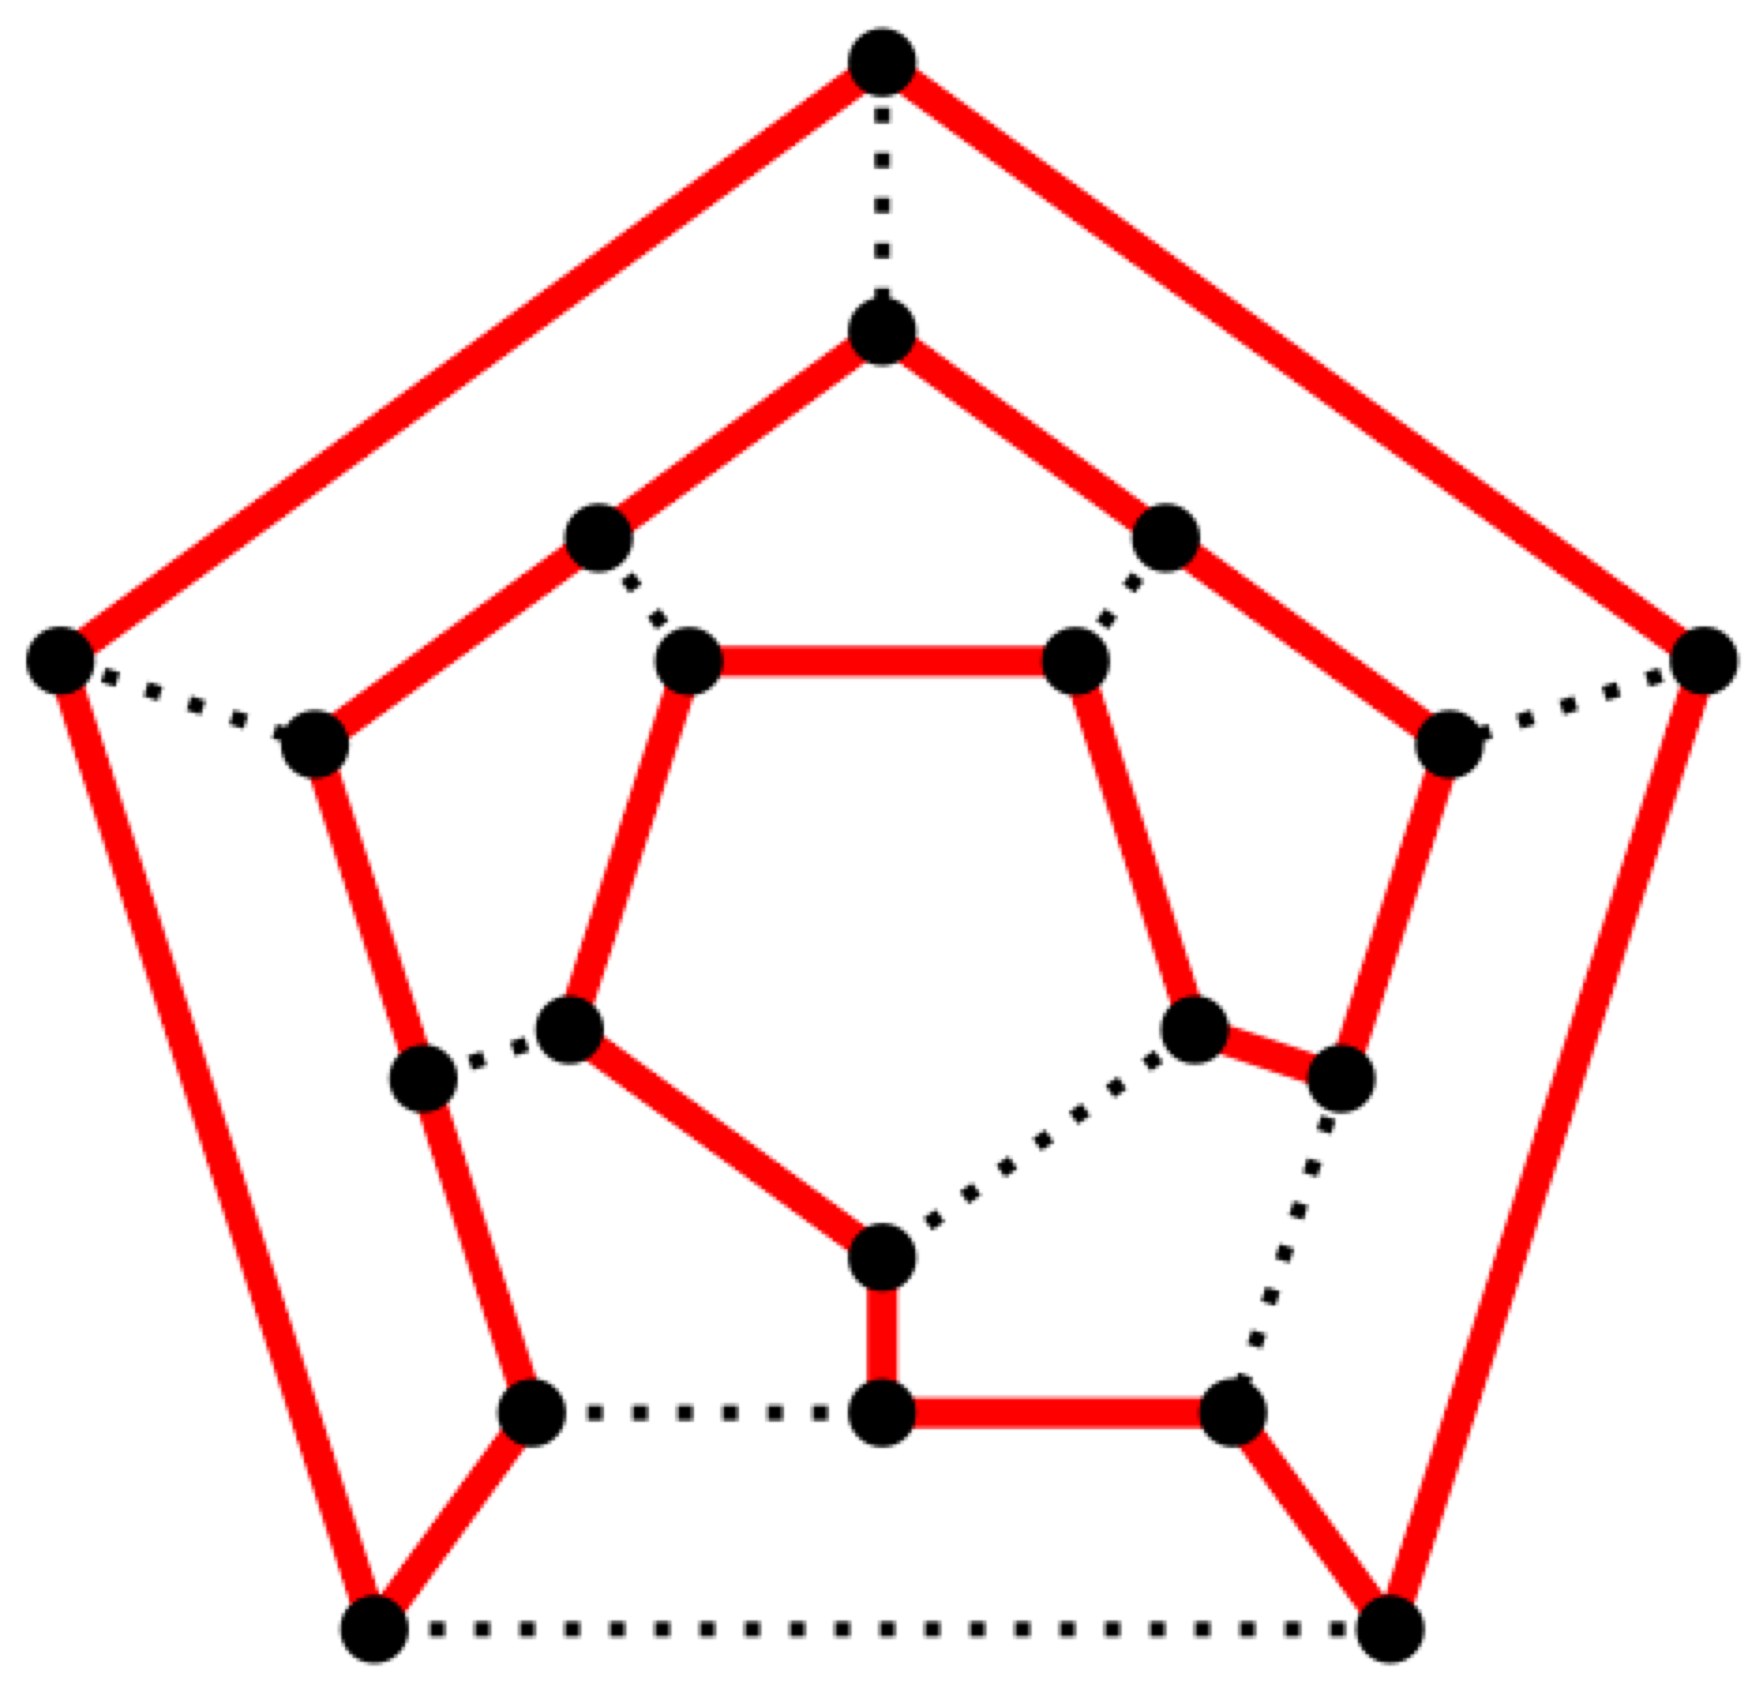
Hamiltonian Paths/Circuits
A Hamiltonian path/circuit: path/circuit that visits every vertex exactly once.
Defined for directed and undirected graphs
Notes:
8

Slide 9
Does any graph have a Hamiltonian circuit or a Hamiltonian path?
a
b
a
b
d
c
a
b
e
d
c
e
d
c
Notes:
1: a,b,c,e,d,a
2: have to go through b > 1 time
3: have to go through e > 1 time

Slide 10
Hamiltonian Paths/Circuits
Is there an efficient way to determine whether a graph has a Hamiltonian circuit?
  NO!
  This problem belongs to a class of problems for which it is believed there is no efficient (polynomial running time) algorithm.
  What is an algorithm for doing this?
  What is its complexity?

Slide 11
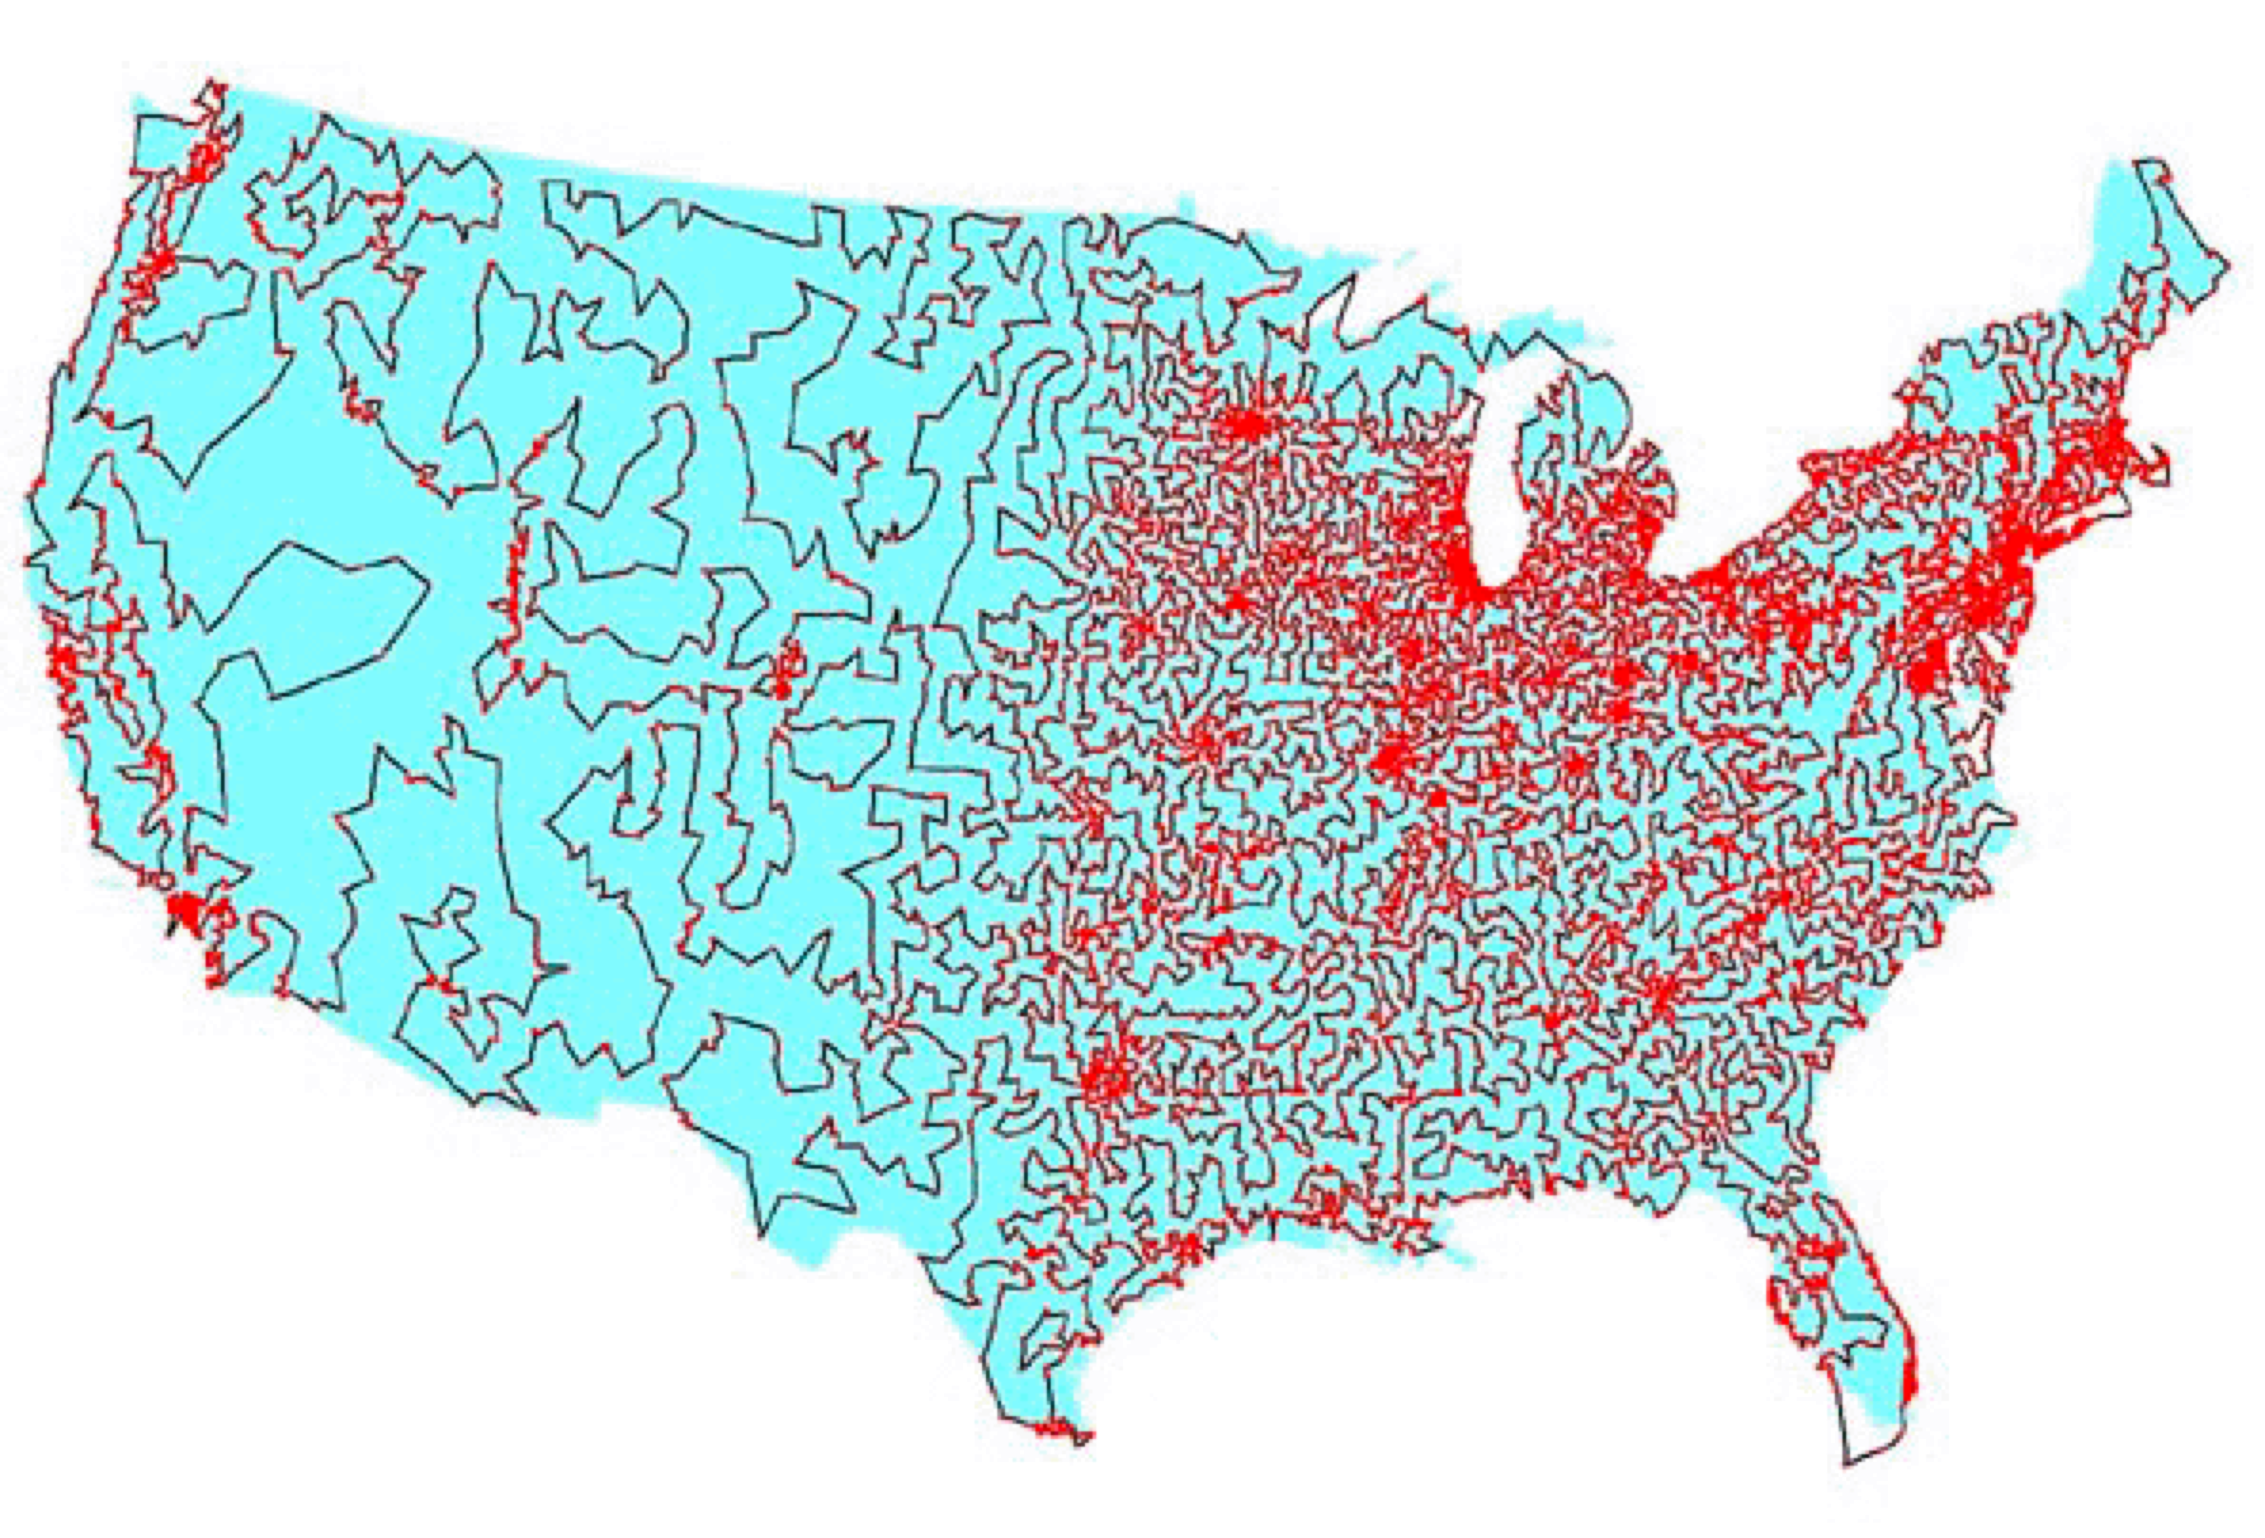
The Traveling Salesman Problem
TSP: Given a list of cities and their pairwise distances, find a shortest possible tour that visits each city exactly once.
13,509 cities and towns in the US that have more than 500 residents

Slide 12
Using Hamiltonian Circuits
Examine all possible Hamiltonian circuits and select one of minimum total length
With n cities..
  (n-1)! Different Hamiltonian circuits
  Ignore the reverse ordered circuits
  (n-1)!/2
With 50 cities
12,413,915,592,536,072,670,862,289,047,373,375,038,521,486,354,677,760,000,000,000 routes

Slide 13
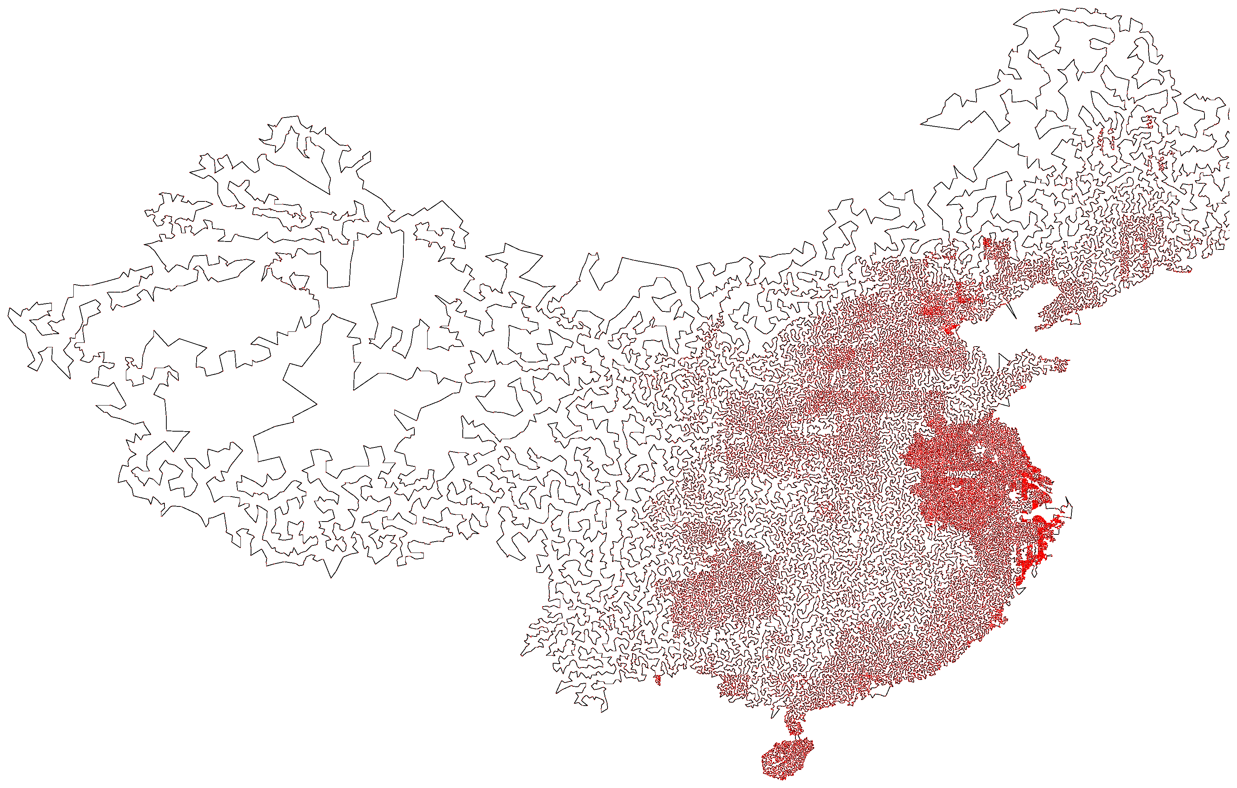
TSP
How would a approximating algorithm for TSP work?
Local search: construct a solution and then modify it to improve it
71,009 Cities in China

Slide 14
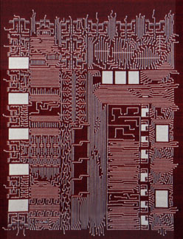
Planar Graphs
You are designing a chip
connections between any two units cannot cross
http://www.dmoma.org/

Slide 15
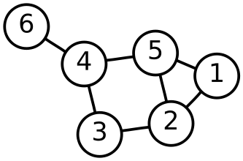
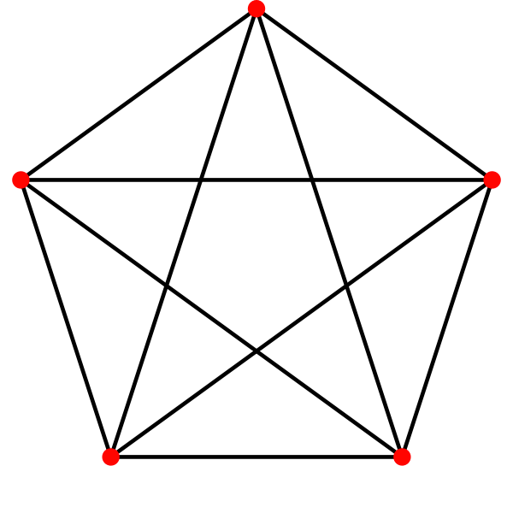
Planar Graphs
You are designing a chip connections between any two units cannot cross
The graph describing the chip must be planar
planar
non-planar
http://en.wikipedia.org/wiki/Planar_graph

Slide 16
Are these graphs planar?

Slide 17
Chip Design
You want more than planarity: the lengths of the connections need to be as short as possible (faster, and less heat is generated)
We are now designing 3D chips, less constraint w.r.t. planarity, and shorter distances, but harder to build.
http://www.dmoma.org/

Slide 18
Graph Coloring
A coloring of a simple graph is the assignment of a color to each vertex of the graph so that no two adjacent vertices are assigned the same color

Slide 19
Map and graph
B
A
C
D
D
G
B
C
F
A
F
E
E
G

Slide 20
Chromatic number
The least number of colors needed for a coloring of this graph.
The chromatic number of a graph G is denoted by χ(G)

Slide 21
The four color theorem
The chromatic number of a planar graph is no greater than four
This theorem was proved by a (theorem prover) program!

Slide 22
Example

Slide 23
Example

