Slide 1
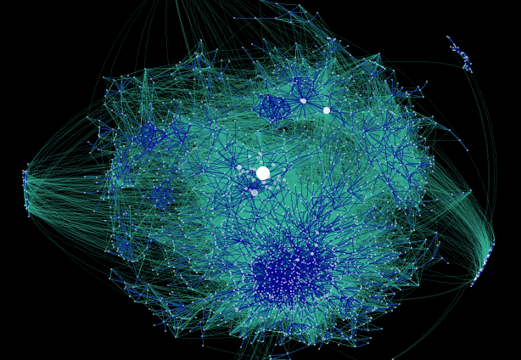
CS 220: Discrete Structures and their Applications
relations and directed graphs; transitive closure, DAGs
zybooks 9.3-9.6
http://datamining.typepad.com/gallery/blog-map-gallery.html
Notes:
http://datamining.typepad.com/gallery/blog-map-gallery.html

Slide 2
binary relations on a set
A binary relation on a set A is a subset of A x A.
Graphical representation of a binary relation on a set:
This special case of a binary relation is also called a directed graph
self loop

Slide 3
directed graphs
Edge (u, v) goes from vertex u to vertex v.
in-degree of a vertex: the number of edges pointing into it.
out-degree of a vertex: the number of edges pointing out of it.
G=(V, E)
vertices edges
edges
v
e
vertices/
nodes
u

Slide 4
terminology
A directed graph (or digraph) is a pair (V, E).
V is a set of vertices, and E, a set of directed edges, is a subset of V × V.
The vertex u is the tail of the edge (u, v) and vertex v is the head. If the head and the tail of an edge are the same vertex, the edge is called a self-loop.
Example: The web. What are the vertices/edges?
u
v

Slide 5
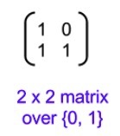
matrices
An n × m matrix over a set S is an array of elements from S with n rows and m columns.
The entry in row i and column j is denoted by A_{i,j}.
A matrix is called a square matrix if the number of rows is equal to the number of columns.
Is the adjacency matrix associated with a
graph square?

Slide 6
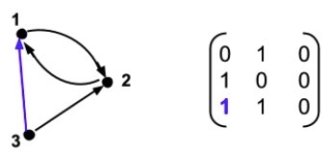
adjacency matrix
A directed graph G with n vertices can be represented by an n × n matrix over the set {0, 1} called the adjacency matrix for G.
If A is the adjacency matrix for a graph G, then A_{i,j} = 1 if there is an edge from vertex i to vertex j in G. Otherwise, A_{i,j} = 0.

Slide 7
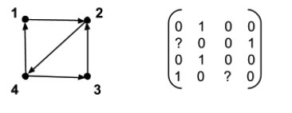
adjacency matrix
What are the missing values in the following adjacency matrix?
A_{2,1} = ?
A_{4,3} = ?

Slide 8
walks
A walk from v₀ to v_{l} in a directed graph G is a sequence of alternating vertices and edges that starts and ends with a vertex:
⟨v₀,(v₀,v₁),v₁,(v₁,v₂),v₂,...,v_{l−1},(v_{l−1},v_{l}),v_{l}⟩
v₄
v₃
v₂
v₁

Slide 9
That’s All for Today!

Slide 10
walks
A walk from v₀ to v_{l} in a directed graph G is a sequence of alternating vertices and edges that starts and ends with a vertex:
⟨v₀,(v₀,v₁),v₁,(v₁,v₂),v₂,...,v_{l−1},(v_{l−1},v_{l}),v_{l}⟩
A walk can also be denoted by the sequence of vertices:
⟨v₀,v₁,...,v_{l}⟩.
The sequence of vertices is a walk only if (v_{i-1}, v_{i}) ∈ E
for i = 1, 2,...,l.
The length of a walk is l, the number of edges in the walk.

Slide 11
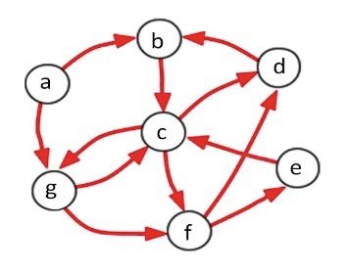
walks, circuits, paths, cycles
A circuit is a walk in which the first vertex is the same as the last vertex.
A sequence of one vertex, denoted <a>, is a circuit of length 0.
A walk is a path if no vertex is repeated in the walk.
A circuit is a cycle if there are no other repeated vertices, except the first and the last.

Slide 12
composite relations
Let R be a relation from A to B, and let S be a relation from B to C. The composite S□R of R and S is defined as:
S□R = {(a,c) : ∃b such that aRb and bSc}
Example: Let R be the relation such that aRb if a is a parent of b. What is the relation R□R?

Slide 13
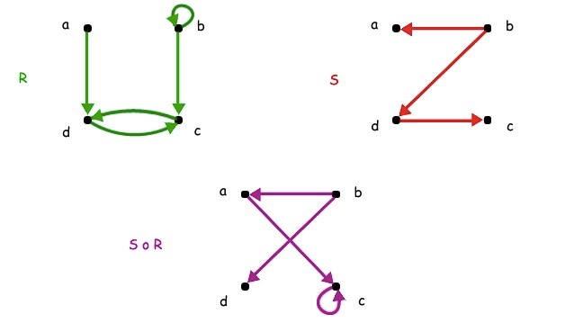
composite relations
Let R be a relation from A to B, and let S be a relation from B to C. The composite S□R of R and S is defined as:
S□R = {(a,c) : ∃b such that aRb and bSc}
Example:
Notes:
Think of function calls: S(R(x))

Slide 14
composite relations
Composite relation on a set:
e
e
d
d
a
a
c
c
b
b
R
R²

Slide 15
composite relations
The powers R^{n} of relation R can be defined recursively:
R¹ = R and R^{n+1 =} R^{n}□R
The statement of six-degrees of separation can be succinctly expressed as aR⁶b for all a,b where R is the relation on the set of people such that aRb if a knows b

Slide 16
paths and relations
The edge set E of a directed graph G can be viewed as a relation.
E^{k} : the relation E composed with itself k times.
G^{k} : the directed graph whose edge set is E^{k}.
The Graph Power Theorem: Let G be a directed graph. Let u and v be any two vertices in G. There is an edge from u to v in G^{k} if and only if there is a walk of length k from u to v in G.
Notes:
base case: there is a walk of length 1 iff aRb
induction step: There is a walk of length n+1 from a to b iff there is a c in A such that there is a walk of length 1 from a to c,
i.e. aRc and a path of length n from c to b, so by the induction hypothesis happens iff cR^nb, and by definition of
composition happens iff aR^{n+1}b

Slide 17
paths and relations
The Graph Power Theorem: Let G be a directed graph. Let u and v be any two vertices in G. There is an edge from u to v in G^{k} if and only if there is a walk of length k from u to v in G.
Proof by induction on k.
Base case: there is a walk of length 1 iff aRb
Induction step: assume that there is an edge from u to v in G^{k} if and only if there is a walk of length k from u to v in G.
Let's prove this for k+1:
There is a walk of length k+1 from a to b iff there is a c in A such that there is a walk of length 1 from a to c, i.e. aRc and a path of length k from c to b; by the induction hypothesis this happens iff cR^{k}b, and by definition of
composition iff aR^{k+1}b
Notes:
show a figure that illustrates this

Slide 18
the transitive closure
The transitive closure of a graph G:
G⁺ = G¹ ∪ G² ∪ G³ ∪ G⁴ ....
In the union, there is only one copy of the vertex set and the union is taken over the edge sets of the graphs.
(u, v) is an edge in G⁺ if vertex v can be reached from vertex u in G by a walk of any length.
Similarly we can define the transitive closure of a relation R:
R⁺ = R¹ ∪ R² ∪ R³ ∪ R⁴ ....

Slide 19
the transitive closure
Examples:
Let R be the relation between states in the US where aRb if a and b share a common border. What is R⁺?
What is R⁺ for the parent relation?
A = {1, 2, b}. What is the transitive closure for:
R = {(1, 1), (b, b)}
S = {(1, 2), (2, b)}
T = {(2, 1), (b, 2),(1,1)}

Slide 20
the transitive closure
The transitive closure of a graph G:
G⁺ = G¹ ∪ G² ∪ G³ ∪ G⁴ ....
If the graph has n vertices:
G⁺ = G¹ ∪ G² ∪ G³ ∪....∪ G^{n}
The same holds for a relation R. Let R be a relation on a finite domain with n elements. Then
R⁺ = R¹ ∪ R² ∪ R³ ∪....∪ R^{n}

Slide 21
the transitive closure
Lemma: Let G be a graph with n vertices. If there is a path from u to v in G, then there is such a path with length not exceeding n.
Notes:
Proof: You can take the cycles out:
Suppose there is a path from a to b in R
x₀=a, x₁, x₂, …, x_{m-1}, x_{m}=b of length m.
Suppose m > n. By the pigenhole principle, because there are n vertices in the graph, two must be equal.

Slide 22
an algorithm for the transitive closure
Let R be a relation over a set A.
Repeat the following step until no pair is added to R:
If there are x, y, z ∈ A such that (x, y) ∈ R, (y, z) ∈ R and (x, z) ∉ R, then add (x, z) to R.

Slide 23
DAGs : directed acyclic graphs
A directed acyclic graph (DAG) is a directed graph that has no cycles.
DAGs are an important class of graphs
Used for representing probabilistic relationships between variables (Bayesian networks)
Are at the core of dataflow programming (TensorFlow)
Many computational problems that are NP-hard on general graphs can be solved efficiently on DAGs
Notes:
Strict orders are closely related to directed acyclic graphs.

Slide 24
Example: CS prerequisite structure
CS163
Question: Is there a
cycle in this graph?
CS165
CS220
CS270
CS253
CS320
CT310
CS314
CT320
CS356
CS370
CS440
CS464
CS410
Notes:
Which course first, second?
But now: which third?

Slide 25
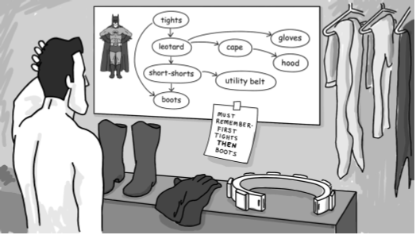
graphs describing precedence
Examples:
prerequisites for a set of courses
dependencies between programs (for installation and compilation)
Edge from a to b indicates a should come before b
Batman images are from the book “Introduction to bioinformatics algorithms”

Slide 26
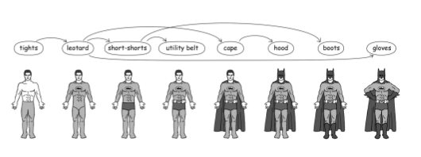
graphs describing precedence
Want an ordering of the vertices of the graph that respects the precedence relation
Example: An ordering of CS courses
Topological sort: listing of nodes such that if (a,b) is an edge, a appears before b in the list

Slide 27
graphs describing precedence
Want an ordering of the vertices of the graph that respects the precedence relation
Topological sort: listing of nodes such that if (a,b) is an edge, a appears before b in the list
Is a topological sort unique?

Slide 28
topological sort
Pick a vertex x with in-degree 0 and remove x from G, including all its outgoing edges.
Then pick another vertex with in-degree 0 from the remaining vertices.
Keep selecting vertices until no vertices left.

