Slide 1
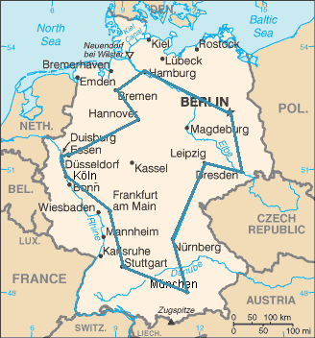
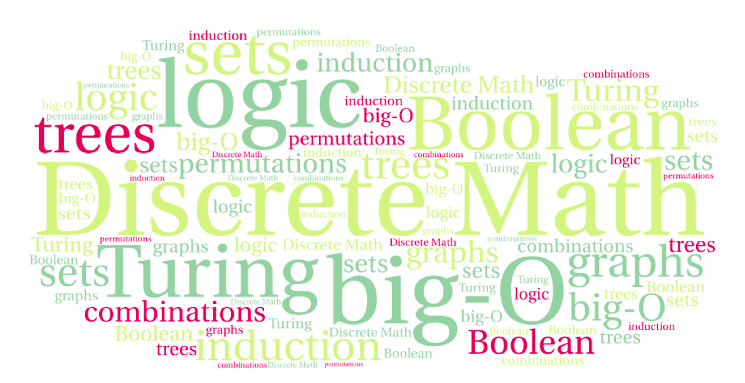
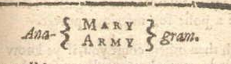
CS 220: Discrete Structures and their Applications
Permutations and combinations
zybooks 7.4-7.6

Slide 2
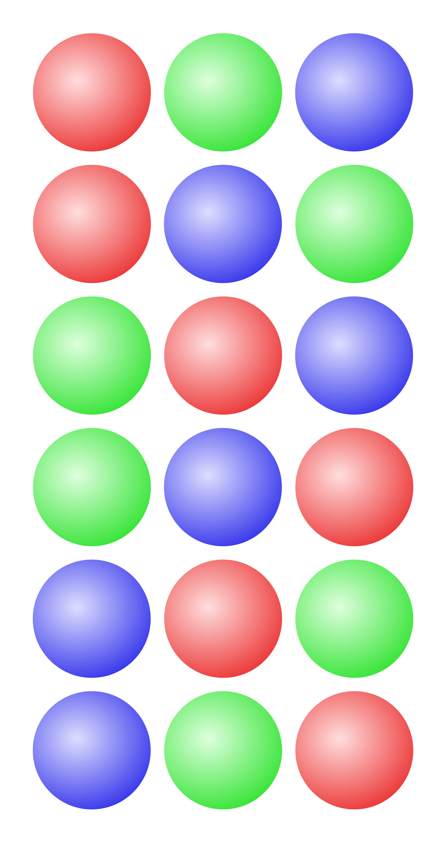
Motivating question
In a family of 3, how many ways are there to arrange the members of the family in a line for a photograph?
3 x 3
3!
3 x 3 x 3
2³

Slide 3
The Traveling Salesman Problem (TSP)
TSP: Given a list of cities and their pairwise distances, find a shortest possible tour that visits each city exactly once.
Objective: find an ordering a₁,…,a_{n} of
the cities that minimizes
where d(i, j) is the distance between
cities i and j
An optimal TSP tour through Germany’s 15 largest cities
Notes:
An optimal TSP tour through Germany’s 15 largest cities. It is the shortest among 43 589 145 600 possible tours visiting each city exactly once.
A lot of computer science problems involve finding the best ordering of a collection of objects. These are called permutations.

Slide 4
Permutations
A permutation of a set of distinct objects is an ordered arrangement of these objects.
  Example: (1, 3, 4, 2) is a permutation of the numbers 1, 2, 3, 4
How many permutations of n objects are there?

Slide 5
How many permutations?
How many permutations of n objects are there?
Using the product rule:
n .(n – 1) . (n – 2) ,…, 2 . 1 = n!

Slide 6

Anagrams
Anagram: a word, phrase, or name formed by rearranging the letters of another.
Examples:
“cinema” is an anagram of iceman
"Tom Marvolo Riddle” is an anagram of
"I am Lord Voldemort”
The anagram server: http://wordsmith.org/anagram/
Notes:
Games with anagrams, e.g. Clabbers: tiles may be placed in any order on the board as long as they anagram to a valid word.
Permutation city begins with a 20 line anagrammatic poem.

Slide 7
Example
How many permutations of {a,b,c,d,e,f,g} end with a?
5!
6!
7!
6 x 6!

Slide 8
Example
You invite 6 people for a dinner party. How many ways are there to seat them around a round table? (Consider two seatings to be the same if everyone has the same left and right neighbors).
6!
5!
7!
Notes:
You can express this as 6!/6 (the book calls this the division rule). Or say 5! From the get go because in a circle it doesn’t matter where you put the first one, so there are 5 others to arrange.

Slide 9
Example
Count the number of ways to arrange n men and n women in a line so that no two men are next to each other and no two women are next to each other.
a) n!
b) n! n!
c) 2 n! n!

Slide 10
The Traveling Salesman Problem (TSP)
TSP: Given a list of cities and their pairwise distances, find a shortest possible tour that visits each city exactly once.
Objective: find an ordering a₁,…,a_{n} of
the cities that minimizes
where d(i, j) is the distance between
cities i and j
An optimal TSP tour through Germany’s 15 largest cities
Notes:
An optimal TSP tour through Germany’s 15 largest cities. It is the shortest among 43 589 145 600 possible tours visiting each city exactly once.
A lot of computer science problems involve finding the best ordering of a collection of objects. These are called permutations.

Slide 11
solving TSP
An algorithm for the TSP problem:
Go through all permutations of cities, and evaluate the sum-of-distances, keeping the optimal tour.
Notes:
(n-1)!/2
side note: Do we actually need to consider all permutations of n cities?

Slide 12
generating permutations
how to generate permutations recursively?

Slide 13
generating permutations
how to generate permutations recursively
all permutations
of {1,2,3}
put 1 first
put 2 first
put 3 first
all permutations
of {2,3}
all permutations
of {1,3}
all permutations
of {1,2}

Slide 14
generating permutations code
Does this work?
def perm(A,f):
if f == len(A)-1:
print(A)
else:
for i in range(f,len(A)) :
A[i], A[f] = A[f], A[i]
perm(A,f+1)
A = []
for i in range(n):
A.append(i)
perm(A,0)
Let’s try it ...

Slide 15
solving TSP
Is our algorithm for TSP that considers all permutations a feasible one for solving TSP problems with hundreds or thousands of cities?
NO: 50 cities:
(n-1)!/2 = 12,413,915,592,536,072,670,862,289,047,373,375,038,521,486,354,677,760,000,000,000
We call problems like TSP intractable.
Question: would there be a faster algorithm for printing all permutations?

Slide 16
r-permutations
r-permutation: An ordered arrangement of r elements of a set.
Example: List the 2-permutations of {a,b,c}.
(a,b), (a,c), (b,a), (b,c), (c,a), (c,b)
The number of r-permutations of a set of n elements: P(n,r) = n(n – 1)… (n – r + 1) (0 ≤ r ≤ n)
Example: P(3,2) = 3 x 2 = 6
Can be expressed as:
P(n, r) = n! / (n – r)!
Note that P(n, 0) = 1.

Slide 17
r-permutations - example
How many ways are there to select a first-prize winner, a second prize winner and a third prize winner from 100 people who have entered a contest?

Slide 18
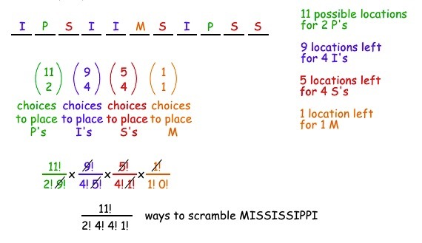
permutations with repetitions
How many ways are there to scramble the letters in the word MISSISSIPPI?

Slide 19
permutations with repetitions
The general statement of the principle:
The number of distinct sequences with n₁ 1's, n₂ 2's, ..., n_{k} k's, where n = n₁ + n₂ +...+ n_{k} is

Slide 20
question
How many poker hands (five cards) can be dealt from a deck of 52 cards?
How is this different than r-permutations?

Slide 21
question
How many poker hands (five cards) can be dealt from a deck of 52 cards?
How is this different than r-permutations?
In an r-permutation we cared about order. In this case we don’t

Slide 22
combinations
An r-combination of a set is a subset of size r
The number of r-combinations out of a set with n elements is denoted as C(n,r) or
  {1,3,4} is a 3-combination of {1,2,3,4}
  How many 2-combinations of {a,b,c,d}?

Slide 23
Unordered versus ordered selections
Two ordered selections are the same if
  the elements chosen are the same
  the elements chosen are in the same order.
Ordered selections: r-permutations.
Two unordered selections are the same if
  the elements chosen are the same
  (regardless of the order in which the elements are chosen)
Unordered selections: r-combinations.

Slide 24
Permutations or combinations?
Determine if the situation represents a permutation or a combination:
  In how many ways can three student-council members be elected from five candidates?
  In how many ways can three student-council members be elected from five candidates to fill the positions of president, vice-president and treasurer
  A DJ will play three songs out of 10 requests.

Slide 25
relationship between P(n,r) and C(n,r)
Constructing an r-permutation from a set of n elements can be thought as a 2-step process:
Step 1: Choose a subset of r elements;
Step 2: Choose an ordering of the r-element subset.
Step 1 can be done in C(n,r) different ways.
Step 2 can be done in r! different ways.
Based on the multiplication rule, P(n,r) = C(n,r) ∙ r!
Thus

Slide 26
r-combinations
How many r-combinations?
Note that C(n, 0) = 1
Note that C(n,r) = C(n,n-r)
Example: How many poker hands (five cards) can be dealt from a deck of 52 cards?
  C(52,5) = 52! / (5!47!)

Slide 27
r-combinations
How many r-combinations?
Note that C(n, 0) = 1
C(n,r) satisfies:
  We can see that easily without using the formula

Slide 28
combinations or permutations?
How many bit strings of length n contain exactly r ones?
P(n,r) or C(n,r)?
Notes:
The positions of the r 1s form an r-combination, so C(n,r)

Slide 29
Example
The faculty in biology and computer science want to develop a program in computational biology. A committee of 4 composed of two biologists and two computer scientists is tasked with doing this. How many such committees can be assembled out of 20 CS faculty and 30 biology faculty?

Slide 30
Example
A coin is flipped 10 times, producing either heads or tails. How many possible outcomes
  are there in total?
  contain exactly two heads?
  contain at least three heads?

Slide 31
Example
How many permutations of the letters ABCDEFGH contain the string ABC?

Slide 32
Example
How many 10 character (digits and lowercase/uppercase letters) passwords are possible if
characters cannot be repeated?
a 62¹⁰ b C(62, 10) c P(62, 10)
b) characters can be repeated?

Slide 33
Enumerating Combinations(5,3)
012 123 234
013 124
014 134
023 what is the largest digit
024 we can place in the first
034 position? Can you
generalize that for C(n,k)?

Slide 34
How do we do it?
place digits d from lo to hi in position p
then recursively place digits in position p+1
lo: previously placed digit +1
hi: n-k for pos 0, n-k+1 for pos 1, n-k+p for pos p
Now write the code for generating combinations (PA4)

