Slide 1
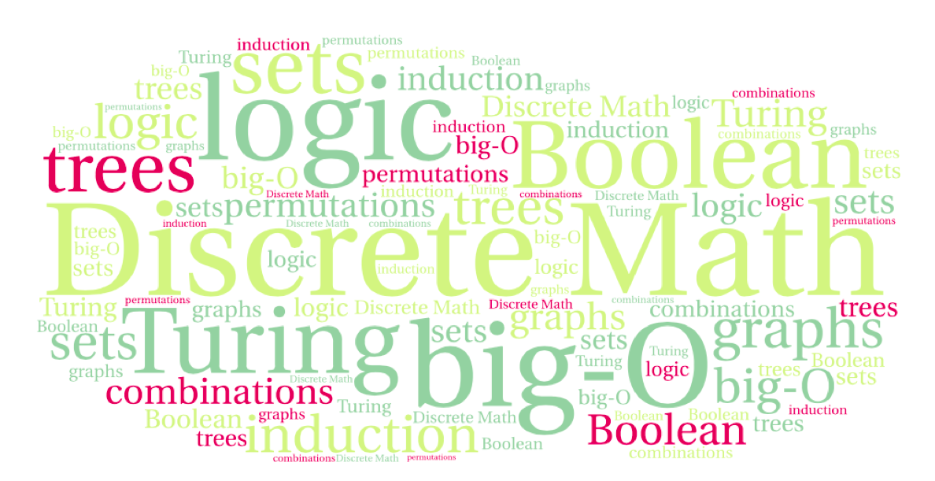
CS 220: Discrete Structures and their Applications
Recursive algorithms and induction
6.8 in zybooks

Slide 2
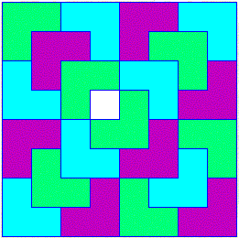
Induction and Recursion
Several of the inductive proofs we looked at lead to recursive algorithms:
The triomino tiling problem
Making postage using 3 and 5 cent stamps
Generating all subsets of a set recursively
E.g., all entries of a truth table with n variables
Induction is useful for designing and proving the correctness of recursive algorithms

Slide 3
String reversal
Consider the following recursive algorithm for reversing a string:
reverse_string(s)
if s is the empty string:
return s
let c be the first character in s
remove c from s
s' = reverse_string(s)
return the string s' with c added to the end

Slide 4
String reversal
Proof of correctness of reverse_string
reverse_string(s)
if s is the empty string:
return s
let c be the first character in s
remove c from s
s' = reverse_string(s)
return the string s' with c added to the end
By induction on the length of the string
Base case: If s has length 0 the algorithm returns s which is its own reverse.

Slide 5
String reversal
Proof of correctness of reverse_string
reverse_string(s)
if s is the empty string:
return s
let c be the first character in s
remove c from s
s' = reverse_string(s)
return the string s' with c added to the end
Inductive step: assume that reverse_string works correctly for strings of length k and show that for k+1
Let s be a string of length k + 1. s = c₁c₂…c_{k}c_{k+1}.
reverse_string makes a recursive call whose input is c₂…c_{k}c_{k+1}.
By the induction hypothesis it returns the inverse: c_{k+1}c_{k}…c₂
It then adds c₁ at the end, returning c_{k+1}c_{k}…c₂c₁, which is the reverse of s

Slide 6
recursive power
def pow(x, n):
#precondition: x and n are positive integers
if (n == 0):
return 1
else :
return x * pow(x, n-1)
}
}

Slide 7
recursive power
def pow(x, n):
#precondition: x and n are positive integers
if (n == 0):
return 1
else :
return x * pow(x, n-1)
Claim: the algorithm correctly computes x^{n}.
Proof: By induction on n
Basis step: n = 0: it correctly returns 1
Inductive step: assume that for n the algorithm correctly returns x^{n}.
Then for n+1 it returns x x^{n} = x^{n+1}.

Slide 8
Egyptian Exponentiation
In PA2 you are implementing an iterative exponentiation algorithm, based on the following recursive definition:
def pow(x, n):
#precondition: x and n are positive integers
if n == 0:
return 1
else if not (n/2 == n//2):
return x * pow(x**2, n//2)
else:
return pow(x**2, n//2)
Does linear induction work for this algorithm? Why (not) ?
What do we need?

