Slide 1
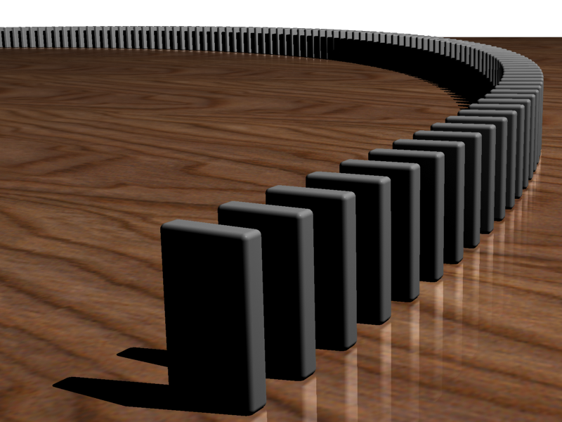
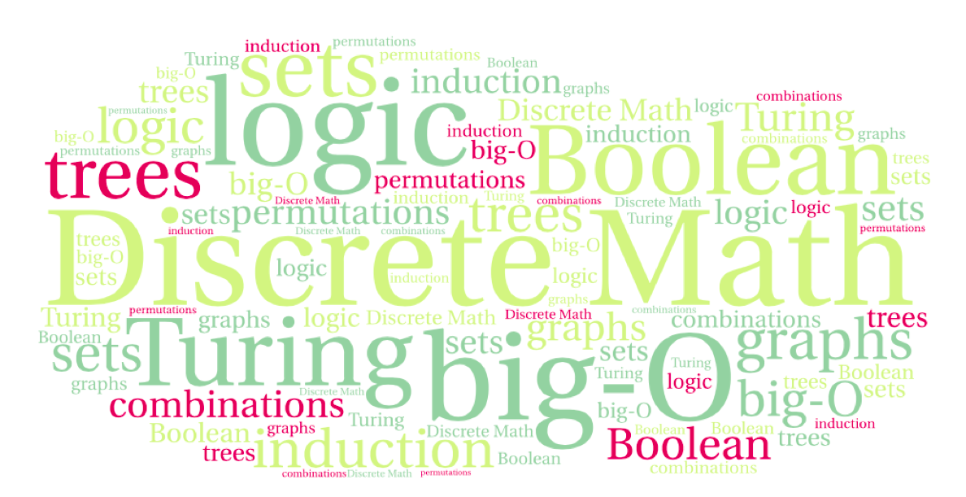
CS 220: Discrete Structures and their Applications
Mathematical Induction
6.4 – 6.6 in zybooks

Slide 2
Why induction?
Prove algorithm correctness (CS320 is full of it)
The inductive proof will sometimes point out an algorithmic solution to a problem
Strongly connected to recursion

Slide 3
Motivation
Show that any postage of ≥ 8¢ can be obtained using 3¢ and 5¢ stamps.
First check for a few values:
8¢ = 3¢ + 5¢
9¢ = 3¢ + 3¢ + 3¢
10¢ = 5¢ + 5¢
11¢ = 5¢ + 3¢ + 3¢
12¢ = 3¢ + 3¢ + 3¢ + 3¢
How to generalize this?
Notes:
3+3+3+1 = 5+5
5+1 = 3+3

Slide 4
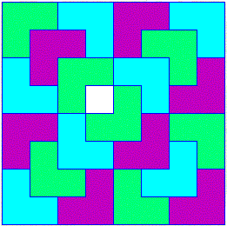
Motivation
Let n be a positive integer. Show that every 2^{n} x 2^{n} chessboard with one square removed can be tiled using triominoes, each covering three squares at a time.

Slide 5
Motivation
Prove that for every positive value of n,
1 + 2 + ,…, + n = n(n + 1)/2.
Notes:
Pie fights

Slide 6
Motivation
Many mathematical statements have the form:
∀n ∈ N, P(n)
Example: For every positive value of n,
1 + 2 + ,…, + n = n(n + 1)/2.
Predicate – propositional function that depends on a variable, and has a truth value once the variable is assigned a value.
Mathematical induction is a proof technique for proving such statements
P(n): Logical predicate
Notes:
Pie fights

Slide 7
Proving P(3)
Suppose we know:
1. P(1) and 2. P(n) → P(n + 1) ∀n ≥ 1.
Prove: P(3)
Proof:
1. P(1). [premise]
2. P(1) → P(2). [specialization of premise]
3. P(2). [step 1, 2, & modus ponens]
4. P(2) → P(3). [specialization of premise]
5. P(3). [step 3, 4, & modus ponens]
We can construct a proof for every finite value of n
Modus ponens: if p and p → q then q

Slide 8
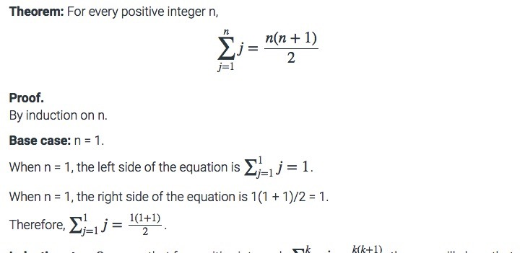
Example
a

Slide 9
Example
a

Slide 10
A Geometrical interpretation
1:
2:
3:
Put these blocks, which represent numbers, together to form sums:
1 + 2 =
1 + 2 + 3 =

Slide 11
A Geometrical interpretation
n
n
Area is n²/2 + n/2 = n(n + 1)/2

Slide 12
The principle of mathematical induction
Let P(n) be a statement that, for each natural number n, is either true or false.
To prove that ∀n∈N, P(n), it suffices to prove:
P(1) is true. (basis step)
∀n∈N, P(n) → P(n + 1). (inductive step)
This is not magic.
It is a recipe for constructing a proof for an arbitrary n∈N.

Slide 13
the domino principle
If
the 1st domino falls over
and
the nth domino falls over implies that domino (n + 1) falls over
then
domino n falls over for all n ∈ N.
image from http://en.wikipedia.org/wiki/File:Dominoeffect.png

Slide 14
proof by induction
3 steps:
Prove P(1). [the basis step]
Assume P(k) [the induction hypothesis]
Using P(k) prove P(k + 1) [the inductive step]

Slide 15
Example
Show that any postage of ≥ 8¢ can be
obtained using 3¢ and 5¢ stamps.
Basis step:
8¢ = 3¢ + 5¢

Slide 16
Example
Let P(n) be the statement “n cents postage can be
obtained using 3¢ and 5¢ stamps”.
Want to show that
“P(k) is true” implies “P(k+1) is true” for all k ≥ 8.
2 cases:
1) P(k) is true and
the k cents contain at least one 5¢.
2) P(k) is true and
the k cents do not contain any 5¢.

Slide 17
Example
Case 1: k cents contain at least one 5¢ stamp.
Case 2: k cents do not contain any 5¢ stamp.
Then there are at least three 3¢ stamp.
Replace 5¢ stamp by two 3¢ stamps
k cents
k+1 cents
5¢
3¢
3¢
Replace three 3¢ stamps by two 5¢ stamps
k cents
k+1 cents
3¢
3¢
3¢
5¢
5¢

Slide 18
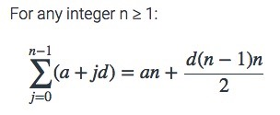
Arithmetic sequences
Sum of an arithmetic sequence:
Proof: By induction on n
Base case: n=1
Induction step:
Assume:
Need to prove:

Slide 19
Examples
Prove that 1 + 2 + 2² + … + 2^{n} = 2^{n + 1} – 1
Prove that for n≥4 2^{n} < n!
Prove that n³–n is divisible by 3 for every positive n.
Prove that 1 + 3 + 5 + ... + (2n+1) = (n+1)²
Prove that a set with n elements has 2^{n} subsets
Prove that 1² + 2² + 3² + … + n² = n(n+1)(2n+1)/6 for n>0
each time ask yourself
1. BASE
What is the base case? Can I prove the base case?
2. STEP
What is the hypothesis?
Obligation: What do I need to prove the inductive step
How do I complete the inductive step?
Hint: 2n²+7n+6 = (n+2)(2n+3)
Notes:
Sk = {1,…,k}
For each subset of of Sk there are two subsets of Sk+1: one that includes k+1 and one that doesn’t.

Slide 20
Example
Prove that P(n): 1² + 2² + 3² + … + n² = n(n+1)(2n+1)/6 for n>0
Base: n=1 1² = 1.2.3/6
Hypothesis: P(k): 1² + 2² + 3² + … + k² = k(k+1)(2k+1)/6
Obligation P(k) → P(k+1) : 1² + 2² + 3² + … + (k+1)² = (k+1)(k+2)(2k+3)/6
Proof:
1² + 2² + 3² + … + (k+1)² =
1² + 2² + 3² + … + k² + (k+1)² =
k(k+1)(2k+1)/6 + (k+1)² = (k+1)(k(2k+1)+6(k+1))/6 =
(k+1)(2k²+7k+6)/6 =
(k+1)(k+2)(2k+3)/6
hypothesis
Hint: 2n²+7n+6 = (n+2)(2n+3)

Slide 21
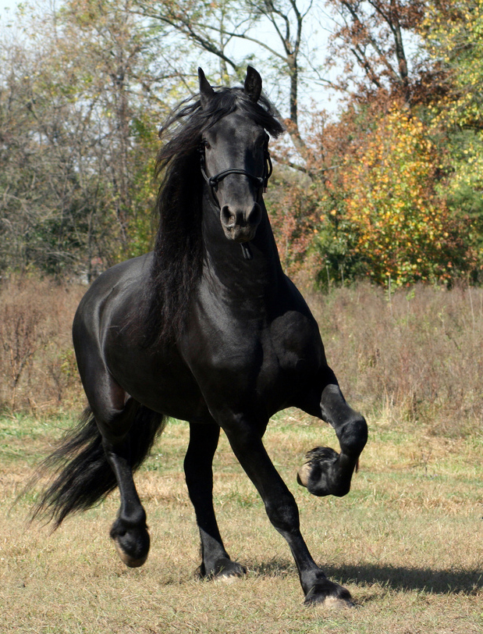
All horses have the same color
Base case: If there is only one horse, there is
only one color.
Induction step: Assume as induction hypothesis that within any set of n horses, there is only one color. Now look at any set of n + 1 horses. Number them: 1, 2, 3, ..., n, n + 1. Consider the sets {1, 2, 3, ..., n} and {2, 3, 4, ..., n + 1}. Each is a set of only n horses, therefore within each there is only one color. But the two sets overlap, so there must be only one color among all n+1 horses.
This is clearly wrong, but can you find the flaw?

Slide 22
NOT all horses have the same color
The step from
k = 1 {1}
to
k = 2 {1,2}
Fails: there is no intersection: {1} ⋂ {2} in a set of two horses, as was incorrectly used in the ”proof”.

Slide 23
More induction examples
Let n be a positive integer. Show that every 2^{n} x 2^{n} chessboard with one square removed can be tiled using L-shaped triominoes, each covering three squares at a time.
First, show that
3 | 2^{n} x 2^{n} – 1
(i.e. 3 divides 2^{n} x 2^{n} – 1 )
Notes:
3 | 3
2^{n+1} x 2^{n+1} -1 = 4( 2^{n} x 2^{n} -1) + 4 - 1 = 4( 2^{n} x 2^{n} -1) + 3
And 3 | 4( 2^{n} x 2^{n} -1) and 3 | 3

Slide 24
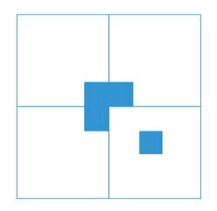
Tiling with triominoes
Divide the board into four sub-boards:
Base case?

Slide 25
A bound on Fibonacci numbers
The Fibonacci sequence:
f₀ = 0, f₁ = 1
f_{n} = f_{n−1} + f_{n−2} for n ≥ 2
Theorem: f_{n} ≤ 2^{n} for n ≥ 0

Slide 26
Strong induction
Induction:
P(1) is true.
∀n ∈N, P(n) → P(n + 1).
Implies ∀n ∈N, P(n)
Strong induction:
P(1) is true.
∀n ∈N, (P(1) ∧ P(2)∧…∧P(n)) → P(n + 1).
Implies ∀n ∈N, P(n)

Slide 27
Example
Prove that all natural numbers ≥ 2 can be represented as a product of primes.
Basis: n=2: 2 is a prime.

Slide 28
Example
Inductive step: show that n+1 can be represented as a product of primes.
If n+1 is a prime: It can be represented as a product of 1 prime, itself.
If n+1 is composite: Then, n + 1 = ab, for some a,b < n + 1.
Therefore, a = p₁p₂ . . . p_{k} & b = q₁q₂ . . . q_{l}, where the p_{i}s & q_{i}s are primes.
Represent n+1 = p₁p₂ . . . p_{k}q₁q₂ . . . q_{l.}
Notes:
Where did we use the IH?

Slide 29
Breaking chocolate
Theorem: Breaking up a chocolate
bar with n “squares” into individual
squares takes n-1 breaks.
(Break = dividing (sub) bar in 2
along a “break line”)
A full binary tree (sometimes proper binary tree or 2-tree) is a tree in which every node other than the leaves has two children.
Prove:
A full binary tree with n leaves has n-1 internal nodes
What is the relation with the chocolate bar?

Slide 30
Induction and the well ordering principle
The well-ordering principle:
any non-empty subset of the non-negative integers has a smallest element.
Surprising fact:
Well-ordering implies the principle of mathematical induction
Smallest element: base
Next element: step

