Slide 1
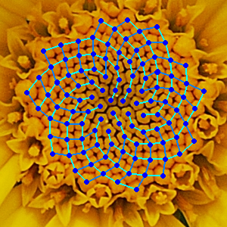
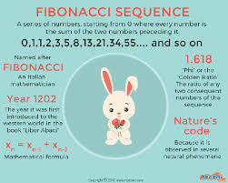
CS 220: Discrete Structures and their Applications
sequences, recurrence relations, summations
zybooks sections 6.1-6.3

Slide 2
sequences
A sequence is a special type of function in which the domain is a consecutive set of integers.
Example:
Consider a student's GPA in each of their four years in college.
Let's express this as a function g : {1,2,3,4} → R, e.g.
g(1)=3.67, g(2)=2.88, g(3)=3.25, g(4)=3.75
As a shorthand we'll use subscripts for the domain:
g₁=3.67, g₂=2.88, g₃=3.25, g₄=3.75
When the indices are known you can simply list the sequence of values:
3.67, 2.88, 3.25, 3.75

Slide 3
sequences
Sequences can have negative indices, e.g.
a₋₂=0, a₋₁=1, a₀=1, a₁=0
They can be finite:
a_{m}, a_{m+1}, ... ,a_{n}
Or infinite:
a_{m}, a_{m+1}, a_{m+2}, ...
The elements of a sequence can be defined by a formula e.g.:
d_{k} = 2^{k} where k = 0,1,2,...
This defines the sequence 1, 2,4,....

Slide 4
geometric sequences
A geometric sequence is a sequence of real numbers of the form
a, ar,ar²,...,ar^{n},...
Each element is obtained by multiplying the previous element by the common ratio of the sequence (r); the first number is some arbitrary number (a)
Example:
1, 1/2, 1/4, 1/8, 1/16, ...
What are a and r for this sequence?
A geometric sequence can be finite or infinite.

Slide 5
geometric sequences
An individual takes out a $20,000 car loan. The interest rate for the loan is 3%, compounded monthly. Assume a monthly payment of $500. Define a_{n} to be the outstanding debt after n months. Since the interest rate describes the annual interest, the percentage increase each month is actually 3% / 12 = 0.25%. Thus, the multiplicative factor increase each month is 1.0025. The recurrence relation for {a_{n}} is:
a₀ = $20,000
a_{n}= (1.0025)⋅a_{n−1} − 500 for n≥1
The first few values, to the nearest dollar, for the sequence {a_{n}} are:
a₀=$20,000 a₁=$19,550
a₂=$19,099 a₃=$18,647⋯

Slide 6
compound interest
You deposit $10,000 in a savings account that yields 5% yearly interest. How much money will you have after 30 years?
Why?
Notes:
For each, calculate values for different n’s.
On compound interest, b is balance and r is rate.
Solve it (by repeated substitution)
Write the python expression: 1.05**30*10000

Slide 7
arithmetic sequences
An arithmetic sequence is a sequence of real numbers the form
a, a + d, a + 2d, . . . , a + nd, ...
Each element is obtained by adding a constant d to the previous element; the first number is some arbitrary number (a)
Example:
3, 1, −1, −3, −5, −7,...
a = ? d = ?

Slide 8
recurrence relations
A recurrence relation for the sequence {a_{n}} is an equation that expresses a_{n} in terms of one or more of the previous terms of the sequence.
Examples:
a₀ = a (initial value)
a_{n} = d + a_{n-1} for n ≥ 1 (recurrence relation)
a₀ = a (initial value)
a_{n} = r⋅ a_{n-1} for n ≥ 1 (recurrence relation)
write closed forms for a_{n}
Notes:
a1 = a+d a2=a+2d an=a + nd
a1 = ra a2=r²a an=r^{n}a

Slide 9
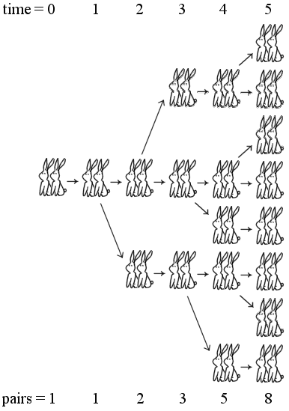
recurrence relations
A recurrence relation for the sequence {a_{n}} is an equation that expresses a_{n} in terms of one or more of the previous terms of the sequence.
Example: the Fibonacci sequence
f₀ = 0
f₁ = 1
f_{n} = f_{n−1} + f_{n−2} for n ≥ 2
Notes:
Suppose a newly-born pair of rabbits, one male, one female, are put on an island.
A pair of rabbits doesn’t breed until 2 months old.
Thereafter each pair produces another pair each month
Rabbits never die.
How many pairs will there be after n months?

Slide 10
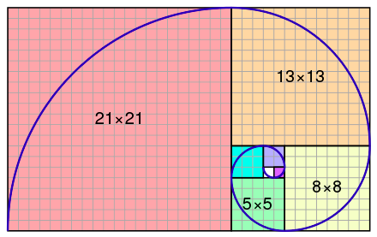
recurrence relations
A recurrence relation for the sequence {a_{n}} is an equation that expresses a_{n} in terms of one or more of the previous terms of the sequence.
Example: the Fibonacci sequence
f₀ = 0
f₁ = 1
f_{n} = f_{n−1} + f_{n−2} for n ≥ 2
https://en.wikipedia.org/wiki/Fibonacci_number
Notes:
Suppose a newly-born pair of rabbits, one male, one female, are put on an island.
A pair of rabbits doesn’t breed until 2 months old.
Thereafter each pair produces another pair each month
Rabbits never die.
How many pairs will there be after n months?

Slide 11
summation notation
Consider a sequence
Notation to express the sum of the sequence:
Some useful sums:
arithmetic series: $\sum_{i=0}^{n}{i=\frac{n(n+1)}{2}}$
sum of squares: $\sum_{i=0}^{n}{i^{2}}$= $\frac{n(n+1)(2n+1)}{6}$
$geometric series: \sum_{i=0}^{n}{r^{i}}$= $\frac{r^{n+1}−1}{r−1}$
upper limit
lower limit
Notes:
0+1+2 = 2*3/2 = 3
0+1+2+3 = 3*4/2 = 6
0+1+4+9 = 14 = (3*4*7)/6
Play with r = ½ , 2,3
1 + ½ + ¼ = 1¾ = 1/2³ - 1 / -1/2
1+ 2 + 4 + 8 = 15 = (16-1)/(2-1)
1+ 3 + 9 + 27 = 40 = (81-1)/(3-1)

Slide 12
summation notation
Careful: Use of parentheses:
is not the same as

