Slide 1
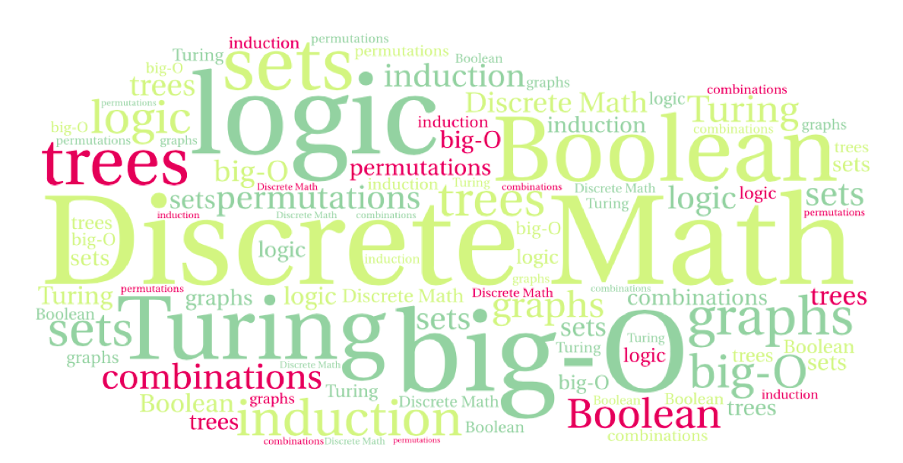
CS 220: Discrete Structures and their Applications
Functions
Chapter 5 in zybooks

Slide 2
Functions
A function maps elements from one set X to elements of another set Y.
A
B
Brian
C
Drew
range: {A, B, D}
Alan
D
F
Ben
domain
X = {Brian, Drew, Alan, Ben}
target
Y = {A,B,C,D,F}
The range contains the target values that the function maps to

Slide 3
definition
Let X and Y be nonempty sets. A function from X to Y is an assignment of exactly one element of Y to each element of X.
Notation: f: X → Y, f(x) = y
Specifying a function:
Formula: f(x) = x + 1
Explicit specification:
A
B
Brian
C
Drew
Alan
D
F
Ben

Slide 4
definition
A function f that maps elements of a set X to elements of a set Y, is a subset of X × Y such that for every x ∈ X, there is exactly one y ∈ Y for which (x, y) ∈ f.
The fact that f maps x to y (or (x, y) ∈ f) is denoted as f(x) = y.
f: X → Y
X - the domain of f
Y - the target of f
The range of f: { y : (x, y) ∈ f, for some x ∈ X }
same as: { y : f(x)=y, for some x ∈ X }
It is a subset of the target.

Slide 5
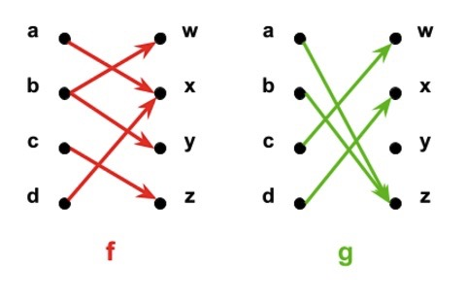
functions
One of these diagrams does not represent a valid function.
domain, target, range?

Slide 6
Examples
Let f be the function that assigns the last two bits of a binary bit string of length >= 2. For example: f(11010) = 10
What is the:
Domain, target, and range?

Slide 7
The floor function
The floor function rounds x down to the closest integer less than or equal to x.
floor: R → Z
floor(x) = the largest integer y such that y ≤ x.
Notation: floor(x)=⌊x⌋
Examples:
⌊4.32⌋=4 ⌊4⌋=4
⌊−4.32⌋=−5 ⌊−4⌋=−4

Slide 8
The ceiling function
The ceiling function rounds x up to the closest integer greater than or equal to x.
ceiling: R → Z
ceiling(x) = the smallest integer y such that x ≤ y.
Notation: ceiling(x)=⌈x⌉
Examples:
⌈4.32⌉=5 ⌈4⌉=4
⌈−4.32⌉=−4 ⌈−4⌉=−4

Slide 9
Floor or ceiling?
A baker is packaging cookies in boxes of 8. He has y cookies to put into boxes. How many boxes can he sell?

Slide 10
one-to-one functions
A function f is said to be one-to-one or injective if and only if x₁ ≠ x₂ implies that f(x₁) ≠ f(x₂) for all x₁ and x₂ in the domain of f.
Example:
1
2
3
4
…
9
…
16
1
2
3
4

Slide 11
one-to-one functions
A function f is said to be one-to-one or injective if and only if x₁ ≠ x₂ implies that f(x₁) ≠ f(x₂) for all x₁ and x₂ in the domain of f.
what about f(x) = x² with the domain Z ?
what about f(x) = x² with the domain Z⁺?
Notes:
f(1) = f(-1) so in Z not injective
Z⁺ positive ints so f injective (see previous slide)

Slide 12
onto functions
A function f: X → Y is said to be onto or surjective if and only if for every y in Y there is an x in X with f(x) = y.
In other words: its range equals its target.
Are these functions onto?
The function f : {a,b,c,d} → {1,2,3} defined by f(a) = 3, f(b) = 2, f(c) = 1 and f(d) = 3
The square function with the domain of Z⁺
The function f(x) = x + 1 on Z

Slide 13
bijections
A function f is a one-to-one correspondence, or a bijection, if it is both one-to-one and onto.
Are these functions one-to-one correspondences?
The function f : {a,b,c,d} → {1,2,3} defined by f(a) = 3, f(b) = 2, f(c) = 1 and f(d) = 3
The square function with the domain of Z⁺
The function f(x) = x + 1 on Z

Slide 14
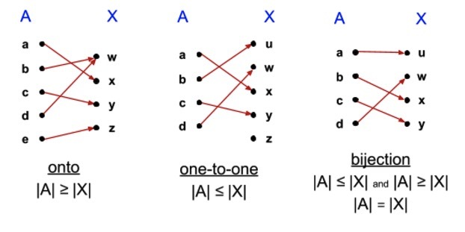
onto/one-to-one/bijections
Consider f : A → X
If f is onto, then for every element in the target, there is at least one element in the domain so |A| ≥ |X|.
If f is one-to-one, then for every element in the domain, there is a at least one element in the target: |A| ≤ |X|.
If f is a bijection: |A| = |X|.

Slide 15
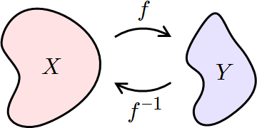
Inverse functions
We want to define the inverse of a function f: a function f⁻¹ that “undoes” the action of f.
Example: the square root undoes the action of f(x) = x².
What properties does f need to have for an inverse to exist?
one-to-one?
onto?

Slide 16
Inverse functions
Let f: X → Y be a bijection. The inverse of f is the function f⁻¹ : Y → X that assigns to an element y in Y the element x in X such that f(x) = y, i.e., f⁻¹(y) = x when f(x) = y.
f
x=f⁻¹(y)
y=f(x)
X
Y
f⁻¹

Slide 17
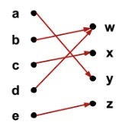
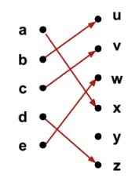
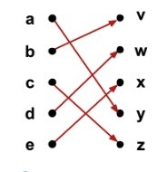
Inverse functions
Let f: X → Y be a bijection. The inverse of f is the function f⁻¹ : Y → X that assigns to an element y in Y the element x in X such that f(x) = y, i.e., f⁻¹(y) = x when f(x) = y.
Do these functions have an inverse?

Slide 18
Inverse functions
Let f: X → Y be a bijection. The inverse of f is the function f⁻¹ : Y → X that assigns to an element y in Y the element x in X such that f(x) = y, i.e., f⁻¹(y) = x when f(x) = y.
An alternative definition:
f⁻¹ = { (y, x) : (x, y) ∈ f }.

Slide 19
Inverse functions
Let f: X → Y be a bijection. The inverse of f is the function f⁻¹ : Y → X that assigns to an element y in Y the element x in X such that f(x) = y, i.e., f⁻¹(y) = x when f(x) = y.
Example:
Let f : Z → Z be f(x) = x + 1. Is f invertible? What’s the inverse?

Slide 20
Inverse functions
Are the following functions invertible?
f: {0, 1}³→{0, 1}³. f takes the input string and reverses the bits. For example, f(011) = 110.
f: {0, 1}³→{0, 1}³. f takes the input string x, removing the first bit of x, and adding the bit to the end of x. For example, f(011) = 110.
f: {0, 1}³→{0, 1}³. f takes the input string and replaces the first bit by 1. For example, f(001) = 101 and f(110) = 110.

Slide 21
Composition of functions
Let f and g be functions f: X → Y and g: Y → Z.
The composition of g with f, denoted g□f, is the function
(g□f) : X → Z, such that (g□f)(x) = g(f(x)) for all x ∈ X.
g
f
X
Y
Z
g □f

Slide 22
Composition of functions
Order of composition matters!
Let f(x) = 2x + 3, g(x) = 3x + 2
(f□g)(x) = f(g(x)) = f(3x + 2) = 2(3x + 2) + 3 = 6x + 7
(g□f)(x) = g(f(x)) = g(2x + 3) = 3(2x + 3) + 2 = 6x + 11

Slide 23
Composition of functions
What is (f⁻¹□f)(x) and (f□f⁻¹)(y) ?

Slide 24
The identity function
The identity function on A, denoted I_{A}: A → A, is defined as I_{A}(a) = a, for all a ∈ A.
The identity function always maps a set onto itself and maps every element to itself.
If a function f from A to B has an inverse, then f composed with its inverse is the identity function.
If f(a) = b, then f⁻¹(b) = a, and (f^{f-1}□f)(a) = f⁻¹(f(a)) = f⁻¹(b) = a.
Let f: A → B be a bijection. Then f⁻¹□f = I_{A} and f□f⁻¹ = I_{B}.

Slide 25
increasing/decreasing functions
A function f is said to be strictly increasing if whenever x₁ < x₂, then f(x₁) < f(x₂).
A function f is said to be strictly decreasing if whenever x₁ < x₂, then f(x₁) > f(x₂).
Is floor increasing? strictly increasing?
Is square (when restricted to positive numbers) increasing? strictly increasing?

Slide 26
increasing functions
A strictly increasing function is one-to-one.
Is “increasing” a sufficient condition? (i.e. is an increasing function one-to-one?)

Slide 27
Cartesian products and functions
A function with multiple arguments has a cartesian product as its domain.
Example:
min maps R x R to R min(5.3, 10) = 5.3

Slide 28
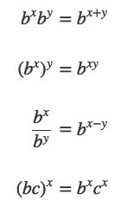
exponents and logarithms
The exponential function exp_{b} : R → R⁺ is defined as:
exp_{b}(x)=b^{x}
where b is a positive real number and b ≠ 1.
The parameter b is called the base of the exponent.
The input x is called the exponent.
Properties of exponents:

Slide 29
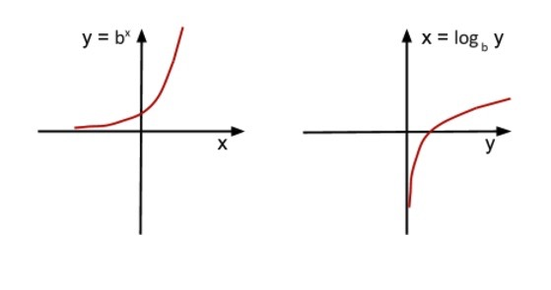
the logarithm function
The exponential function is one-to-one and onto, and therefore has an inverse.
The logarithm function is the inverse of the exponential function. For real number b > 0 and b ≠ 1, log_{b}: R⁺ → R is defined as:
b^{x}=y ⇔ log_{b}y=x
The parameter b is called the base of the logarithm

Slide 30
dividing chocolates
Ingrid has a bag with n chocolates, where n > 0. Ingrid meets a friend and splits her chocolates into two evenly sized piles and gives her friend the chocolates in one of the piles and puts the rest in her bag. Then she meets another friend and splits her chocolates again. Every time she meets a friend, she shares half of her chocolates with the friend.
How many friends can she meet and share half her chocolates before she is down to one chocolate in her bag?

Slide 31
dividing chocolates
Ingrid has a bag with n chocolates, where n > 0. Ingrid meets a friend and splits her chocolates into two evenly sized piles and gives her friend the chocolates in one of the piles and puts the rest in her bag. Then she meets another friend and splits her chocolates again. Every time she meets a friend, she shares half of her chocolates with the friend.
How many friends can she meet and share half her chocolates before she is down to one chocolate in her bag?
First, consider the case where n is a power of 2, i.e. n=2^{k}

Slide 32
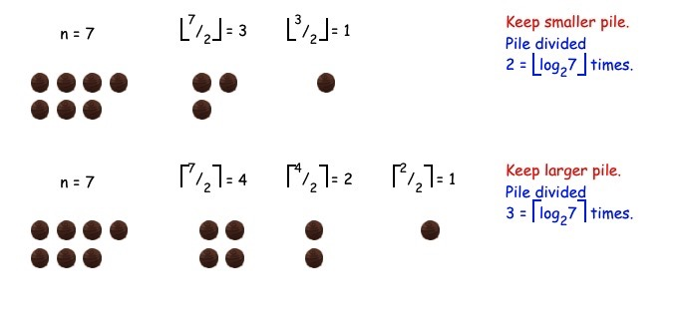
dividing chocolates
What if the number of chocolates is not a power of 2?
At some point, Ingrid will have an odd number of chocolates, and she needs to choose whether to take the smaller or larger half.

Slide 33
dividing chocolates
Theorem: Dividing piles and the logarithm function.
Let n and b be positive integers with b > 1. Consider a process in which in each step, n is replaced with ⌊n/b⌋ until n < b. The process takes ⌊log_{b}n⌋ steps.
If instead in each step, n is replaced with ⌈n/b⌉ until n < b, the process takes ⌈log_{b}n⌉ steps.

Slide 34
Logarithms and programming
Binary search
define the steps, explain how many steps
Merge sort
define the steps, explain how many steps
Quick sort?

